Slide 1
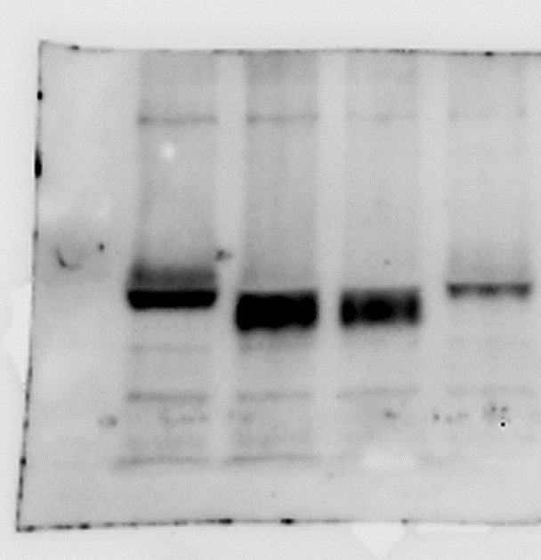
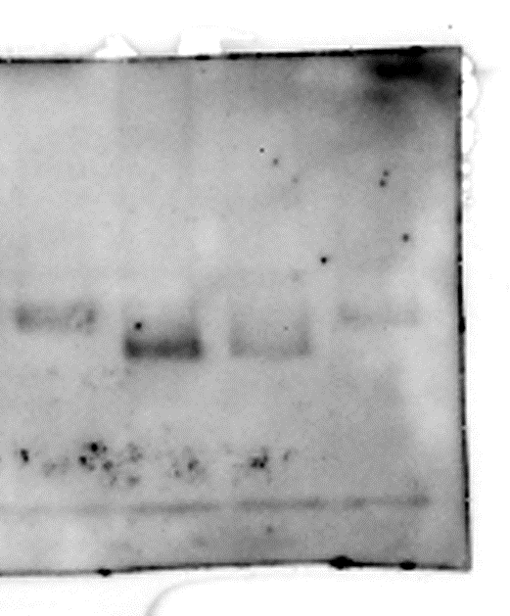
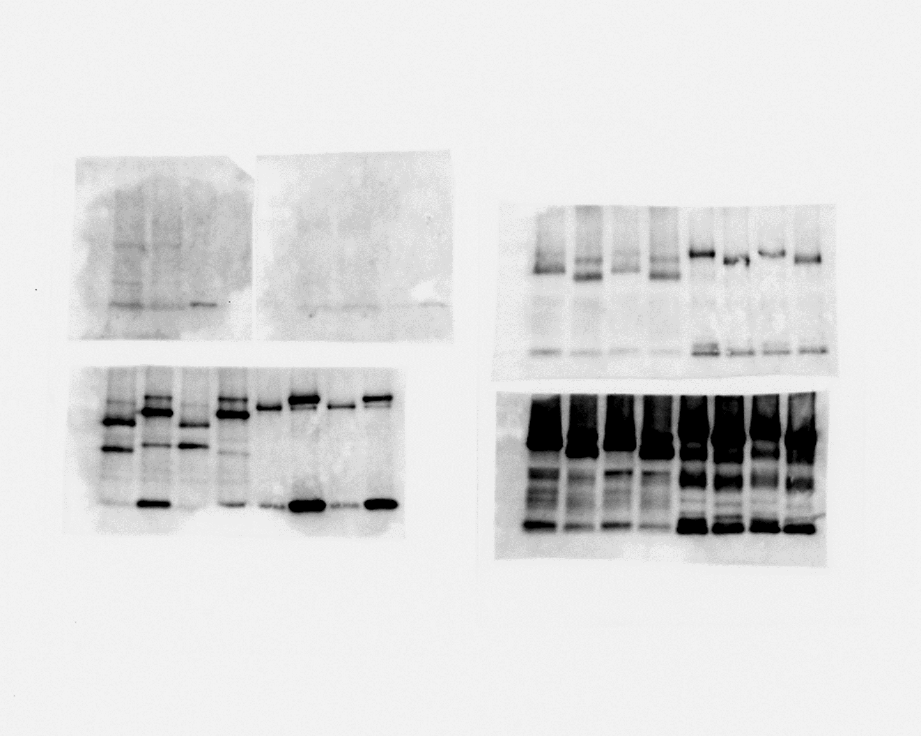
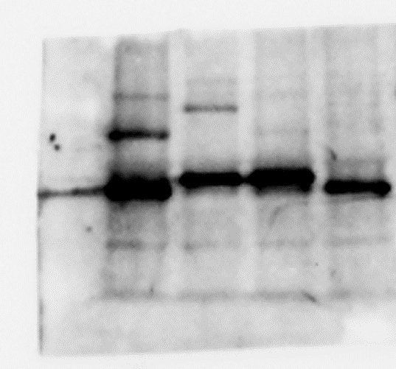
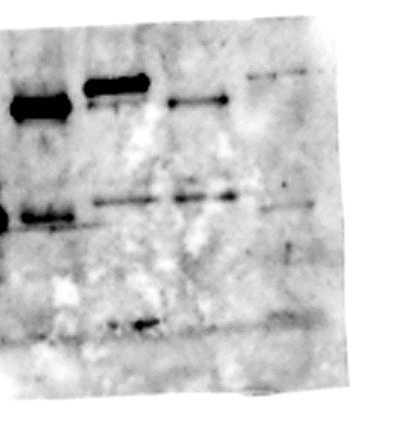
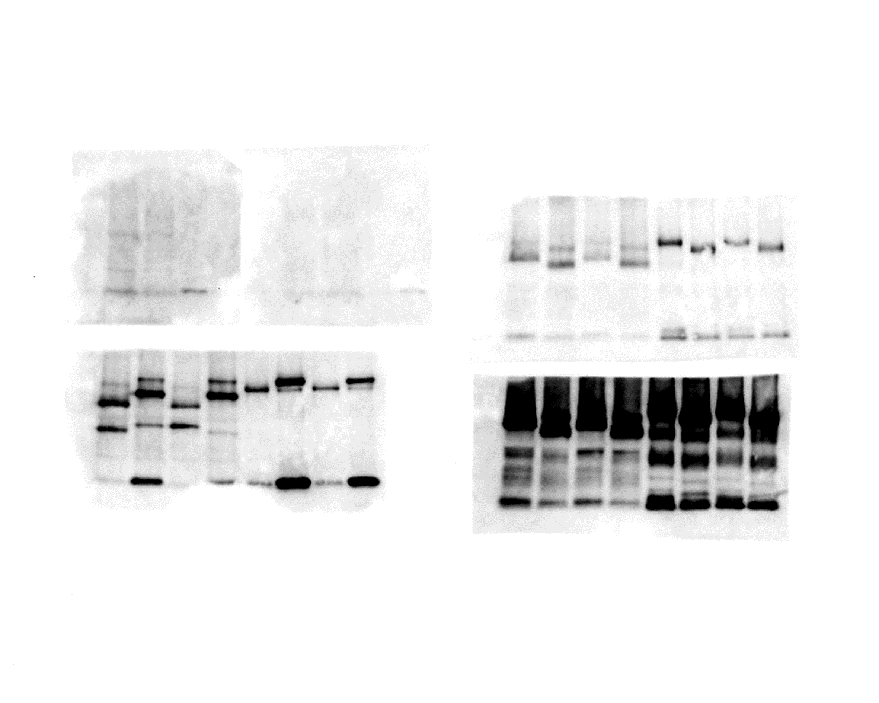
Fig. 1C
Input GFP-IP
MKK4-GFP
MKK5-GFP
MKK4-myc
MKK5-myc
+
-
+
-
-
+
-
+
+
-
-
+
-
+
+
-
+
-
+
-
-
+
-
+
+
-
-
+
-
+
+
-
55
40
55
40
α-myc
70
55
70
55
α-GFP
Fig. 1D
Input GFP-IP
+
-
+
-
-
+
-
+
+
-
-
+
-
+
+
-
+
-
+
-
-
+
-
+
+
-
-
+
-
+
+
-
MPK3-GFP
MPK6-GFP
MPK3-FLAG
MPK6-FLAG
55
40
55
40
α-FLAG
70
55
70
55
α-GFP

Slide 2
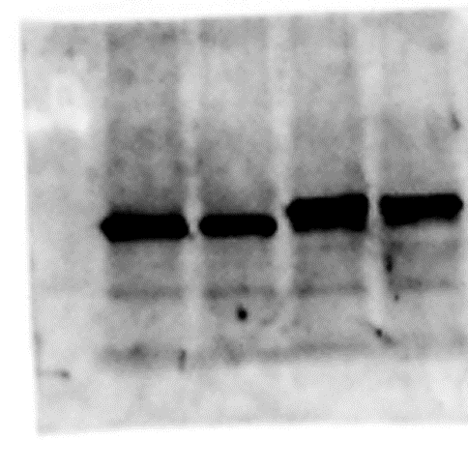
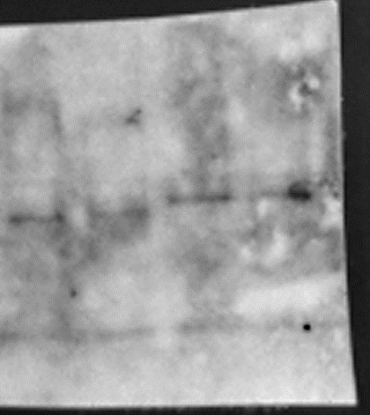
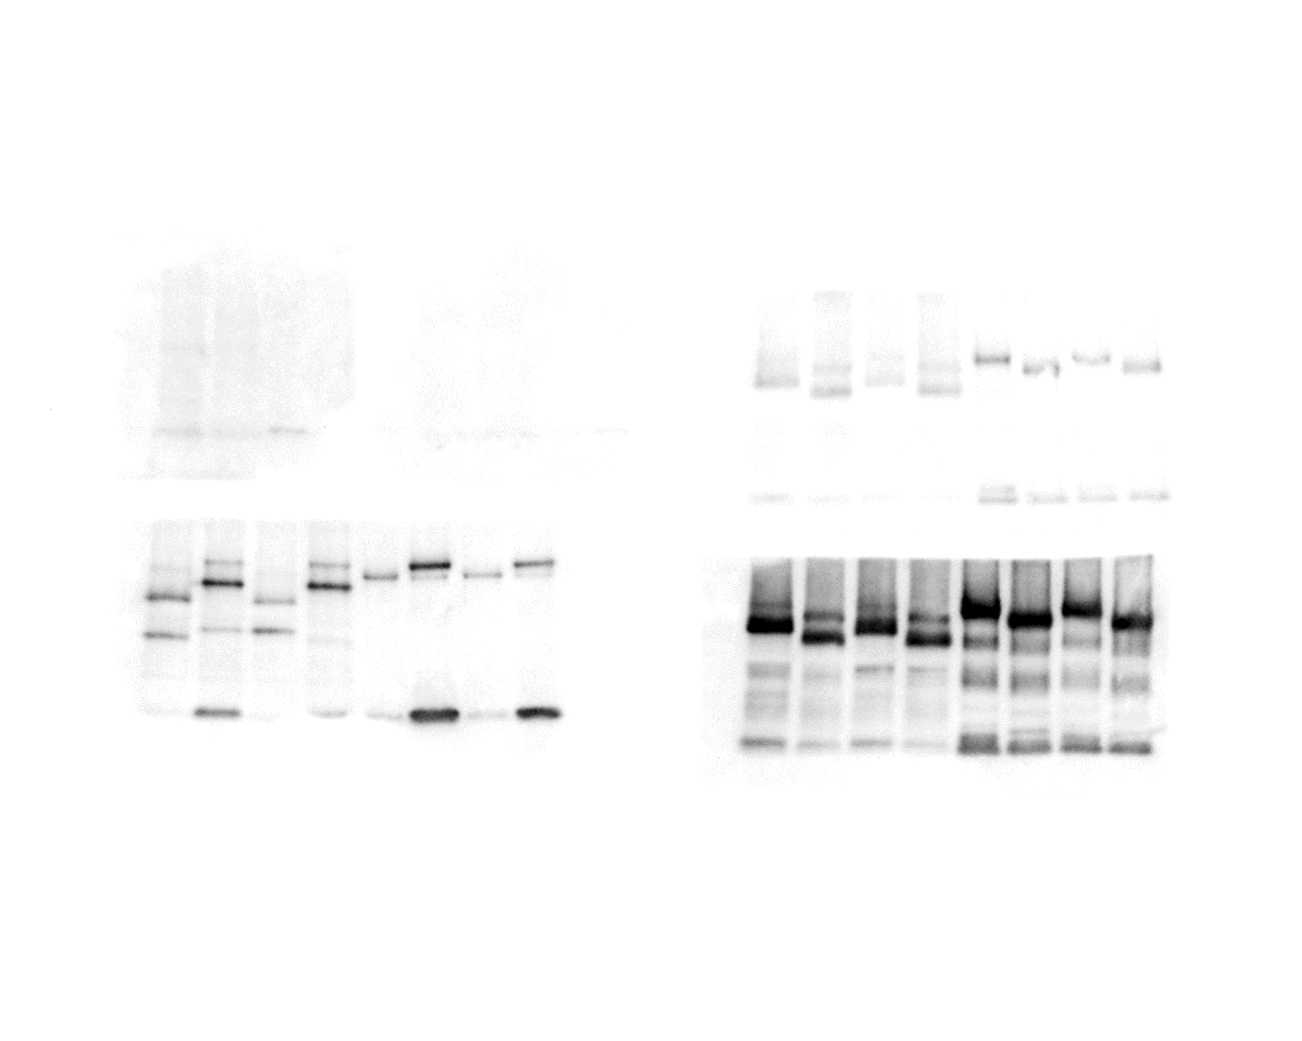
Fig. 1E
Input GFP-IP
MPK3-FLAG
MPK6-FLAG
MKK4-GFP
MKK5-GFP
+
-
+
-
+
-
-
+
-
+
+
-
-
+
-
+
+
-
+
-
+
-
-
+
-
+
+
-
-
+
-
+
55
40
55
40
α-FLAG
70
55
70
55
α-GFP
Fig. 1F
Input GFP-IP
35S:GFP
MKK4-myc
MKK5-myc
+
+
-
+
-
+
+
+
-
+
-
+
55
40
55
40
α-myc
25
25
α-GFP

Slide 3
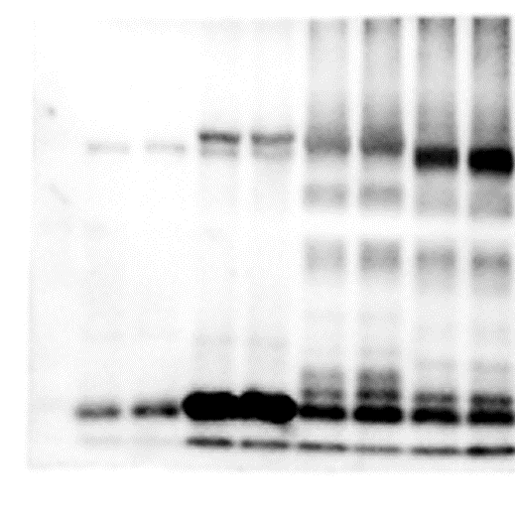
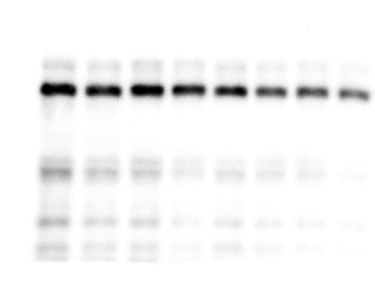
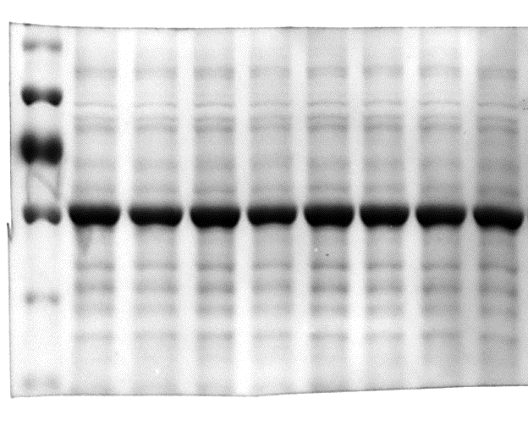
Fig. 5C
DCP1-mC
MKK4-GFP (20)
MKK5-GFP (40)
MPK6-GFP (20)
MKK5-GFP (20)
MKK4-GFP (40)
MPK6-GFP (40)
MPK3-GFP (40)
MPK3-GFP (20)
100
70
α-GFP
70
α-RFP
Rubisco

Slide 4
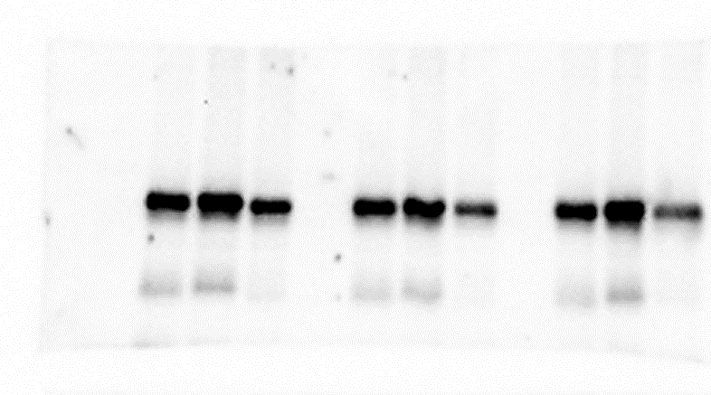
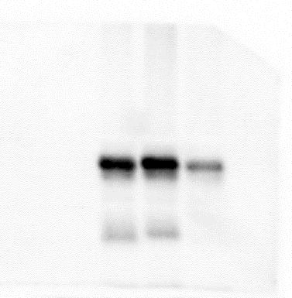


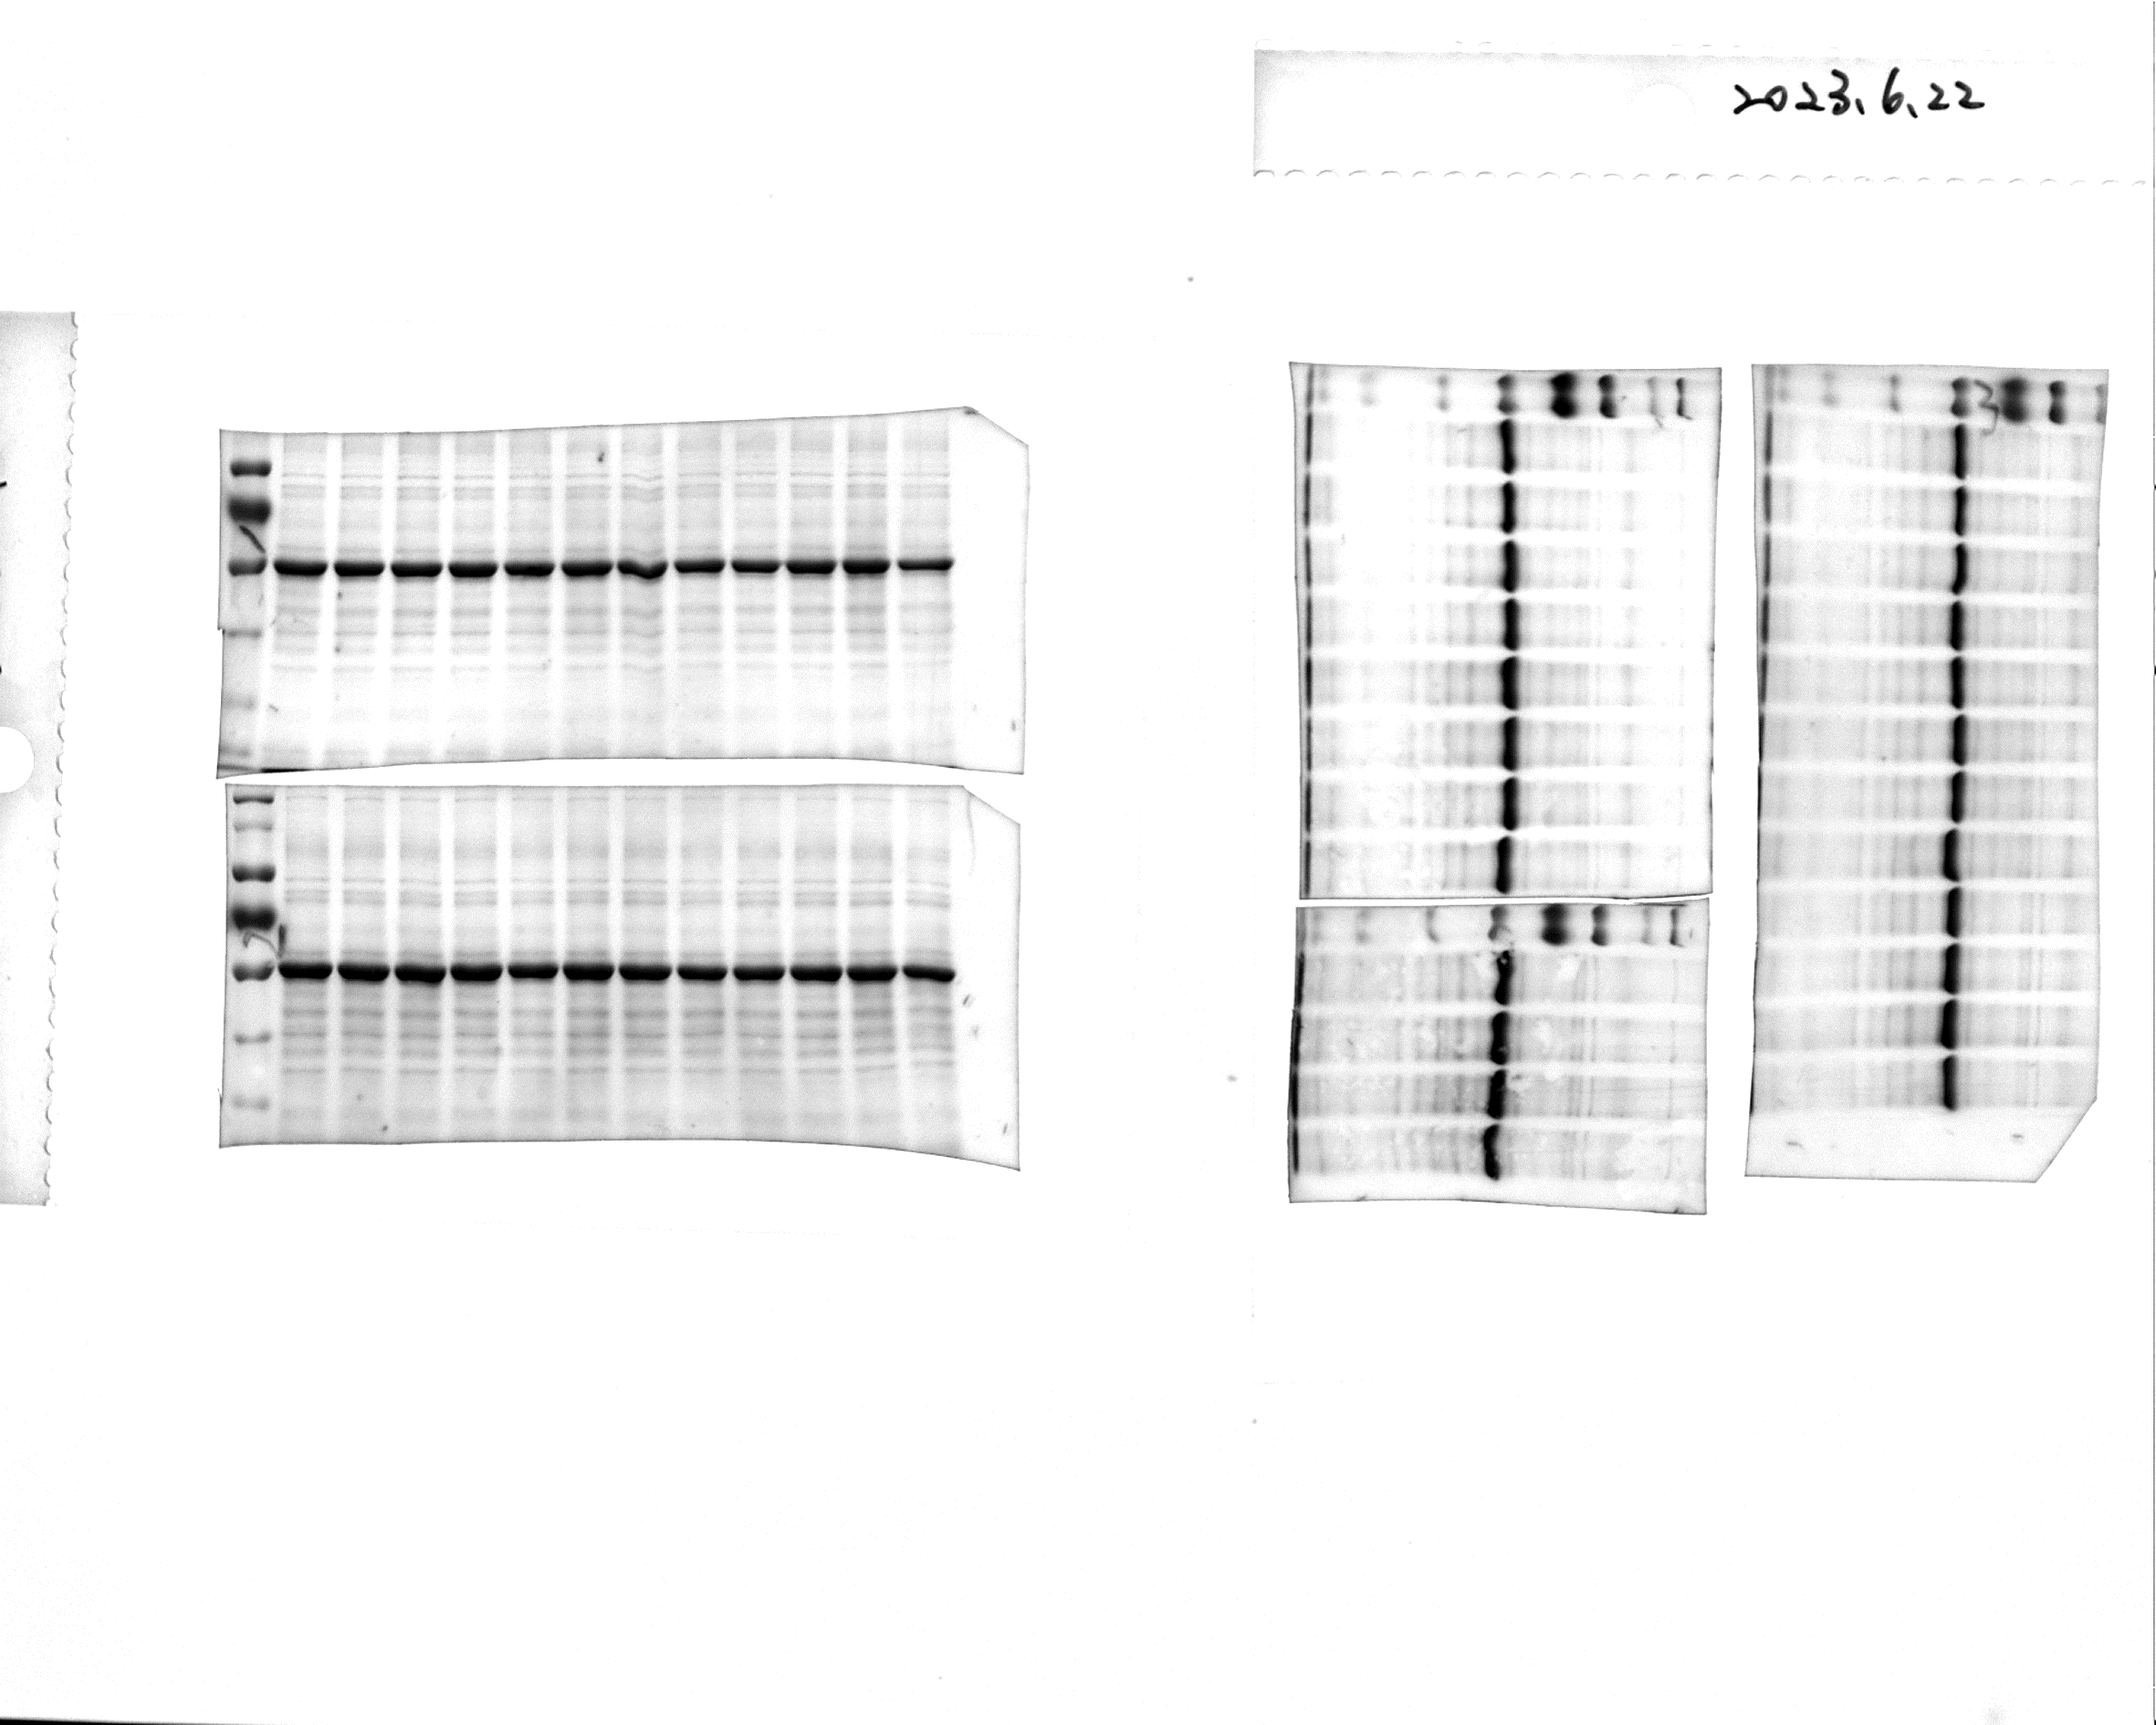
Fig. 7
DCP1^{WT}
-GFP
DCP1^{S237A}
-GFP
DCP1^{S237D}
-GFP
DCP2^{WT}
-GFP
MKK5-myc
MKK5^{DD}-myc
MKK5^{KR}-myc
MKK5-myc
MKK5^{DD}-myc
MKK5^{KR}-myc
MKK5-myc
MKK5^{DD}-myc
MKK5^{KR}-myc
MKK5-myc
MKK5^{DD}-myc
MKK5^{KR}-myc
55
40
55
40
α-myc
70
70
α-GFP
Rubisco

Slide 5
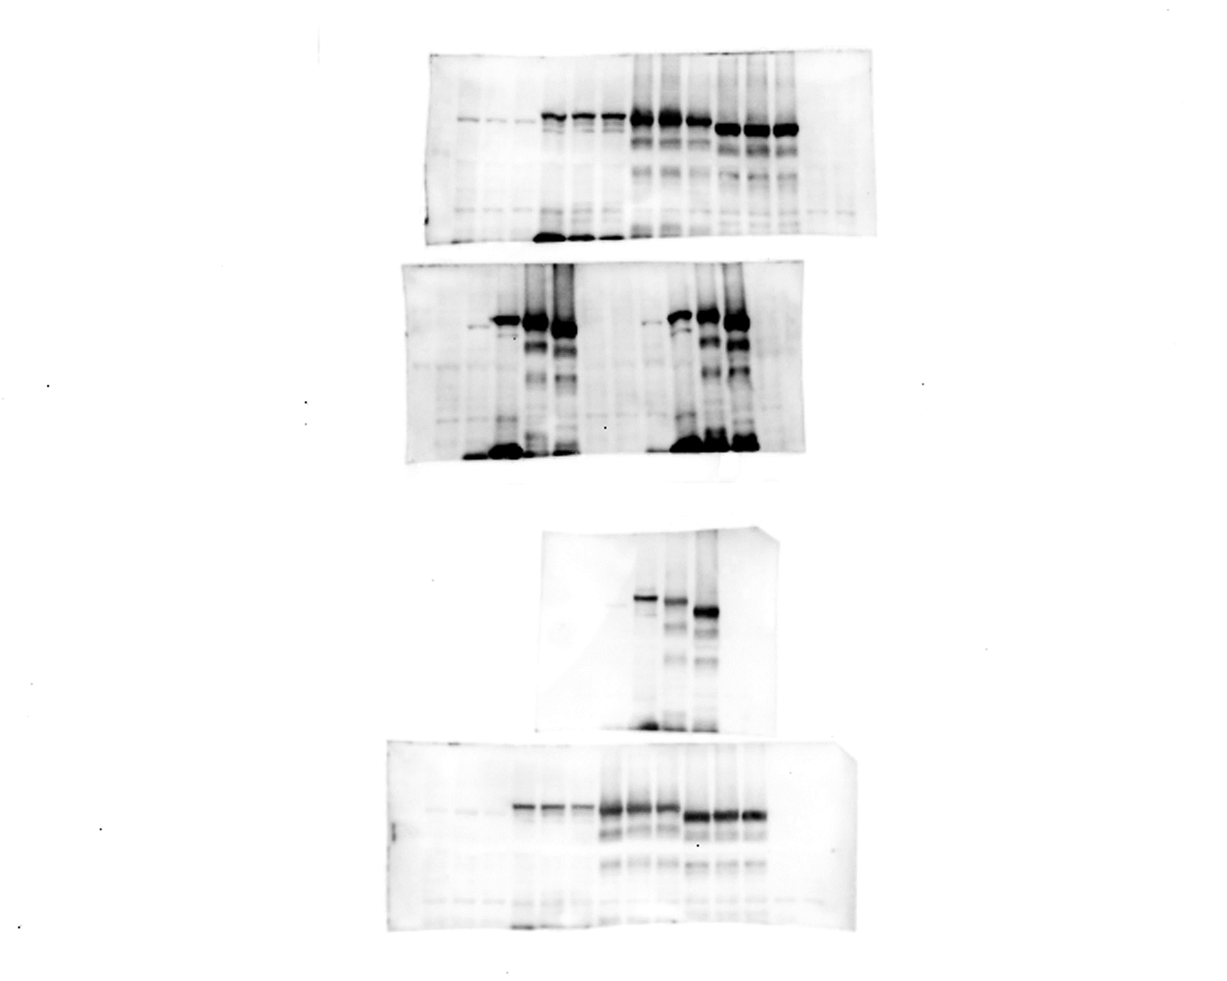
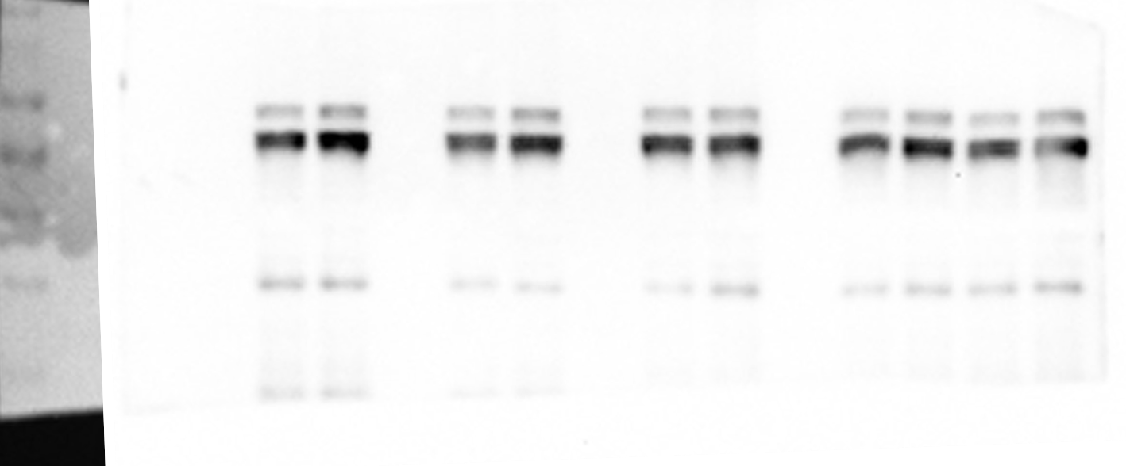
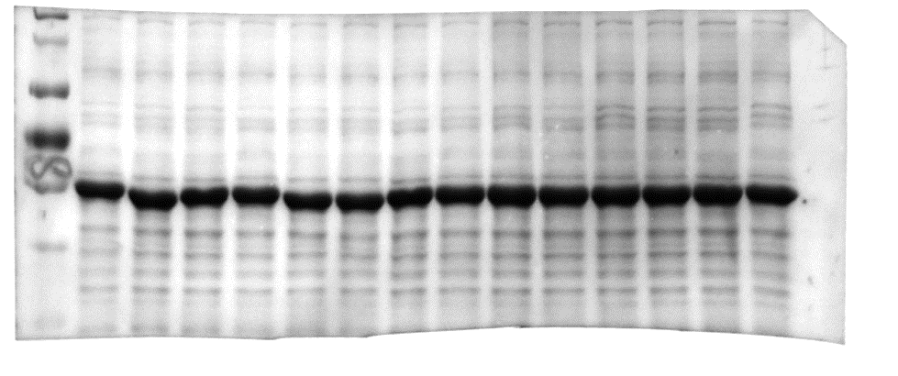
None
UBP1b-mC (20)
UBP1b-mC (40)
None
UBP1b-mC (20)
UBP1b-mC (40)
None
UBP1b-mC (20)
UBP1b-mC (40)
None
UBP1b-mC (20)
UBP1b-mC (40)
UBP1b-mC (20)
UBP1b-mC (40)
Fig. 10B
MPK3
MPK6
MKK4
MKK5
70
α-GFP
70
α-RFP
Rubisco

Slide 6
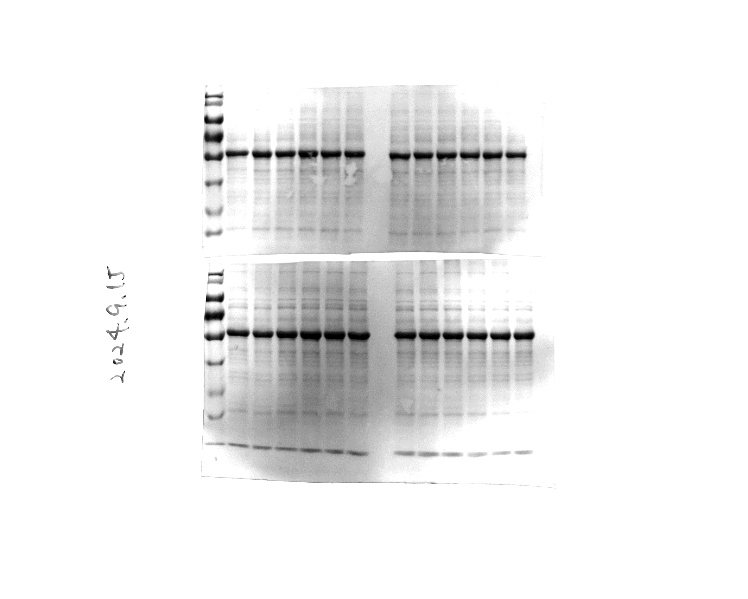
Fig. 11D
Free GFP
UBP1b-GFP
DCP1^{S237A}-mC
DCP1^{S237A}-mC
DCP1-mC
DCP1^{S237D}-mC
DCP1-mC
DCP1^{S237D}-mC
70
70
α-RFP
25
70
α-GFP
Rubisco

Slide 7
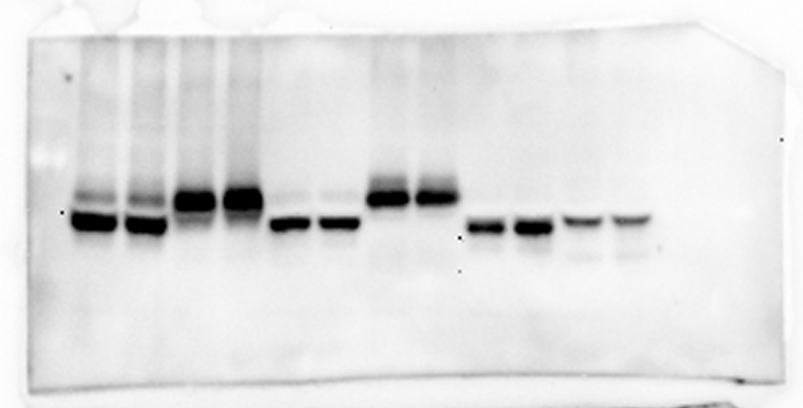
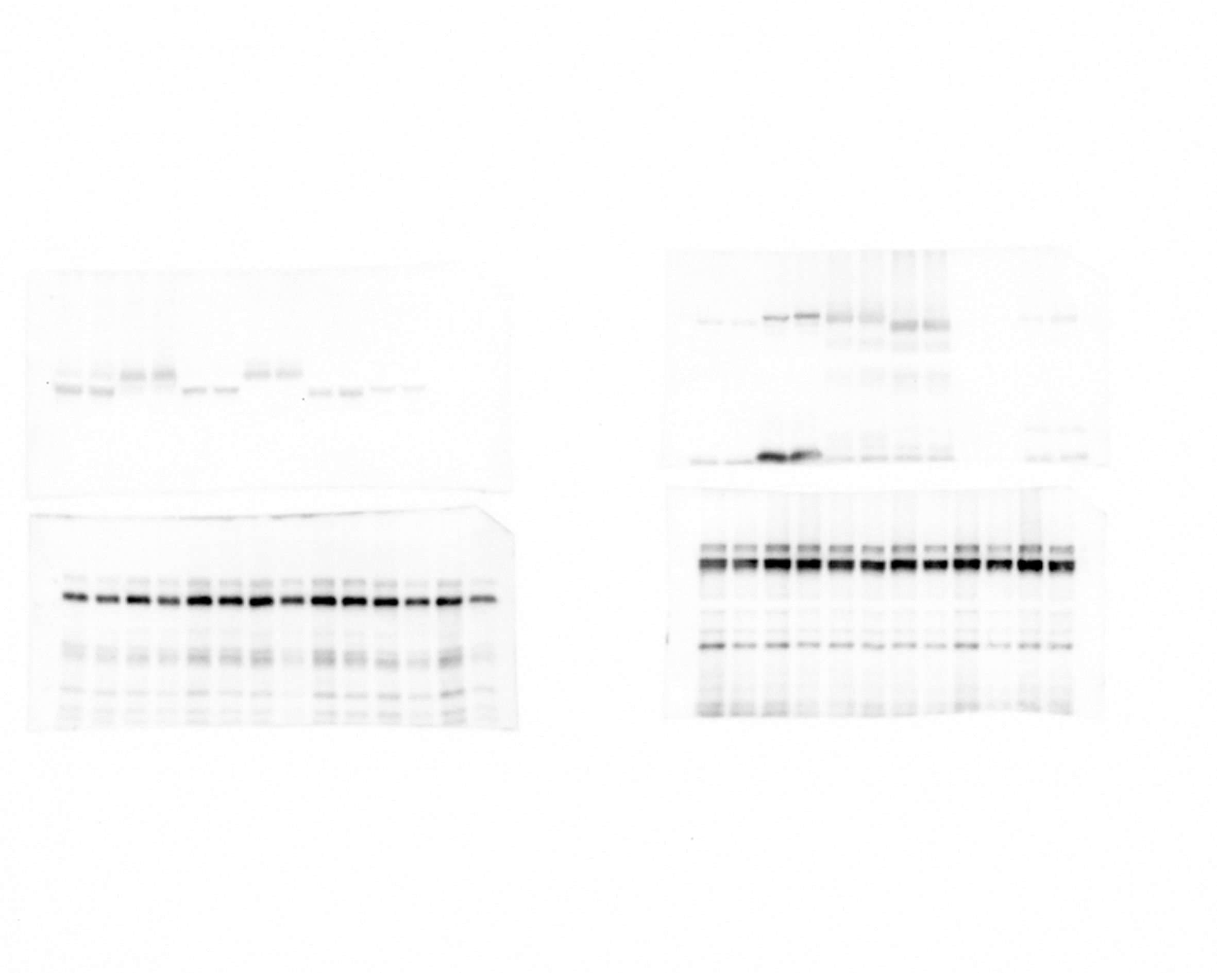
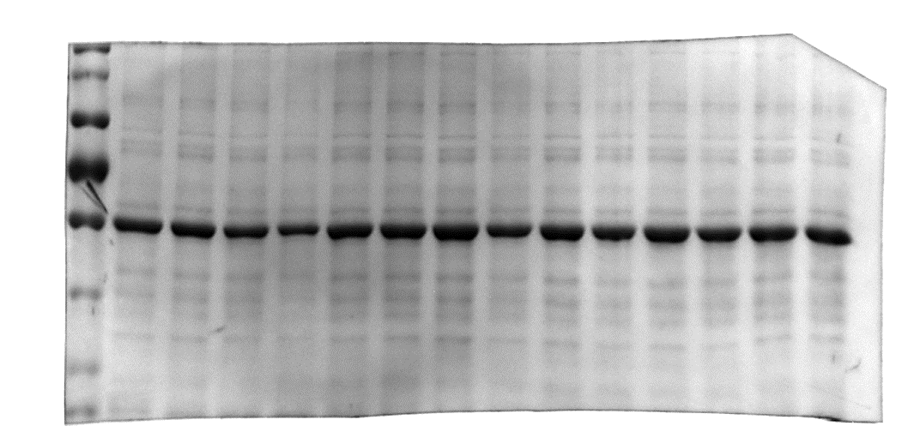
MPK1-C (20)
MPK1-C (40)
MPK3-C (20)
MPK3-C (40)
MPK4-C (20)
MPK4-C (40)
MPK6-C (20)
MPK6-C (40)
MPK7-C (20)
MPK7-C (40)
MPK11-C (20)
MPK11-C (40)
DCP1-mC (20)
DCP1-mC (10)
Fig. S5
DCP1-mC (20)
70
55
α-GFP
70
α-RFP
Rubisco

