Slide 1
TZF1
MPK3
MKK4
MPK6
MKK5
Fig. S1 Proposed model of TZF1-MPK3/6-MKK4/5 interacting network in stress granules.
The model is based on the results of current study and in a previous report (He et al., 2024) showing interaction between TZF1 and MPK3/6 and MKK4/5, respectively.

Slide 2
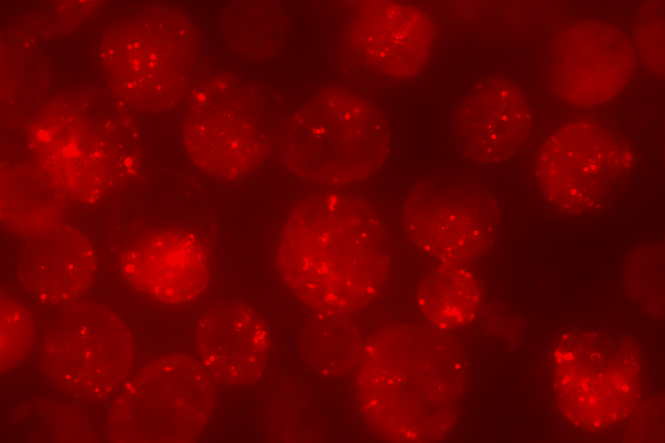
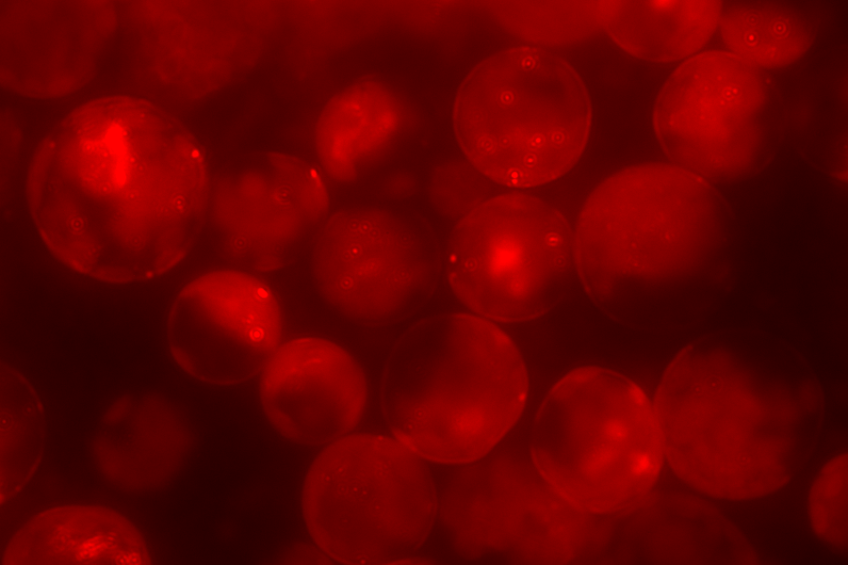
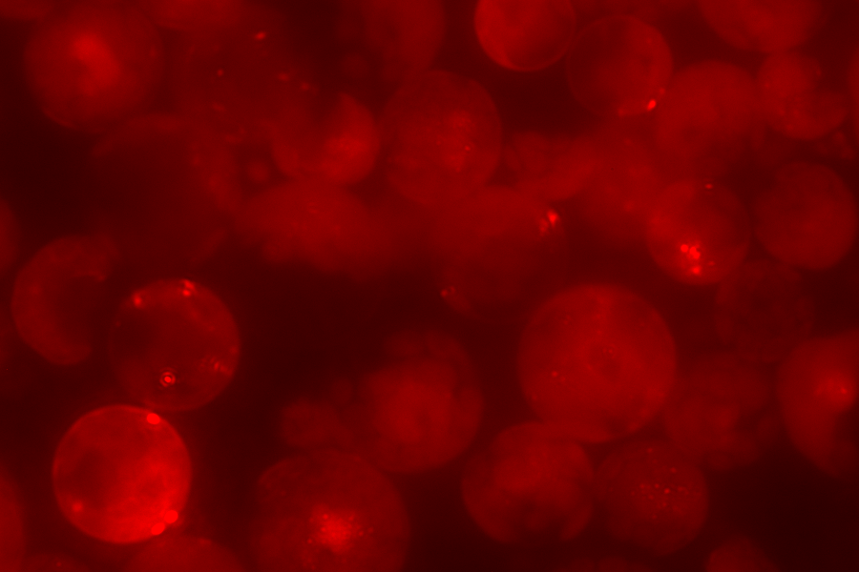
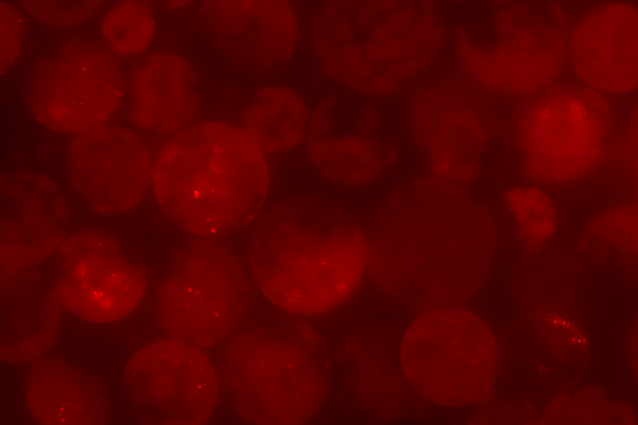
A
MKK4-nYFP+MKK4-cYFP
MKK4-nYFP+MKK5-cYFP
MKK5-nYFP+MKK4-cYFP
MKK5-nYFP+MKK5-cYFP
B
a
Granule number per cell
b
b
b
Fig. S2 MKK4 and MKK5 interactions affect DCP1 granule assembly.
(A) The granule assembly of co-expressed PB marker DCP1-mCherry is suppressed by hetero-dimers of MKK4 and MKK5 and homo-dimers of MKK5, whereas unaffected by homo-dimers of MKK4 (upper left), in BiFC analyses. Scale bar= 15 μm. Images of the BiFC signals (YFP) are not shown. (B) Quantitative analysis of granule number per cell as shown in (A). Columns represent means ± SE. Different letters above the bars indicate significant differences as indicated by ANOVA (P < 0.05).

Slide 3
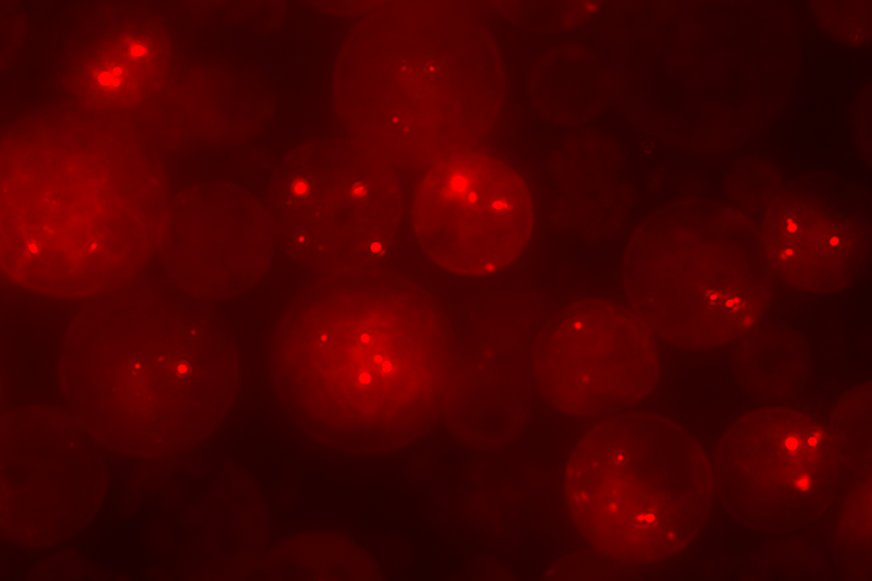
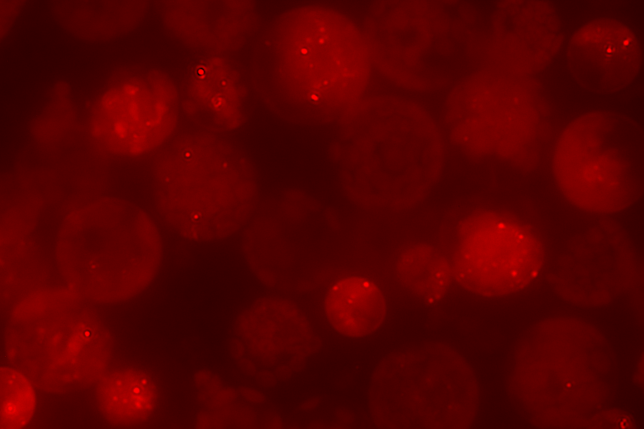
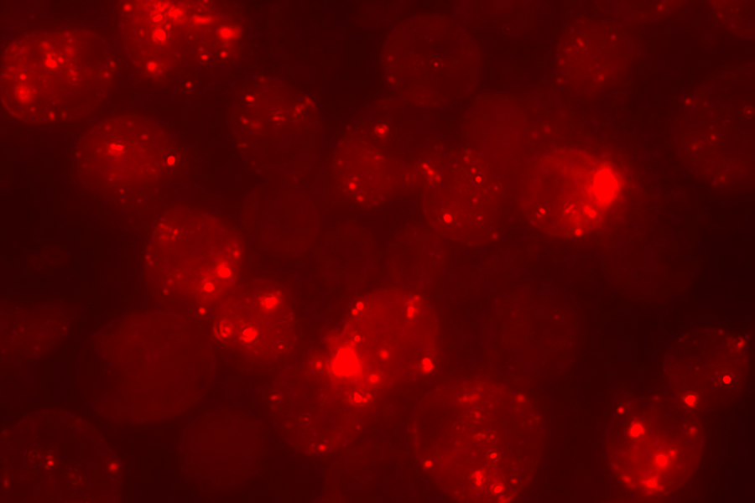
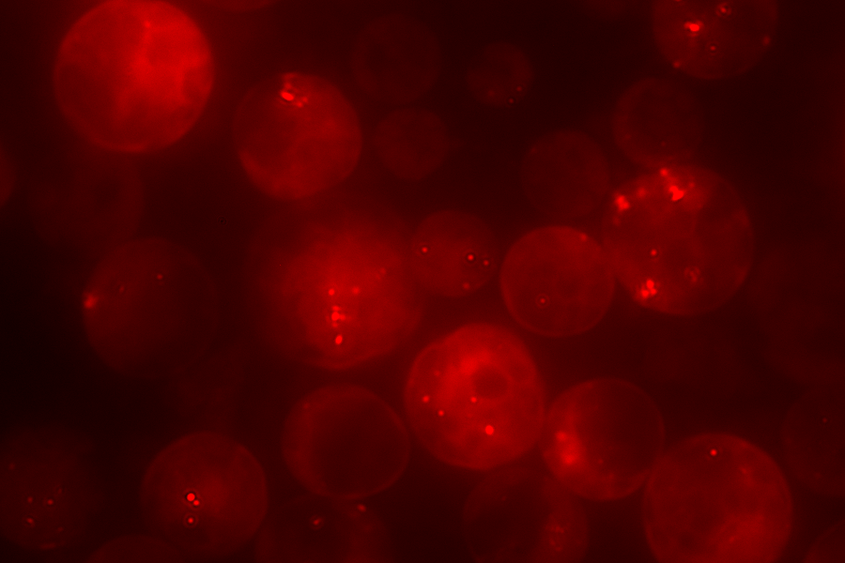
A
MPK3-nYFP+MKK4-cYFP
MPK3-nYFP+MKK5-cYFP
MPK3-nYFP+MPK3-cYFP
MPK3-nYFP+MPK6-cYFP
B
b
Granule number per cell
a
a
a
Fig. S3 MPK3/6 and MKK4/5 interactions affect DCP1 granule assembly.
(A) The granule assembly of co-expressed PB marker DCP1-mCherry is suppressed by hetero-dimers of MPK3-MKK4, MPK3-MKK5, and MPK3-MPK6 (right panel), whereas unaffected by homo-dimer of MPK3 (lower left panel), in BiFC analyses. Scale bar= 15 μm. Images of the BiFC signals (YFP) are not shown. (B) Quantitative analysis of granule number per cell as shown in (A). Columns represent means ± SE. Different letters above the bars indicate significant differences as indicated by ANOVA (P < 0.05).

Slide 4
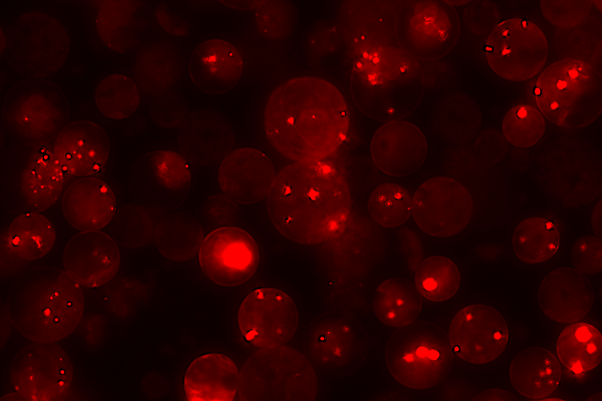
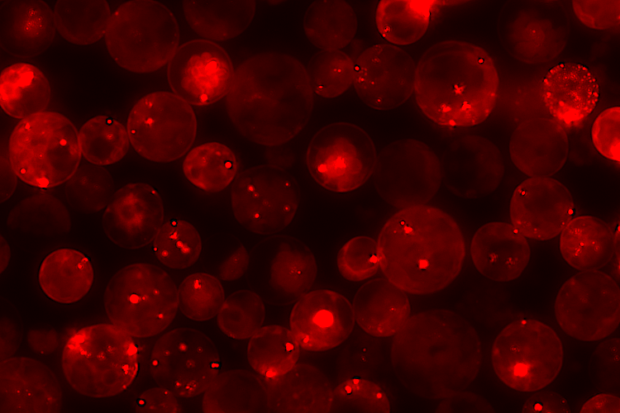
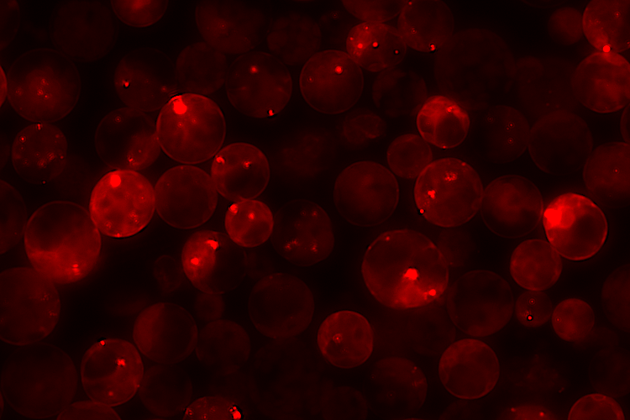
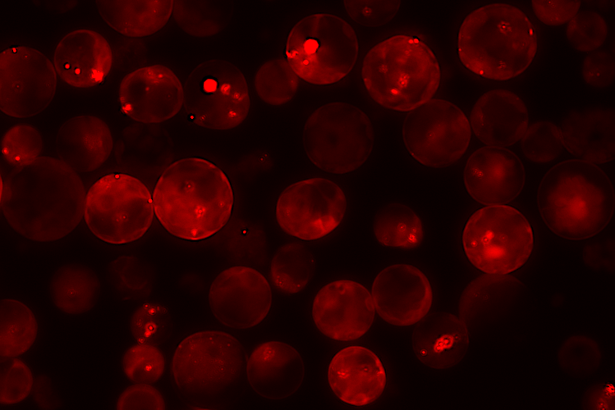
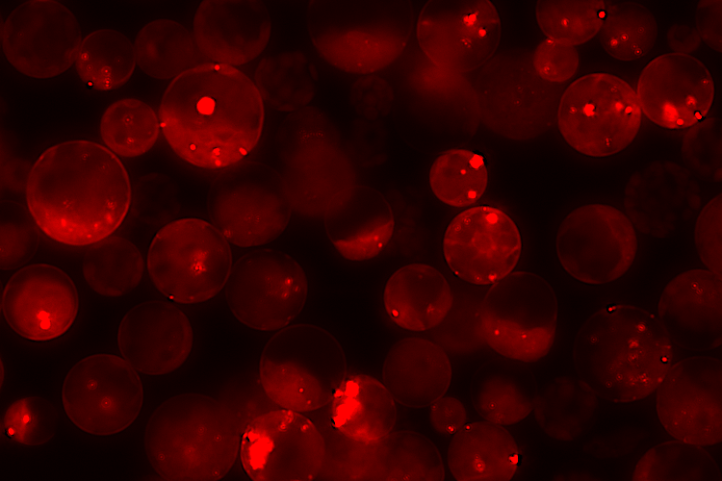
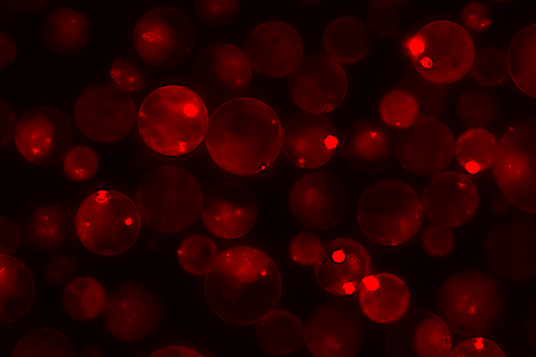
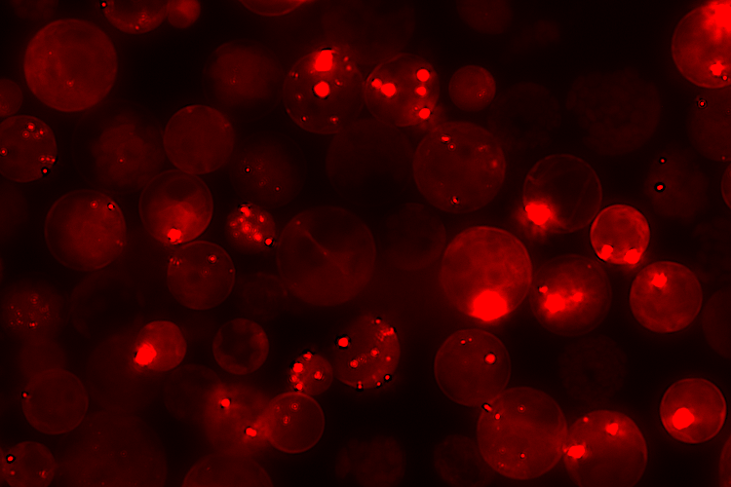
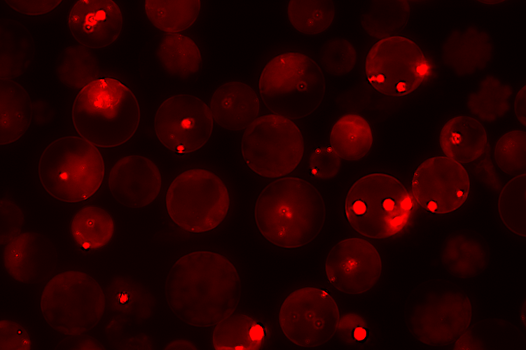
A
MPK3-GFP
MPK3-cYFP
MPK6-GFP
MPK6-cYFP
MPK1-cYFP
MPK4-cYFP
MPK7-cYFP
MPK11-cYFP
B
a
a
Granule number per cell
ad
b
b
b
c
b
Fig. S4 MPKs affect DCP1-mCherry granule dynamics.
(A) Images of co-expressed GFP-MPK3/6 are not shown. MPKs-cYFP are single BIFC constructs not being able to generate yellow fluorescence signals. All the images were taken with the same exposure time. Scale bar= 25 μm. (B) Quantitative analysis of granule number per cell as shown in (A). Columns represent means ± SE. Different letters above the bars indicate significant differences as indicated by ANOVA (P < 0.05).

Slide 5
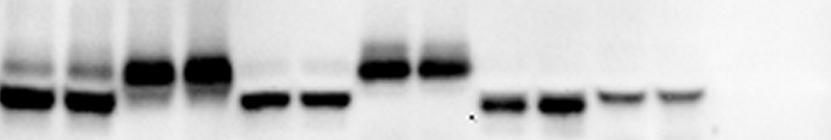
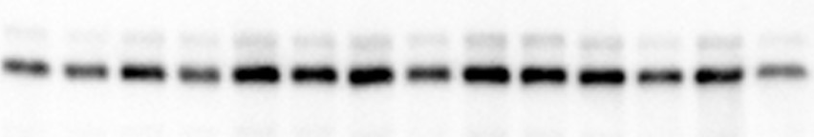
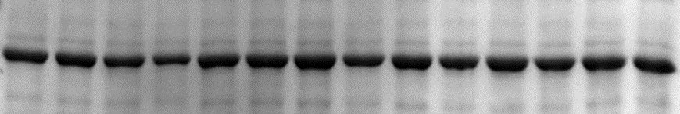
MPK1-C (20)
MPK1-C (40)
MPK3-C (20)
MPK3-C (40)
MPK4-C (20)
MPK4-C (40)
MPK6-C (20)
MPK6-C (40)
MPK7-C (20)
MPK7-C (40)
MPK11-C (20)
MPK11-C (40)
DCP1-mC (20)
DCP1-mC (10)
DCP1-mC (20)
70
55
α-GFP
70
α-RFP
Rubisco
Fig. S5 DCP1-mCherry accumulation affected by MPKs and MKKs.
DCP1-mCherry was co-expressed with two different doses (20 vs 40 mg of plasmid) of MPK-cYFP in a protoplast transient expression assay. Immunoblot analysis was conducted using protein samples as indicated. GFP tagged proteins and MPK-cYFP were detected by GFP antibody and DCP1-mCherry was detected by RFP antibody.

Slide 6
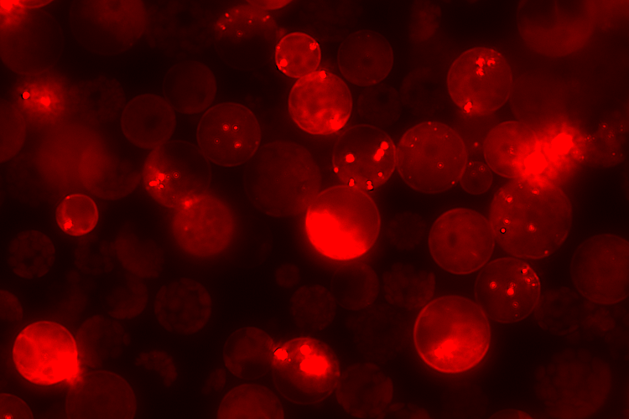
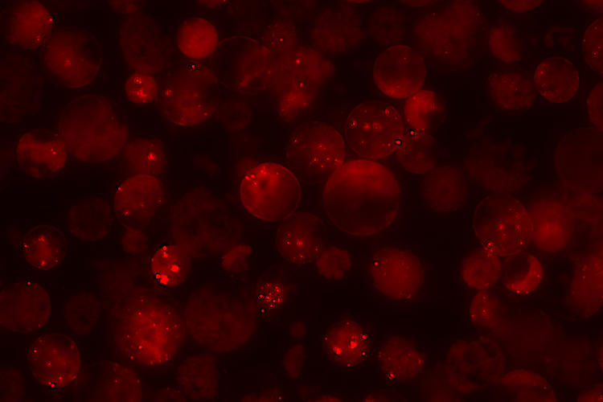
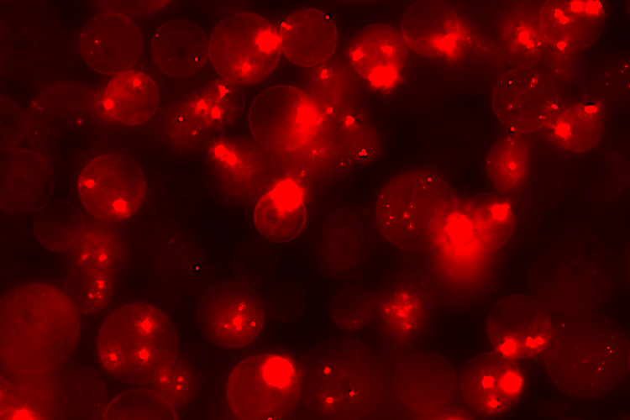
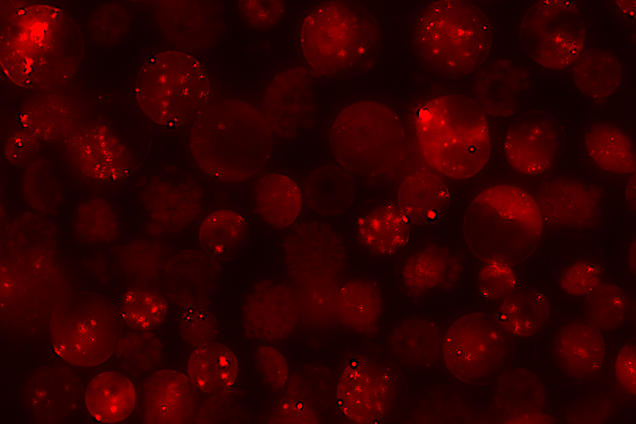
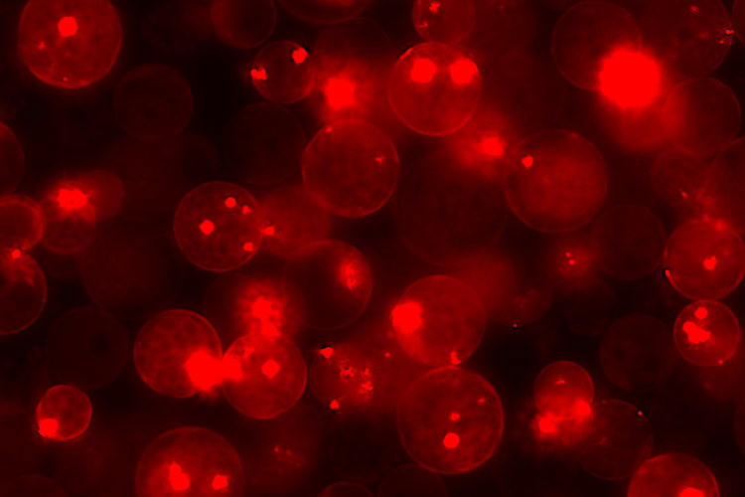
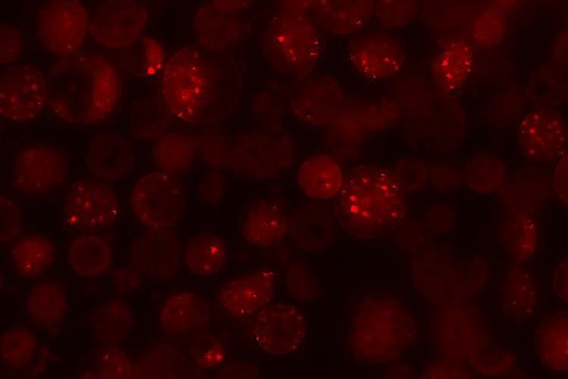
A
Mock
+MEKK1-2FLAG
DCP1^{WT}-mC
DCP1^{WT}-mC
DCP1^{S237A}-mC
DCP1^{S237A}-mC
DCP1^{S237D}-mC
DCP1^{S237D}-mC
B
+MEKK1
e
Granule number per cell
d
d
a
b
c
DCP1
DCP1
DCP1^{S237A}
DCP1^{S237D}
DCP1^{S237A}
DCP1^{S237D}
Fig. S6 The MEEK1 enhances DCP1-mCherry granule assembly when co-expressing in an Arabidopsis protoplast transient expression analysis.
(A) The enhancement is more pronunced for phospho-dead DCP1^{S237A} but not phospho-mimetic DCP1^{S237D} form. All the red images were taken with the same exposure time. Scale bar= 20 μm. (B) Quantitative analysis of typical small granule number per cell as shown in (A). Columns represent means ± SE. Different letters above the bars indicate significant differences as indicated by ANOVA (P < 0.05).

