Slide 1
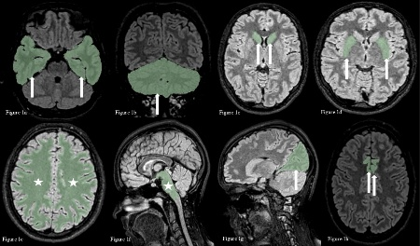

Volumetric analysis assessment of cranial magnetic resonance imaging in pediatric patients with migraine
To compare brain region volumes between pediatric migraine patients and healthy controls using voxel-based morphometric analysis via 3D Slicer.
Cranial MRIs of 33 pediatric migraine patients and 22 healthy controls were analyzed using semi-automated segmentation in 3D Slicer to compare brain region volumes by age and sex.
Figure 1 displays segmented anatomical regions obtained using 3D fluid-attenuated inversion recovery (FLAIR) imaging
Voxel-based analysis revealed age- and sex-specific brain volume differences in pediatric migraine, suggesting structural alterations in the developing brain
……, et al.2025
Notes:
Graphical Abstract for Original Research

