Slide 1

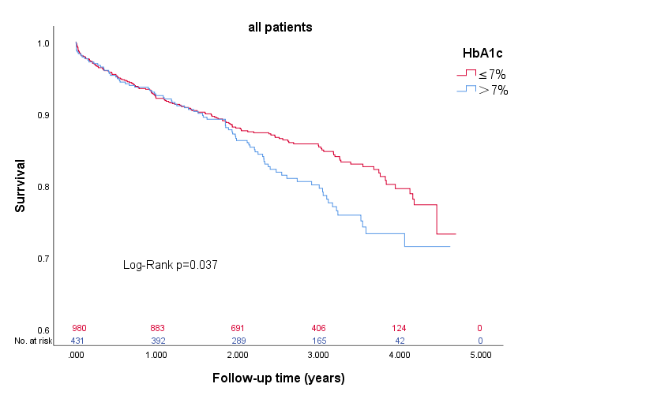




Guangdong General Hospital
(2015-2019)
ischemic heart failure
(N =1413)
In all participants
In sex subgroup
In age subgroup
Conclusions: Elevated admission HbA1c level (>7%) is an independent risk factor for all-cause mortality of IHF in the general population, and there is also a consistent trend among male and younger individuals.
HbA1c ＞7%
(N =432)
HbA1c ≤7%
(N =981)
Follow-up
(median follow-up of 2.9 years)

