Slide 1
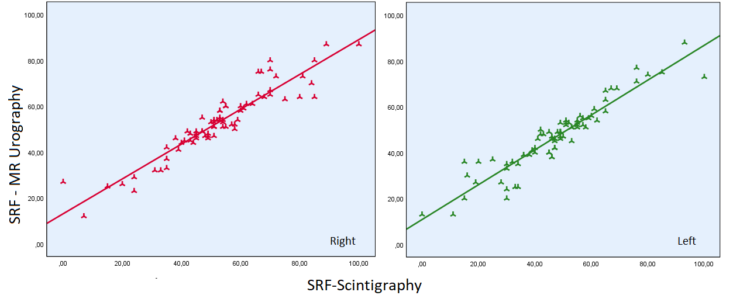
Prediction of Split Renal Function and Obstruction with MR Urography in Comparison with Dynamic Renal Scintigraphy
AIM: To advance our knowledge of split real functions by comparing MRU and MAG3 scintigraphy.
DESIGN & OUTCOMES: Dynamic contrast enhanced MR urography and MAG3 scintigraphy studies of 90 children (age: 1-216 months)
90 patients
43 females (48%), and 47 males (52%)
MR urography
Clinical assessment
76.82±62.59 months.
MAG3 scintigraphy
Abbreviations: SRF: split renal function
CONCLUSION: There is a significant positive correlation between SRF values obtained via MRU and MAG3 scintigraphy. RTT values obtained from MRU offer valuable diagnostic accuracy for prediction of urinary obstruction when compared with T1/2 obtained from MAG3 scintigraphy. Thus, dynamic contrast enhanced MRU-based quantitative results are helpful in determining functional status of kidney.
.
Çobanoglu et al. 2025

