Slide 1
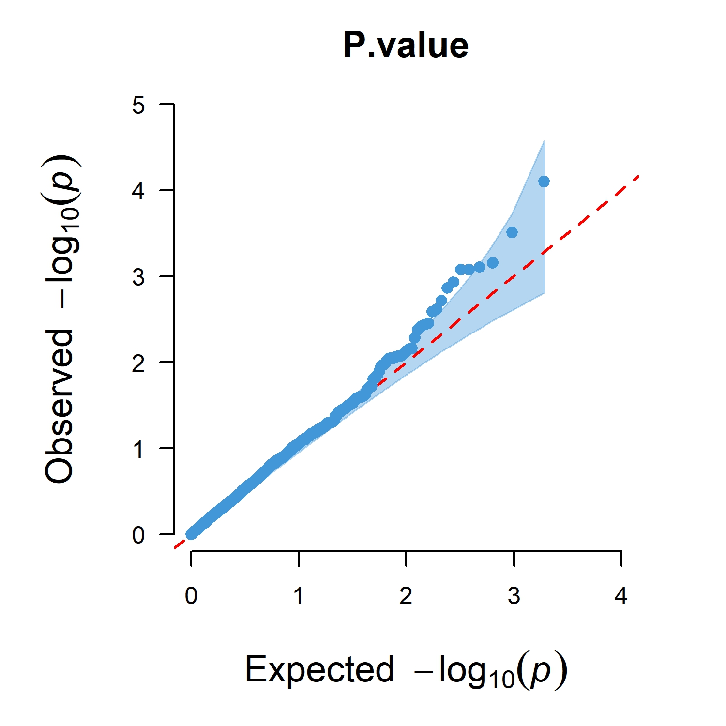
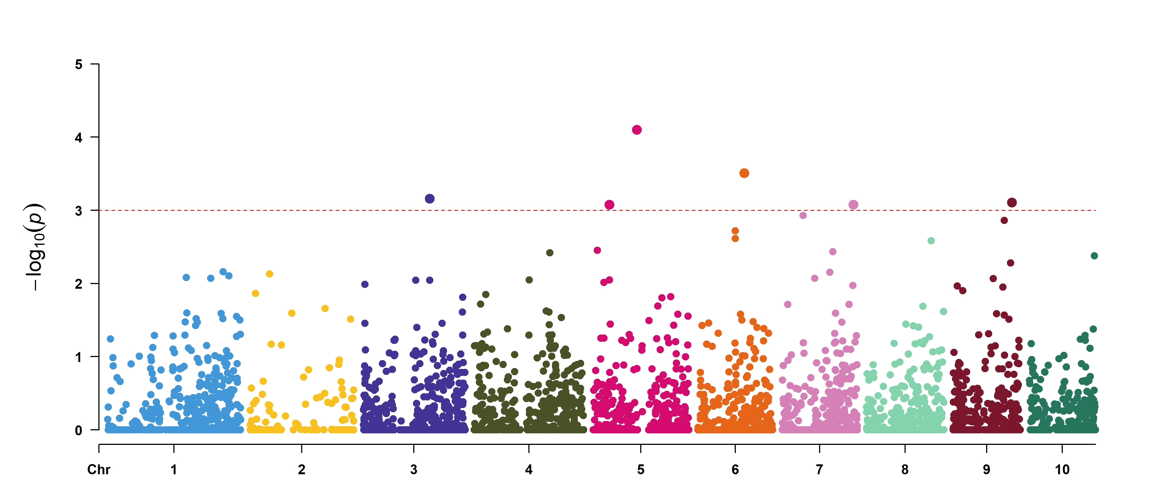
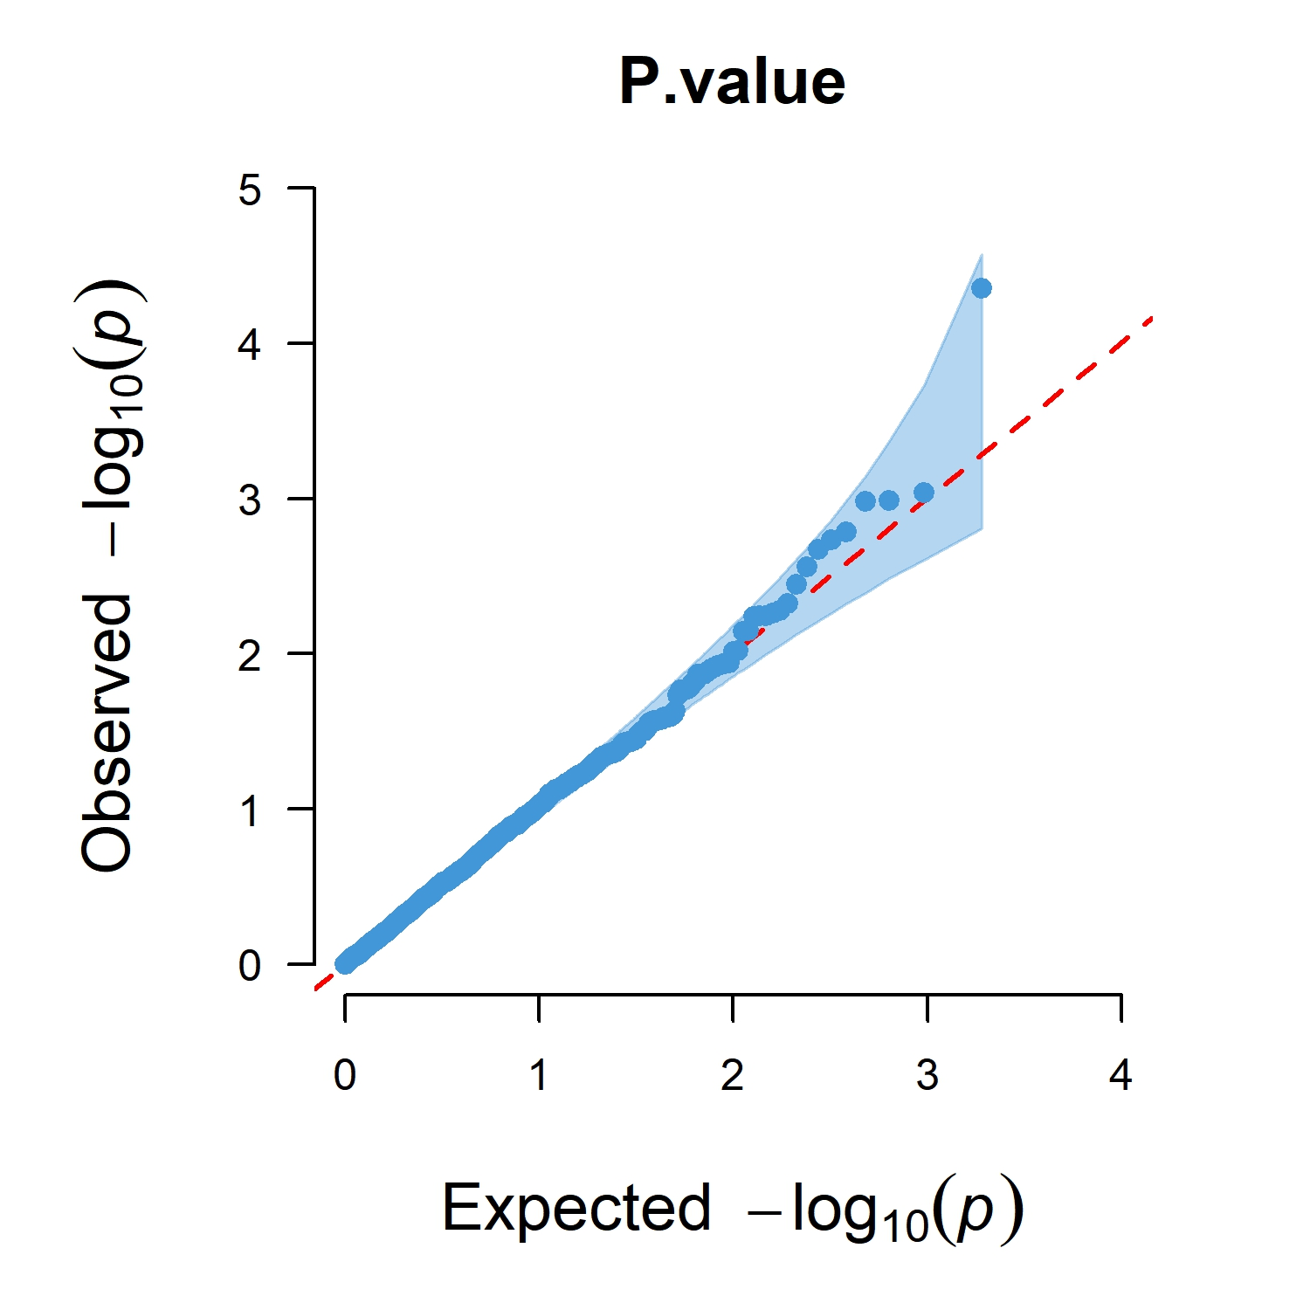
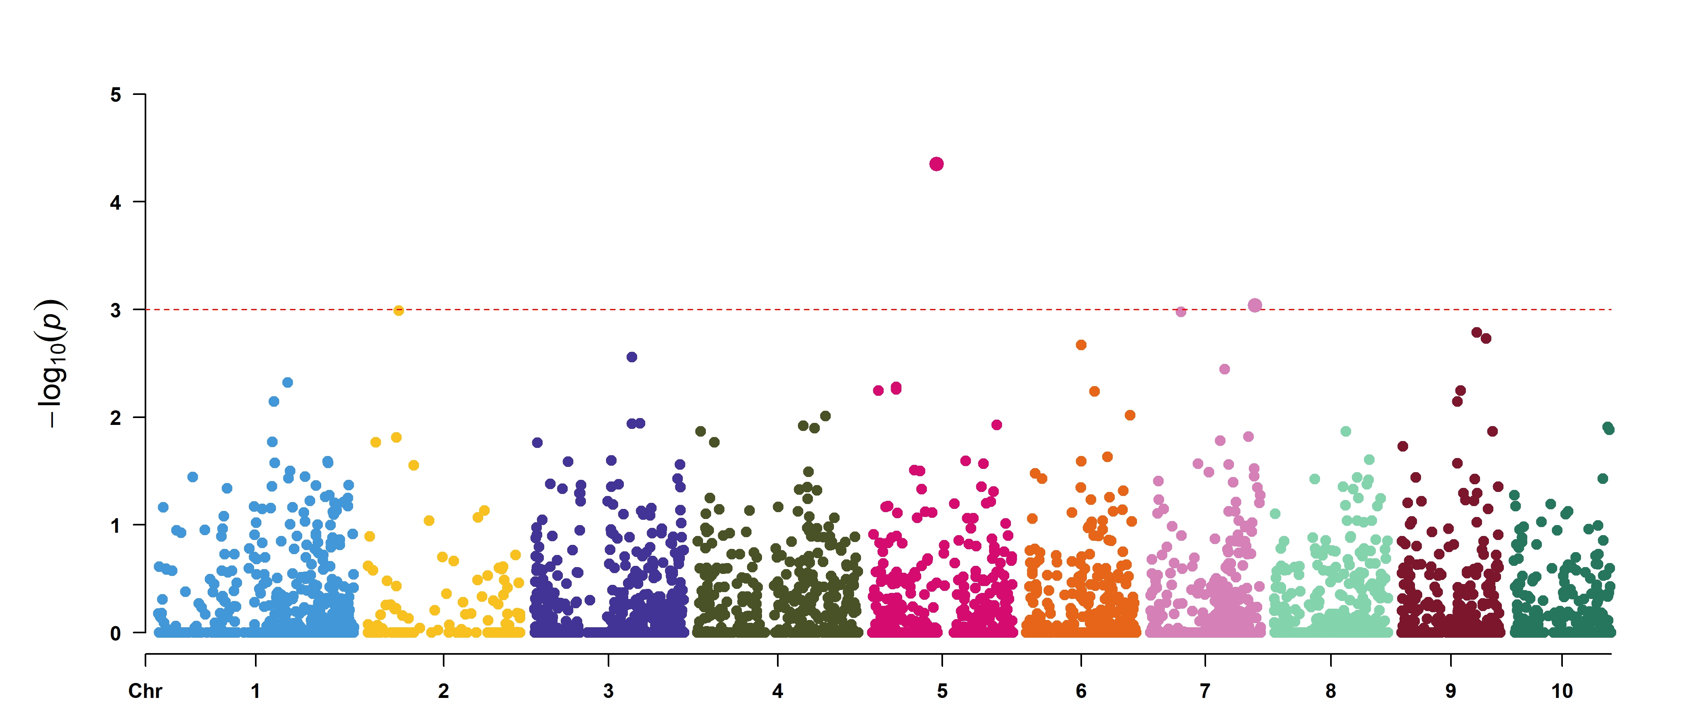
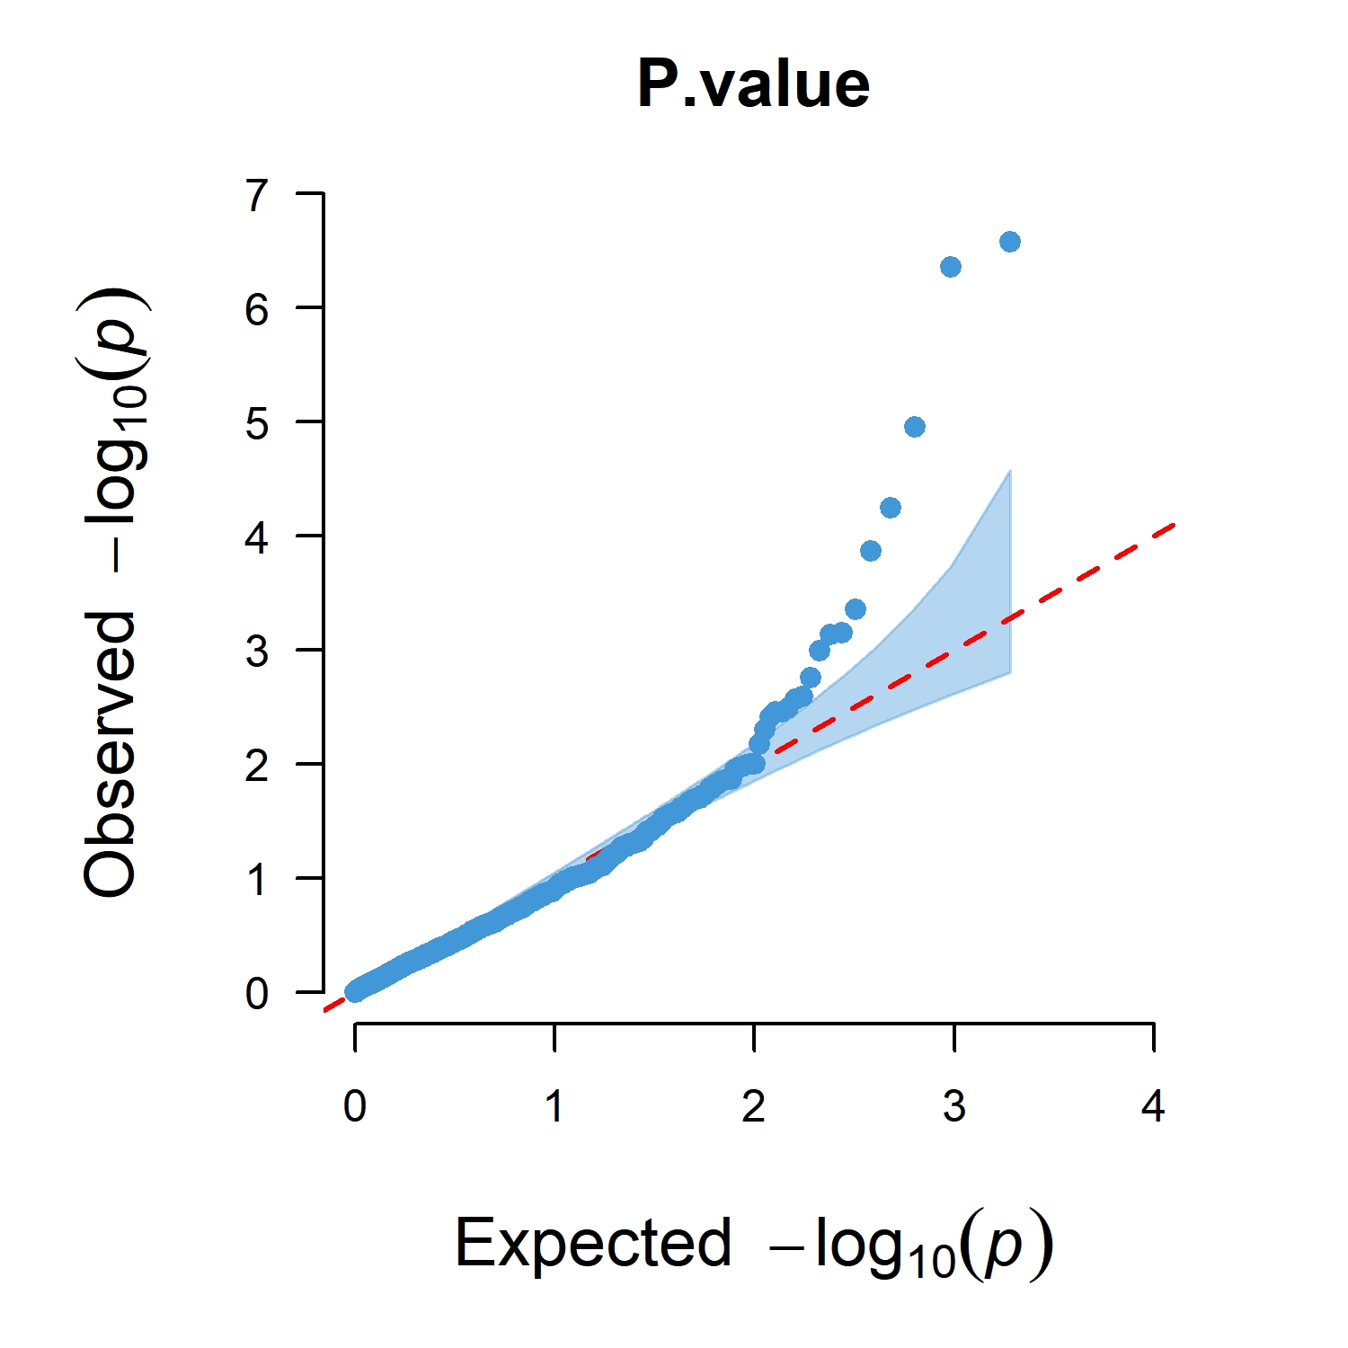
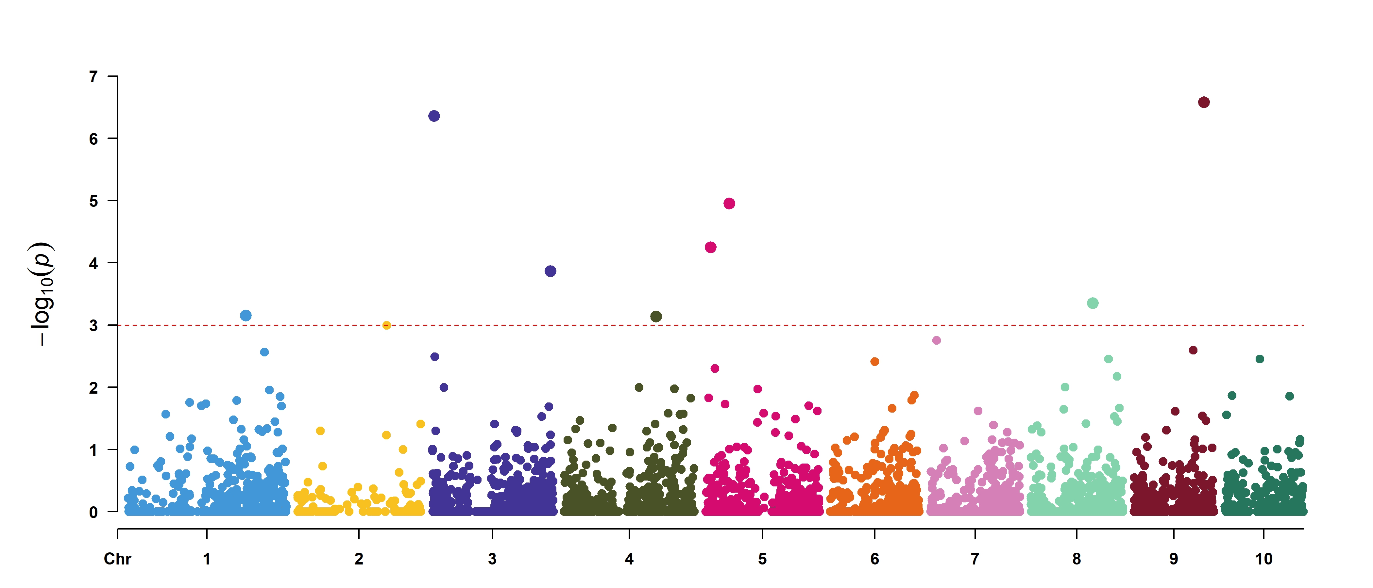

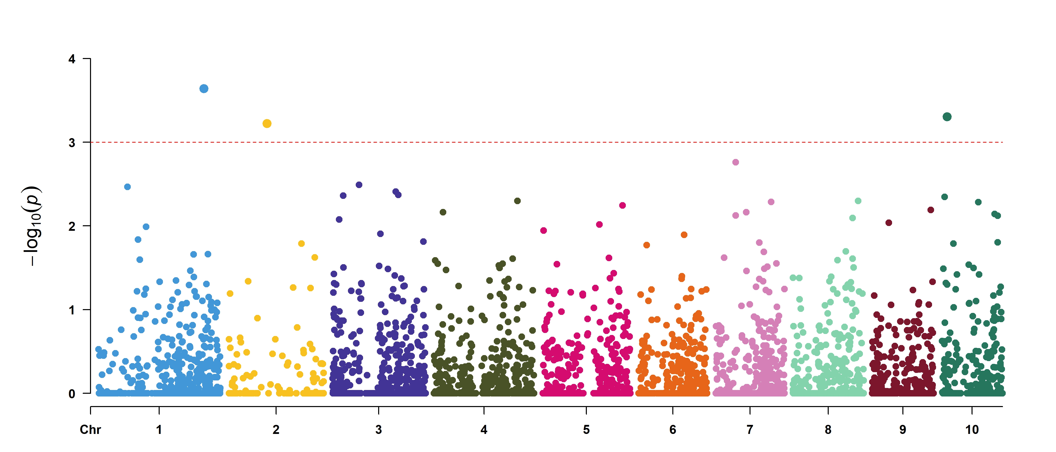
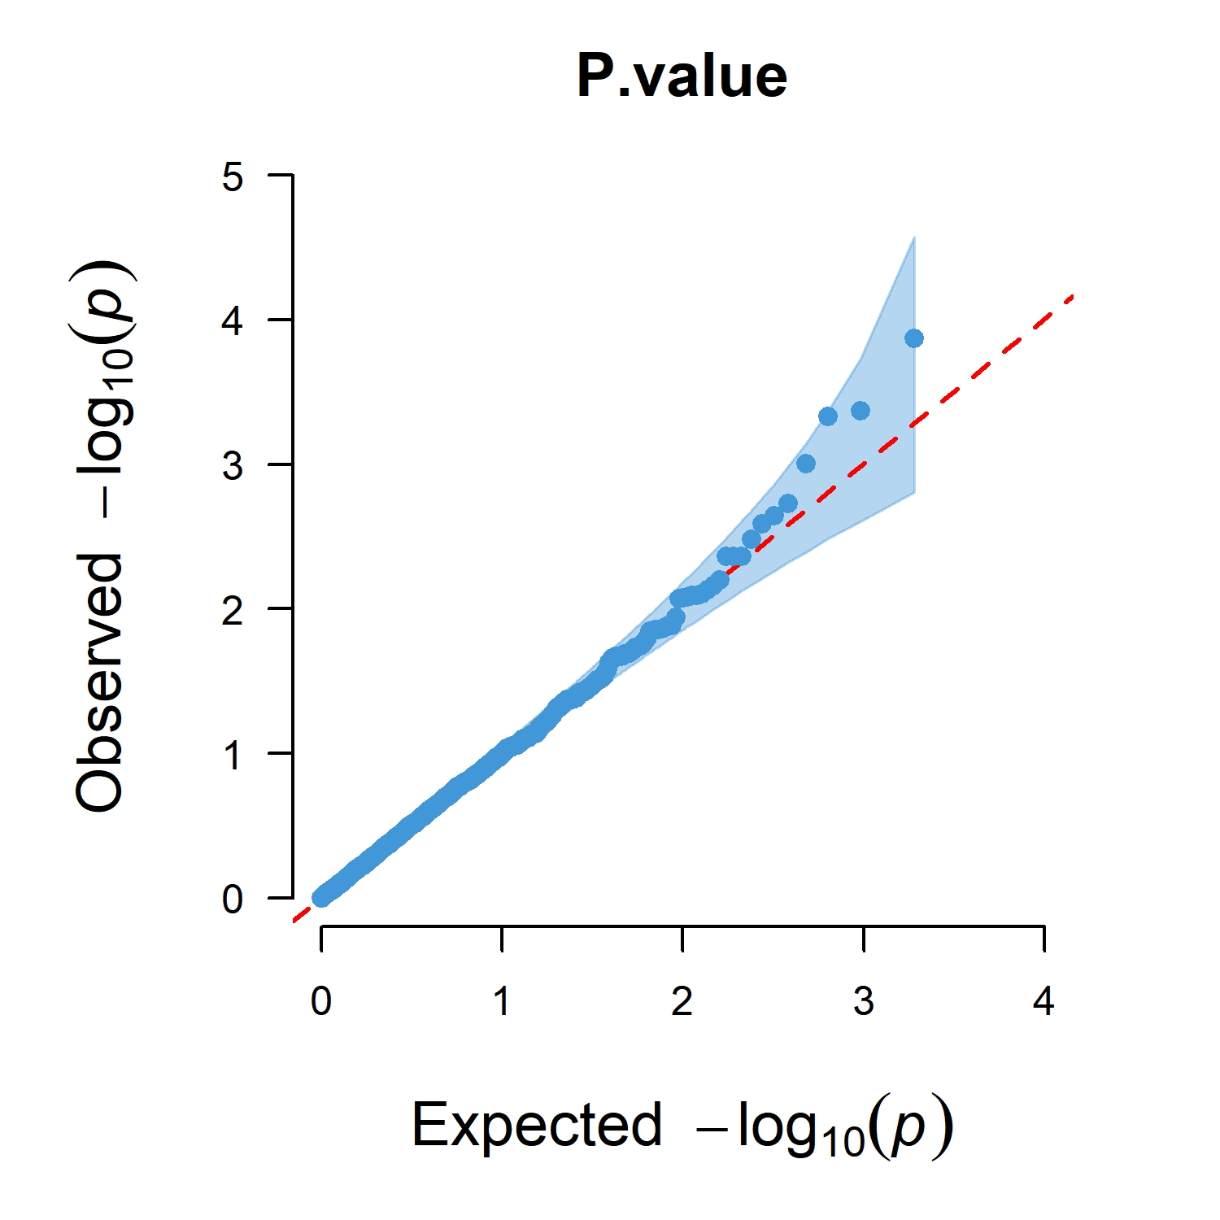
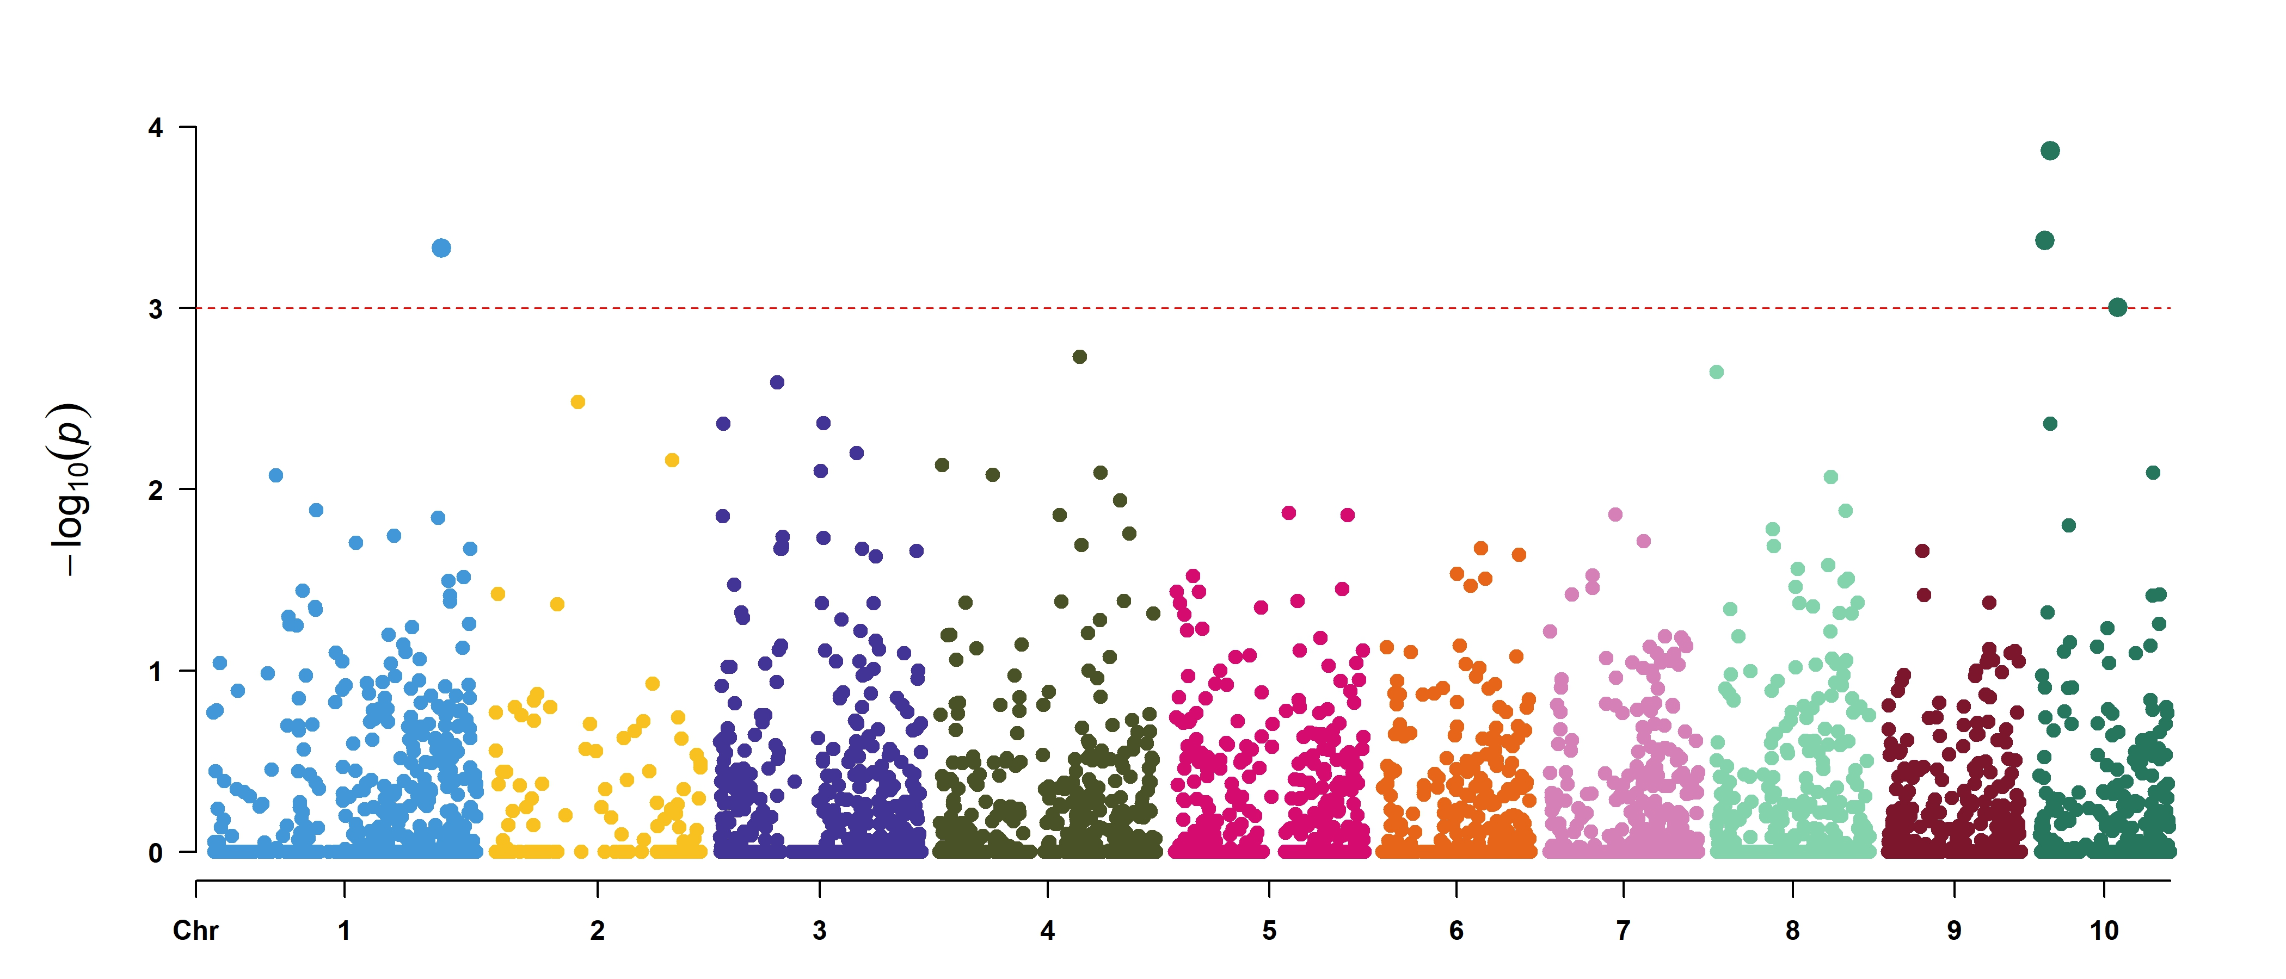
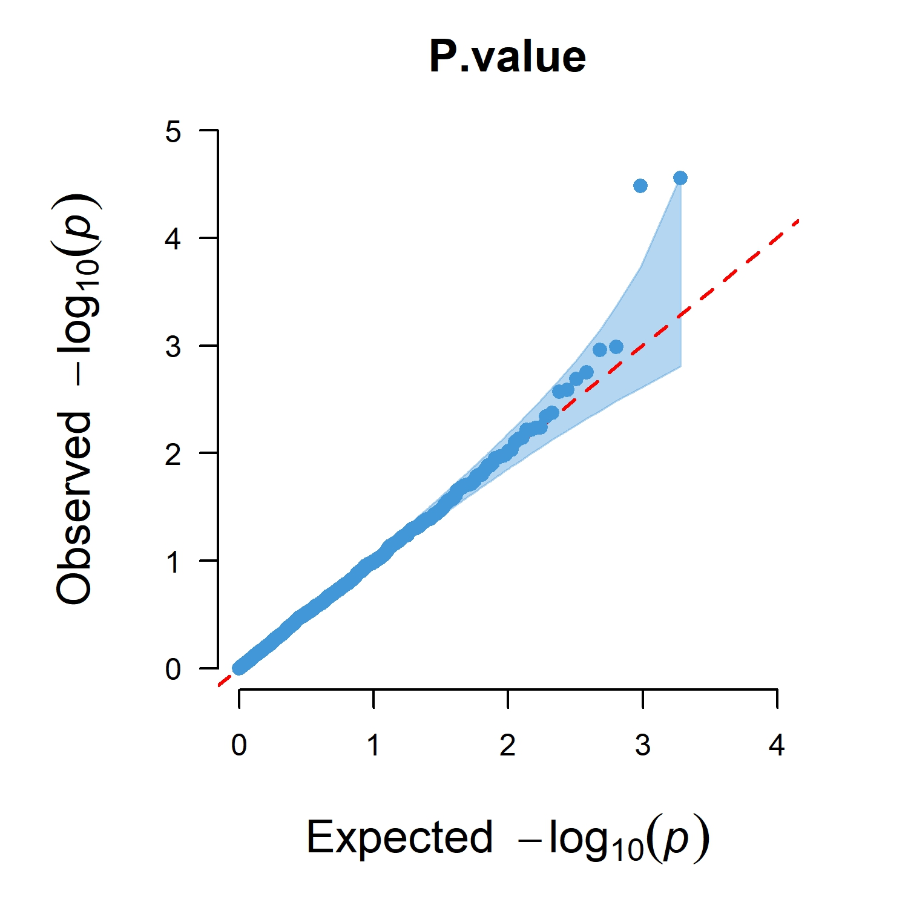
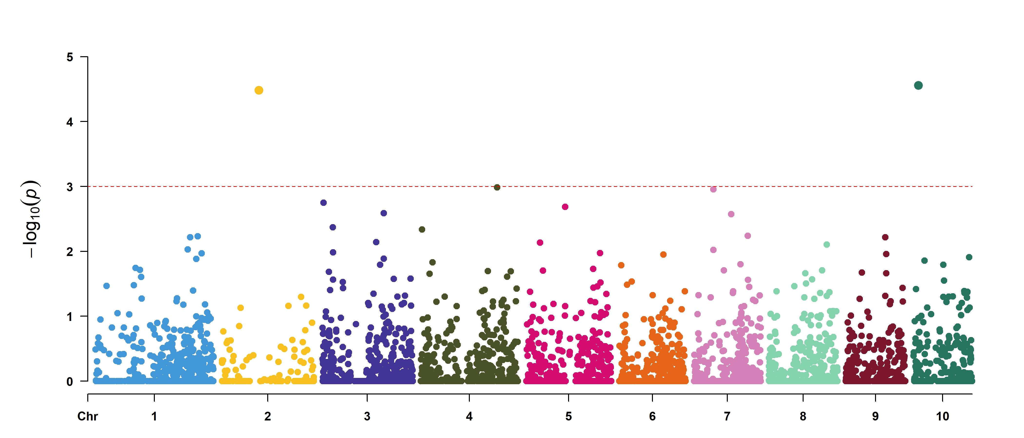

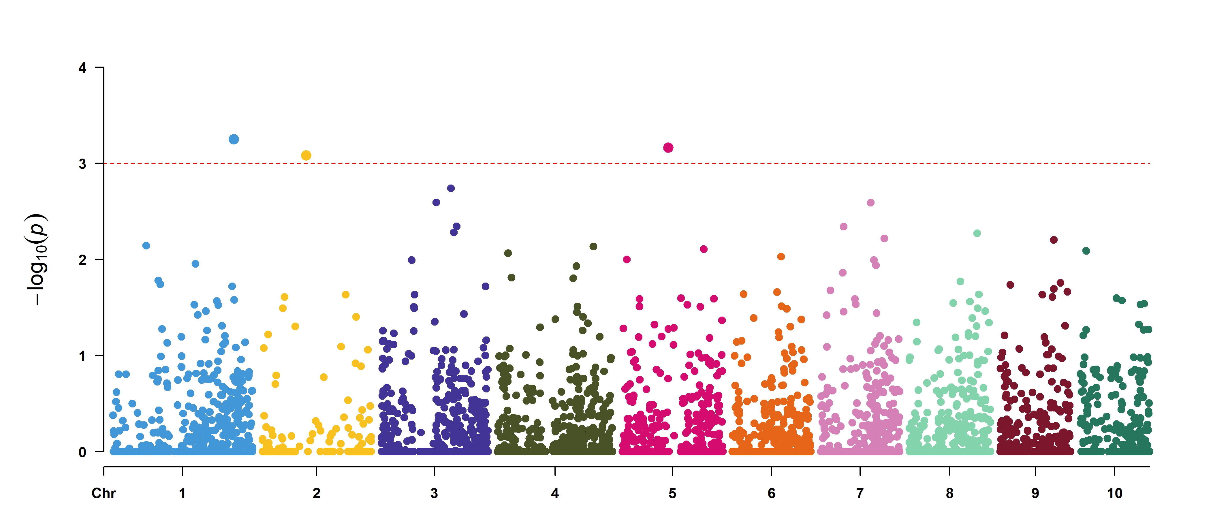

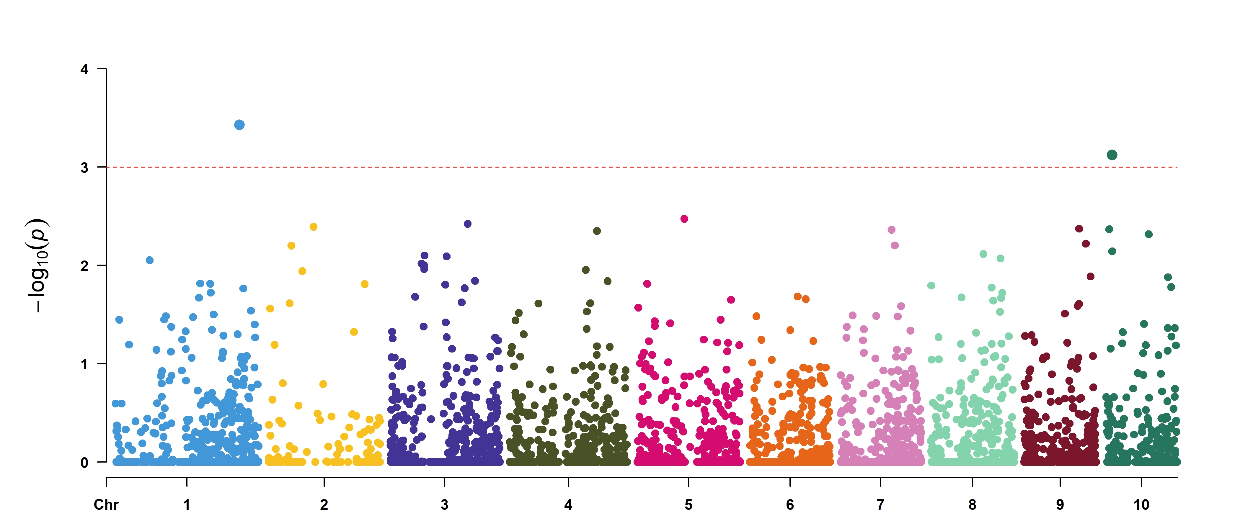

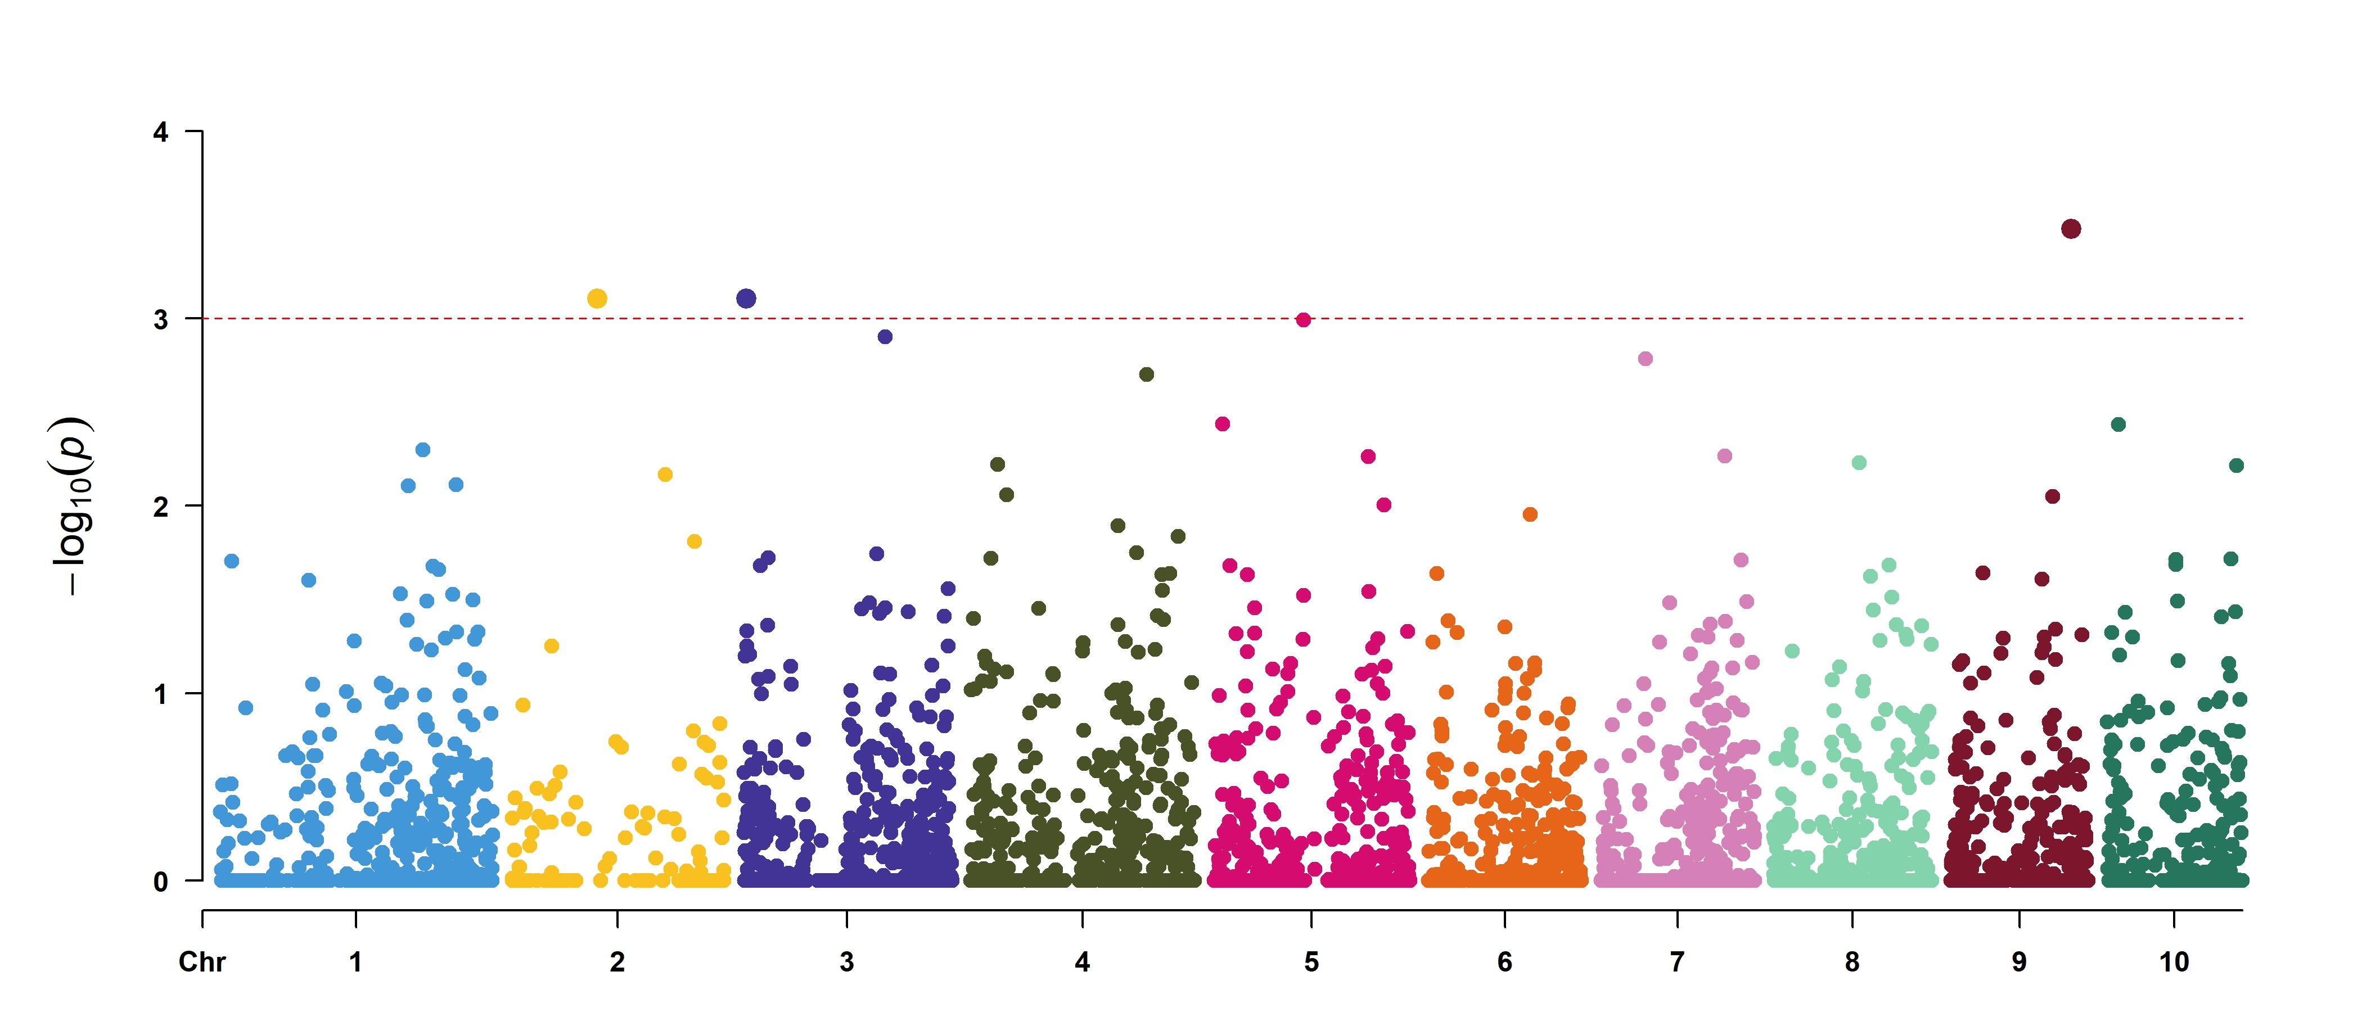
(A)
(B)
(C)
(D)
(E)
(F)
(G)
(H)
(I)
Supplementary Figures S2. The FarmCPU model was used in the Laiyang area to analyze the traits and construct Manhattan and QQ plots. The x-axis represents the chromosomes, and the y-axis represents the thresholds. (A) 2019 Lignin; (B) 2019 Cellulose; (C) 2019 Hemicellulose; (D) 2020 Lignin; (E) 2020 Cellulose; (F) 2020 Hemicellulose; (G ) BLUE Lignin; (H) BLUE Cellulose; and (I) BLUE Hemicellulose were analyzed by Manhattan and Q-Q plots.

