Slide 1
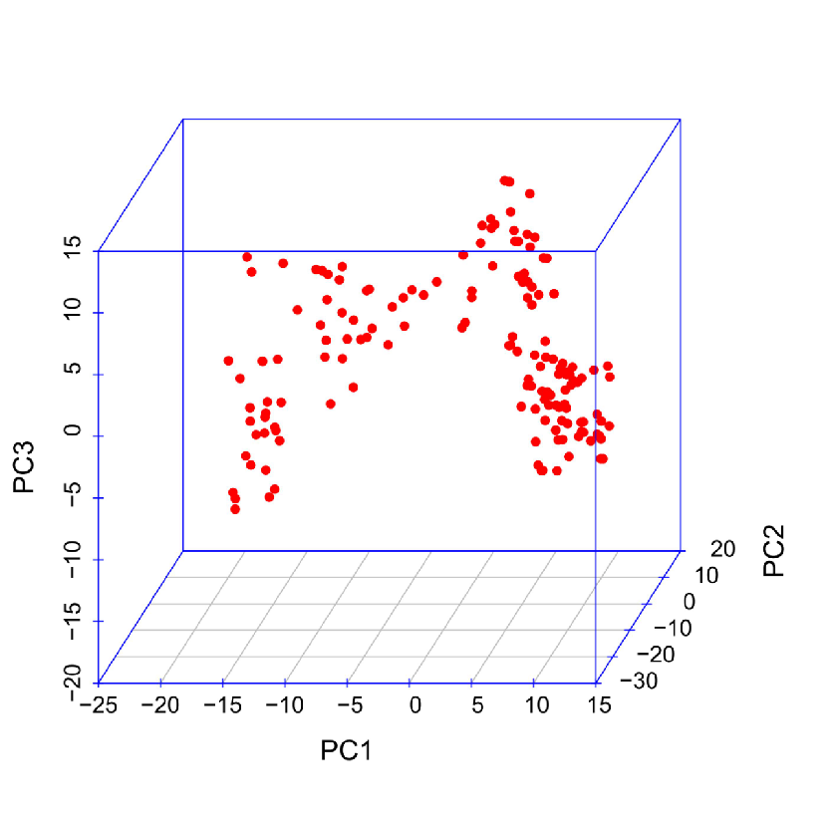
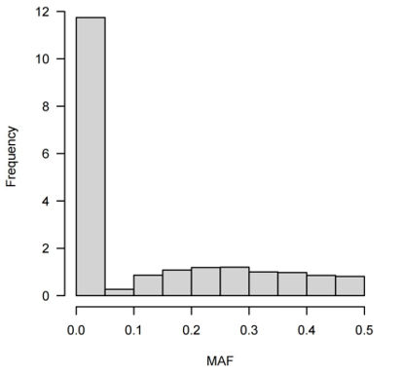
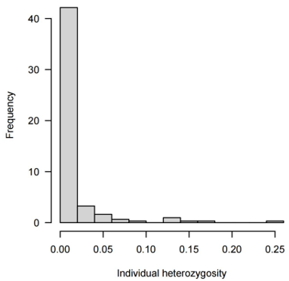
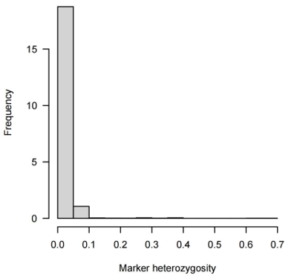
(A) (B)
(C) (D)
Supplementary Figures S1. Heterozygosity 4666 SNP markers in the 153 inbred lines. (A) Principal component analysis based on maize groups. (B) MAF (C) Heterozygosity of individuals. (D) Heterozygosity of markers.

