Slide 1
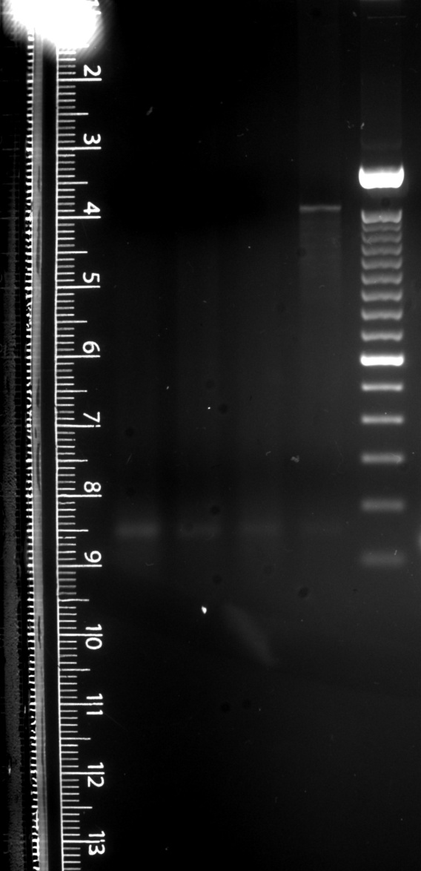

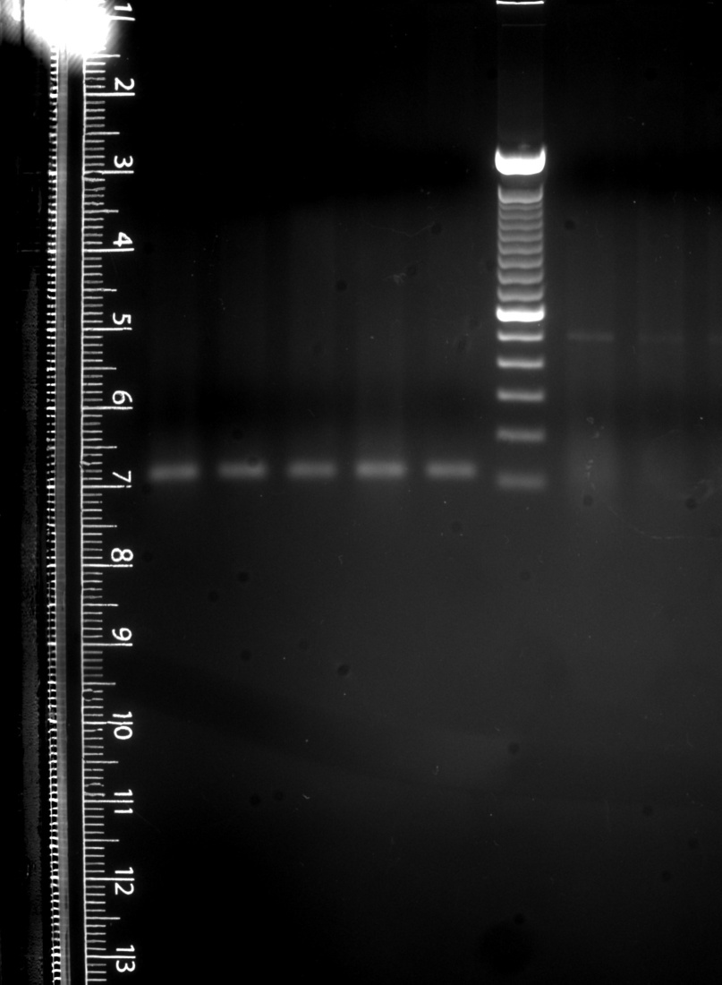
Figure 3: Original Gel Pictures
RR CC
RR CC
RR CC
RR CC
495 bp
Oct4
140 bp
GAPDH
153 bp
125 bp
Nanog
SOX2

Slide 2
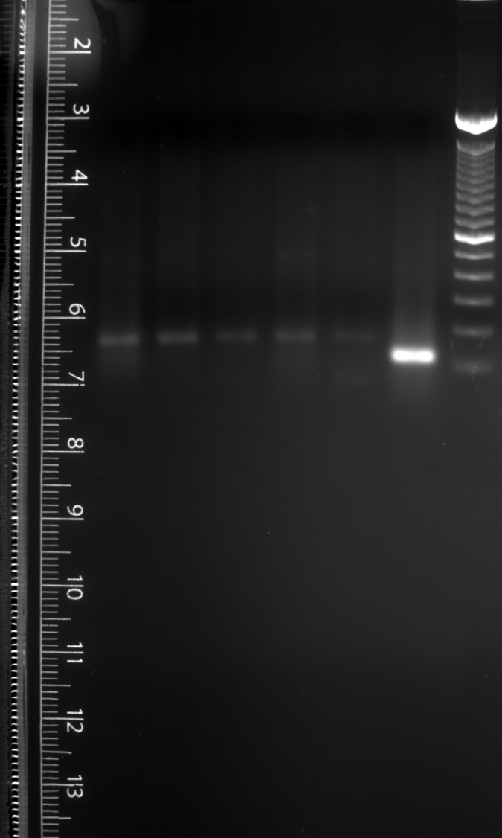
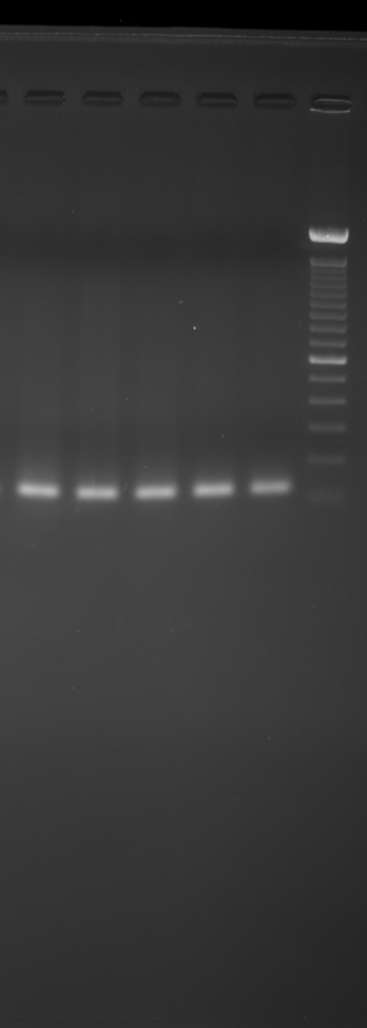
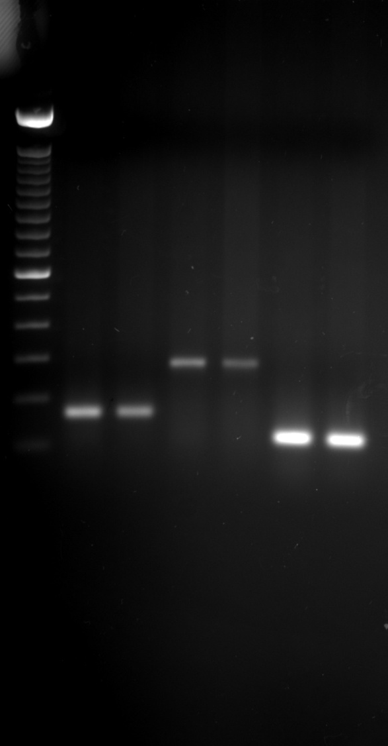
Figure 3: Original Gel Pictures
RR CC
RR CC
RR CC
165 bp
TERT
121 bp
CD166
119 bp
GDC

Slide 3
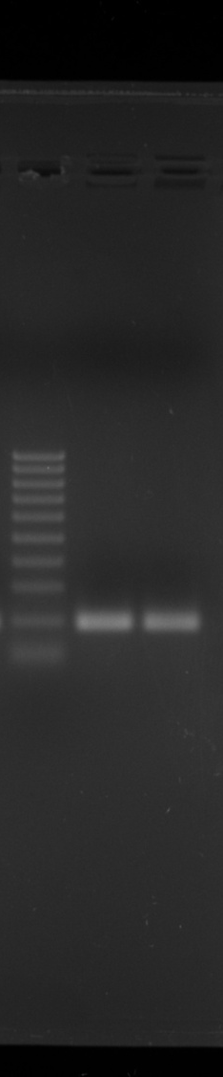
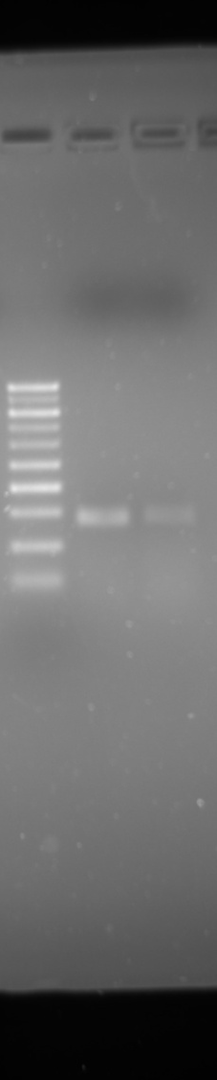
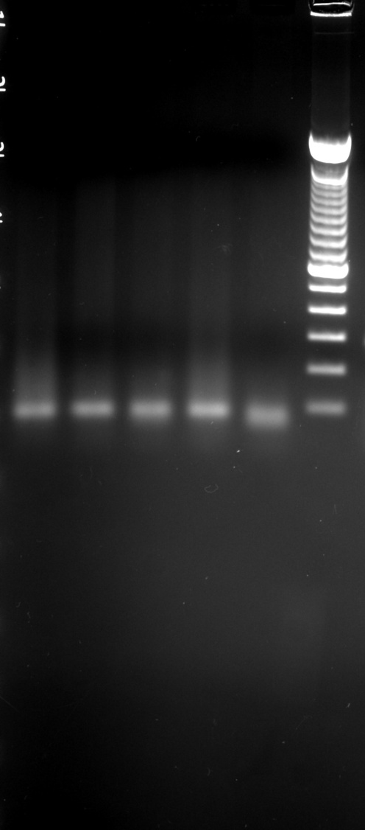
Figure 3: Original Gel Pictures
Supplementary Figure S3b: Original Gel Pictures
Template Negative PCR reaction
with GAPDH Primers
CC RR
CC RR
RR CC
237 bp
185 bp
NR3C2
76 bp
Primer Dimers
β-Actin
CCSP

Slide 4
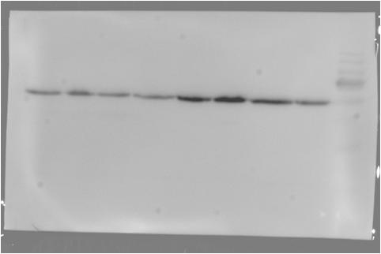
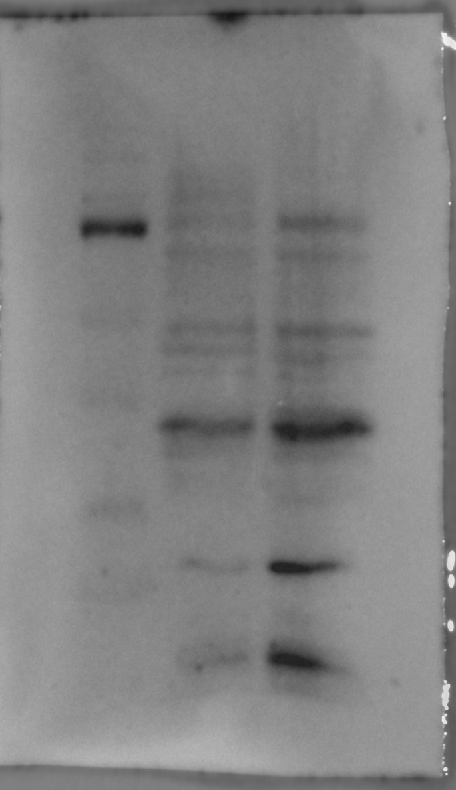
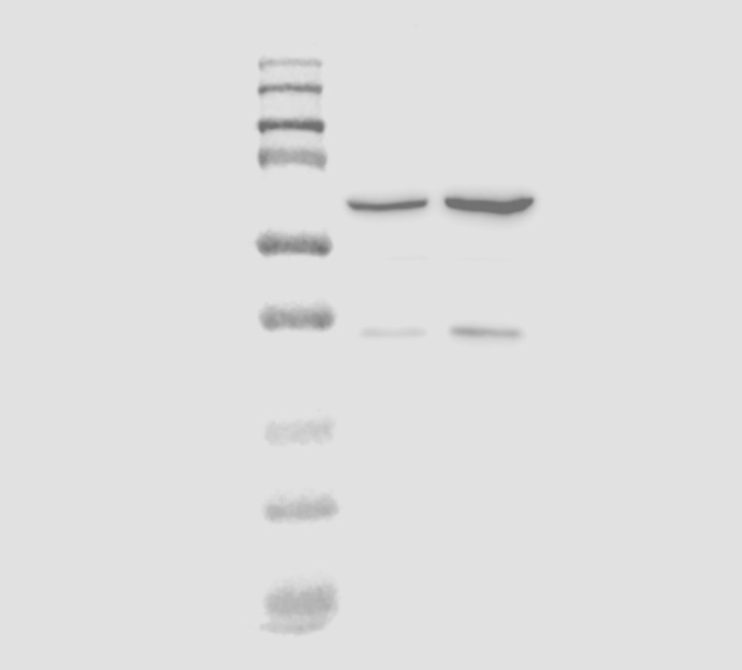
Supplementary Figure S3a: Original Western Blot Pictures
CC RR
CC RR
180
180
135
135
100
100
75
75
55 KDa
63
48
35
35 KDa
25
17
β-actin
CC RR
Oct-4
180
135
100
75
63
48
37 KDa
35
25
17
Nanog

