Slide 1
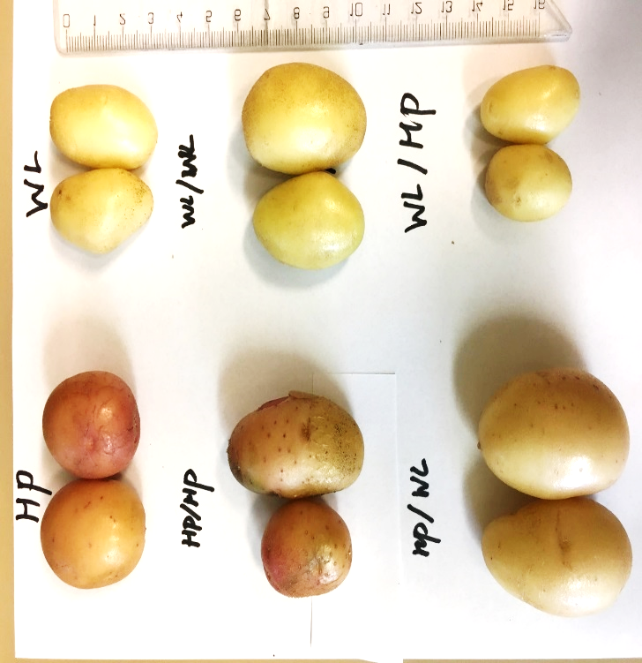
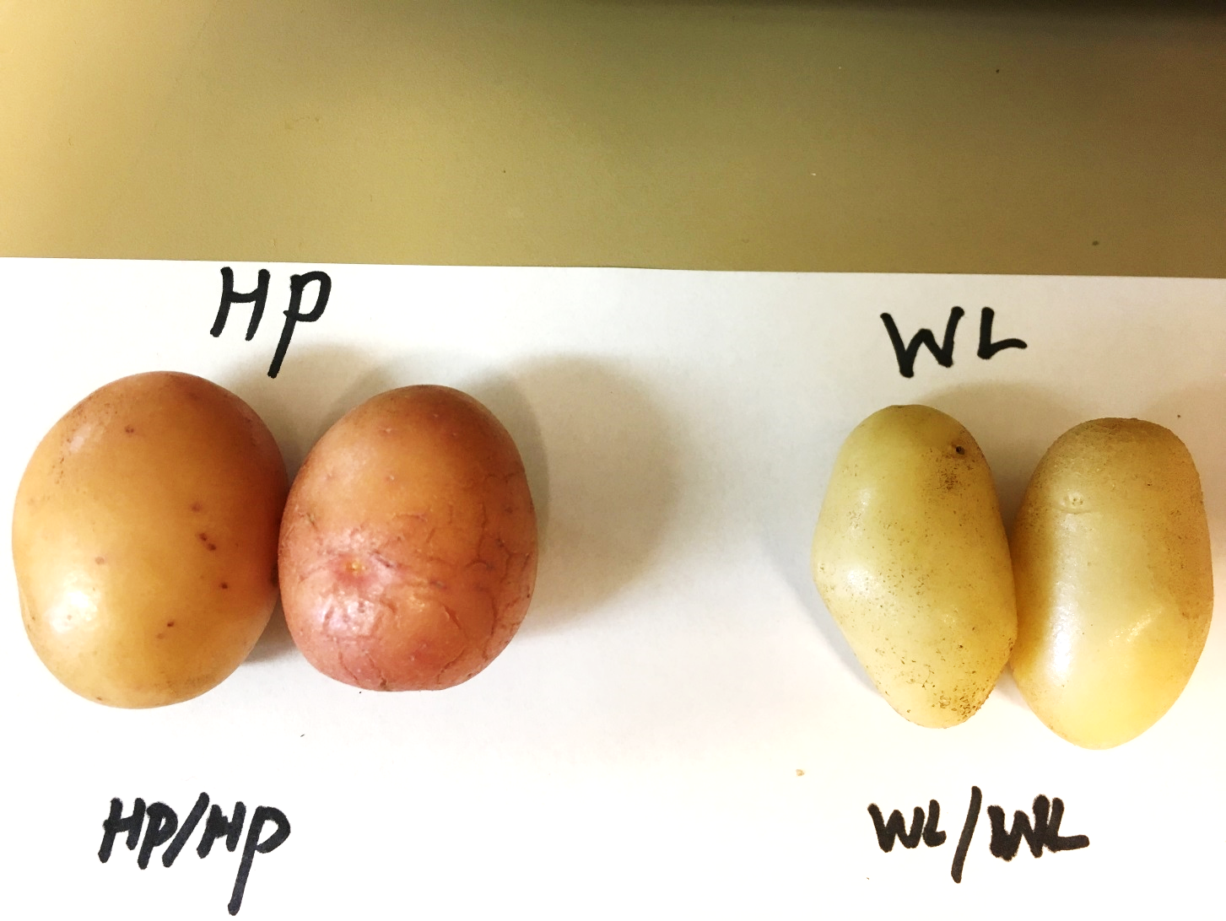

A
C
E
B
D
F
Fig. S1 Morphology of mature tubers collected from the non-grafted and grafted potato plants. (A) non-grafted HP, (B) non-grafted WL, (C) homo-grafted HP/HP (D) homo-grafted WL/WL, (E) hetero-graft WL/HP, HP is the rootstock (F) hetero-graft HP/WL, WL is the rootstock
Notes:
.at the End of the vegetation period. Tuber colour are determined by the rootstock. Shape is determined by the scion

Slide 2
A
B
C
Fig. S2 Tuber number (A), size (B) and yield per plant (C) at the end of the vegetation period. The means are obtained from three consecutive experiments. The standard deviations are indicated by error bars. No significant differences were detected between the means at p ≤ 0.05 by one-way ANOVA with post-hoc Tukey HSD test.

Slide 3
Amino acids
Sugars
Sugar alc.
Organic acids
Inorg. ac.
Amino acids
Sugars
Sugar alc.
Organic acids
Inorg. ac.
Fig. S3 Metabolite composition of leaves. The relative data shown on the y axis are derived from a comparison of the peak sizes of the samples and an internal standard, ribitol. The means were obtained from two consecutive experiments from three-four biological repeats (Table S1). The standard deviations are indicated by error bars.

Slide 4
A
B
Fig. S4 Sugar concentrations in leaves (A) and tubers (B). The concentrations were calculated by comparing the peak sizes (Table S1 and S2) to those of authentic standards.

Slide 5
A
B
C
D
E
Fig. S5 PCA biplot analysis of the leaf metabolite data presented in Table S1. (A) HP-WL, (B) HP-HP/HP, (C) WL-WL/WL, (D) HP/HP-HP/WL, (E) WL/WL-WL/HP

Slide 6
Amino acids
Sugars
Sugar alc.
Organic acids
Inorg. ac.
Amino acids
Sugars
Sugar alc.
Organic acids
Inorg. ac.
Fig. S6 Metabolite composition of tubers. The relative data shown on the y axis are derived from a comparison of the peak sizes of the samples and an internal standard, ribitol. The means were obtained from two consecutive experiments from four-five biological repeats (Table S2). The standard deviations are indicated by error bars.

Slide 7
A
B
C
D
E
Fig. S7 PCA biplot analysis of the tuber metabolite data presented in Table S2. (A) HP-WL, (B) HP-HP/HP, (C) WL-WL/WL, (D) HP/HP-WL/HP, (E) WL/WL-HP/WL

