Slide 1
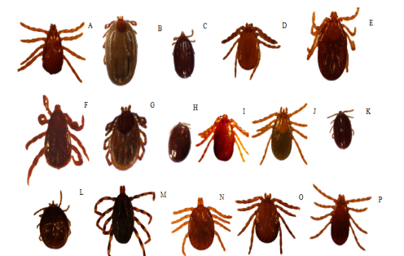
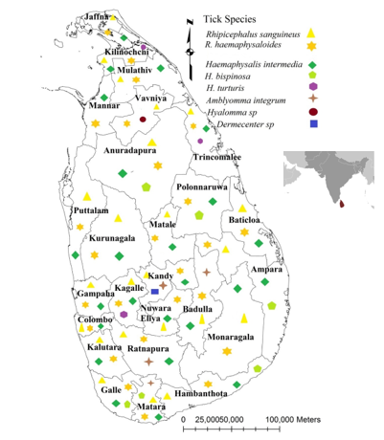
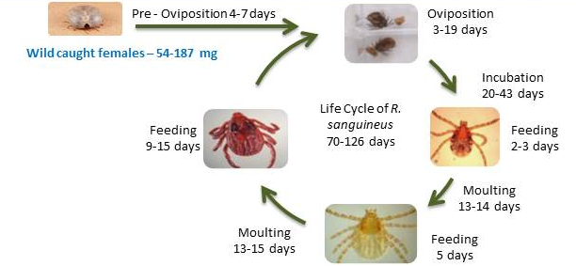
Tick species infesting domestic dog in Sri Lanka. a-f) Rhipicephalus species a) R. sanguineus Adult male, b) R. sanguineus Adult female, c) R. sanguineus Nymph , d) R. haemaphysaloides Adult male, e) R. haemaphysaloides Adult female, f) R. haemaphysaloides Nymph g–m) Haemaphysalis species g) H. intermedia Adult male , h) H. intermedia Adult female, i) H. intermedia Nymph, j) H. bispinosa Adult male, k) H. bispinosa Adult female, l) H. turturis Adult male, m) H. turturis Adult female. n–p) Other species n) Dermacenter auratus Nymph , o) Hyalomma sp Adult female, p) Amblyomma integrum Nymph

