Slide 1
Supplementary Information
Synthetic phytosiderophore, proline-2′-deoxymugineic acid, is efficiently utilized by dicots
Plant and Soil
Daisei Ueno^{1,*}, Yuta Ito¹, Miho Ohnishi^{2,3}, Chikahiro Miyake^{2,3}, Takayuki Sohtome⁴, Motofumi Suzuki⁵
¹Faculty of Agriculture and Marine Science, Kochi University, 200 Otsu, Monobe, Nankoku, Kochi 783-8502, Japan
²Department of Applied Biological Science, Graduate School for Agricultural Science, Kobe University, 1-1, Rokkodai, Nada, Kobe, Hyogo 657-8501, Japan
³Core Research for Environmental Science and Technology (CREST) of Japan Science and Technology Agency, 7, Goban, Chiyoda, Tokyo 102-0076, Japan
⁴Research and Development Department, Bunkoukeiki Co., Ltd, 4-8, Takakura, Hachioji, Tokyo 192-0033, Japan
⁵Aichi Steel Corporation, 1 Wanowari, Arao, Tokai, Aichi 476-8666, Japan
*Corresponding author: Daisei Ueno
E-mail: daisei_u@kochi-u.ac.jp

Slide 2
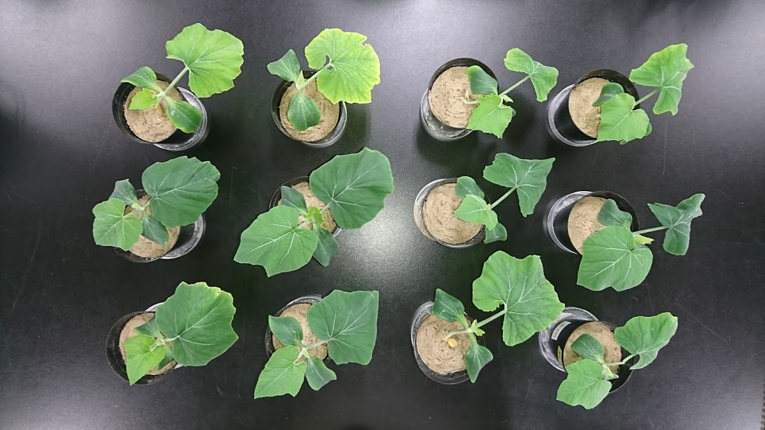
(a)
Control
PDMA-Fe
EDDHA-Fe
(b)
a
(c)
a
a
a
a
a
a
a
b
b
b
b
b
b
b
Fig. S1 Effects of PDMA-Fe(III) on chlorophyll and Fe concentrations of pumpkin grown in calcareous soil
Seedlings were treated with or without Fe chelates for 5 d. (a) Image of shoots, (b) change in chlorophyll concentration (SPAD value) in expanded true leaves, and (c) Fe concentration in true leaves and other aerial parts (seed leaves and stems). Data are presented as mean ± standard deviation (n = 4). Different letters indicate significant differences (P < 0.05) using Tukey’s test.

Slide 3
(a)
c
(b)
c
Fig. S2 Effects of Fe chelates on chlorophyll and Fe concentrations in cucumber grown in hydroponic culture
Seedlings were treated with or without 0.5 µM Fe chelates at pH 8.0 for 6 d. (a) Chlorophyll concentration (SPAD value) in expanded true leaves and (b) Fe concentration in shoots. Data are presented as mean ± standard deviation (n = 3). Different letters indicate significant differences (P < 0.05) using Tukey’s test.

