Slide 1
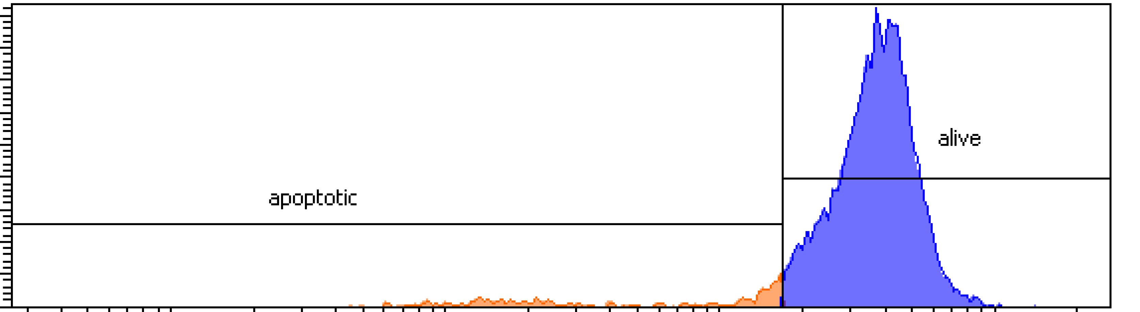
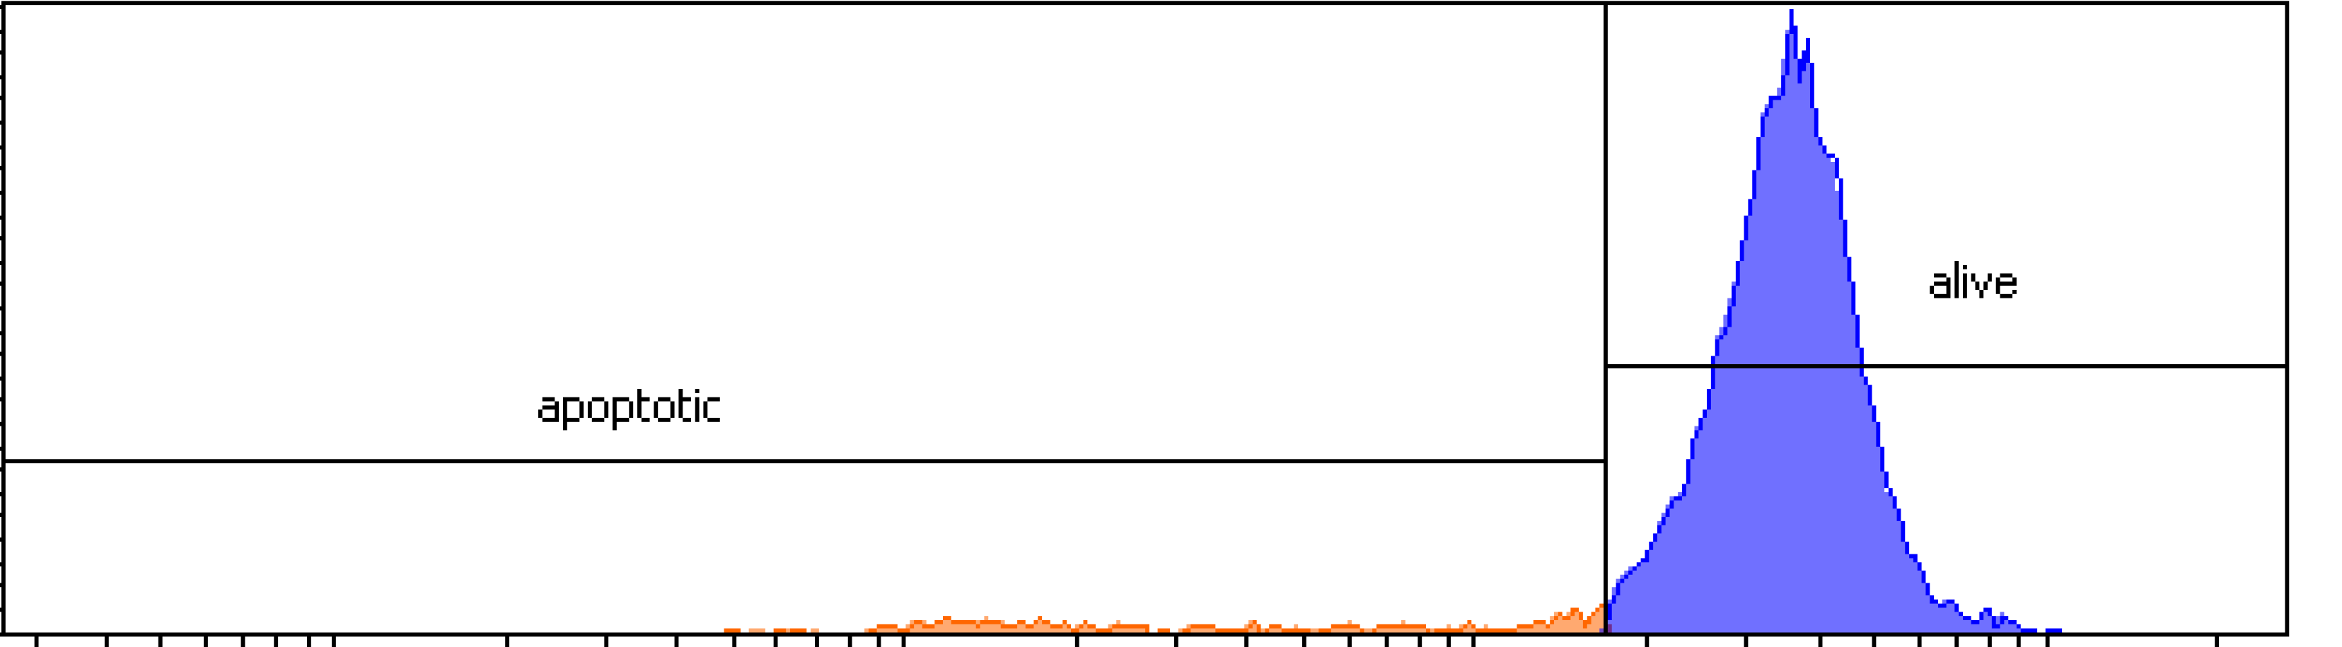
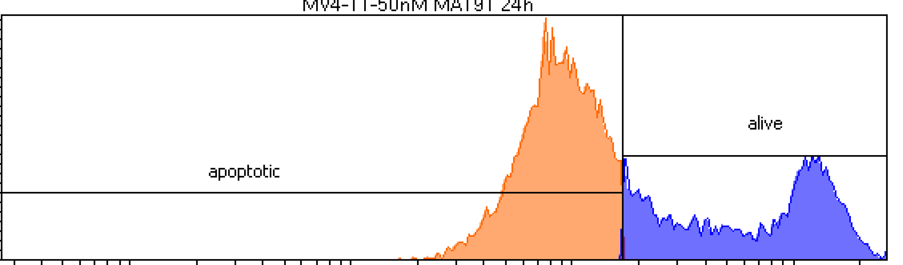
Halilovic_Figure S1
a
MA191
MV4-11
100
MOLM-13
cell viability
[%]
 | IC50 (nM) 72 h
MV4-11 | 11.0
MOLM-13 | 9.6
50
0
10
100
log concentration [nM]
b
100
MV4-11
100
MOLM-13
80
late apoptosis
80
late apoptosis
60
early apoptosis
60
early apoptosis
cell death
[% of population]
cell death
[% of population]
40
***
***
40
20
****
**
20
****
****
0
-
+
-
-
+
-
0
-
+
-
-
+
-
MA191 50 nM
MA225 100 nM
-
+
-
-
-
+
-
-
+
MA191 50 nM
MA225 100 nM
-
+
-
-
-
+
-
-
+
-
-
+
-
-
+
c
6 h
16 h
24 h
6 h
16 h
24 h
400-
200-
0-
control
count
apoptotic
alive
10² 10³ 10⁴ 10⁵ FITC-A
ns
MA191 (50 nM, 6 h)
*
400-
200-
0-
% of DIOC6 high
count
apoptotic
alive
10² 10³ 10⁴ 10⁵ FITC-A
control
MA191 (50 nM, 24 h)
MA191 (50 nM, 6 h)
200-
100-
0-
MA191 (50 nM,24 h)
count
apoptotic
alive
10² 10³ 10⁴ 10⁵ FITC-A
Figure S1. Identification of novel MA191 FLT3 PROTAC. a IC₅₀ values for apoptosis induction by MA191 in MV4-11 and MOLM-13 cells were determined by annexin-V and PI staining and flow cytometry. The cells were treated with 0, 5, 10, 20, 50, or 100 nM MA191 for 72 h. IC50 values were calculated with GraphPad Prism 6. b MV4-11 and MOLM-13 cells were treated with 50 nM MA191 or 100 nM MA225 for 6, 16, or 24 h and analyzed for apoptosis by annexin-V and PI staining using flow cytometry. The data are representative for the outcome of two independent experiments; -, untreated, +, treated. Two-way ANOVA statistical test was used to determine statistical significance; *p, <0.05; **p, <0.01; ***p, <0.001; ****p, <0.0001. c Representative histograms of DiOC₆ staining of MV4-11 cells (left) and percentage of the DiOC₆ high population of MV4-11 and MOLM13 cells (right) treated with 50 nM MA191 for 6 and 24 h respectively. Analysis was made using flow cytometry. The data are representative for the outcome of three independent experiments; One-way ANOVA statistical test was used to determine statistical significance; *p, <0.05; **p, <0.01; ***p, <0.001; ****p, <0.0001.

Slide 2
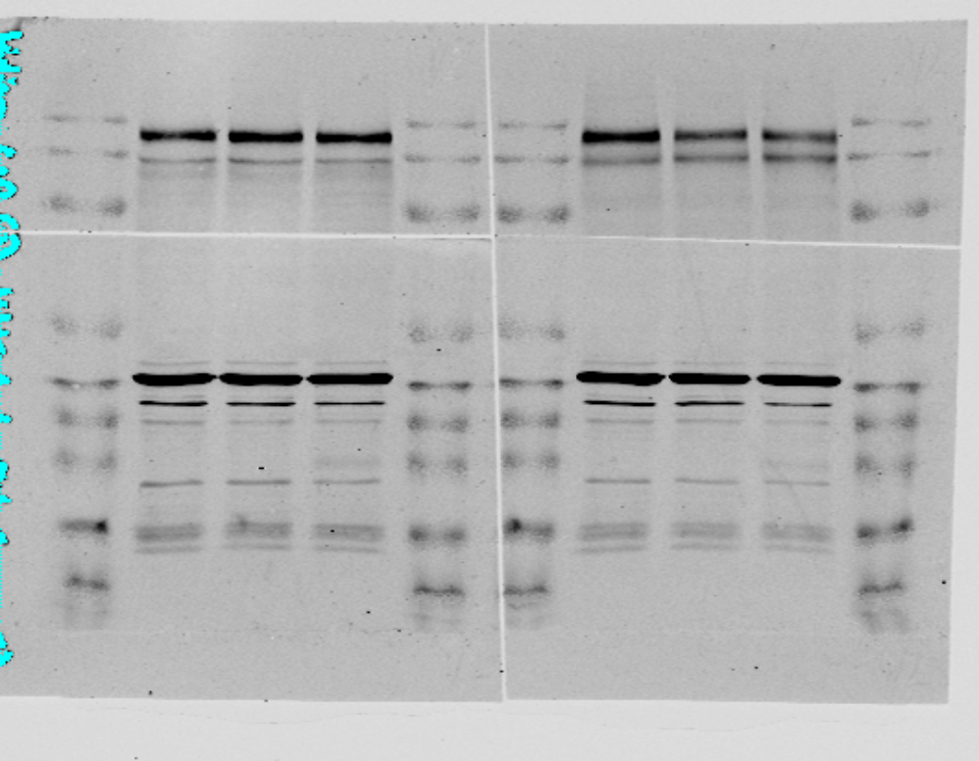
Halilovic_Figure S2
a
b
c
100
HMC-1.1
MA191 [nM]
0
50
100
100
late apoptosis
cell death
[% of population]
[kDa]
****
early apoptosis
50
c-KIT
145
cell death
[% of population]
120
50
****
0
****
β-actin
40
***
MA191
-
+
++
p-c-KIT
145
0
ns
β-actin
120
MA191
-
+
-
+
-
+
100
HMC-1.2
HMC-1.1
40
MV4-11
MOLM-13
RS4-11
cell death
[% of population]
50
0
MA191
-
+
++
late apoptosis
early apoptosis
Figure S2. MA191 is most toxic for cells carrying FLT3-ITD. a MV4-11, MOLM-13, and RS4-11 cells were treated with 50 nM MA191 for 72 h and analyzed for apoptosis by annexin-V and PI staining using flow cytometry. The data are representative for the outcome of two independent experiments; -, untreated, +, treated. Two-way ANOVA statistical test was used to determine statistical significance; ns, not significant; *p, <0.05; **p, <0.01; ***p, <0.001; ****p, <0.0001. b HMC-1.1 (carrying c-KIT with the activating V560G KIT mutation; upper panel) and HMC-1.2 (carrying c-KIT with the activating mutations G560V and D816V; lower panel), were treated with 50 nM or 100 nM MA191 for 72 h and analyzed for apoptosis by annexin-V and PI staining using flow cytometry. The data are representative for the outcome of two independent experiments; -, untreated, +, 50 nM, ++ 100 nM. Two-way ANOVA statistical test was used to determine statistical significance; ****p, <0.0001. c HMC-1.1 cells were treated with 50 or 100 nM MA191 for 24 h and analyzed by immunoblot for the expression of c-KIT and p-Y719-c-KIT. The protein levels of β-actin were determined to verify equal loading of samples on all tested membranes. The data are representative for the outcome of three independent experiments; p-, phosphorylated; kDa, molecular weight in kilodalton.

Slide 3
Halilovic_Figure S3
a
b
100
late apoptosis
100
late apoptosis
80
*
early apoptosis
80
early apoptosis
cell death
[% of population]
****
60
****
cell death
[% of population]
40
****
****
ns
*
60
****
20
ns
40
ns
ns
0
20
-
+
-
-
+
-
-
+
-
0
+
-
+
MA49
MA191
-
-
+
-
-
+
-
-
+
MA68
-
+
-
MOLM-13
MOLM-13
-RES
MOLM-13
-RES-AC
MOLM-13
MOLM-13
-RES
MOLM-13
-RES-AC
c
HS-5 (24 h)
HS-5 (48 h)
50
late apoptosis
50
late apoptosis
cell death
[% of population]
early apoptosis
cell death
[% of population]
early apoptosis
25
25
0
0
-
+
++
MA191
-
+
++
MA191
Figure S3. MA191 is effective against FLT3-ITD with secondary D835Y TKD mutation. a, b MOLM-13, MOLM-13-RES, and MOLM-13-RES-AC were treated with 200 nM a MA49, MA191, or b MA68 for 48 h and analyzed for apoptosis by annexin-V and PI staining using flow cytometry. The data are representative for the outcome of two independent experiments; -, untreated, +, 200 nM. Two-way ANOVA test was used to determine statistical significance; ns, not significant; *p, <0.05; **p, <0.01; ***p, <0.001; ****p, <0.0001. c HS-5 cells that were co-cultured with MV4-11 cells were treated with 50 or 100 nM MA191 for c 24 h or d 48 h and analyzed for the apoptosis by annexin-V and PI staining using flow cytometry. The data are representative for the outcome of three independent experiments; -, untreated, +, 50 nM, ++, 100 nM. Two-way ANOVA statistical test was used to determine statistical significance.

