Slide 1
1f
[kDa]
1g
180
[kDa]
FLT3
FLT3
180
130
130
70
70
pERK1/2
55
pERK1/2
55
40
40
35
35
70
70
55
β-actin
55
β-actin
40
40
35
35
25
pFLT3
180
130
pFLT3
180
pSTAT5
100
130
70
pSTAT5
100
70
55
pAKT
40
70
35
55
pAKT
40
70
35
β-actin
55
40
70
35
β-actin
55
40
35

Slide 2
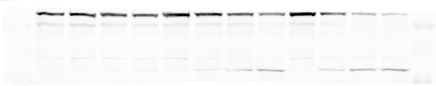
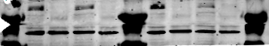
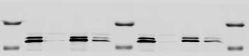
2a
[kDa]
2c
[kDa]
FLT3
180
FLT3
180
HSP110
130
130
100
pAKT
55
70
40
55
35
HSP70
100
180
70
HSP110
130
55
100
35
100
cl. caspase-3
HSP70
70
15
55
10
25
BIM
15
180
10
vinculin
130
100
β-actin
55
70
35
55
25
pFLT3
180
HSP27
15
130
10
pSTAT5
100
40
55
35
pERK1/2
25
35
GAPDH
15
35
10
cl. caspase-3
15
10
pFLT3
180
HSP90
100
130
25
pSTAT5
100
HSP27
15
HSP90
100
10
40
55
35
β-actin
BIM-EL
25
35
15
10
40
35
β-actin
15
10

Slide 3
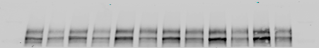
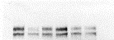

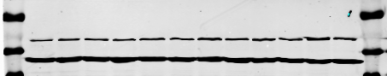
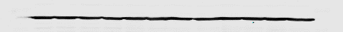
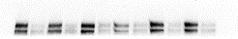
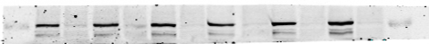

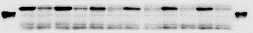
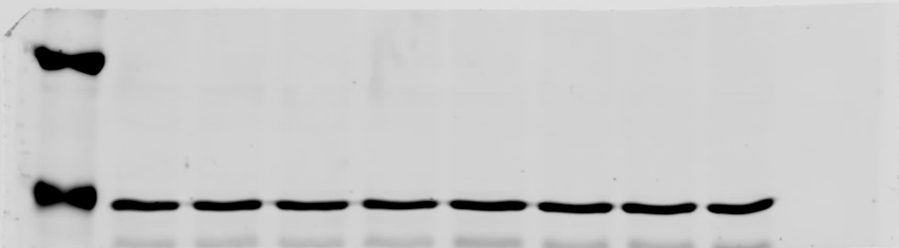
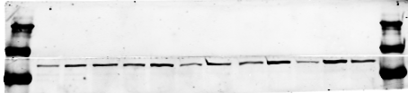
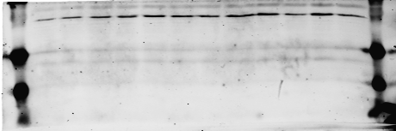
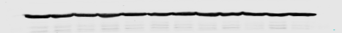
2d
[kDa]
[kDa]
2f
FLT3
180
130
FLT3
180
100
130
β-actin
70
55
25
40
35
cl. caspase-3
15
pFLT3
180
10
130
35
100
25
70
VHL
15
HSP90
55
10
40
100
100
HSP70
70
β-actin
70
55
55
35
40
55
35
β-actin
35
pFLT3
180
130
2e
[kDa]
pSTAT5
100
FLT3
250
55
130
pAKT
GAPDH
55
180
35
HSP110
130
100
35
25
HSP27
15
10
β-actin
55
35

Slide 4
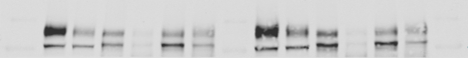
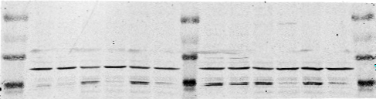
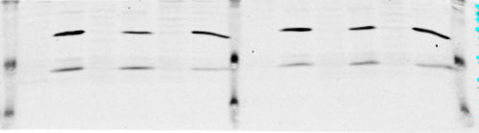
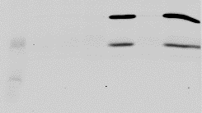
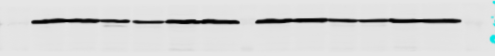
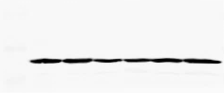
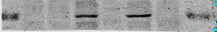
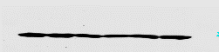
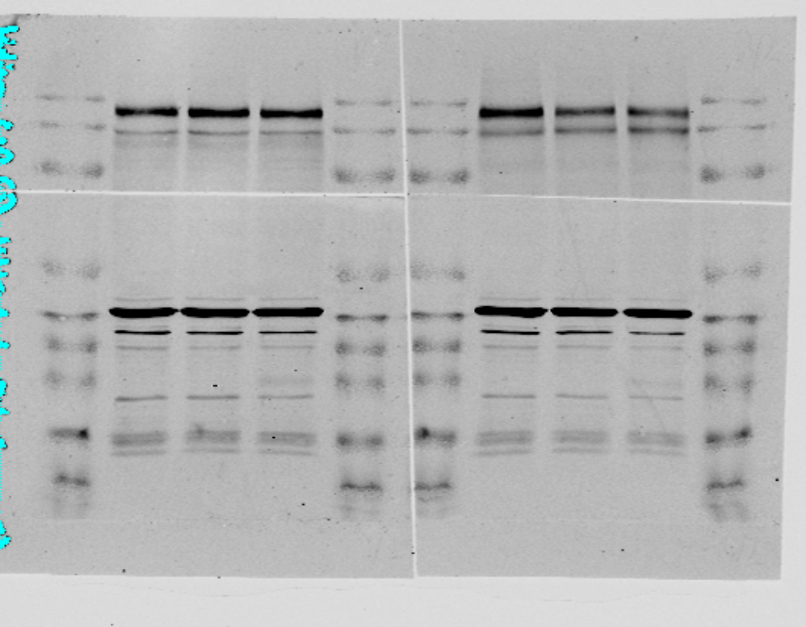
3c
[kDa]
5d
[kDa]
FLT3
180
FLT3
180
130
130
100
pSTAT5
100
β-actin
70
35
55
35
cl. caspase-3
15
[kDa]
10
cl. caspase-3
25
15
10
β-actin
40
70
β-actin
55
35
pSTAT5
100
β-actin
55
35
S2c
c-kit
180
130
100
55
40
35
β-actin
25
15
10
p-c-kit
180
130
100
55
40
35
β-actin
25
15
10

