Slide 1
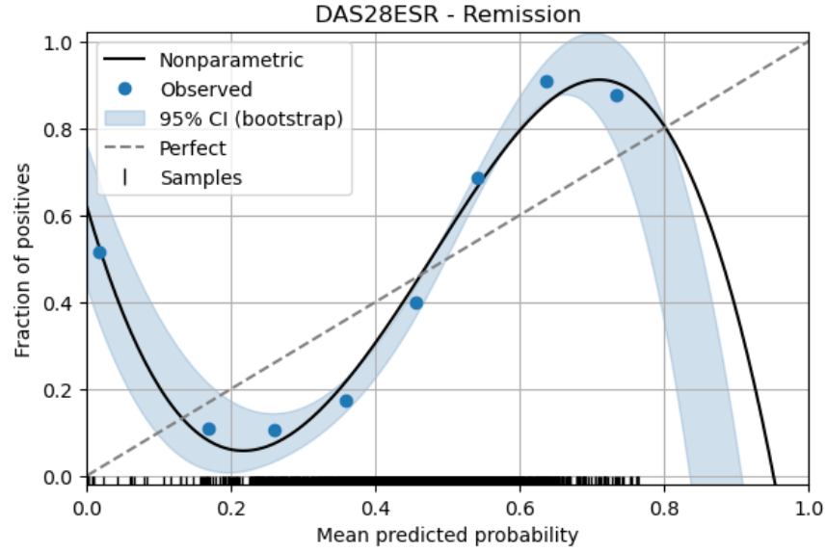
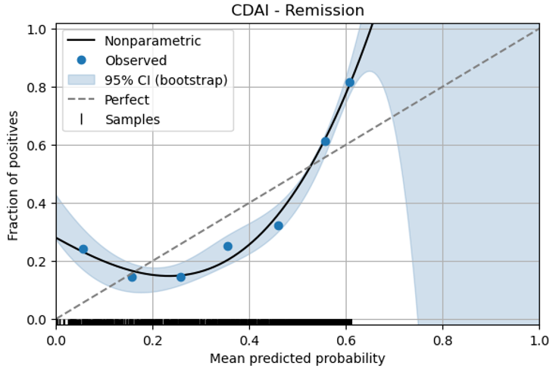
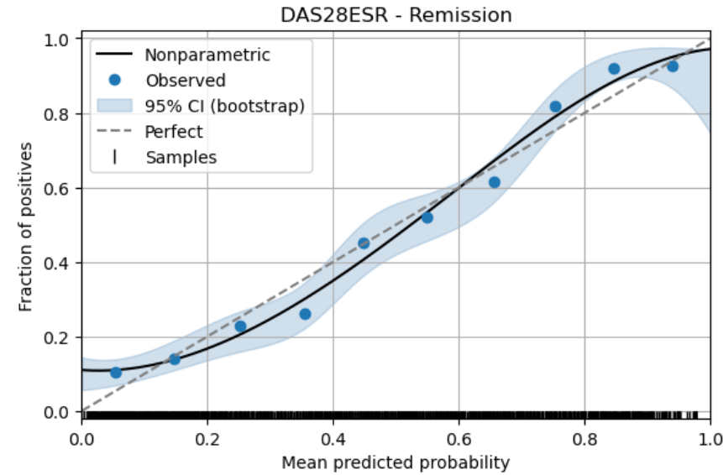
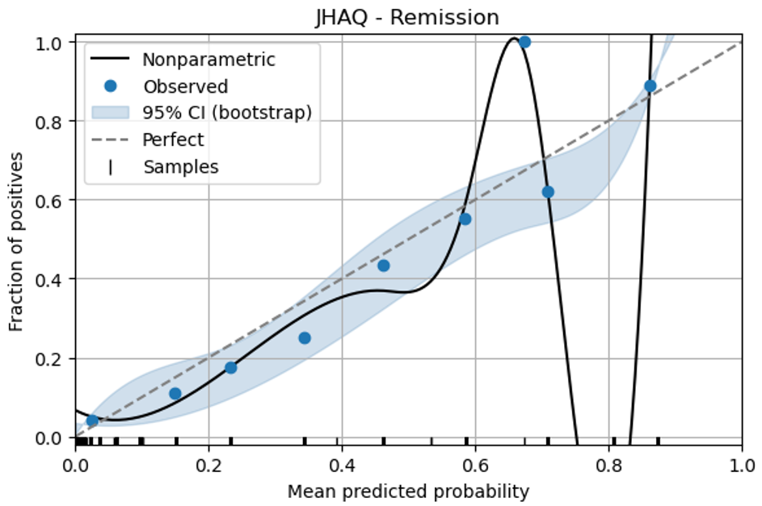
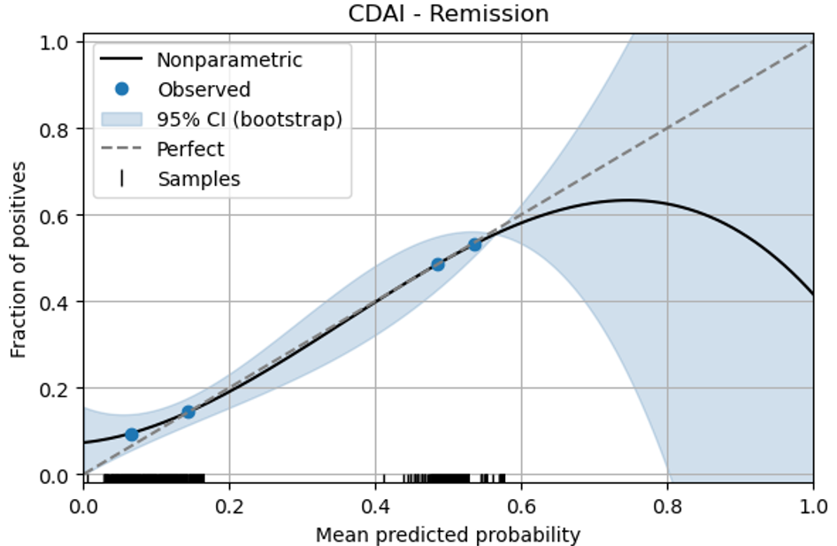
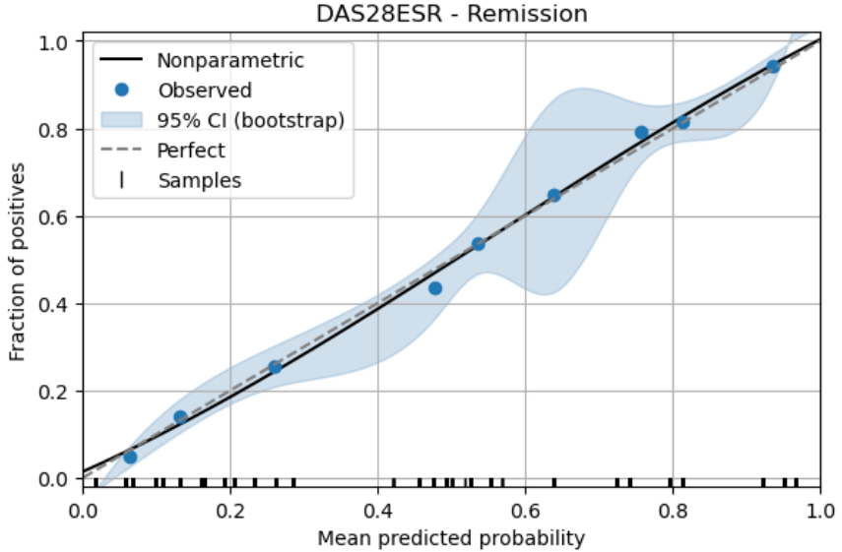
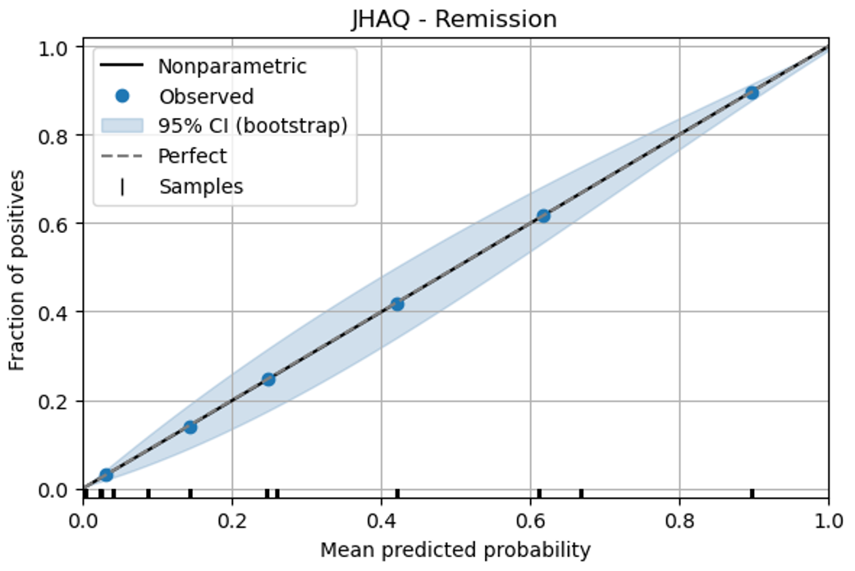
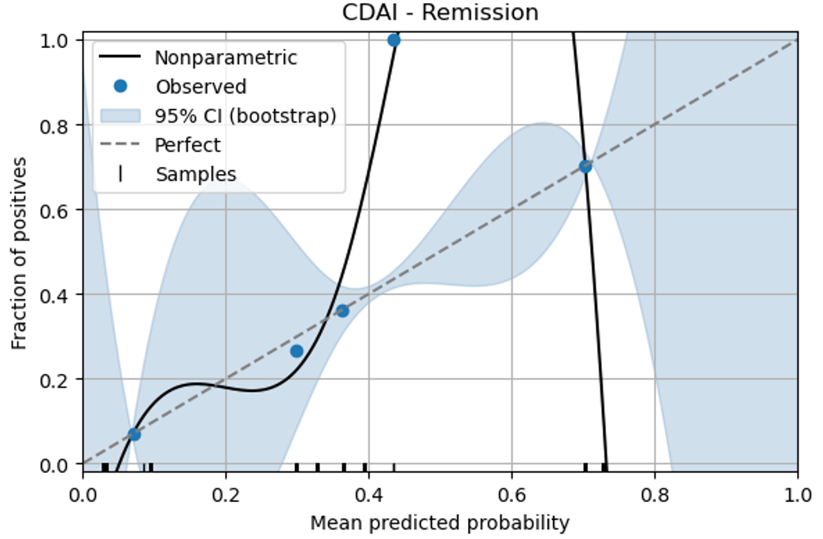
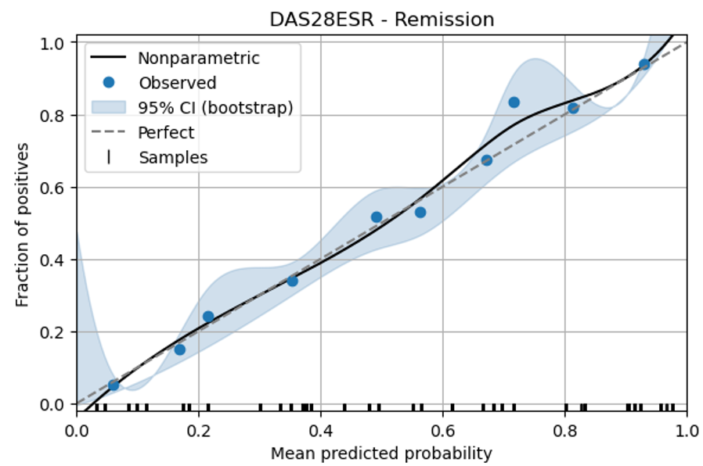
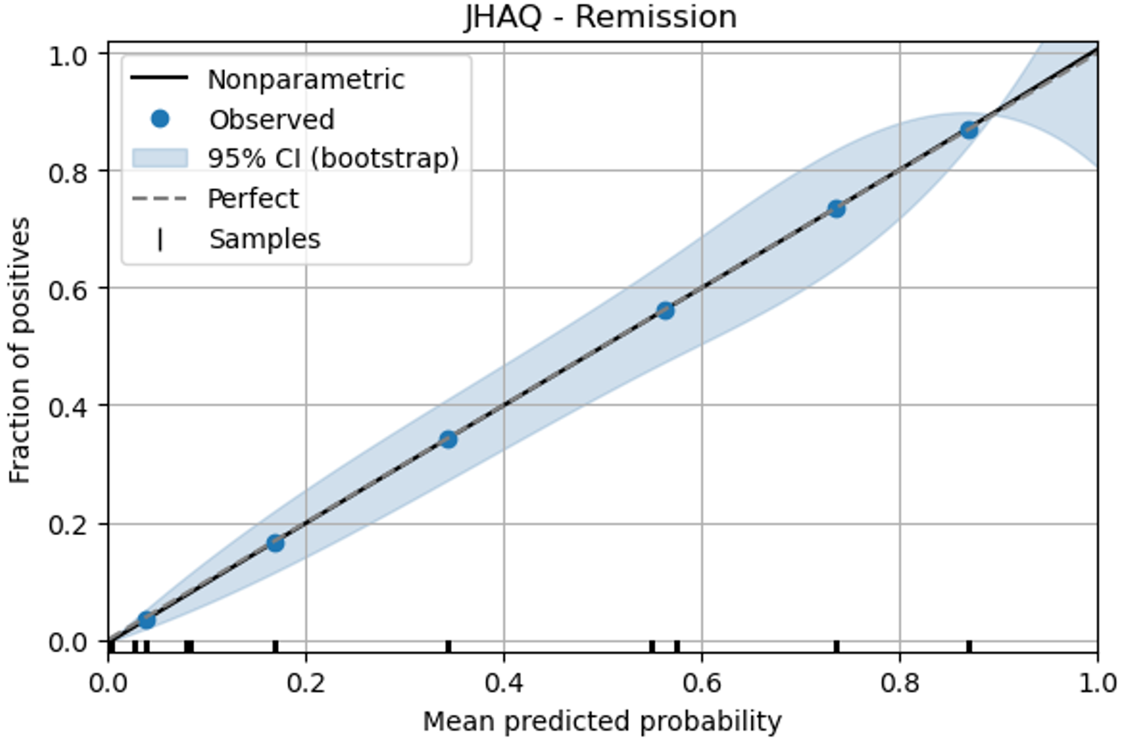
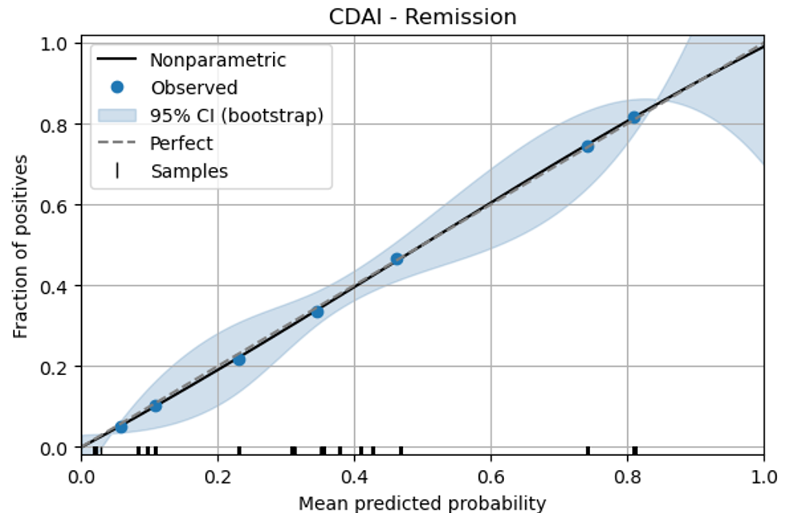
A
B
C
Llama2 - FT
Meditron - FT
Llama2 + FT
Meditron + FT
Supplementary Figure 1. Calibration curves for Llama 2 and Meditron models. Rows correspond to the base model without task-specific fine-tuning (–FT) and the QLoRA fine-tuned model (+FT); columns show calibration for DAS28-ESR (A), J-HAQ (B) and CDAI remission (C) at two years. Solid line = non-parametric isotonic fit; dashed line = perfect calibration; shaded area = 95 % bootstrap CI (1000 resamples). The J-HAQ remission panel for Llama 2 –FT is omitted because the model’s predicted probabilities were concentrated in a single extreme bin, leaving fewer than two positive samples and preventing a stable non-parametric fit.

Slide 2
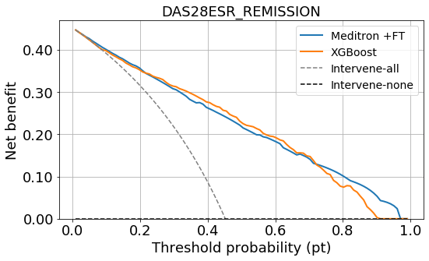
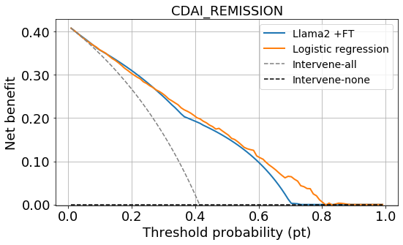
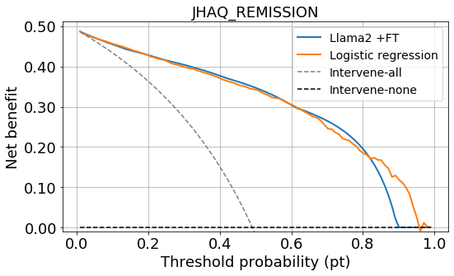
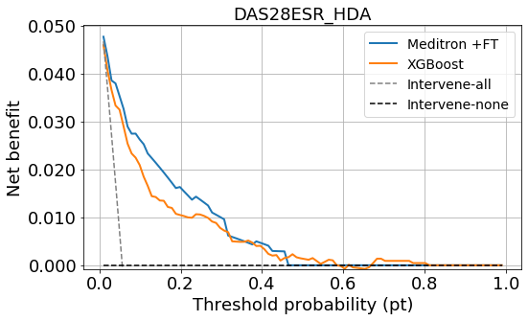
A
B
C
D
Supplementary Figure 2. Decision-curve analysis for four representative rheumatoid arthritis outcomes
For each endpoint (panel A: DAS28-ESR remission, B: CDAI remission, C: J-HAQ remission, D: DAS28-ESR high disease activity) net benefit is plotted against the decision threshold probability pt. The solid blue curve shows the model that achieved the highest ROC-AUC among all LLM variants, whereas the solid orange curve represents the conventional baseline that obtained the highest ROC-AUC in the non-LLM group. Dashed grey and black lines depict the “treat-all’’ and “treat-none’’ strategies, respectively, providing clinical reference points for comparison.

