Slide 1
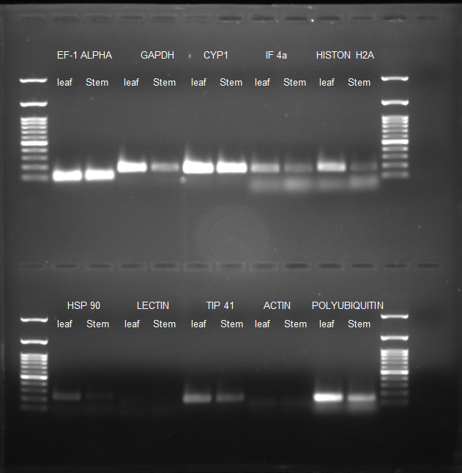
WT
fah 1-2
35S:AnAXE1
fah 1-2/35S:AnAXE1
Figure S1. Uncropped gel image of PCR product of semi-quantitative PCR for all the ten candidate genes in leaf and stem cDNA with 1Kb (left) and 100 bp (right) ladder.
Notes:
This whole figure needs rearrangement.

Slide 2
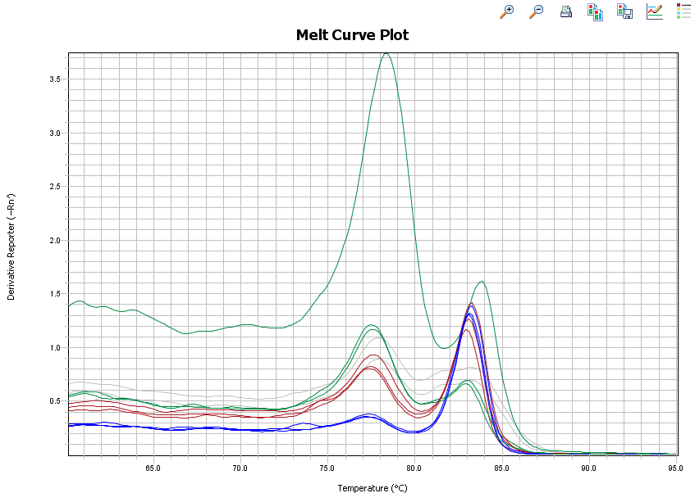
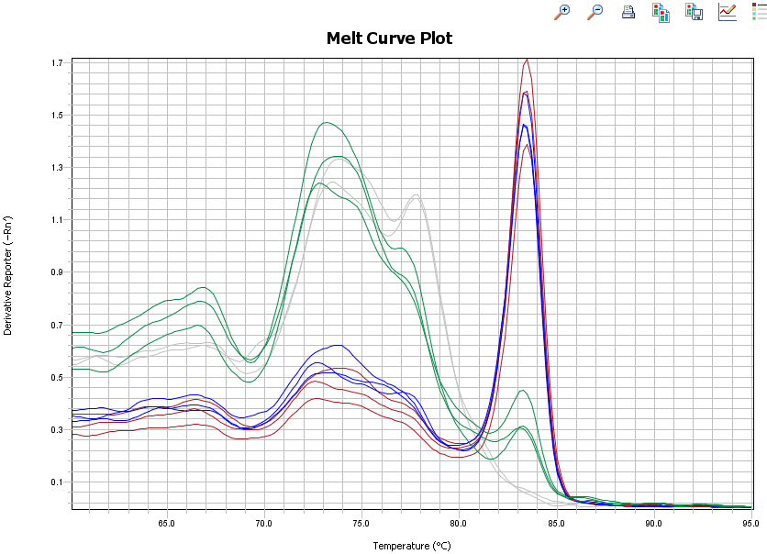
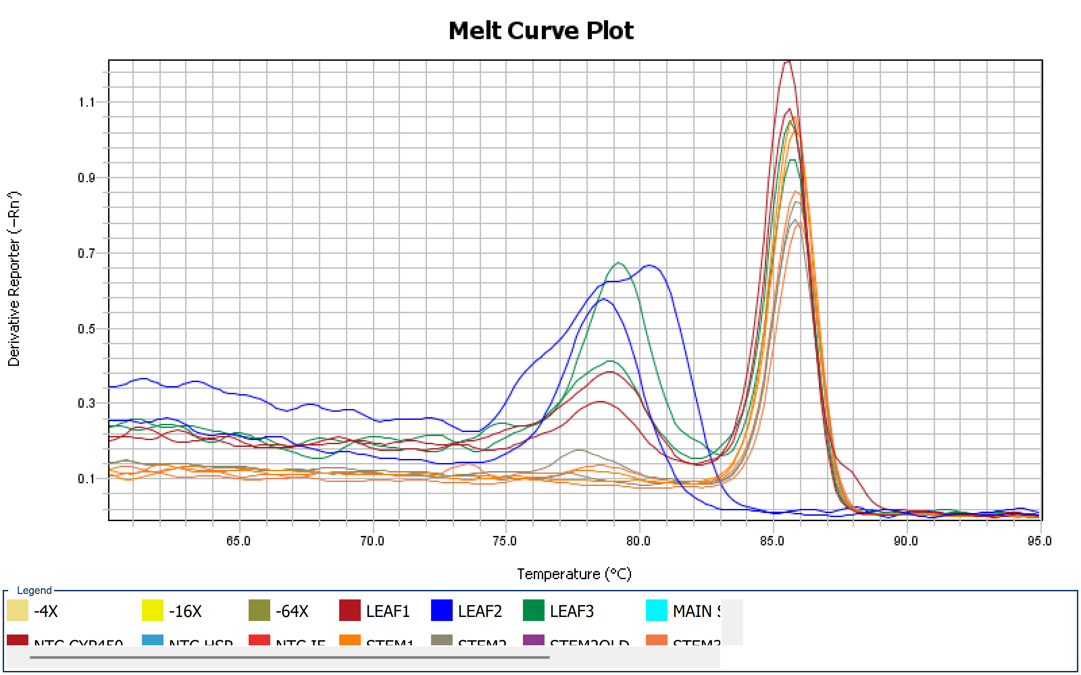
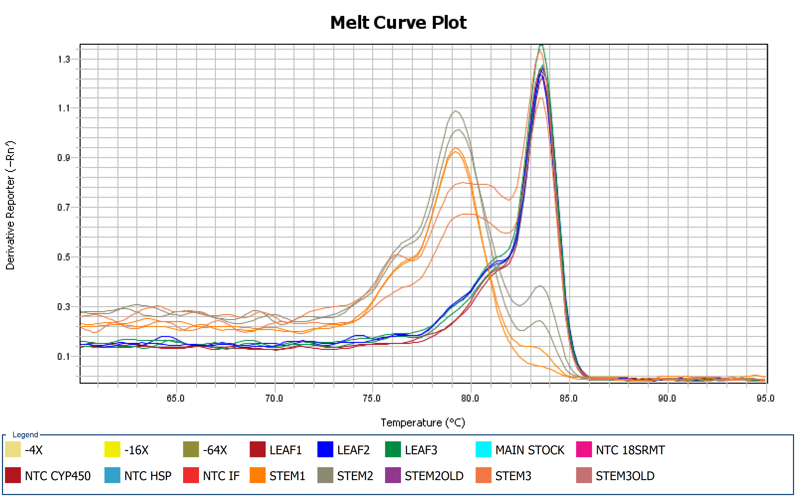
WT
fah 1-2
3.5
ALPHA TUBULIN
3.0
2.5
2.0
1.5
1.0
0.5
35S:AnAXE1
1.7
BETA TUBULIN
1.5
1.3
1.1
0.9
0.7
0.5
0.3
0.1
Derivative reporter (-Rn)
1.1
CYP 450
0.9
0.7
0.5
0.3
0.1
1.3
18s RMT
1.1
0.9
0.7
0.5
0.3
0.1
65
70
75
80
85
90
95
Temperature ( ͦͦͦ C)
Figure S2. Melting curve analysis of candidate genes using RT-qPCR
Notes:
This whole figure needs rearrangement.

Slide 3
WT
fah 1-2
35S:AnAXE1
fah 1-2/35S:AnAXE1
Figure S3. Primer efficiency determination. The plot denotes Plot log cDNA concentration versus the Ct value. The slope of this plot was used to predict the primer efficiencies for the given pair of primers and the amplification factor.
Notes:
This whole figure needs rearrangement.

Slide 4
WT
fah 1-2
35S:AnAXE1
fah 1-2/35S:AnAXE1
Figure S4. Determination of the optimal number of reference genes calculated by geNorm. Determination of the optimal number of reference genes for accurate normalizationn of gene expression. Average pairwise variations Vn/Vn+1 are calculated between the normalizationn factors NFn and NFn+1 to indicate whether inclusion of extra reference gene adds to the stability of the normalizationn factor.
Notes:
This whole figure needs rearrangement.

Slide 5
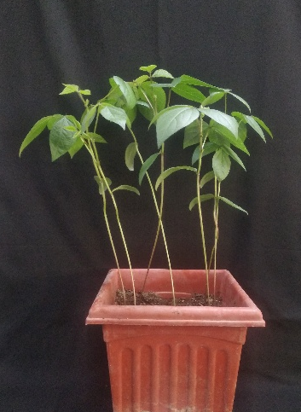
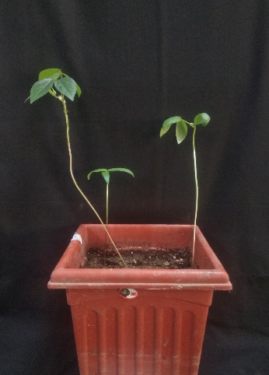
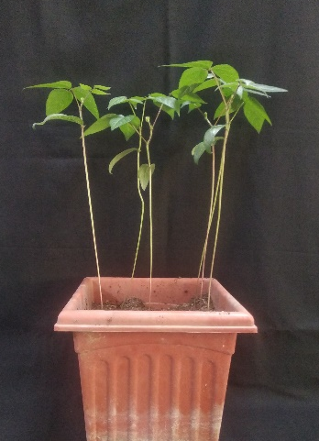
(a)
Pusa Vishal
Pusa 1641
Pusa 1431
(b)
P.Vishal
P.1641
P.1431
P.Vishal
P.1641
P.1431
P.Vishal
P.1641
P.1431
2-week leaf
4-week leaf
4-week Stem
(c)
P.Vishal
P.1641
P.1431
P.Vishal
P.1641
P.1431
P.Vishal
P.1641
P.1431
NTC
4-week Stem
2-week leaf
4-week leaf
Figure S5. (a) Picture showing 4-week old mungbean genotype Pusa Visal, Pusa 1641 and Pusa 1431. The samples from these genotypes were used for RNA extraction. (b) Crude RNA loaded on 1.3% agarose gel along with 1 Kb (extreme left) and 100 bp (extreme right) ladder. (c) Gel picture showing RT-qPCR products using EF-1 AlFA primers, single PCR product obtained using these primers

Slide 6
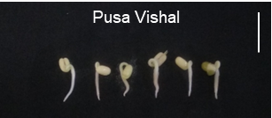
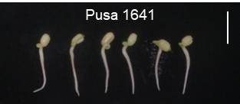
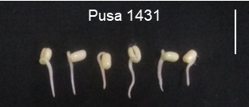
(a)
(b)
P.Vishal
control
P.Vishal
salt
P.vishalosmotic
P.1641
control
P.1641
salt
P.1641osmotic
P.1431
control
P.1431
salt
P.1431osmotic
(c)
P.Vishal
control
P.Vishal
salt
P.vishalosmotic
NTC
P.1641
control
P.1641
salt
P.1641osmotic
NTC
P.1431
control
P.1431
salt
P.1431osmotic
NTC
Ef-1
(d)
P.Vishal
control
P.Vishal
salt
P.vishalosmotic
NTC
P.1641
control
P.1641
salt
P.1641osmotic
NTC
P.1431
control
P.1431
salt
P.1431osmotic
NTC
(e)
P.Vishal
control
P.Vishal
salt
P.vishalosmotic
NTC
P.1641
control
P.1641
salt
P.1641osmotic
NTC
P.1431
control
P.1431
salt
P.1431osmotic
NTC
Figure S6. Picture showing two days old seedlings germinated on wet germination paper (Pusa Vishal, Pusa 1641, Pusa 1431). Vertical scale bar = 2 cm. (b) Crude RNA extracted from 5 days old seedling grown under control (non-treated), salt (100 mM NaCl) and osmotic (20% PEG4000) conditions and run on 1.3% agarose gel (c, (d), and (e) RT-qPCR products run on 1.3% agarose gel of EF1-ALPHA, GAPDH and Rubisco respectively.

