Slide 1
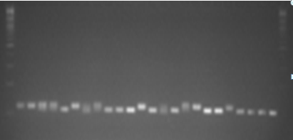
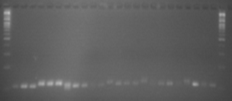
Ladder
†
Kibnar_1
Guarye_1
Dere_1
Sinwet_1
Kibnar_2
Astara_1
Guarye_2
Dere_2
Sinwet_2
Denkinet_1
Bishaeset_1
Denkinet_2
Astara_2
Dere_3
Guarye_3
Kibnar_3
Atshkit_1
Chehuye_1
Bishaeset_2
Chehuyet_2
Sinwot_3
Denkinet_3
Atshakit_2
Ladder
Ladder
Terye_1
Terye_2
Oniya_1
Kiniwara_1
Mekelwesa_1
Agede_1
Gishra_1
Mekelwesa_2
Oniya_2
Gishra_2
Haywona_1
Kiniwara_2
Kombotra_1
Agede_2
Kombotra_2
Kiniwara_3
Astar_1
Hywona_2
Kombotra_3
Gishra_K_1
Tesa_1
Kikle_nech
Cherkiwa
Tesa_2
Ladder
Additional file3.1: DNA fragments of 48 enset landraces (sample numbers 1- 48) amplified by SSR primer, Evg1; †= sample not clearly identified, which was not included in the analysis

Slide 2
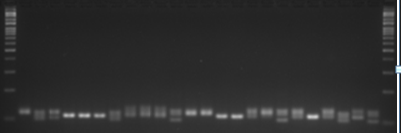
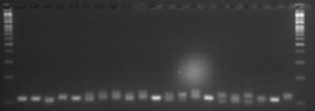
Ladder
Asu
Kikle_key_1
Gishra_K_2
Sebera_1
Agene
Mintiwea
Oniya_K
Gishra_K_3
Beleka_1
Beleka_2
Tesa_3
Tesa_4
Kikle_key_2
Sebera_2
Arke_1
Arke_2
Lochingia_1
Meze_1
Meze_2
Lochingia_2
Arke_3
Lochingia_3
Tsela
Ladder
Kinkisir
Ladder
Ladder
Gariye_1
Gariye_2
Deya_1
Anchiro
Deya_2
Karona
Guadamerat
Sapara
Agade_1
Agade_2
Yeshira_qinke_2
Nechiwe
Lemat
Yiregiye
Yeshira_qinke_1
Shodedine
Kertiya
Ame
Unjeme
Sorpe
Siskela
Ladder
Additional file3.2: DNA fragments of 45 enset landraces (sample 49-93) amplified by SSR primer, Evg1

Slide 3
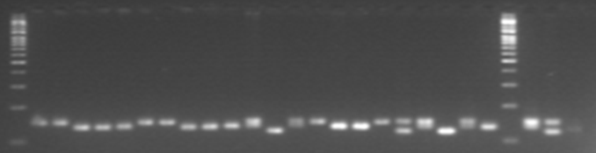
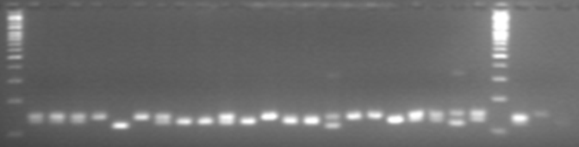
Ladder
†
Kibnar_1
Guarye_1
Dere_1
Sinwet_1
Kibnar_2
Astara_1
Guarye_2
Dere_2
Sinwet_2
Denkinet_1
Bishaeset_1
Denkinet_2
Astara_2
Dere_3
Guarye_3
Kibnar_3
Atshkit_1
Chehuye_1
Bishaeset_2
Chehuyet_2
Sinwot_3
Ladder
Denkinet_3
Atshakit_2
††
Ladder
Terye_1
Terye_2
Oniya_1
Kiniwara_1
Mekelwesa_1
Agede_1
Gishra_1
Mekelwesa_2
Oniya_2
Gishra_2
Haywona_1
Kiniwara_2
Kombotra_1
Agede_2
Kombotra_2
Kiniwara_3
Astar_1
Hywona_2
Kombotra_3
Gishra_K_1
Tesa_1
Kikle_nech
Ladder
Cherkiwa
Tesa_2
Additional file3.3: DNA fragments of 48 enset landraces (sample numbers 1- 48) amplified by SSR primer, Evg2; †= sample not clearly identified, which was not included in the analysis; ††= negative control

Slide 4
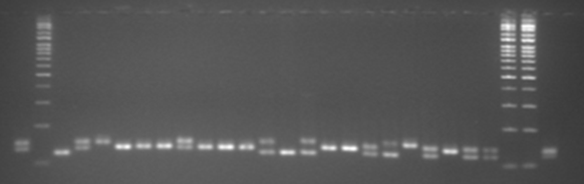
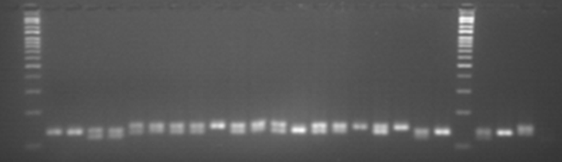
Asu
Ladder
Kikle_key_1
Gishra_K_2
Sebera_1
Agene
Mintiwea
Oniya_K
Gishra_K_3
Beleka_1
Beleka_2
Tesa_3
Tesa_4
Kikle_key_2
Sebera_2
Arke_1
Arke_2
Lochingia_1
Meze_1
Meze_2
Lochingia_2
Arke_3
Lochingia_3
Tsela
Ladder
Ladder
Kinkisir
Ladder
Gariye_1
Gariye_2
Deya_1
Anchiro
Deya_2
Karona
Guadamerat
Agade_1
Sapara
Yiregiye
Yeshira_qinke_1
Nechiwe
Lemat
Agade_2
Yeshira_qinke_2
Shodedine
Kertiya
Ame
Unjeme
Sorpe
Ladder
Siskela
†
†
Additional file3.4: DNA fragments of 47 enset landraces (sample 49-95) amplified by SSR primer, Evg2;
†= samples not clearly identified, which were not included in the analysis

Slide 5
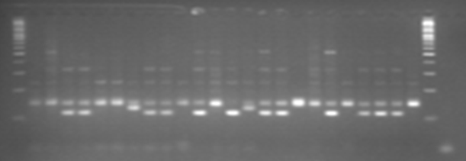
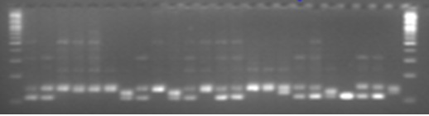
Ladder
†
Kibnar_1
Guarye_1
Dere_1
Sinwet_1
Kibnar_2
Astara_1
Guarye_2
Dere_2
Sinwet_2
Denkinet_1
Bishaeset_1
Denkinet_2
Astara_2
Dere_3
Guarye_3
Kibnar_3
Atshkit_1
Chehuye_1
Bishaeset_2
Chehuyet_2
Sinwot_3
Denkinet_3
Atshakit_2
Ladder
††
Ladder
Terye_1
Terye_2
Oniya_1
Kiniwara_1
Mekelwesa_1
Agede_1
Gishra_1
Mekelwesa_2
Oniya_2
Gishra_2
Haywona_1
Kiniwara_2
Kombotra_1
Agede_2
Kombotra_2
Kiniwara_3
Astar_1
Hywona_2
Kombotra_3
Gishra_K_1
Tesa_1
Kikle_nech
Cherkiwa
Tesa_2
Ladder
Additional file3.5: DNA fragments of 48 enset landraces (sample numbers 1- 48) amplified by SSR primer, Evg4; †= sample not clearly identified, which was not included in the analysis; ††= negative control

Slide 6
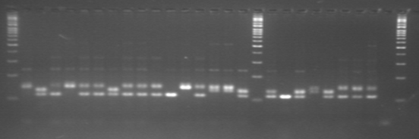
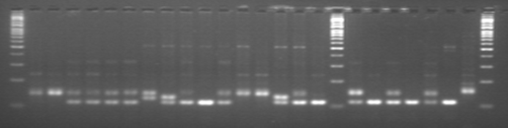
Ladder
Asu
Kikle_key_1
Gishra_K_2
Sebera_1
Agene
Mintiwea
Oniya_K
Gishra_K_3
Beleka_1
Beleka_2
Tesa_3
Tesa_4
Kikle_key_2
Sebera_2
Arke_1
Arke_2
Ladder
Lochingia_1
Meze_1
Meze_2
Lochingia_2
Arke_3
Lochingia_3
Tsela
Kinkisir
††
Ladder
Ladder
Gariye_1
Gariye_2
Deya_1
Anchiro
Deya_2
Karona
Guadamerat
Agade_1
Sapara
Yiregiye
Yeshira_qinke_1
Nechiwe
Lemat
Agade_2
Yeshira_qinke_2
Shodedine
Ladder
Kertiya
Ame
Unjeme
Sorpe
Siskela
†
†
Ladder
Additional file3.6: DNA fragments of 47 enset landraces (sample 49-95) amplified by SSR primer, Evg4;
††= negative control; †=samples not clearly identified, which were not included in the analysis

Slide 7
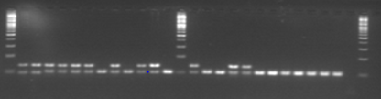

Ladder
†
Kibnar_1
Guarye_1
Dere_1
Sinwet_1
Kibnar_2
Astara_1
Guarye_2
Dere_2
Sinwet_2
Denkinet_1
Bishaeset_1
Ladder
Denkinet_2
Astara_2
Dere_3
Guarye_3
Kibnar_3
Atshkit_1
Chehuye_1
Bishaeset_2
Chehuyet_2
Sinwot_3
Denkinet_3
Atshakit_2
††
Ladder
Ladder
Terye_1
Terye_2
Oniya_1
Kiniwara_1
Mekelwesa_1
Agede_1
Gishra_1
Mekelwesa_2
Oniya_2
Gishra_2
Haywona_1
Kiniwara_2
Ladder
Kombotra_1
Agede_2
Kombotra_2
Kiniwara_3
Astar_1
Hywona_2
Kombotra_3
Gishra_K_1
Tesa_1
Kikle_nech
Cherkiwa
Tesa_2
Ladder
Additional file3.7: DNA fragments of 48 enset landraces (sample numbers 1- 48) amplified by SSR primer, Evg5; †= sample not clearly identified, which was not included in the analysis; ††= negative control

Slide 8
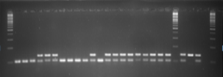
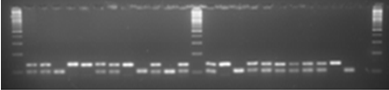
Ladder
Asu
Kikle_key_1
Gishra_K_2
Sebera_1
Agene
Mintiwea
Oniya_K
Gishra_K_3
Beleka_1
Beleka_2
Tesa_3
Kikle_key_2
Tesa_4
Sebera_2
Arke_1
Arke_2
Lochingia_1
Meze_1
Meze_2
Lochingia_2
Arke_3
Ladder
Lochingia_3
Tsela
Kinkisir
††
Ladder
Ladder
Gariye_1
Gariye_2
Deya_1
Anchiro
Deya_2
Karona
Guadamerat
Agade_1
Sapara
Yiregiye
Yeshira_qinke_1
Nechiwe
Ladder
Lemat
Agade_2
Yeshira_qinke_2
Shodedine
Ladder
Kertiya
Ame
Unjeme
Sorpe
Siskela
†
††
Ladder
Additional file3.8: DNA fragments of 47 enset landraces (sample 49-95) amplified by SSR primer, Evg5;
††= negative control; †=samples not clearly identified, which were not included in the analysis

Slide 9
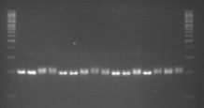
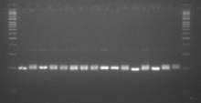
Ladder
†
Kibnar_1
Guarye_1
Dere_1
Sinwet_1
Kibnar_2
Astara_1
Guarye_2
Dere_2
Sinwet_2
Denkinet_1
Bishaeset_1
Denkinet_2
Astara_2
Dere_3
Guarye_3
Ladder
Ladder
Kibnar_3
Atshkit_1
Chehuye_1
Bishaeset_2
Chehuyet_2
Sinwot_3
Denkinet_3
Atshakit_2
Terye_1
Terye_2
Oniya_1
Kiniwara_1
Mekelwesa_1
Agede_1
Gishra_1
Mekelwesa_2
Ladder
Additional file3.9: DNA fragments of 32 enset landraces (sample numbers 1- 32) amplified by SSR primer, Evg6; †= sample not clearly identified, which was not included in the analysis

Slide 10


Ladder
Oniya_2
Gishra_2
Haywona_1
Kiniwara_2
Kombotra_1
Agede_2
Kombotra_2
Kiniwara_3
Astar_1
Hywona_2
Kombotra_3
Gishra_K_1
Tesa_1
Kikle_nech
Cherkiwa
Tesa_2
Ladder
Ladder
Asu
Kikle_key_1
Gishra_K_2
Sebera_1
Agene
Mintiwea
Oniya_K
Gishra_K_3
Beleka_1
Beleka_2
Tesa_3
Tesa_4
Kikle_key_2
Sebera_2
Arke_1
Arke_2
Ladder
Additional file3.10: DNA fragments of 32 enset landraces (sample numbers 33-64) amplified by SSR primer, Evg6

Slide 11
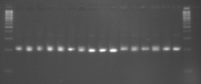
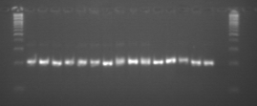
Ladder
Lochingia_1
Meze_1
Meze_2
Lochingia_2
Arke_3
Lochingia_3
Tsela
Kinkisir
Gariye_1
Gariye_2
Deya_1
Anchiro
Deya_2
Karona
Guadamerat
Agade_1
Ladder
Ladder
Sapara
Yiregiye
Yeshira_qinke_1
Nechiwe
Lemat
Agade_2
Yeshira_qinke_2
Shodedine
Kertiya
Ame
Unjeme
Sorpe
Siskela
†
†
††
Ladder
Additional file3.11: DNA fragments of 31 enset landraces (sample numbers 65-95) amplified by SSR primer, Evg6; †= samples not clearly identified, which were not included in the analysis; ††= negative control

Slide 12
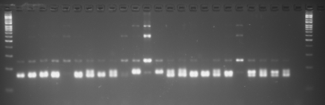
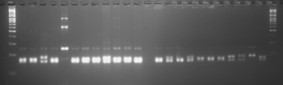
Ladder
†
Kibnar_1
Guarye_1
Dere_1
Sinwet_1
Kibnar_2
Astara_1
Guarye_2
Dere_2
Sinwet_2
Denkinet_1
Bishaeset_1
Denkinet_2
Astara_2
Dere_3
Guarye_3
Kibnar_3
Atshkit_1
Chehuye_1
Bishaeset_2
Chehuyet_2
Sinwot_3
Denkinet_3
Atshakit_2
††
Ladder
Ladder
Terye_1
Terye_2
Oniya_1
Kiniwara_1
Mekelwesa_1
Agede_1
Gishra_1
Mekelwesa_2
Oniya_2
Gishra_2
Haywona_1
Kiniwara_2
Kombotra_1
Agede_2
Kombotra_2
Kiniwara_3
Astar_1
Hywona_2
Kombotra_3
Gishra_K_1
Tesa_1
Kikle_nech
Cherkiwa
Tesa_2
Ladder
Additional file3.12: DNA fragments of 48 enset landraces (sample numbers 1- 48) amplified by SSR primer, Evg8; †= sample not clearly identified, which was not included in the analysis; ††= negative control

Slide 13
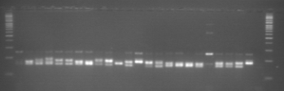
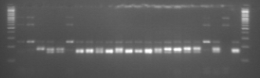
Ladder
Asu
Kikle_key_1
Gishra_K_2
Sebera_1
Agene
Mintiwea
Oniya_K
Gishra_K_3
Beleka_1
Beleka_2
Tesa_3
Tesa_4
Kikle_key_2
Sebera_2
Arke_1
Arke_2
Lochingia_1
Meze_1
Meze_2
Lochingia_2
Arke_3
Lochingia_3
Tsela
Kinkisir
††
Ladder
Ladder
Gariye_1
Gariye_2
Deya_1
Anchiro
Deya_2
Karona
Guadamerat
Agade_1
Sapara
Yiregiye
Yeshira_qinke_1
Nechiwe
Lemat
Agade_2
Yeshira_qinke_2
Shodedine
Ladder
Kertiya
Ame
Unjeme
Sorpe
Siskela
†
†
Ladder
Additional file3.13: DNA fragments of 47 enset landraces (sample 49-95) amplified by SSR primer, Evg8;
††= negative control; †=samples not clearly identified, which were not included in the analysis

Slide 14
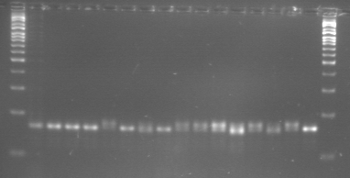
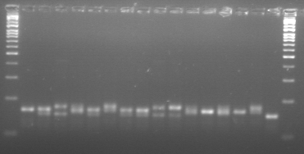
Ladder
†
Kibnar_1
Guarye_1
Dere_1
Sinwet_1
Kibnar_2
Astara_1
Guarye_2
Dere_2
Sinwet_2
Denkinet_1
Bishaeset_1
Denkinet_2
Astara_2
Dere_3
Guarye_3
Ladder
Ladder
Kibnar_3
Atshkit_1
Chehuye_1
Bishaeset_2
Chehuyet_2
Sinwot_3
Denkinet_3
Atshakit_2
Terye_1
Terye_2
Oniya_1
Kiniwara_1
Mekelwesa_1
Agede_1
Gishra_1
Mekelwesa_2
Ladder
Additional file3.14: DNA fragments of 32 enset landraces (sample numbers 1- 32) amplified by SSR primer, Evg9; †= sample not clearly identified, which was not included in the analysis

Slide 15
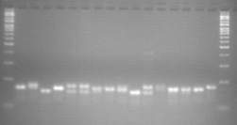
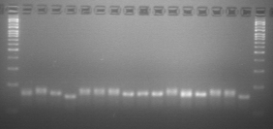
Ladder
Oniya_2
Gishra_2
Haywona_1
Kiniwara_2
Kombotra_1
Agede_2
Kombotra_2
Kiniwara_3
Astar_1
Hywona_2
Kombotra_3
Gishra_K_1
Tesa_1
Kikle_nech
Cherkiwa
Tesa_2
Ladder
Ladder
Asu
Kikle_key_1
Gishra_K_2
Sebera_1
Agene
Mintiwea
Oniya_K
Gishra_K_3
Beleka_1
Beleka_2
Tesa_3
Tesa_4
Kikle_key_2
Sebera_2
Arke_1
Arke_2
Ladder
Additional file3.15: DNA fragments of 32 enset landraces (sample numbers 33-64) amplified by SSR primer, Evg9

Slide 16
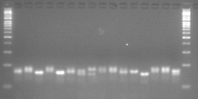
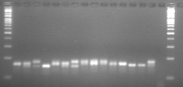
Ladder
Lochingia_1
Meze_1
Meze_2
Lochingia_2
Arke_3
Lochingia_3
Tsela
Kinkisir
Gariye_1
Gariye_2
Deya_1
Anchiro
Deya_2
Karona
Guadamerat
Agade_1
Ladder
Ladder
Sapara
Yiregiye
Yeshira_qinke_1
Nechiwe
Lemat
Agade_2
Yeshira_qinke_2
Shodedine
Kertiya
Ame
Unjeme
Sorpe
Siskela
†
†
††
Ladder
Additional file3.16: DNA fragments of 31 enset landraces (sample numbers 65-95) amplified by SSR primer, Evg9; †= samples not clearly identified, which were not included in the analysis; ††= negative control

Slide 17
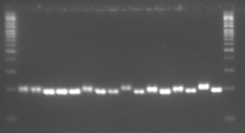
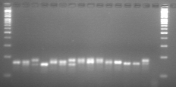
Ladder
†
Kibnar_1
Guarye_1
Dere_1
Sinwet_1
Kibnar_2
Astara_1
Guarye_2
Dere_2
Sinwet_2
Denkinet_1
Bishaeset_1
Denkinet_2
Astara_2
Dere_3
Guarye_3
Ladder
Ladder
Kibnar_3
Atshkit_1
Chehuye_1
Bishaeset_2
Chehuyet_2
Sinwot_3
Denkinet_3
Atshakit_2
Terye_1
Terye_2
Oniya_1
Kiniwara_1
Mekelwesa_1
Agede_1
Gishra_1
Mekelwesa_2
Ladder
Additional file3.17: DNA fragments of 32 enset landraces (sample numbers 1- 32) amplified by SSR primer, Evg10; †= sample not clearly identified, which was not included in the analysis

Slide 18
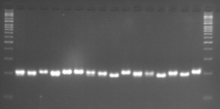
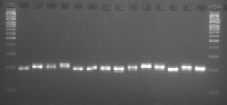
Ladder
Oniya_2
Gishra_2
Haywona_1
Kiniwara_2
Kombotra_1
Agede_2
Kombotra_2
Kiniwara_3
Astar_1
Hywona_2
Kombotra_3
Gishra_K_1
Tesa_1
Kikle_nech
Cherkiwa
Tesa_2
Ladder
Ladder
Asu
Kikle_key_1
Gishra_K_2
Sebera_1
Agene
Mintiwea
Oniya_K
Gishra_K_3
Beleka_1
Beleka_2
Tesa_3
Tesa_4
Kikle_key_2
Sebera_2
Arke_1
Arke_2
Ladder
Additional file3.18: DNA fragments of 32 enset landraces (sample numbers 33-64) amplified by SSR primer, Evg10

Slide 19
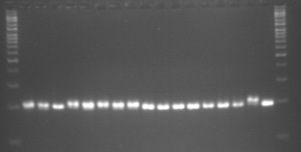
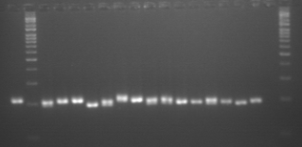
Ladder
Lochingia_1
Meze_1
Meze_2
Lochingia_2
Arke_3
Lochingia_3
Tsela
Kinkisir
Gariye_1
Gariye_2
Deya_1
Anchiro
Deya_2
Karona
Guadamerat
Agade_1
Ladder
Sapara
Ladder
Yiregiye
Yeshira_qinke_1
Nechiwe
Lemat
Agade_2
Yeshira_qinke_2
Shodedine
Kertiya
Ame
Unjeme
Sorpe
Siskela
†
†
††
Ladder
Additional file3.19: DNA fragments of 31 enset landraces (sample numbers 65-95) amplified by SSR primer, Evg10; †= samples not clearly identified, which were not included in the analysis; ††= negative control

Slide 20
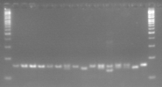
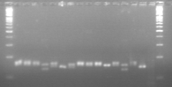
Ladder
†
Kibnar_1
Guarye_1
Dere_1
Sinwet_1
Kibnar_2
Astara_1
Guarye_2
Dere_2
Sinwet_2
Denkinet_1
Bishaeset_1
Denkinet_2
Astara_2
Dere_3
Guarye_3
Ladder
Ladder
Kibnar_3
Atshkit_1
Chehuye_1
Bishaeset_2
Chehuyet_2
Sinwot_3
Denkinet_3
Atshakit_2
Terye_1
Terye_2
Oniya_1
Kiniwara_1
Mekelwesa_1
Agede_1
Gishra_1
Mekelwesa_2
Ladder
Additional file3.20: DNA fragments of 32 enset landraces (sample numbers 1- 32) amplified by SSR primer, Evg11; †= sample not clearly identified, which was not included in the analysis

Slide 21
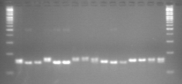
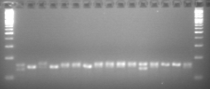
Ladder
Oniya_2
Gishra_2
Haywona_1
Kiniwara_2
Kombotra_1
Agede_2
Kombotra_2
Kiniwara_3
Astar_1
Hywona_2
Kombotra_3
Gishra_K_1
Tesa_1
Kikle_nech
Cherkiwa
Tesa_2
Ladder
Ladder
Asu
Kikle_key_1
Gishra_K_2
Sebera_1
Agene
Mintiwea
Oniya_K
Gishra_K_3
Beleka_1
Beleka_2
Tesa_3
Tesa_4
Kikle_key_2
Sebera_2
Arke_1
Arke_2
Ladder
Additional file3.21: DNA fragments of 32 enset landraces (sample numbers 33-64) amplified by SSR primer, Evg11

Slide 22
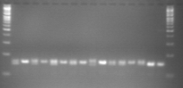
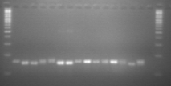
Ladder
Lochingia_1
Meze_1
Meze_2
Lochingia_2
Arke_3
Lochingia_3
Tsela
Kinkisir
Gariye_1
Gariye_2
Deya_1
Anchiro
Deya_2
Karona
Guadamerat
Agade_1
Ladder
Ladder
Sapara
Yiregiye
Yeshira_qinke_1
Nechiwe
Lemat
Agade_2
Yeshira_qinke_2
Shodedine
Kertiya
Ame
Unjeme
Sorpe
Siskela
†
†
††
Ladder
Additional file3.22: DNA fragments of 31 enset landraces (sample numbers 65-95) amplified by SSR primer, Evg11; †= samples not clearly identified, which were not included in the analysis; ††= negative control

Slide 23
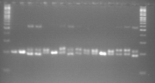
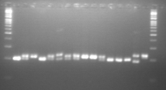
Ladder
†
Kibnar_1
Guarye_1
Dere_1
Sinwet_1
Kibnar_2
Astara_1
Guarye_2
Dere_2
Sinwet_2
Denkinet_1
Bishaeset_1
Denkinet_2
Astara_2
Dere_3
Guarye_3
Ladder
Ladder
Kibnar_3
Atshkit_1
Chehuye_1
Bishaeset_2
Chehuyet_2
Sinwot_3
Denkinet_3
Atshakit_2
Terye_1
Terye_2
Oniya_1
Kiniwara_1
Mekelwesa_1
Agede_1
Gishra_1
Mekelwesa_2
Ladder
Additional file3.23: DNA fragments of 32 enset landraces (sample numbers 1- 32) amplified by SSR primer, Evg13; †= sample not clearly identified, which was not included in the analysis

Slide 24
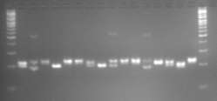
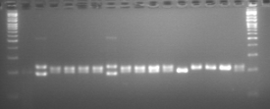
Ladder
Oniya_2
Gishra_2
Haywona_1
Kiniwara_2
Kombotra_1
Agede_2
Kombotra_2
Kiniwara_3
Astar_1
Hywona_2
Kombotra_3
Gishra_K_1
Tesa_1
Kikle_nech
Cherkiwa
Tesa_2
Ladder
Ladder
Asu
Kikle_key_1
Gishra_K_2
Sebera_1
Agene
Mintiwea
Oniya_K
Gishra_K_3
Beleka_1
Beleka_2
Tesa_3
Tesa_4
Kikle_key_2
Sebera_2
Arke_1
Arke_2
Ladder
Additional file3.24: DNA fragments of 32 enset landraces (sample numbers 33-64) amplified by SSR primer, Evg13

Slide 25
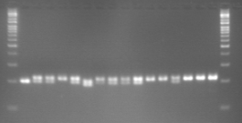
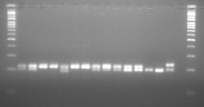
Ladder
Lochingia_1
Meze_1
Meze_2
Lochingia_2
Arke_3
Lochingia_3
Tsela
Kinkisir
Gariye_1
Gariye_2
Deya_1
Anchiro
Deya_2
Karona
Guadamerat
Agade_1
Ladder
Ladder
Sapara
Yiregiye
Yeshira_qinke_1
Nechiwe
Lemat
Agade_2
Yeshira_qinke_2
Shodedine
Kertiya
Ame
Unjeme
Sorpe
Siskela
†
†
††
Ladder
Additional file3.25: DNA fragments of 31 enset landraces (sample numbers 65-95) amplified by SSR primer, Evg13; †= samples not clearly identified, which were not included in the analysis; ††= negative control

Slide 26
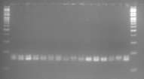
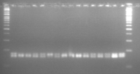
Ladder
†
Kibnar_1
Guarye_1
Dere_1
Sinwet_1
Kibnar_2
Astara_1
Guarye_2
Dere_2
Sinwet_2
Denkinet_1
Bishaeset_1
Denkinet_2
Astara_2
Dere_3
Guarye_3
Ladder
Ladder
Kibnar_3
Atshkit_1
Chehuye_1
Bishaeset_2
Chehuyet_2
Sinwot_3
Denkinet_3
Atshakit_2
Terye_1
Terye_2
Oniya_1
Kiniwara_1
Mekelwesa_1
Agede_1
Gishra_1
Mekelwesa_2
Ladder
Additional file3.26: DNA fragments of 32 enset landraces (sample numbers 1- 32) amplified by SSR primer, Evg14; †= sample not clearly identified, which was not included in the analysis

Slide 27
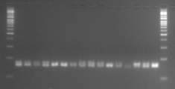

Ladder
Oniya_2
Gishra_2
Haywona_1
Kiniwara_2
Kombotra_1
Agede_2
Kombotra_2
Kiniwara_3
Astar_1
Hywona_2
Kombotra_3
Gishra_K_1
Tesa_1
Kikle_nech
Cherkiwa
Tesa_2
Ladder
Ladder
Asu
Kikle_key_1
Gishra_K_2
Sebera_1
Agene
Mintiwea
Oniya_K
Gishra_K_3
Beleka_1
Beleka_2
Tesa_3
Tesa_4
Kikle_key_2
Sebera_2
Arke_1
Arke_2
Ladder
Additional file3.27: DNA fragments of 32 enset landraces (sample numbers 33-64) amplified by SSR primer, Evg14

Slide 28


Ladder
Lochingia_1
Meze_1
Meze_2
Lochingia_2
Arke_3
Lochingia_3
Tsela
Kinkisir
Gariye_1
Gariye_2
Deya_1
Anchiro
Deya_2
Karona
Guadamerat
Agade_1
Sapara
Yiregiye
Ladder
Ladder
Yeshira_qinke_1
Nechiwe
Lemat
Agade_2
Yeshira_qinke_2
Shodedine
Kertiya
Ame
Unjeme
Sorpe
Siskela
†
†
††
Ladder
Additional file3.28: DNA fragments of 31 enset landraces (sample numbers 65-95) amplified by SSR primer, Evg14; †= samples not clearly identified, which were not included in the analysis; ††= negative control

Slide 29


Ladder
†
Kibnar_1
Guarye_1
Dere_1
Sinwet_1
Kibnar_2
Astara_1
Guarye_2
Dere_2
Sinwet_2
Denkinet_1
Bishaeset_1
Denkinet_2
Astara_2
Dere_3
Guarye_3
Ladder
Ladder
Kibnar_3
Atshkit_1
Chehuye_1
Bishaeset_2
Chehuyet_2
Sinwot_3
Denkinet_3
Atshakit_2
Terye_1
Terye_2
Oniya_1
Kiniwara_1
Mekelwesa_1
Agede_1
Gishra_1
Mekelwesa_2
Ladder
Additional file3.29: DNA fragments of 32 enset landraces (sample numbers 1- 32) amplified by SSR primer, EnOnjSSR049028; †= sample not clearly identified, which was not included in the analysis

Slide 30


Ladder
Oniya_2
Gishra_2
Haywona_1
Kiniwara_2
Kombotra_1
Agede_2
Kombotra_2
Kiniwara_3
Astar_1
Hywona_2
Kombotra_3
Gishra_K_1
Tesa_1
Kikle_nech
Cherkiwa
Tesa_2
Ladder
Ladder
Asu
Kikle_key_1
Gishra_K_2
Sebera_1
Agene
Mintiwea
Oniya_K
Gishra_K_3
Beleka_1
Beleka_2
Tesa_3
Tesa_4
Kikle_key_2
Sebera_2
Arke_1
Arke_2
Ladder
Additional file3.30: DNA fragments of 32 enset landraces (sample numbers 33-64) amplified by SSR primer, EnOnjSSR049028

Slide 31


Ladder
Lochingia_1
Meze_1
Meze_2
Lochingia_2
Arke_3
Lochingia_3
Tsela
Kinkisir
Gariye_1
Gariye_2
Deya_1
Anchiro
Deya_2
Karona
Guadamerat
Agade_1
Ladder
Ladder
Sapara
Yiregiye
Yeshira_qinke_1
Nechiwe
Lemat
Agade_2
Yeshira_qinke_2
Shodedine
Kertiya
Ame
Unjeme
Sorpe
Siskela
†
†
††
Ladder
Additional file3.31: DNA fragments of 31 enset landraces (sample numbers 65-95) amplified by SSR primer, EnOnjSSR049028; †= samples not clearly identified, which were not included in the analysis; ††= negative control

Slide 32


Ladder
†
Kibnar_1
Guarye_1
Dere_1
Sinwet_1
Kibnar_2
Astara_1
Guarye_2
Dere_2
Sinwet_2
Denkinet_1
Bishaeset_1
Denkinet_2
Astara_2
Dere_3
Guarye_3
Ladder
Ladder
Kibnar_3
Atshkit_1
Chehuye_1
Bishaeset_2
Chehuyet_2
Sinwot_3
Denkinet_3
Atshakit_2
Terye_1
Terye_2
Oniya_1
Kiniwara_1
Mekelwesa_1
Agede_1
Gishra_1
Mekelwesa_2
Ladder
Additional file3.32: DNA fragments of 32 enset landraces (sample numbers 1- 32) amplified by SSR primer, EnBedSSR020585; †= sample not clearly identified, which was not included in the analysis

Slide 33


Ladder
Oniya_2
Gishra_2
Haywona_1
Kiniwara_2
Kombotra_1
Agede_2
Kombotra_2
Kiniwara_3
Astar_1
Hywona_2
Kombotra_3
Gishra_K_1
Tesa_1
Kikle_nech
Cherkiwa
Tesa_2
Ladder
Ladder
Asu
Kikle_key_1
Gishra_K_2
Sebera_1
Agene
Mintiwea
Oniya_K
Gishra_K_3
Beleka_1
Beleka_2
Tesa_3
Tesa_4
Kikle_key_2
Sebera_2
Arke_1
Arke_2
Ladder
Additional file3.33: DNA fragments of 32 enset landraces (sample numbers 33-64) amplified by SSR primer EnBedSSR020585

Slide 34


Ladder
Lochingia_1
Meze_1
Meze_2
Lochingia_2
Arke_3
Lochingia_3
Tsela
Kinkisir
Gariye_1
Gariye_2
Deya_1
Anchiro
Deya_2
Karona
Guadamerat
Agade_1
Ladder
Ladder
Sapara
Yiregiye
Yeshira_qinke_1
Nechiwe
Lemat
Agade_2
Yeshira_qinke_2
Shodedine
Kertiya
Ame
Unjeme
Sorpe
Siskela
†
†
††
Ladder
Additional file3.34: DNA fragments of 31 enset landraces (sample numbers 65-95) amplified by SSR primer, EnBedSSR020585; †= samples not clearly identified, which were not included in the analysis; ††= negative control

Slide 35


Ladder
†
Kibnar_1
Guarye_1
Dere_1
Sinwet_1
Kibnar_2
Astara_1
Guarye_2
Dere_2
Sinwet_2
Denkinet_1
Bishaeset_1
Denkinet_2
Astara_2
Dere_3
Guarye_3
Ladder
Ladder
Kibnar_3
Atshkit_1
Chehuye_1
Bishaeset_2
Chehuyet_2
Sinwot_3
Denkinet_3
Atshakit_2
Terye_1
Terye_2
Oniya_1
Kiniwara_1
Mekelwesa_1
Agede_1
Gishra_1
Mekelwesa_2
Ladder
Additional file3.35: DNA fragments of 32 enset landraces (sample numbers 1- 32) amplified by SSR primer, EnM00011571; †= sample not clearly identified, which was not included in the analysis

Slide 36


Ladder
Oniya_2
Gishra_2
Haywona_1
Kiniwara_2
Kombotra_1
Agede_2
Kombotra_2
Kiniwara_3
Astar_1
Hywona_2
Kombotra_3
Gishra_K_1
Tesa_1
Kikle_nech
Cherkiwa
Tesa_2
Ladder
Ladder
Asu
Kikle_key_1
Gishra_K_2
Sebera_1
Agene
Mintiwea
Oniya_K
Gishra_K_3
Beleka_1
Beleka_2
Tesa_3
Tesa_4
Kikle_key_2
Sebera_2
Arke_1
Arke_2
Ladder
Additional file3.36: DNA fragments of 32 enset landraces (sample numbers 33-64) amplified by SSR primer, EnM00011571

Slide 37


Ladder
Lochingia_1
Meze_1
Meze_2
Lochingia_2
Arke_3
Lochingia_3
Tsela
Kinkisir
Gariye_1
Gariye_2
Deya_1
Anchiro
Deya_2
Karona
Guadamerat
Agade_1
Ladder
Ladder
Sapara
Yiregiye
Yeshira_qinke_1
Nechiwe
Lemat
Agade_2
Yeshira_qinke_2
Shodedine
Kertiya
Ame
Unjeme
Sorpe
Siskela
†
†
††
Ladder
Additional file3.37: DNA fragments of 31 enset landraces (sample numbers 65-95) amplified by SSR primer, EnM00011571; †= samples not clearly identified, which were not included in the analysis; ††= negative control

Slide 38


Ladder
†
Kibnar_1
Guarye_1
Dere_1
Sinwet_1
Kibnar_2
Astara_1
Guarye_2
Dere_2
Sinwet_2
Denkinet_1
Bishaeset_1
Denkinet_2
Astara_2
Dere_3
Guarye_3
Ladder
Ladder
Kibnar_3
Atshkit_1
Chehuye_1
Bishaeset_2
Chehuyet_2
Sinwot_3
Denkinet_3
Atshakit_2
Terye_1
Terye_2
Oniya_1
Kiniwara_1
Mekelwesa_1
Agede_1
Gishra_1
Mekelwesa_2
Ladder
Additional file3.38: DNA fragments of 32 enset landraces (sample numbers 1- 32) amplified by SSR primer, EnM00025665; †= sample not clearly identified, which was not included in the analysis

Slide 39


Ladder
Oniya_2
Gishra_2
Haywona_1
Kiniwara_2
Kombotra_1
Agede_2
Kombotra_2
Kiniwara_3
Astar_1
Hywona_2
Kombotra_3
Gishra_K_1
Tesa_1
Kikle_nech
Cherkiwa
Tesa_2
Ladder
Ladder
Asu
Kikle_key_1
Gishra_K_2
Sebera_1
Agene
Mintiwea
Oniya_K
Gishra_K_3
Beleka_1
Beleka_2
Tesa_3
Tesa_4
Kikle_key_2
Sebera_2
Arke_1
Arke_2
Ladder
Additional file3.39: DNA fragments of 32 enset landraces (sample numbers 33-64) amplified by SSR primer, EnM00025665

Slide 40


Ladder
Lochingia_1
Meze_1
Meze_2
Lochingia_2
Arke_3
Lochingia_3
Tsela
Kinkisir
Gariye_1
Gariye_2
Deya_1
Anchiro
Deya_2
Karona
Guadamerat
Agade_1
Ladder
Ladder
Sapara
Yiregiye
Yeshira_qinke_1
Nechiwe
Lemat
Agade_2
Yeshira_qinke_2
Shodedine
Kertiya
Ame
Unjeme
Sorpe
Siskela
†
†
††
Ladder
Additional file3.40: DNA fragments of 31 enset landraces (sample numbers 65-95) amplified by SSR primer, EnM00025665; †= samples not clearly identified, which were not included in the analysis; ††= negative control

