Slide 1
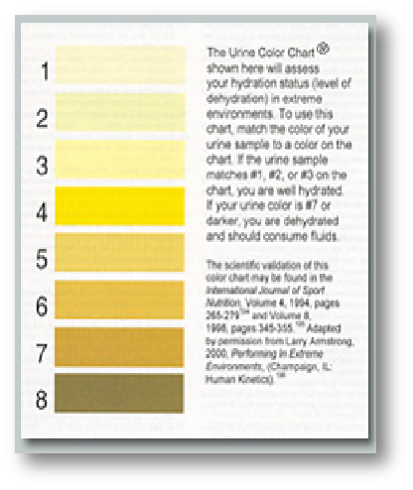
Every color on the market has a digital code.
Color 1, 255255199,
Color 2, 255251186;
Color 3, 255249164;
Color 4, 255232077;
Color 5, 245227157;
Color 6: 229201135;
Color 7, 207159072;
Color 8, 147140074

Slide 2
