Slide 1
SUPPLEMENTARY

Slide 2
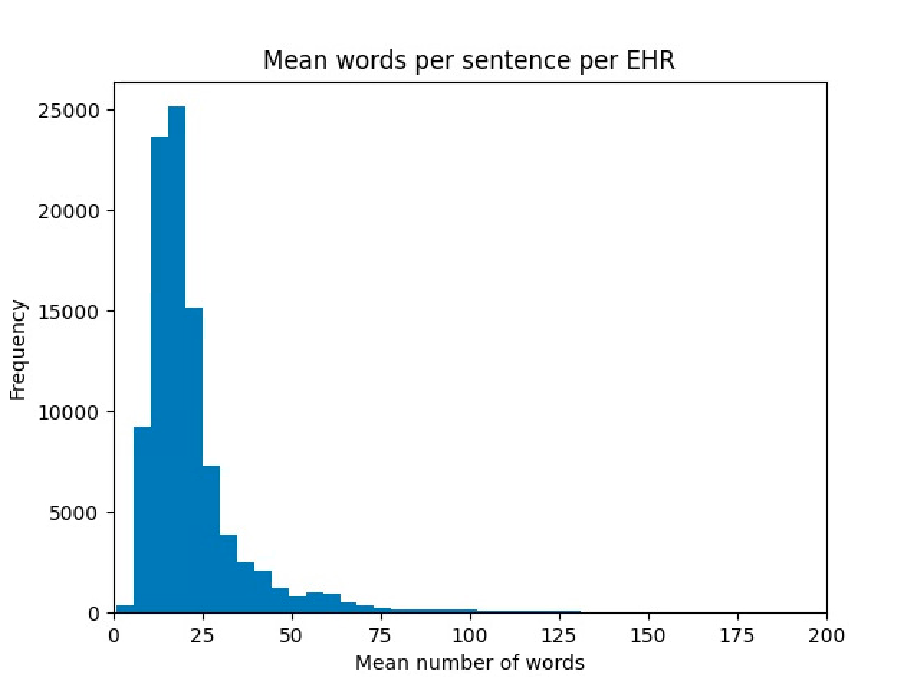
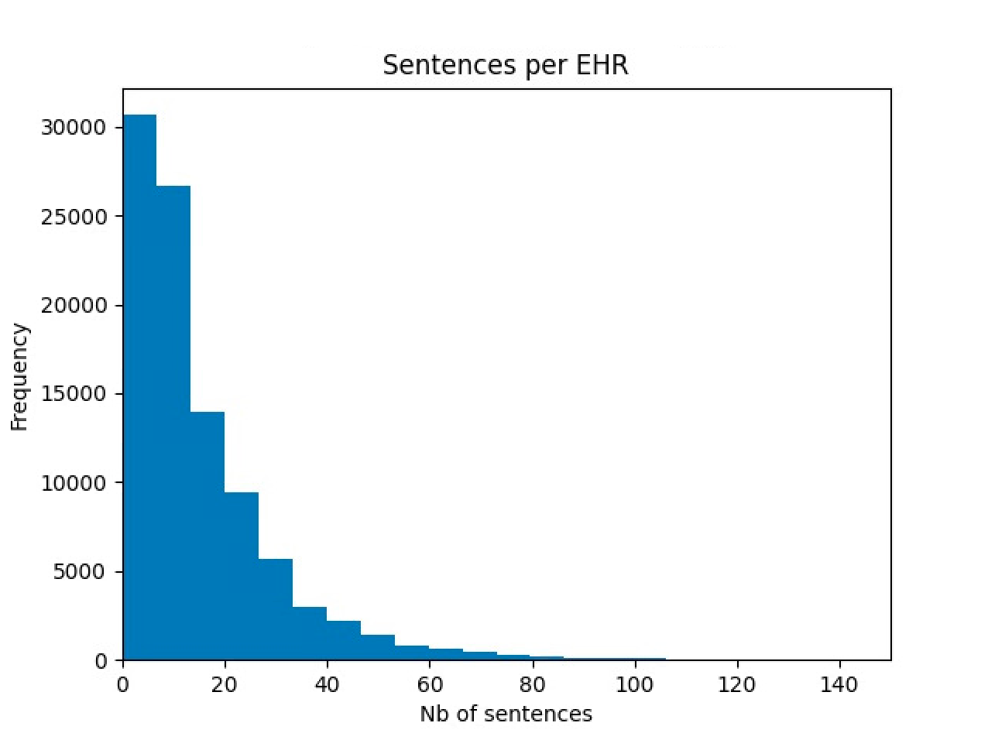
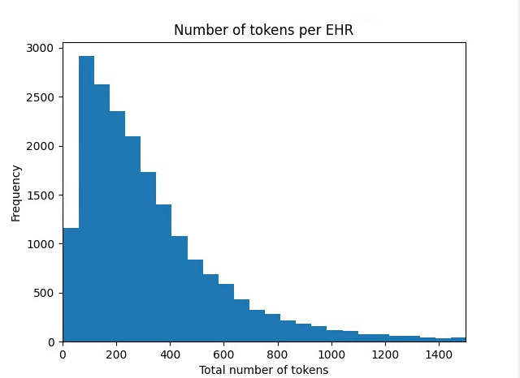
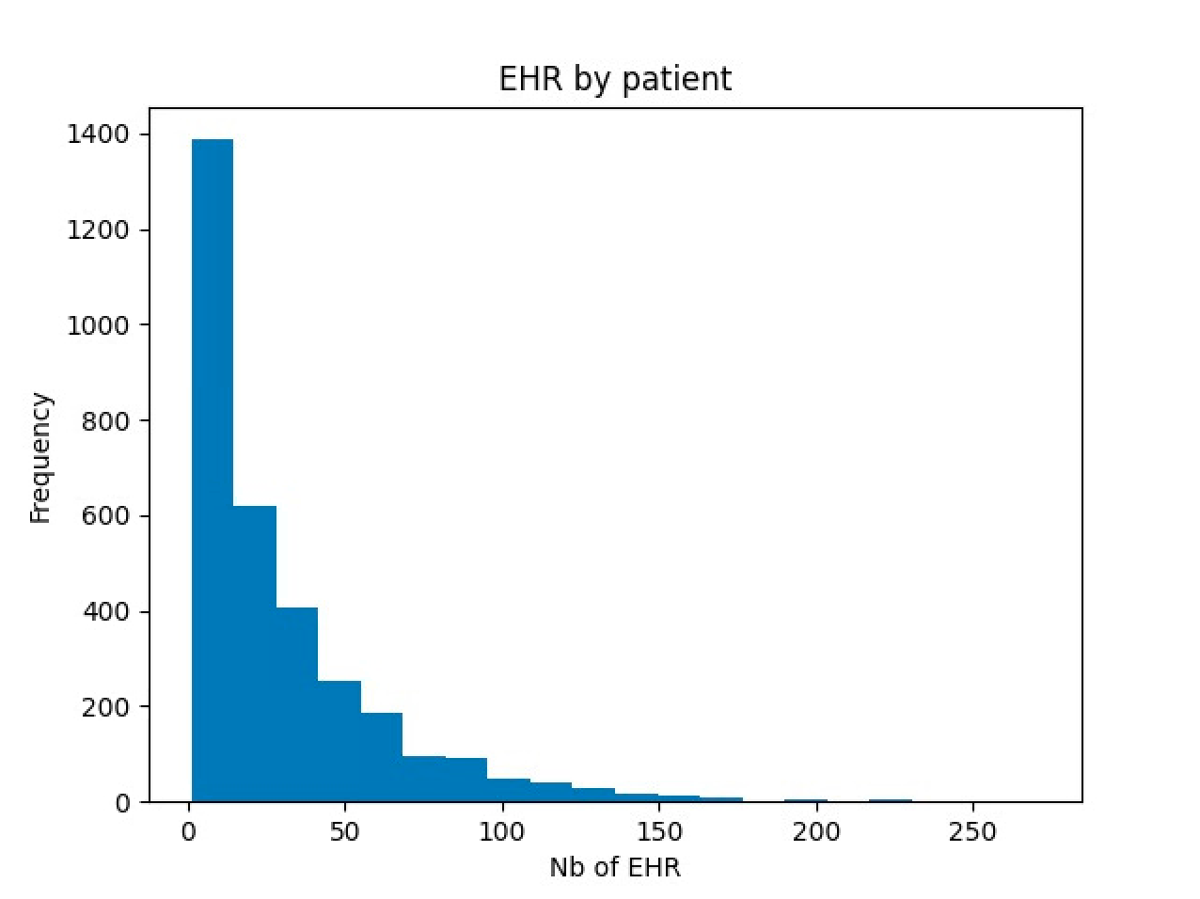
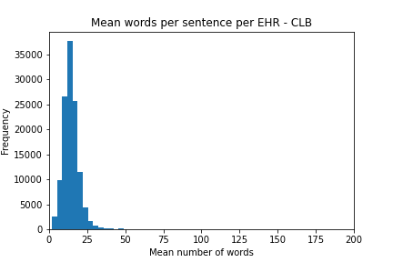
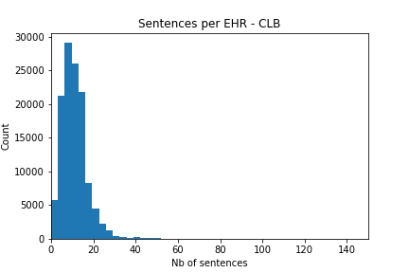
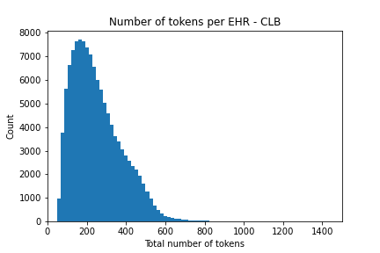
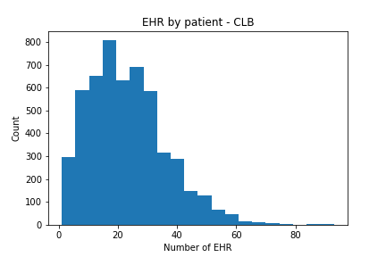
supp figure 1
GR cohort
a
b
c
d
e
CLB cohort
f
g
h

Slide 3
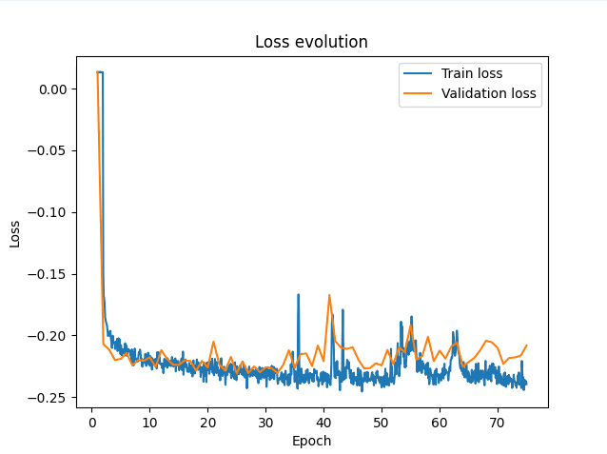
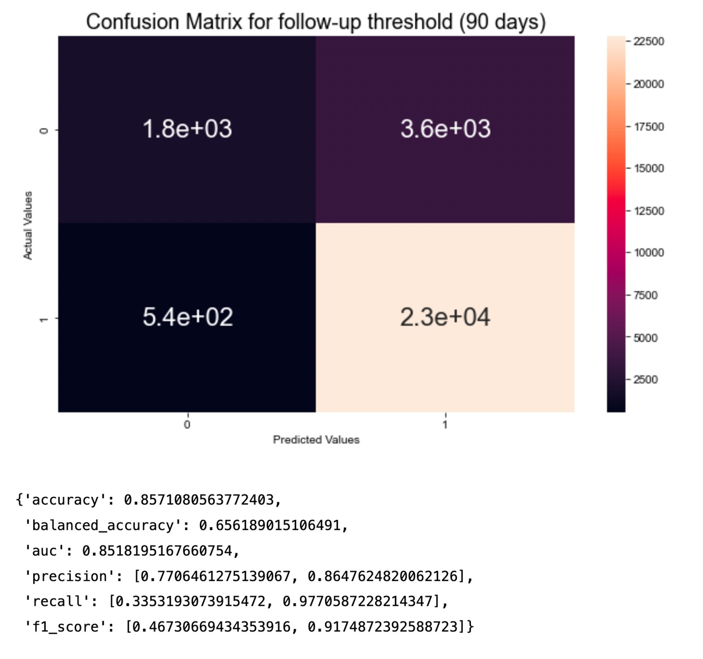
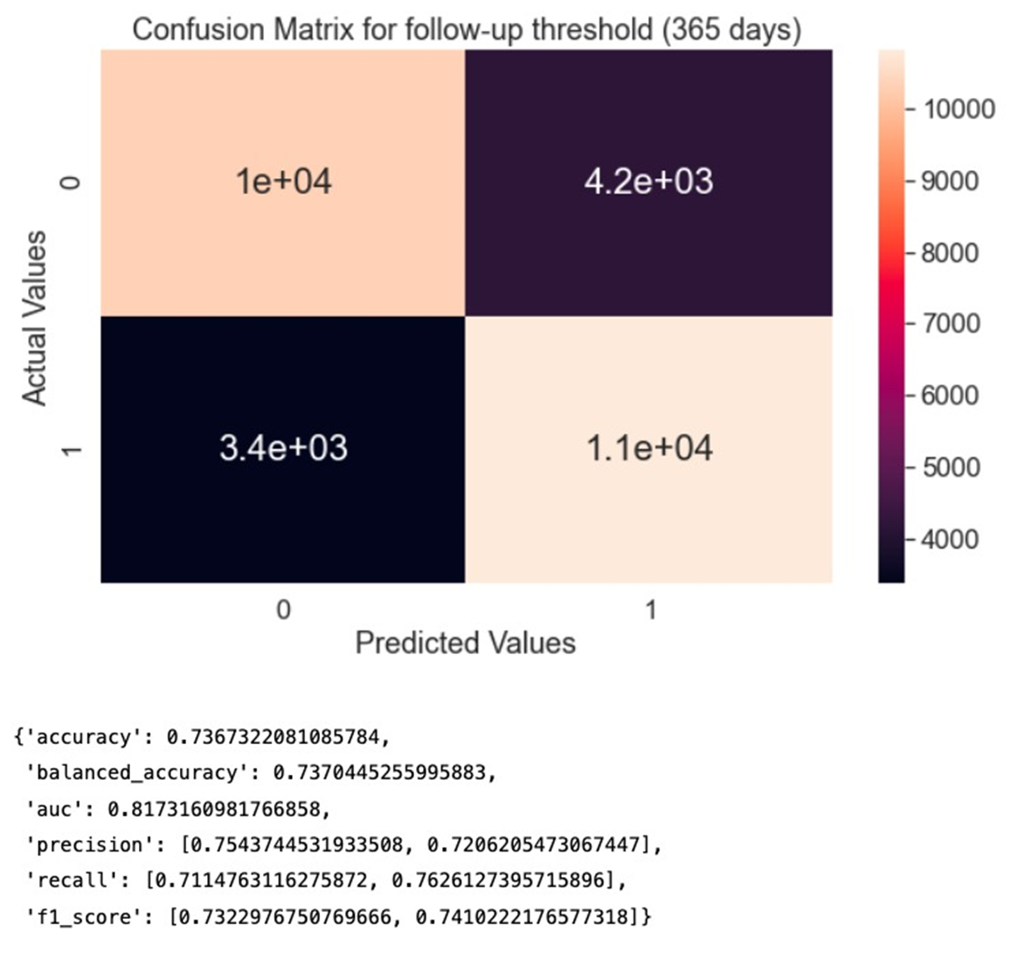
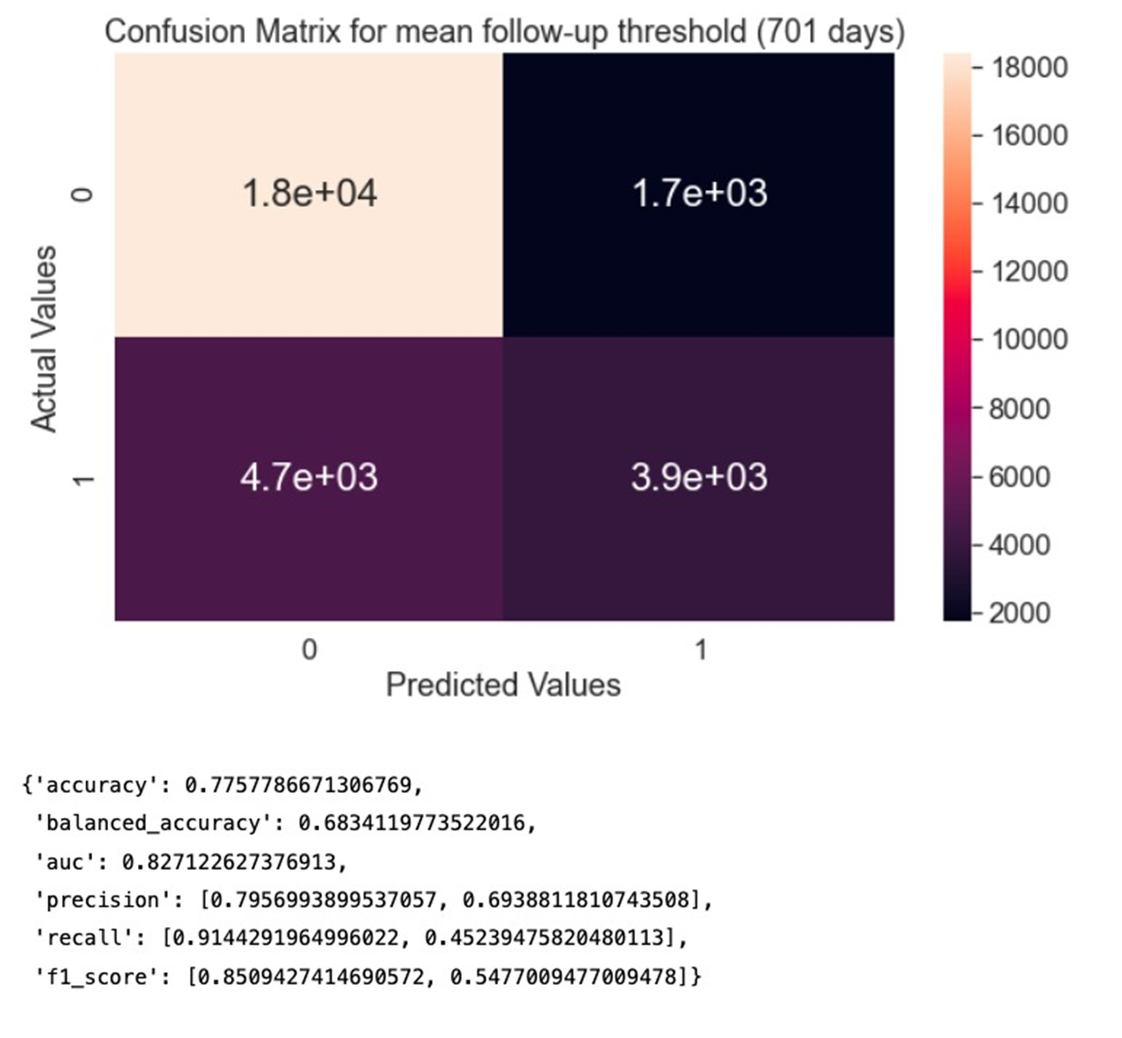
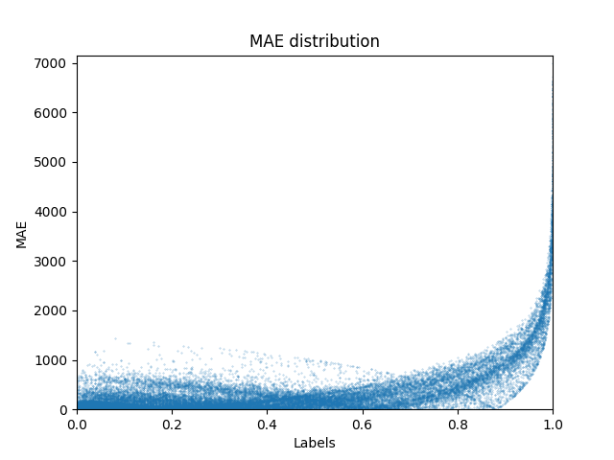
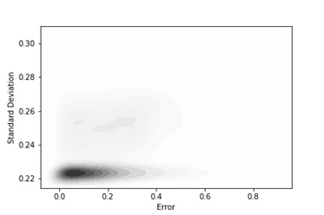
Supplementary Figure 2
a
b
True values
c
d
True values
True values
0=death
1=survival
e
f

Slide 4
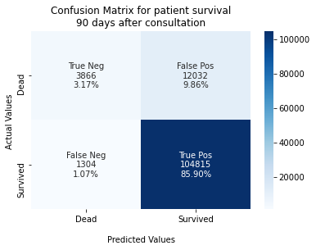
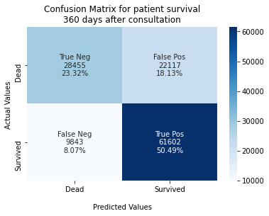
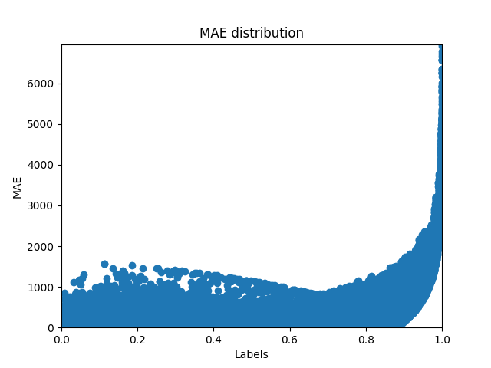
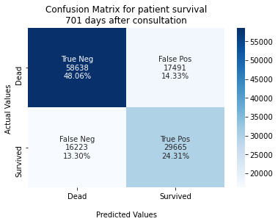
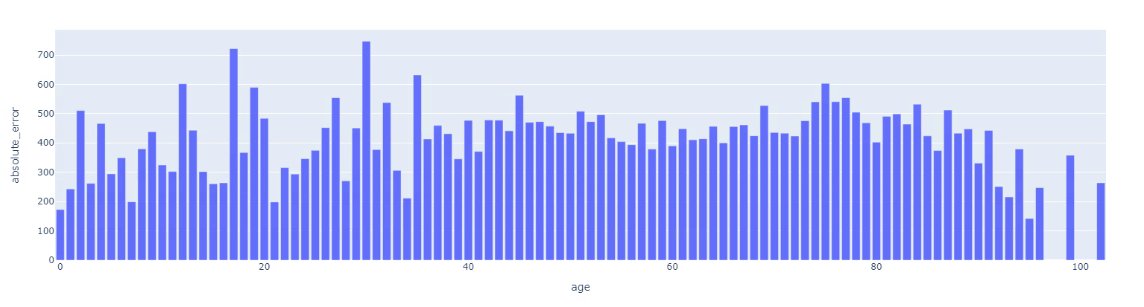
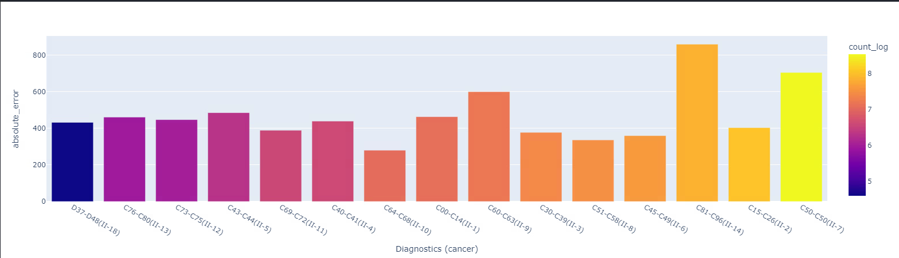
Supplementary figure 3
a
b
c
d
e
Mean absolute error
f
Mean absolute error
Miscellaneous
Thyroid
Melanoma
Unknow primary
Nervous system
Head and neck
Male genitals
Lung
Female genitals
Mesothelioma
Hematological
Digestive tract
Bones
Breast
Nervous system

Slide 5
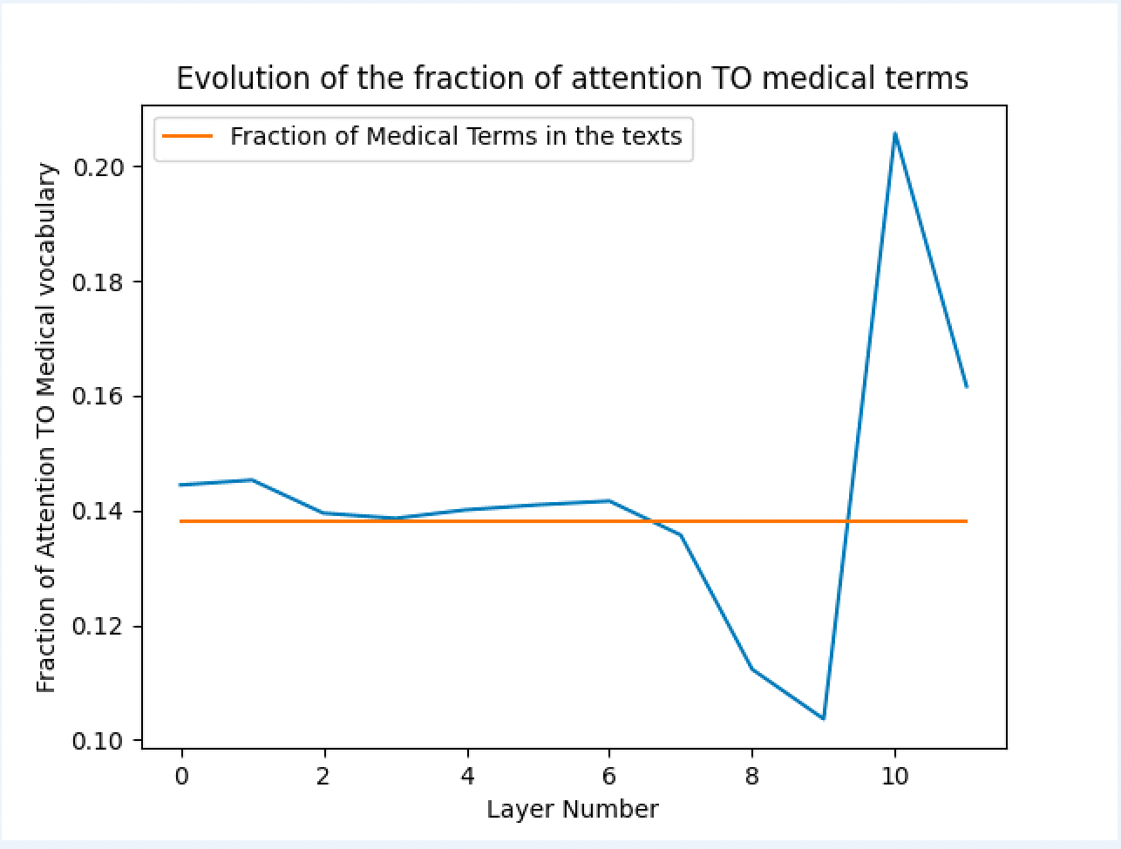
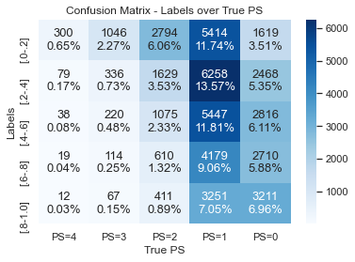
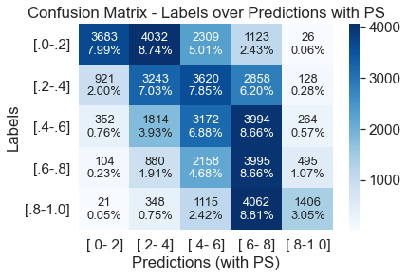
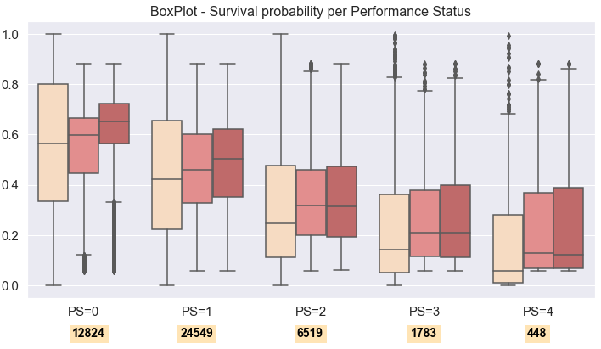
Supplementary figure 4
a
b
c
d
PS score for each time point
Observed survival [0-1]
Intervals of predicted survival with PS and KS removed from the texts
Intervals of predicted survival with full texts
Number of documents

Slide 6



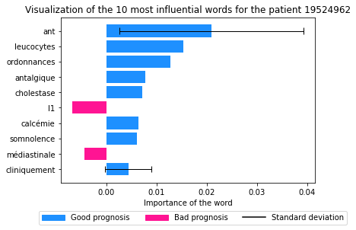
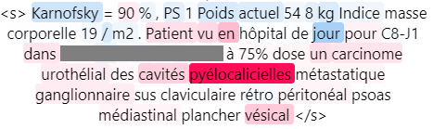
Supplementary figure 5a
time
True survival = 141 days
True label 0.117
Prediction = 0.116

Slide 7
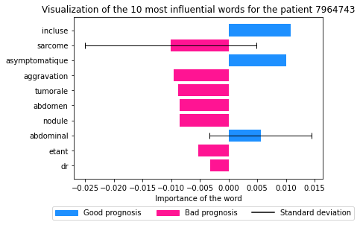
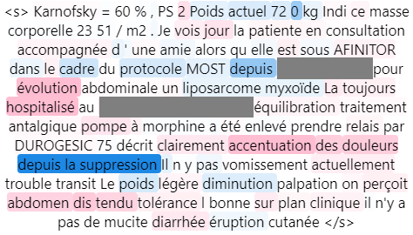
Supplementary figure 5b
time
True survival = 73 days
True label 0.088
Prediction = 0.087

Slide 8
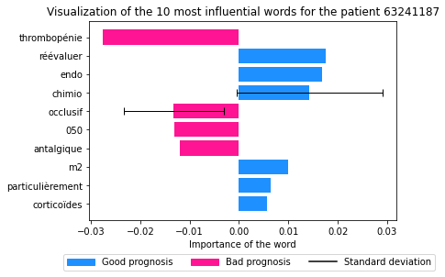
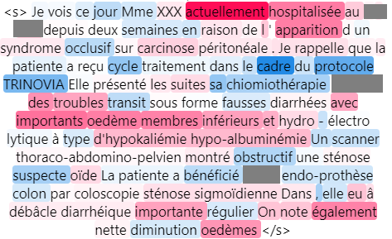
Supplementary figure 5c
time
True survival = 391 days
True label 0.387
Prediction = 0.222

Slide 9
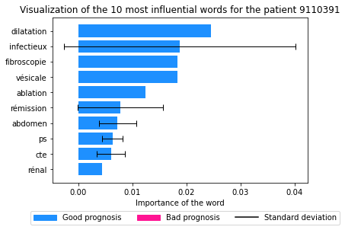
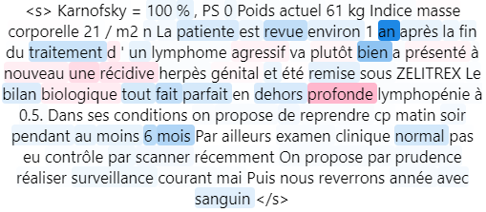
Supplementary figure 5d
time
True survival = 1666 days
True label 0.874
Prediction = 0.875

Slide 10
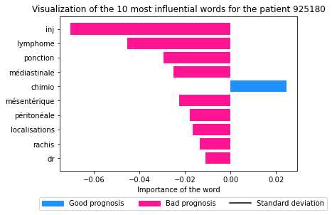
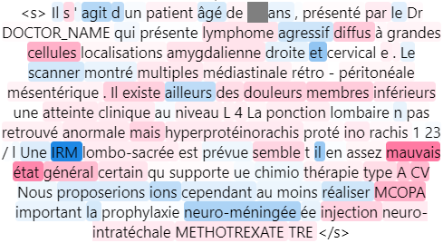
Supplementary figure 5e
time
True survival = 2350 days
True label 0.947
Prediction = 0.078

Slide 11
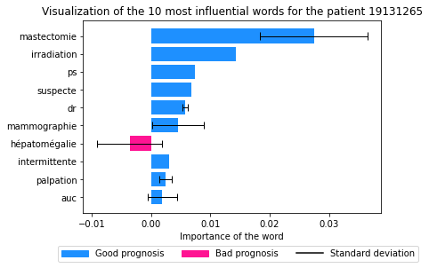
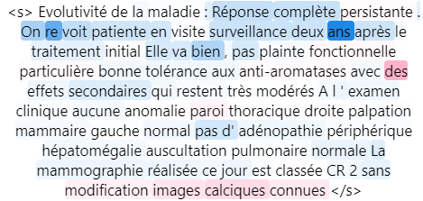
Supplementary figure 5f
time
True survival = 96 days
True label 0.113
Prediction = 0.874

