Slide 1
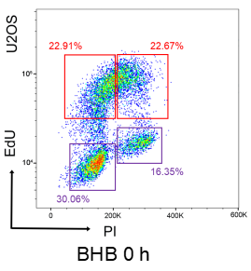
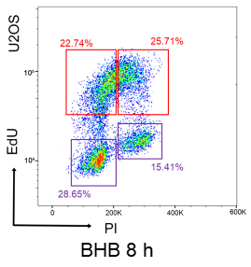
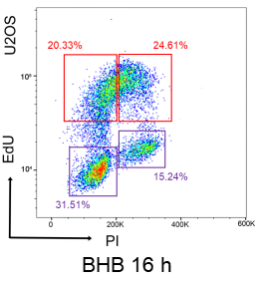
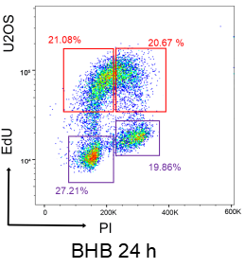
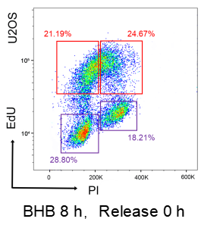
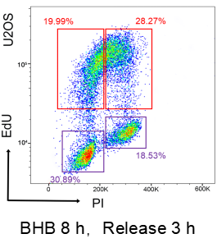
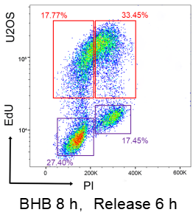
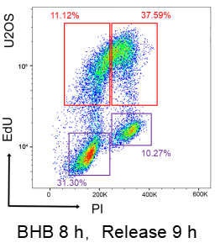
Supplementary Figure 1
A
B

Slide 2
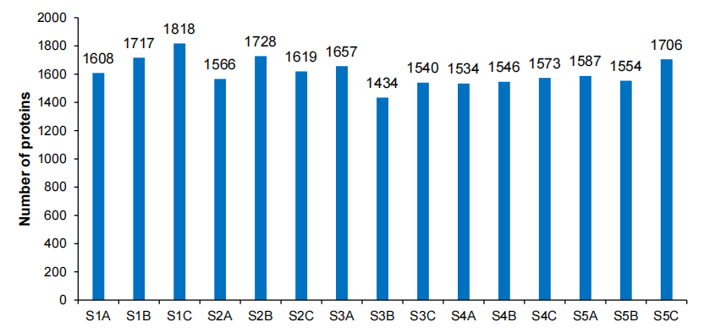
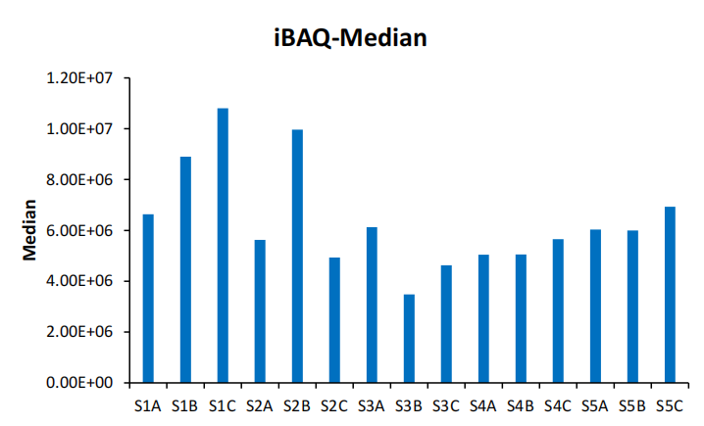
Supplementary Figure 1
C
D

Slide 3
E

Slide 4
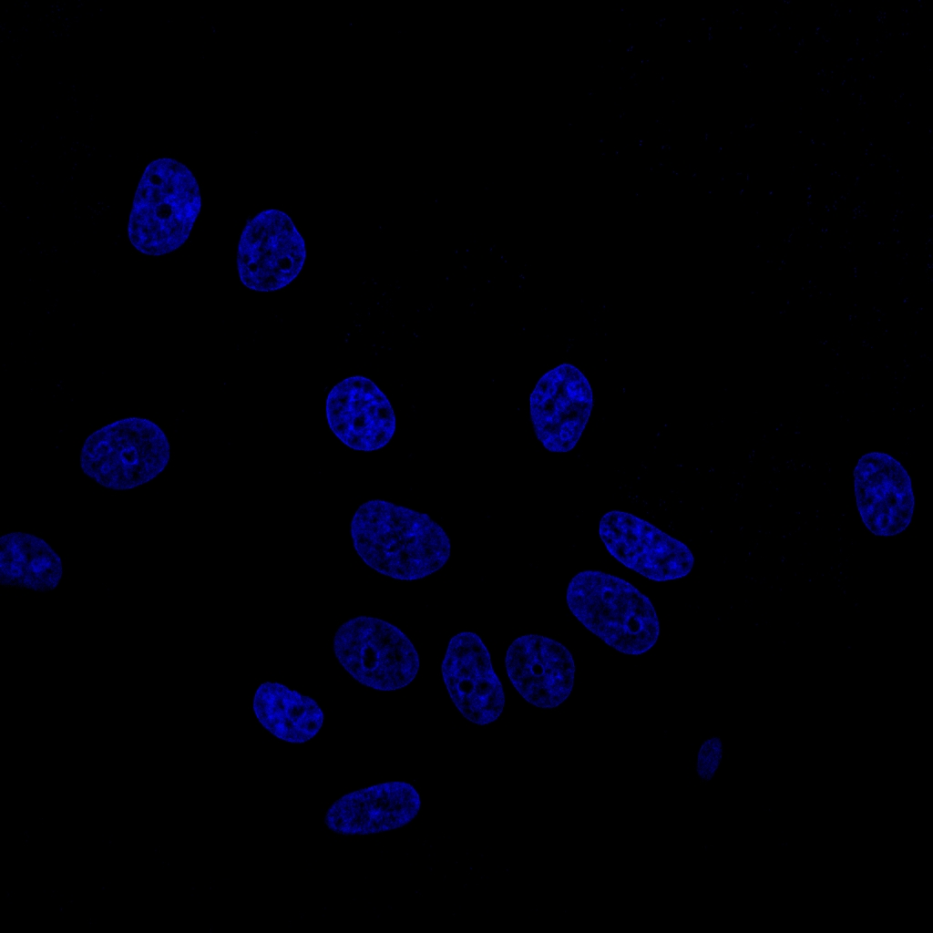
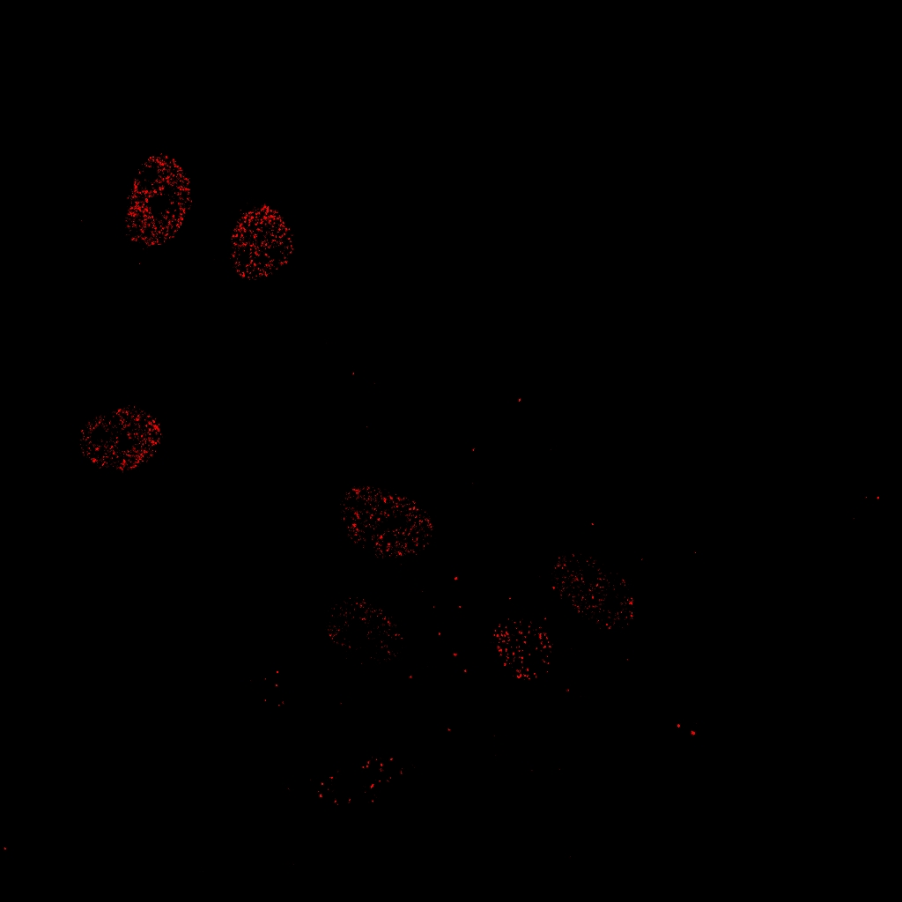
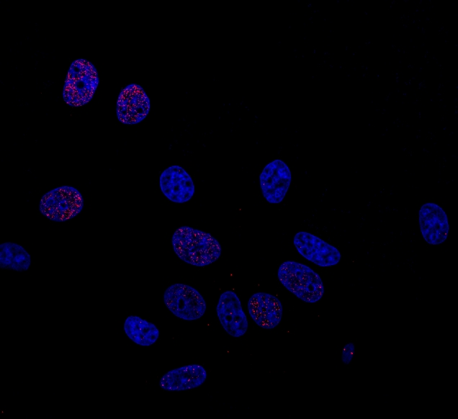
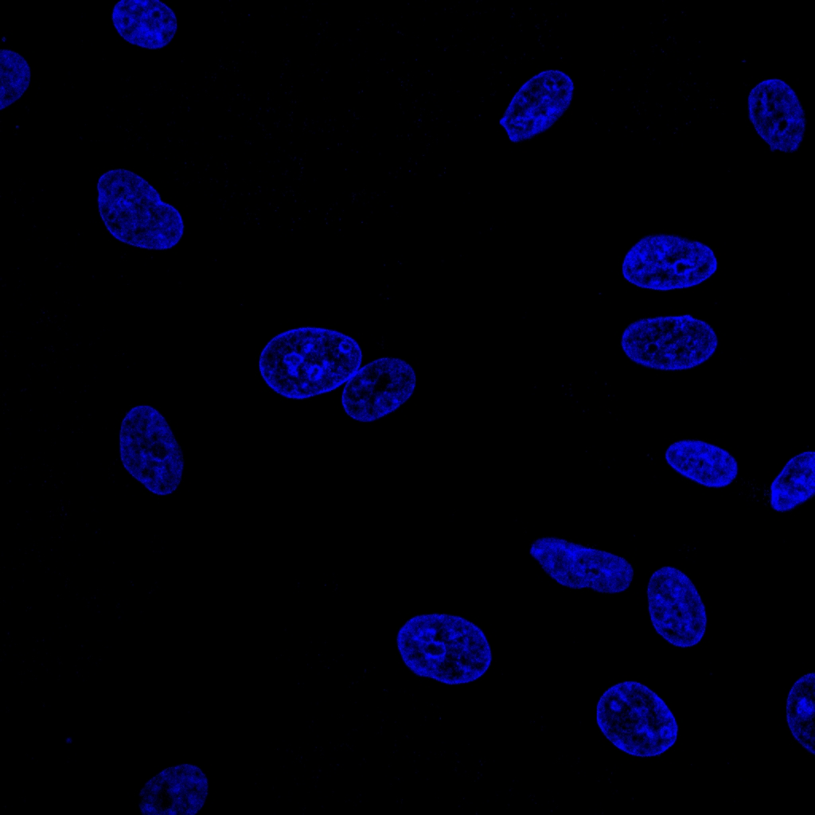
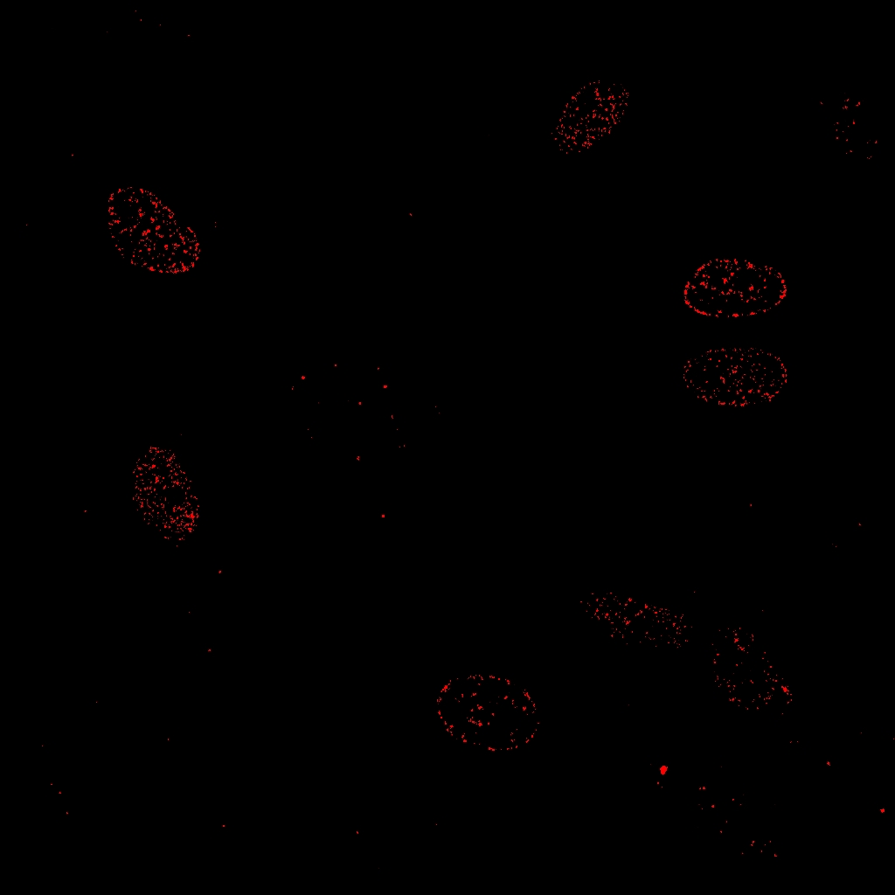
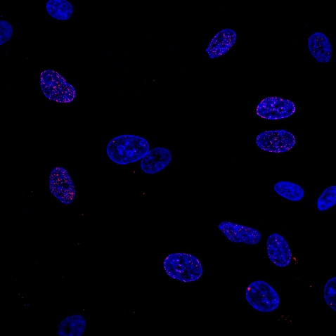
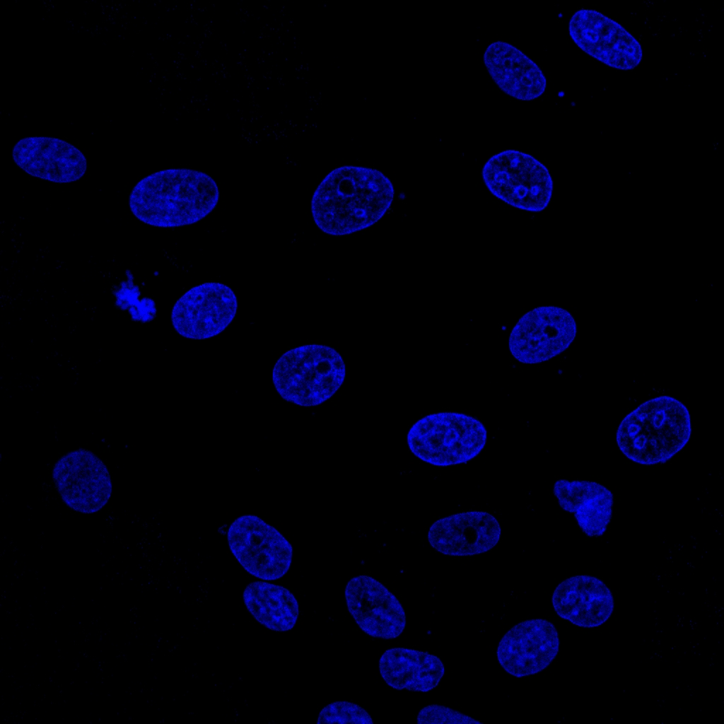
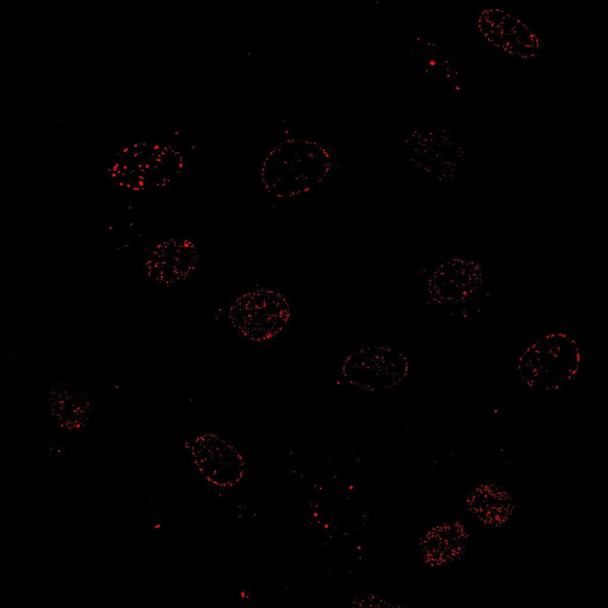
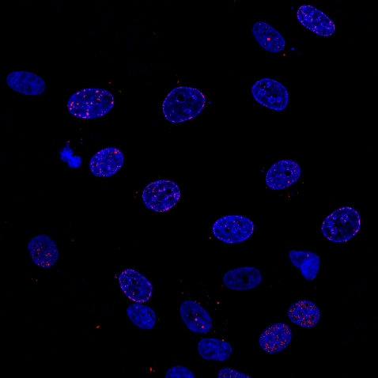
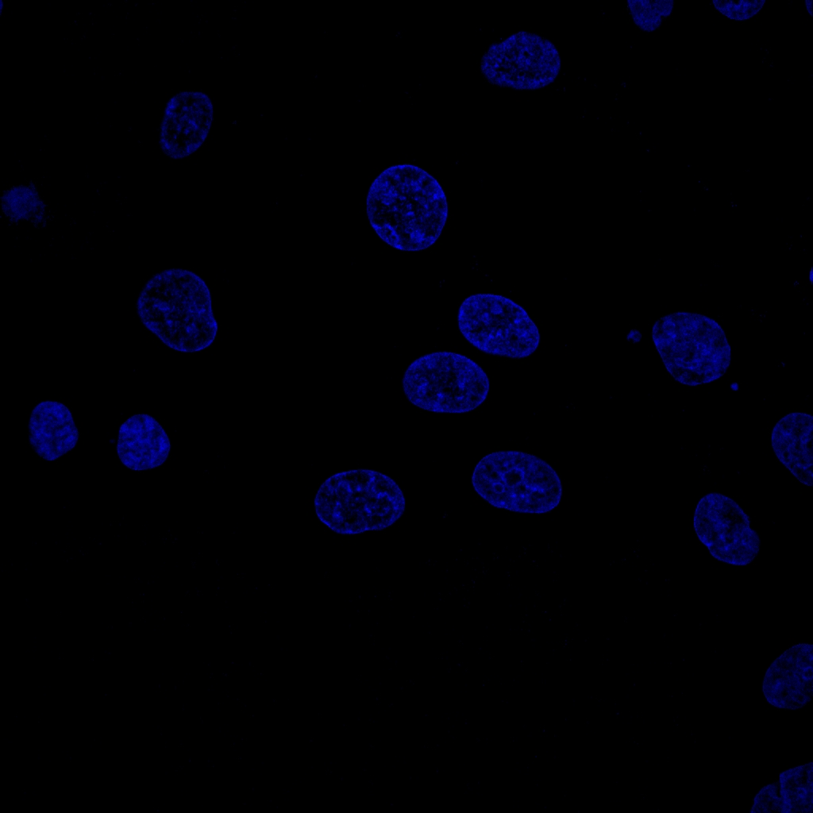
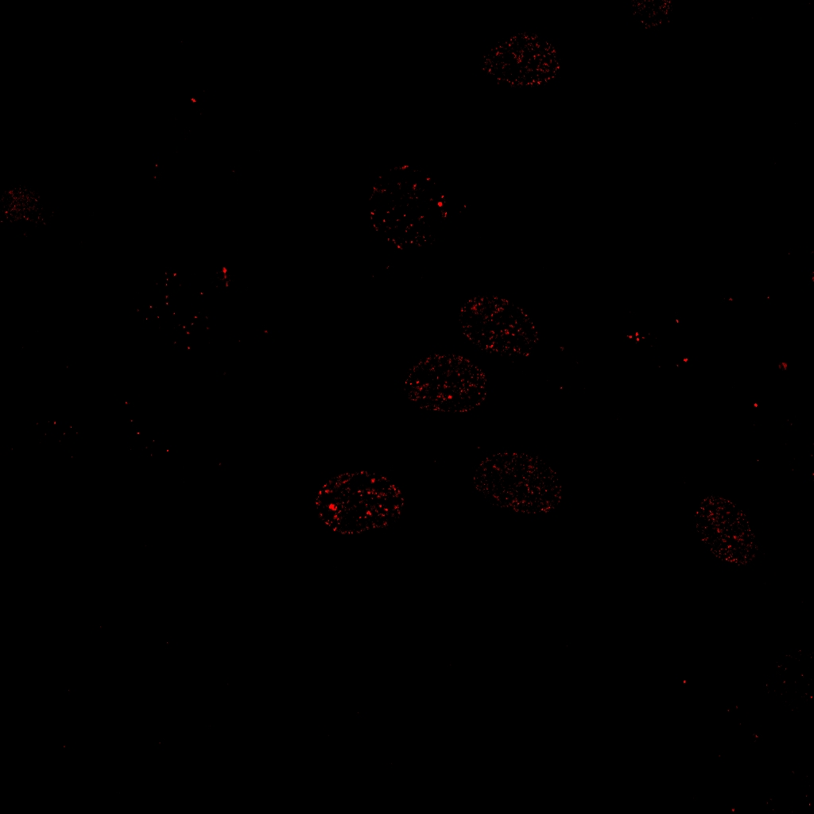
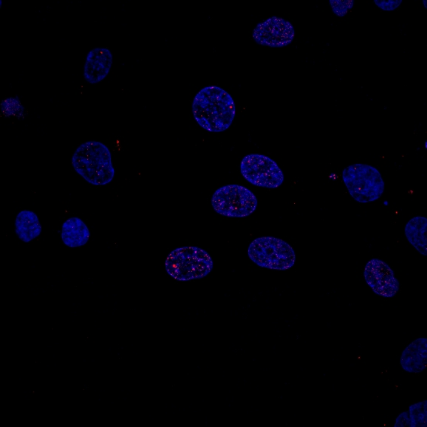
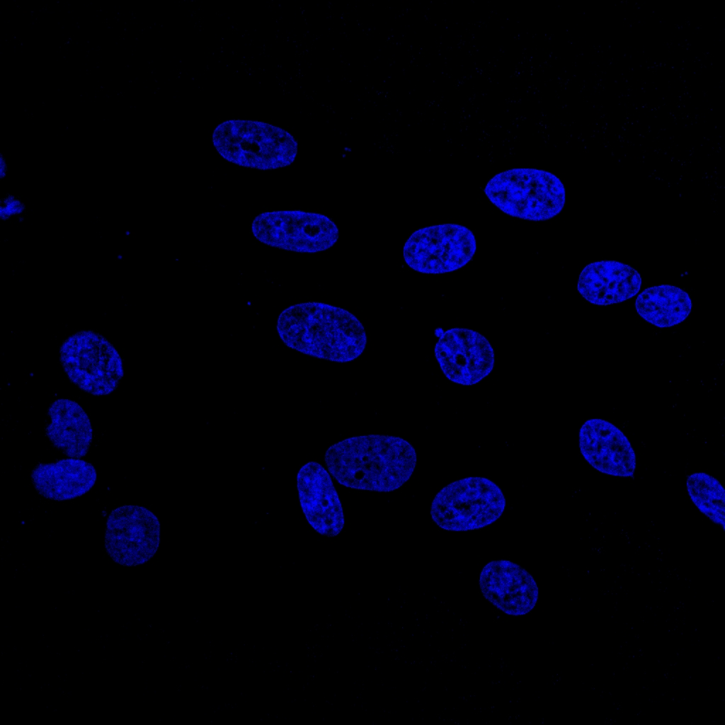
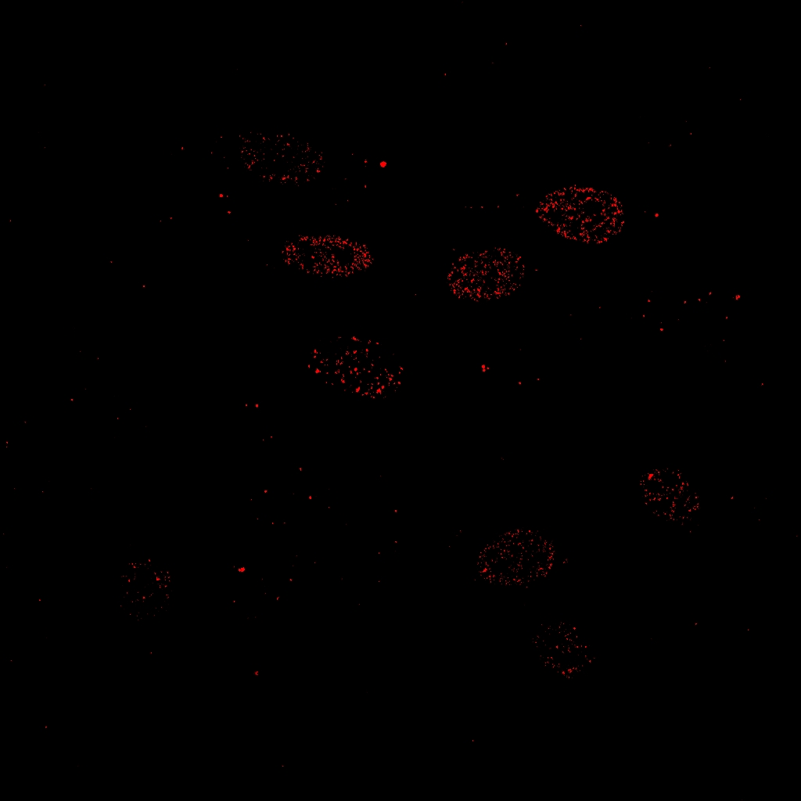
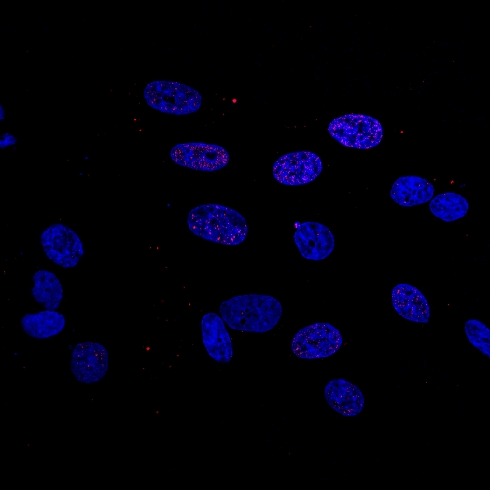
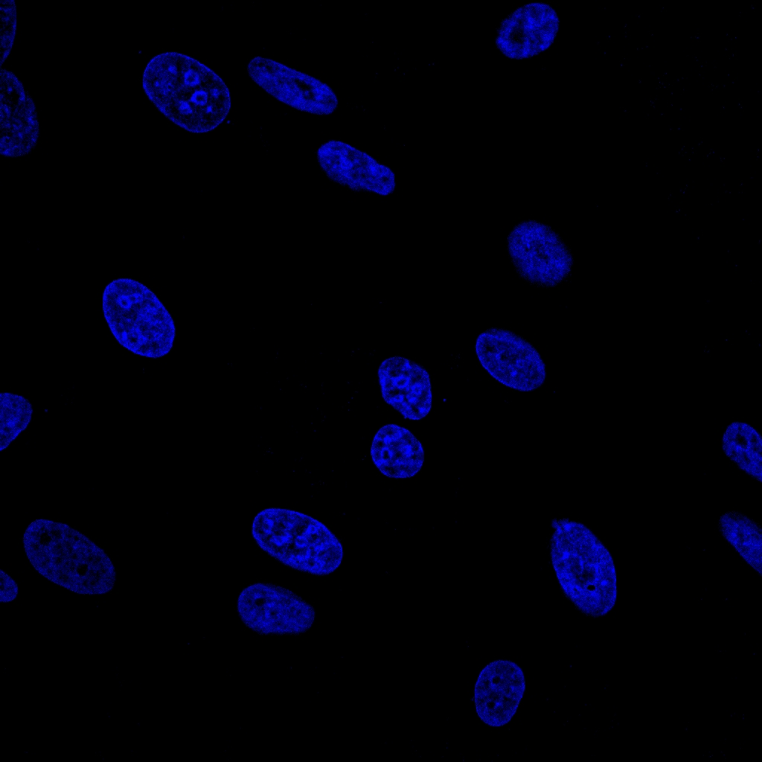
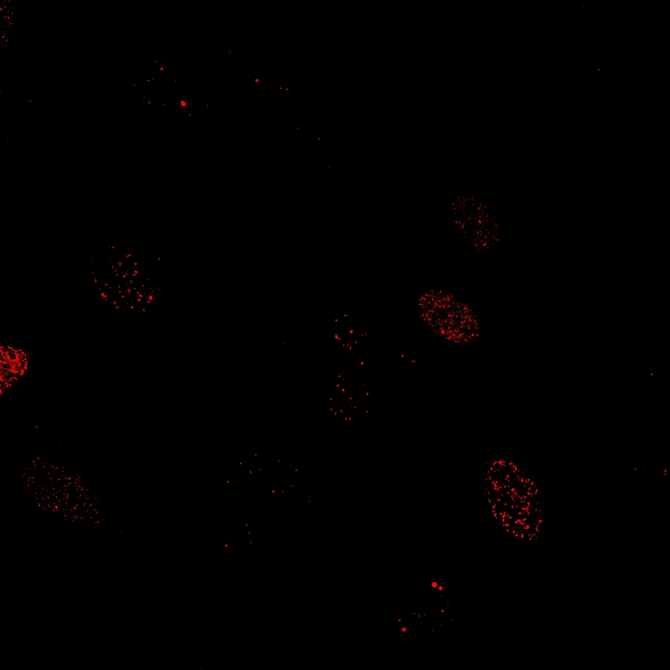
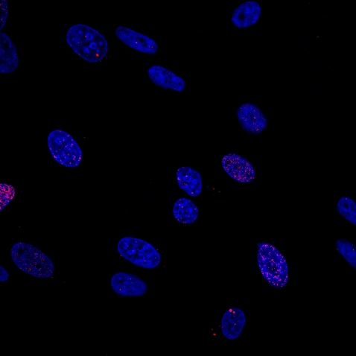
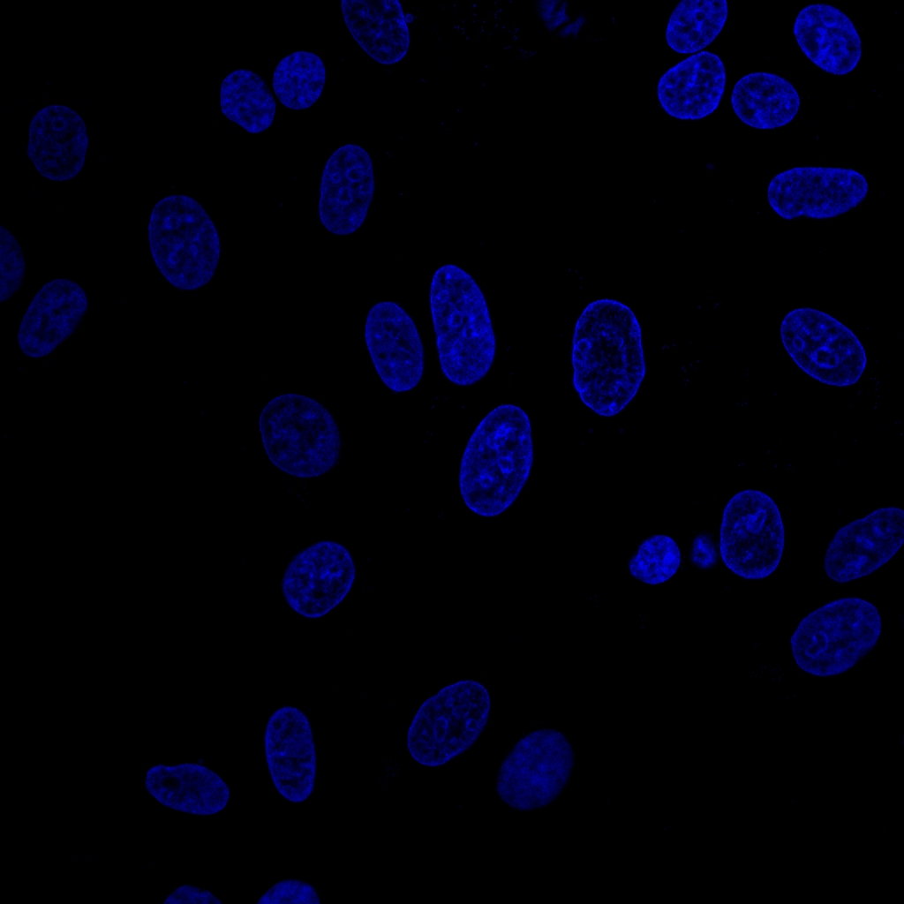
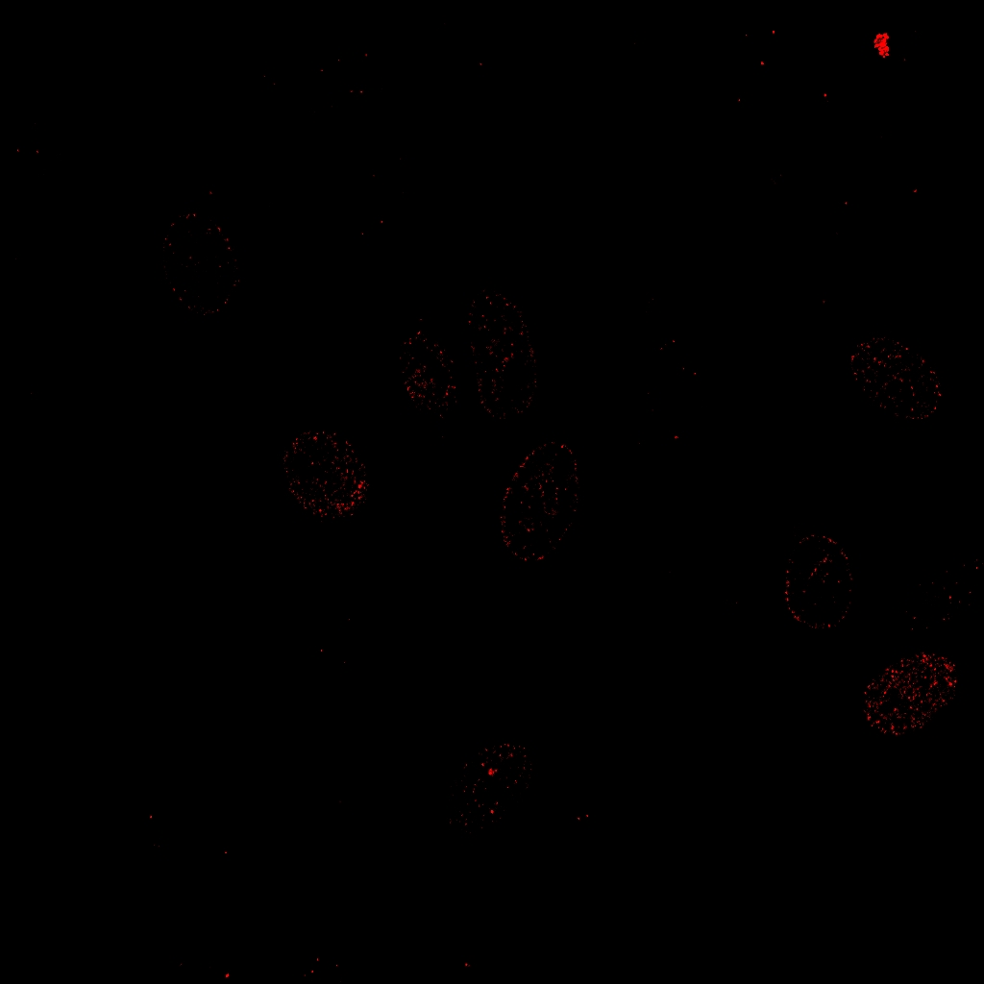
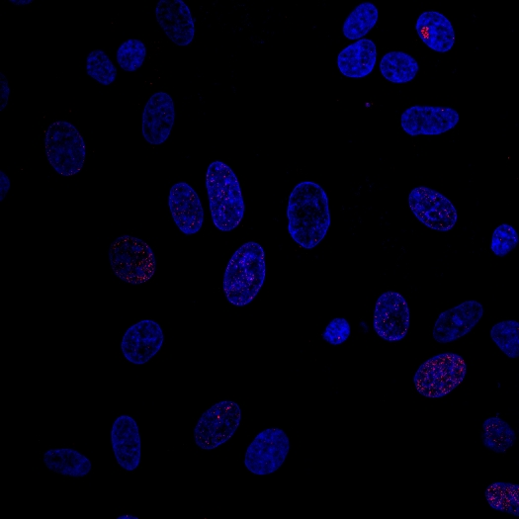
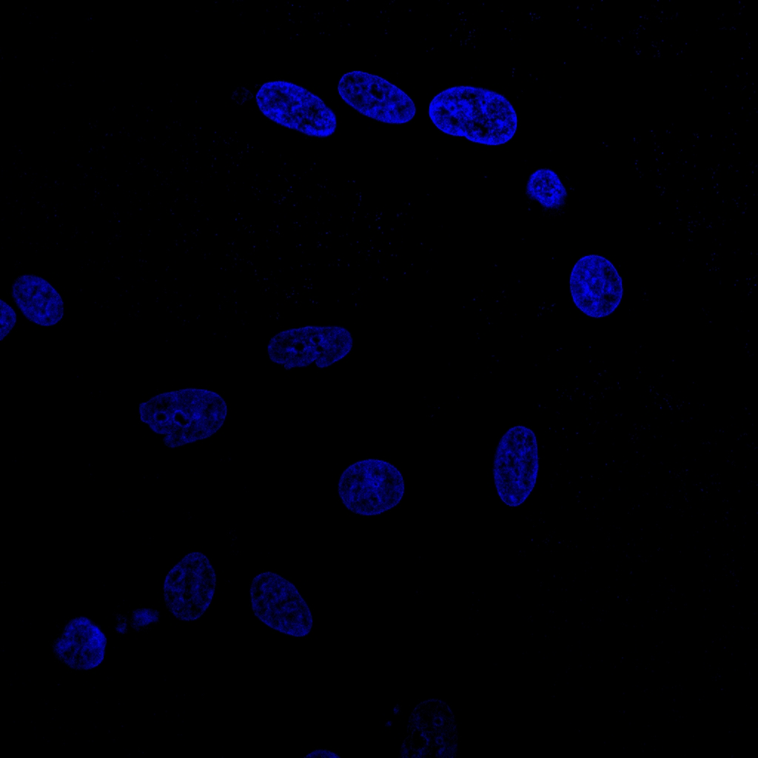

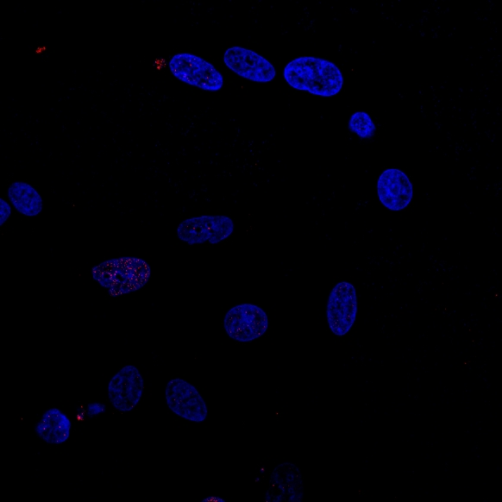
Supplementary Figure 2
A
DAPI
RPA2
Merge
BHB
0 h
8 h
16 h
24 h
B
DAPI
ƳH2AX
Merge
BHB
0 h
8 h
16 h
24 h

Slide 5
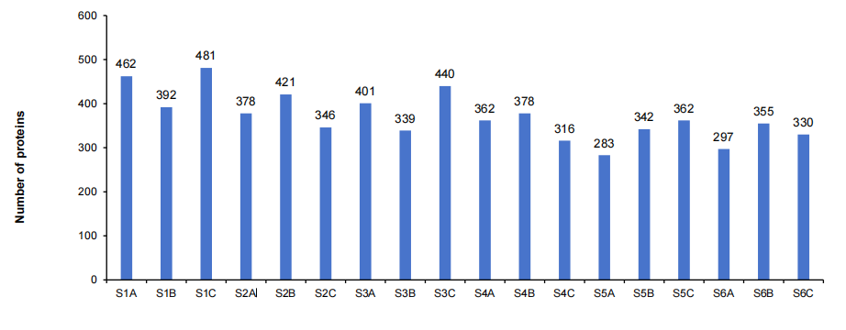
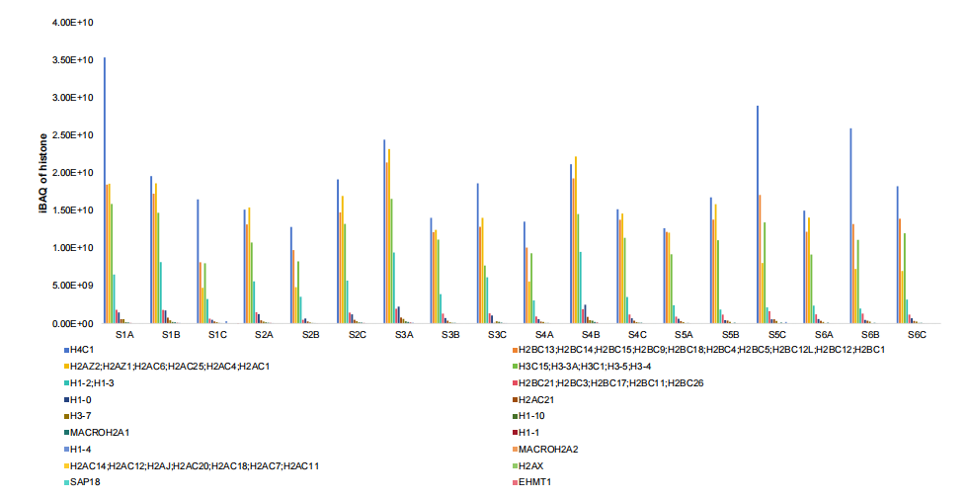
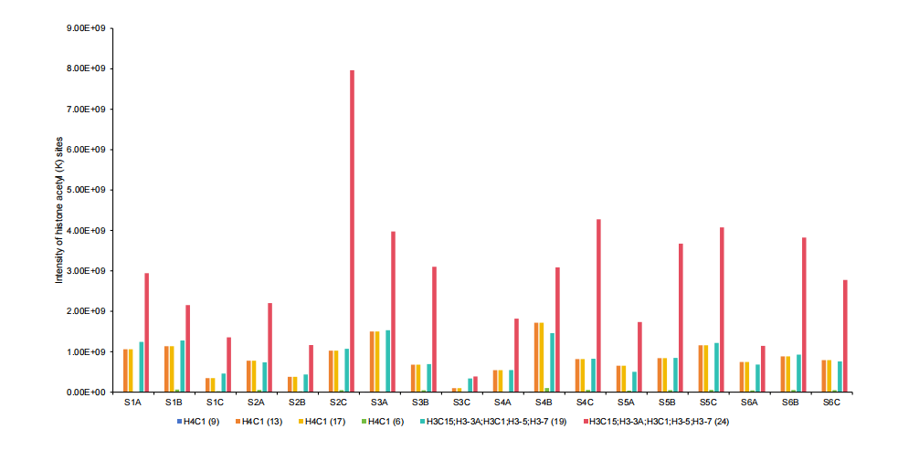
Supplementary Figure 3

Slide 6
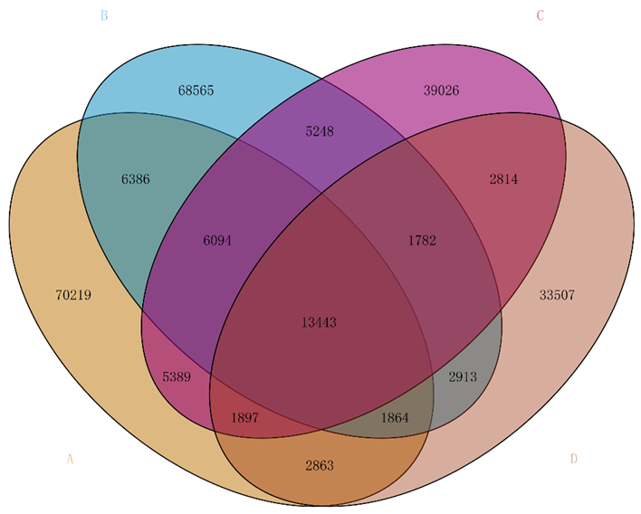
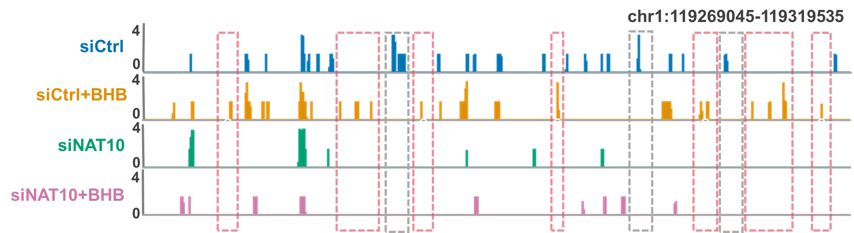
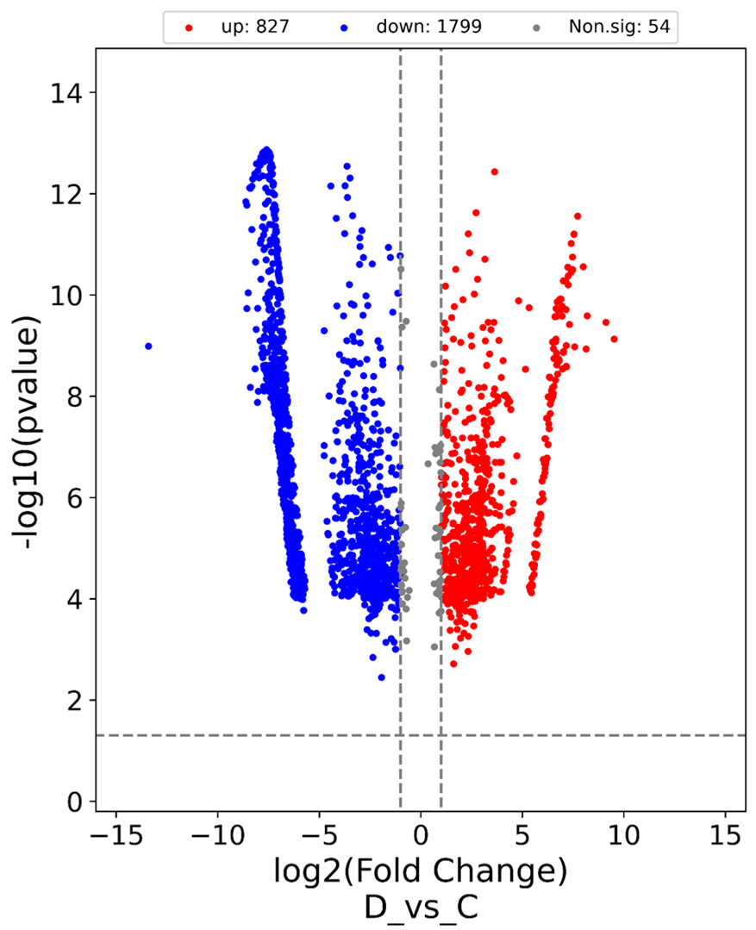
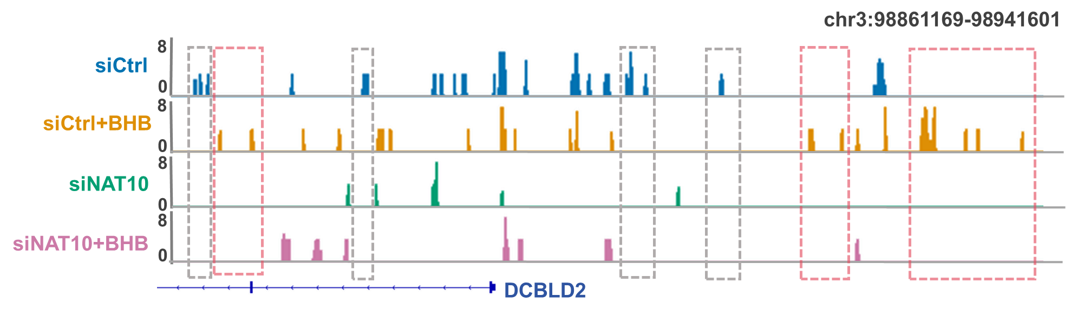
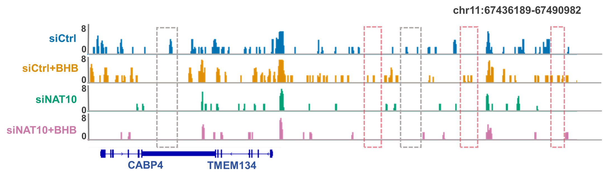
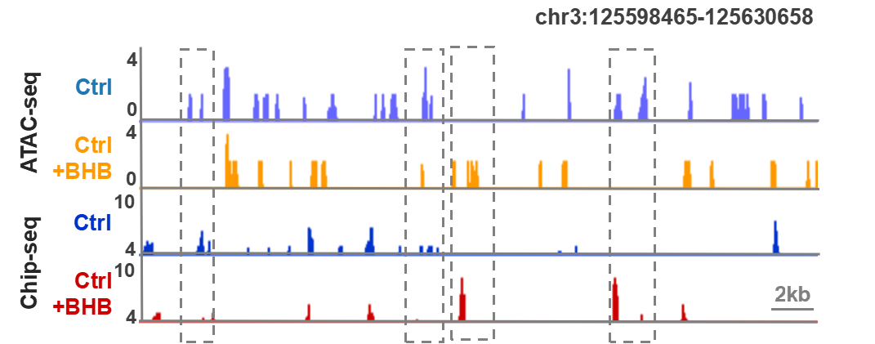
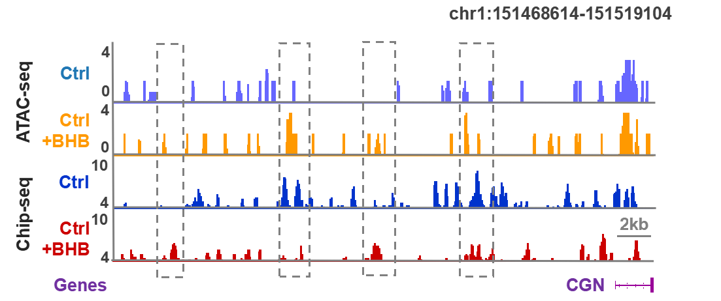
Supplementary Figure 4
A
C
B
D
E
F
G

Slide 7
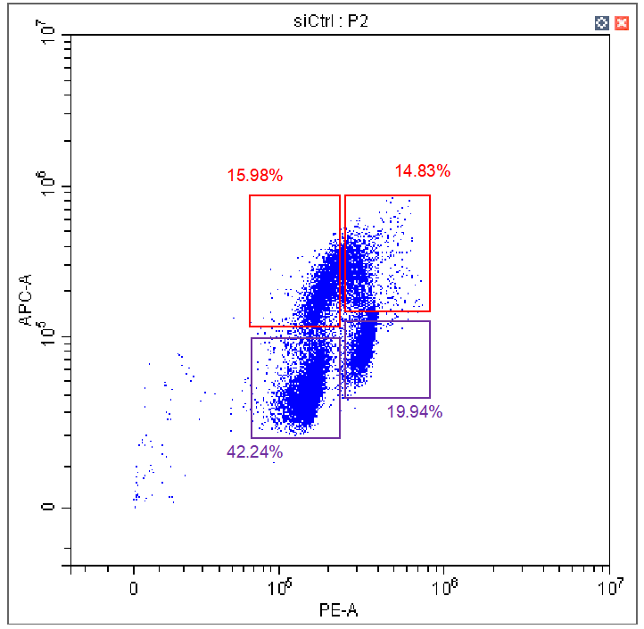
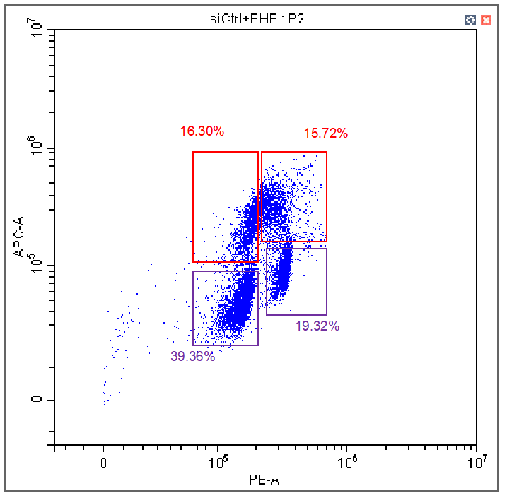
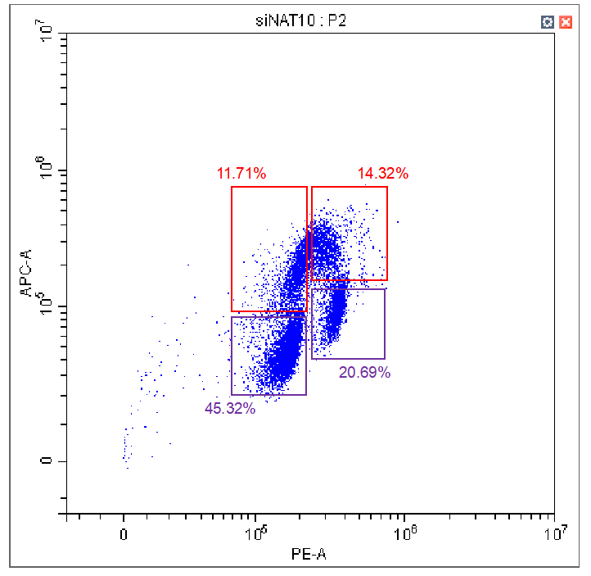
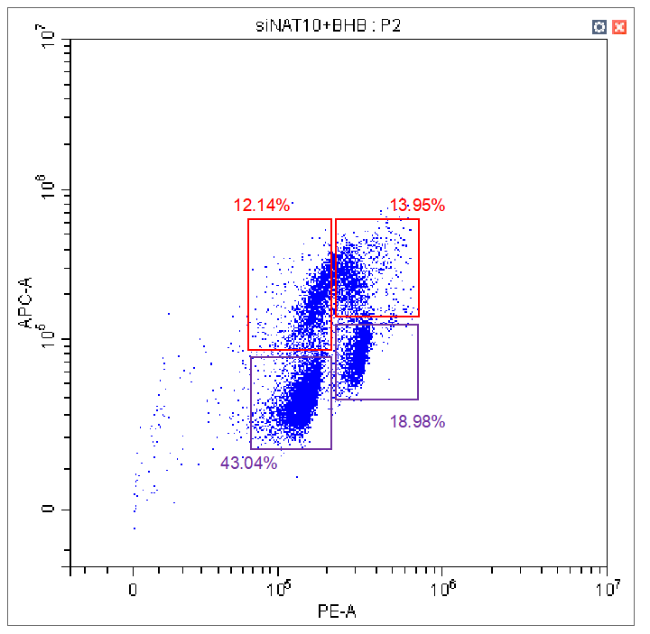
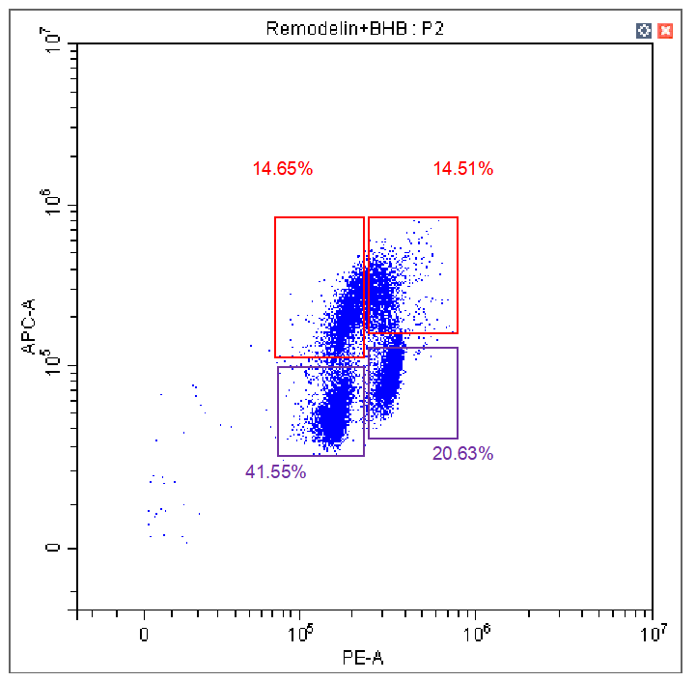
Supplementary Figure 5
A
siCtrl
B
siCtrl+BHB
C
siNAT10
D
siNAT10+BHB
E
Remodelin+BHB

Slide 8
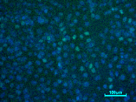
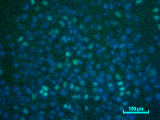










Supplementary Figure 6
A
BHB (10mM)
BHB (10mM)
12 h
24 h
12 h
24 h
siCtrl
Control
siNAT10
Remodelin
B
siCtrl
siCtrl+BHB
siNAT10
siNAT10+BHB
BrdU intensity
DAPI intensity

Slide 9













































Supplementary Figure 7
A
B
ƳH2AX
Merge
DAPI
RPA2
Merge
DAPI
siCtrl
siCtrl
siCtrl
+BHB
siCtrl
+BHB
siNAT10
siNAT10
siNAT10
+BHB
siNAT10
+BHB
Remodelin
+BHB
Remodelin
+BHB
C
DAPI
BrdU
RPA2
siCtrl
5 μM
5 μM
5 μM
siCtrl
+BHB
5 μM
5 μM
5 μM
siNAT10
5 μM
5 μM
5 μM
siNAT10
+BHB
5 μM
5 μM
5 μM
Remodelin
+BHB
5 μM
5 μM
5 μM

Slide 10
Supplementary Figure 7
D
DAPI
BrdU
cyclin A
Merge
siCtrl
siCtrl
+BHB
siNAT10
siNAT10
+BHB
DAPI+Brdu
E
DAPI
γH2AX
cyclin A
Merge
siCtrl
siCtrl
+BHB
siNAT10
siNAT10
+BHB

Slide 11










Supplementary Figure 8
A
BrdU
cyclin A
DAPI
Merge
B
Normal
Bridge
Bridge
siCtrl
5μm
5μm
5μm
siCtrl
+BHB
Normal
Micronuclei
Micronuclei
siNAT10
5μm
5μm
5μm
siNAT10
+BHB
Merge
DAPI
C
D
1
1
2
EdU
3
2
1
2
1
2
3

Slide 12







Supplementary Figure 9
A
BrdU
cyclin A
DAPI
Merge
B
Normal
Bridge
Bridge
siCtrl
siCtrl
+BHB
5μm
5μm
5μm
Normal
Micronuclei
Micronuclei
siNAT10
5μm
5μm
5μm
siNAT10
+BHB
D
Merge
DAPI
C
1
1
2
3
EdU
2
2
1
1
2
3

