Slide 1
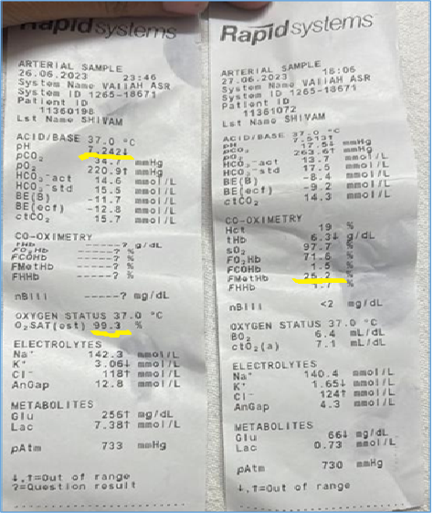
Figure 1: Arterial blood gas test results along with co-oximetry ( to monitor levels of methaemoglobin and saturation gap) on day 1 & 2

Slide 2
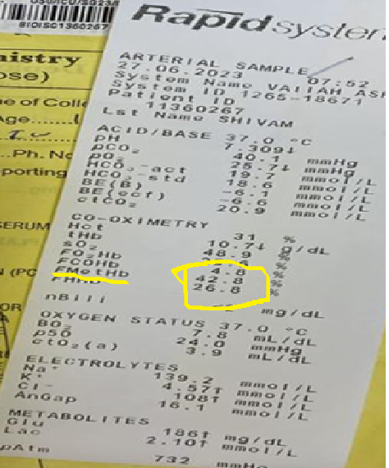
Figure 2: Arterial blood gas test results ( to monitor levels of methaemoglobin) on day 2

Slide 3
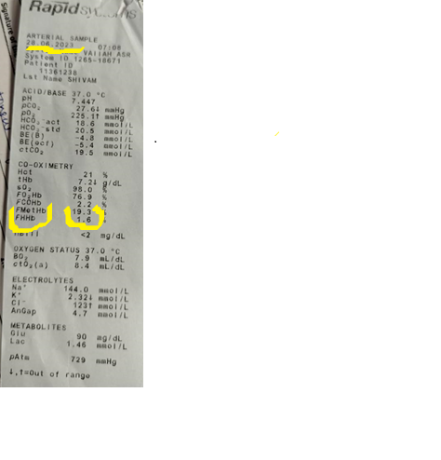
Figure 3: Arterial blood gas test results ( to monitor levels of methaemoglobin) on day 3

Slide 4
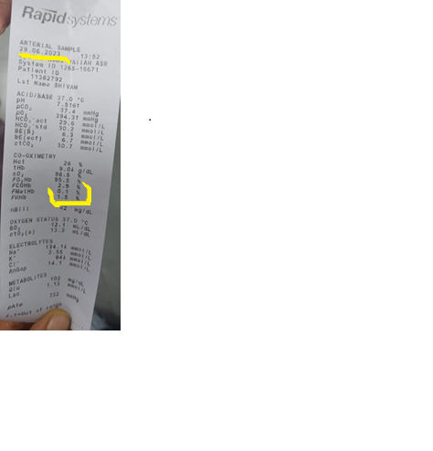
Figure 4: Arterial blood gas test results ( to monitor levels of methaemoglobin) on day 4

Slide 5
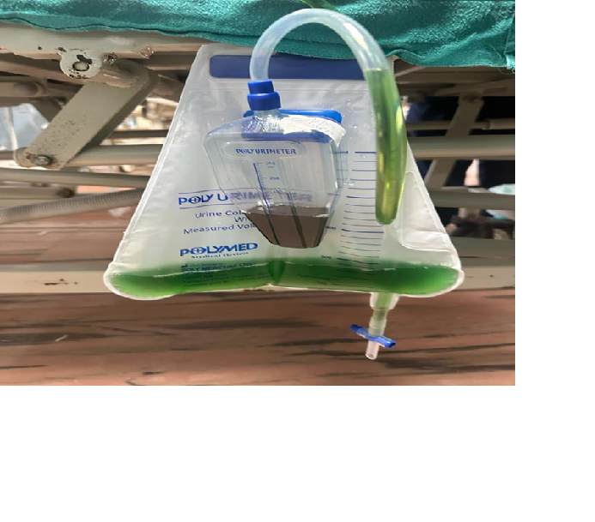
Figure 5: Methylene blue induced green coloured urine^{α}
α : Methylene blue [Antidote of choice for acquired (toxic) methemoglobinemia] is metabolized to leuco-methylene blue and combine with urochrome (yellow pigment in urine), which results in green colour.

Slide 6
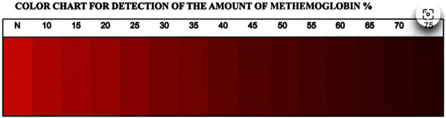
Figure 6: represents colour scale of different shades of blood (from bright red to dark brown) indicating rough estimation of
methemoglobinemia percentage.
Image source: Shihana F, Dissanayake D, Buckley N, Dawson A. A Simple Quantitative Bedside Test to Determine
Methemoglobin.
Annals of emergency medicine. 2009. 55. 184-9. 10.1016/j.annemergmed.2009.07.022. (Accessed on 9th April 2024) Copyright
© 2009
The Authors Available under: Creative Commons Attribution 4.0 International.
Available From: https://www.researchgate.net/figure/Color-chart-for-the-measurement-of-methemoglobin-
The-color-chart-was-prepared-according_fig2_26884296

