Slide 1
Temporal and Spatial Expression Characteristics of MiR-155 and Rheb/mTOR Signaling Pathway in Ischemia–Reperfusion Injury of Rats
Yu-E Yan ^{1,†,*}, Xu-Rong Zhu^{1,†} , Fang He¹, Jing Xiong¹, Ye Tian¹ , Wen-Zhen Shi¹ ,Bing Li¹, Zhi-Qin Liu¹,Nai-Bin Gu¹, Xiao-Tao Jia¹,Ge-Min Zhu¹, Jing-Jing Du¹, Hua Guo¹, Zheng-Li Di^{1,*}

Slide 2
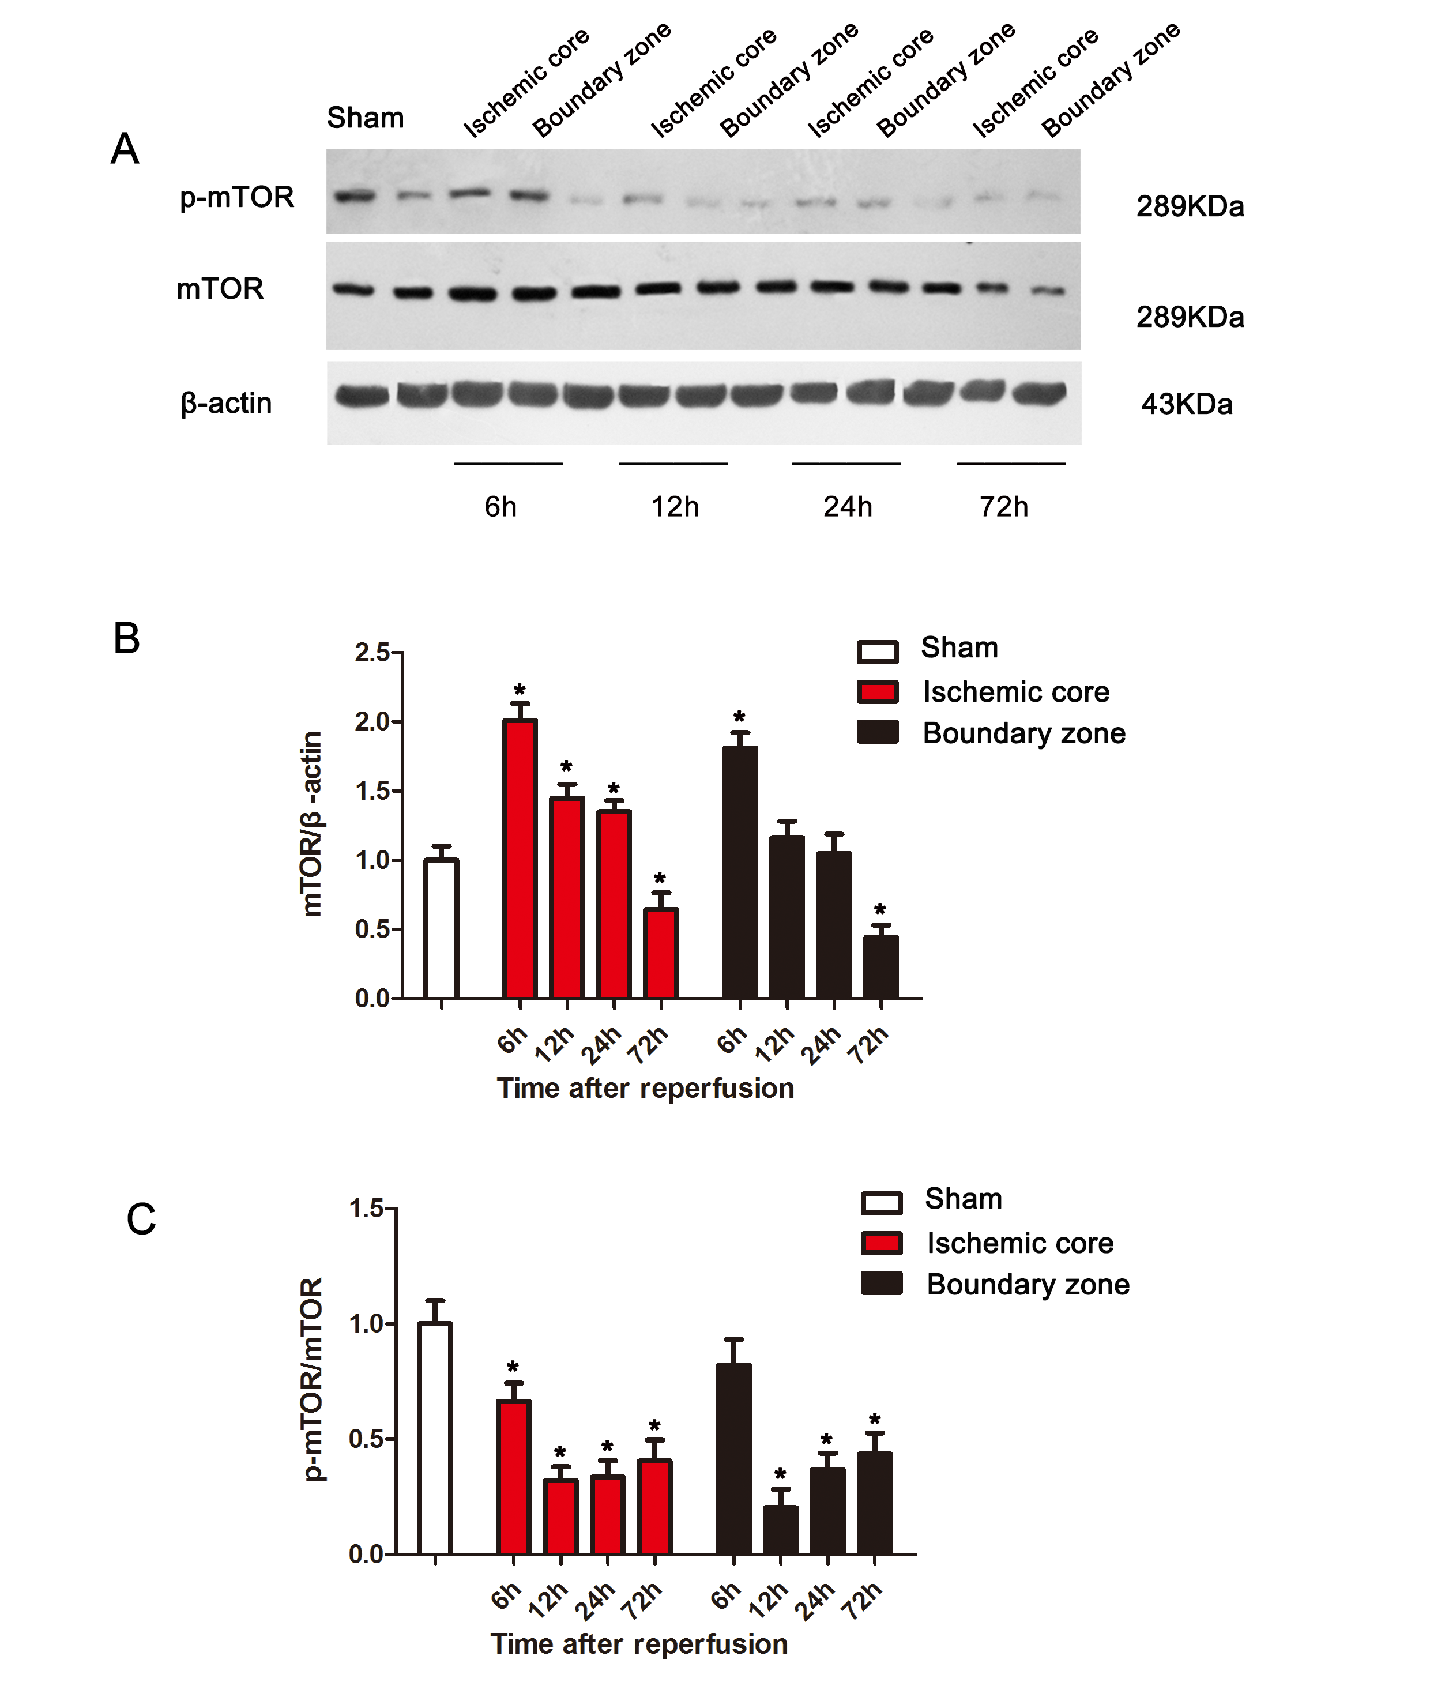
Complementary Figure1：the expression change of mTOR、p-mTOR in the MCAO/R model rats’ brain tissues
A：Expression of mTOR and p-mTOR by Western blot method；
B：analysis of mTOR gray value；
C： analysis of p-mTOR/mTOR gray value.
The data was showed as mean ± SD ，*compared to the relative control group，P﹤0.05，** compared to the relative control group ，P<0.01， All the data are from four independent assays(n=4), one-way ANOVA analysis was used.

Slide 3
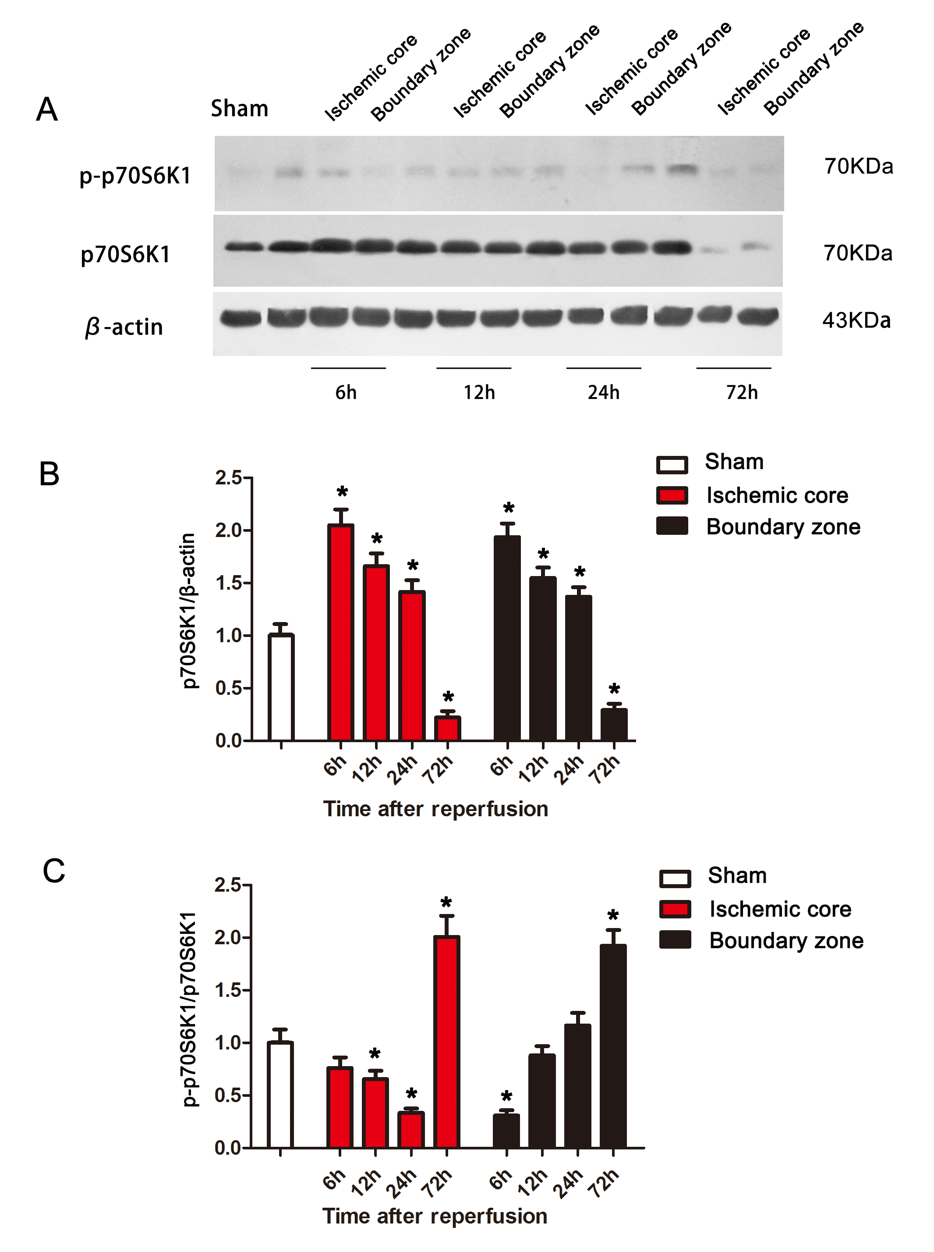
Complementary Figure2：the expression change of p70S6K1、p-p70S6K1 in the MCAO/R model rats’ brain tissues
A：Expression of p70S6K1 and p-p70S6K1 by Western blot method；
B：analysis of p70S6K1 gray value；
C： analysis of p-p70S6K1/ p70S6K1 gray value.
The data was showed as mean ± SD ，*compared to the relative control group，P﹤0.05，** compared to the relative control group ，P<0.01， All the data are from four independent assays(n=4), one-way ANOVA analysis was used .

Slide 4
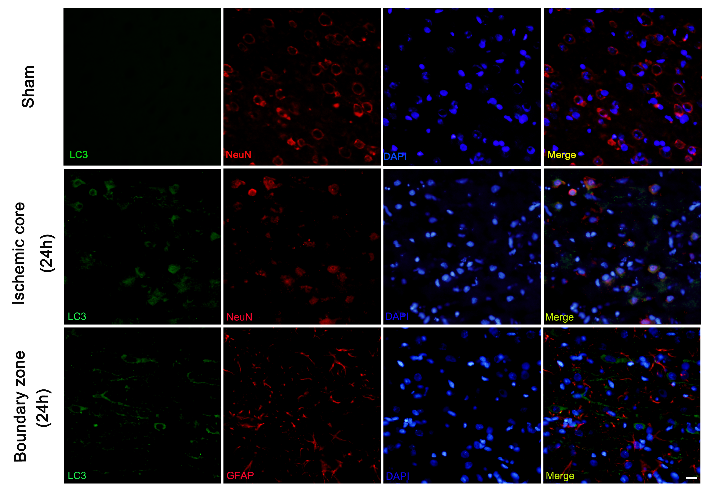
Complementary Figure3：the cellular location of autophagy in the MCAO/R model rats’ brain tissues
Label the brain cells by LC3、NeuN、GFAP and DAPI, respectively representing autophagy, neurons, astrocytes and nucleus.
Scale bar = 50μm.

Slide 5
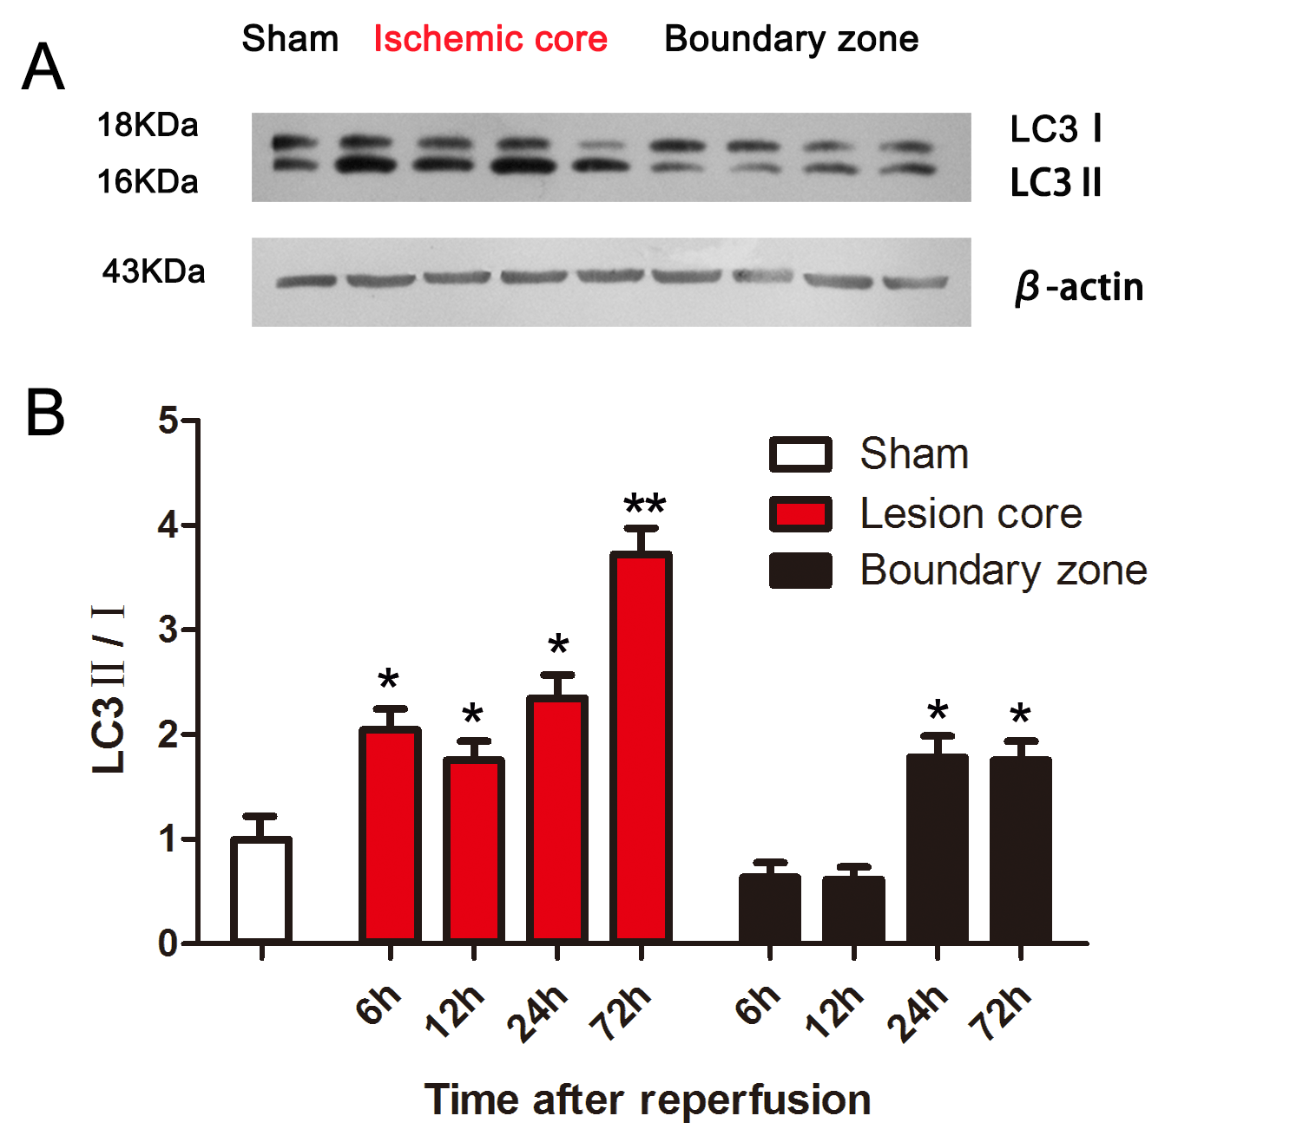
Complementary Figure4：the expression change of LC3-II/I in the MCAO/R model rats’ brain tissues
A： Expression of LC3-II/I by Western blot method；analysis of LC3-I and LC3-II gray value. The data was showed as mean ± SD ，*compared to the relative control group，P﹤0.05，** compared to the relative control group ，P<0.01， All the data are from four independent assays(n=4), one-way ANOVA analysis was used .

