Slide 1
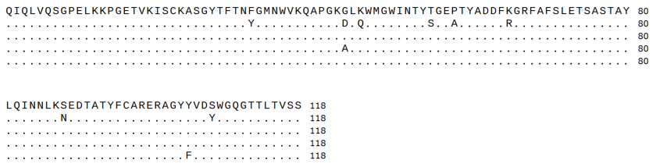
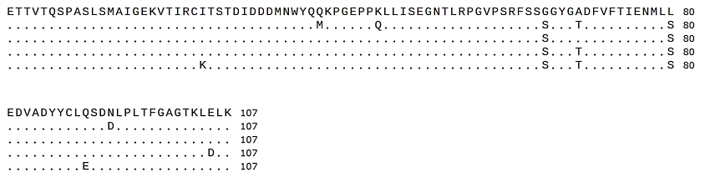
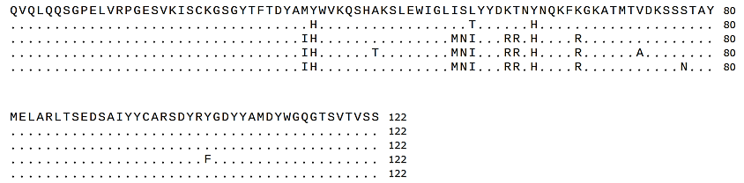
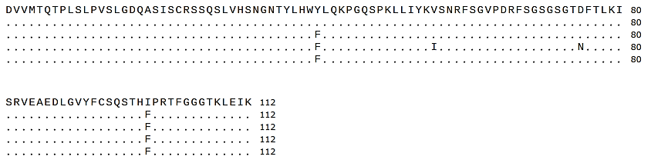
a
AGP-R1
1
HFR1
HCDR1
HFR2
HCDR2
HFR3
80
AGP-R7
1
80
AGP-R12
1
80
AGP-R15
1
80
AGP-R17
1
80
AGP-R1
81
HCDR3
HFR4
118
AGP-R7
81
118
AGP-R12
81
118
AGP-R15
81
118
AGP-R17
81
118
b
AGP-R1
1
LFR1
LCDR1
LFR2
LCDR2
LFR3
80
AGP-R7
1
80
AGP-R12
1
80
AGP-R15
1
80
AGP-R17
1
80
AGP-R1
81
LCDR3
LFR4
107
AGP-R7
81
107
AGP-R12
81
107
AGP-R15
81
107
AGP-R17
81
107
c
AGP-R4
1
HFR1
HCDR1
HFR2
HCDR2
HFR3
80
AGP-R5
1
80
AGP-R11
1
80
AGP-R20
1
80
AGP-R22
1
80
AGP-R4
81
HCDR3
HFR4
122
AGP-R5
81
122
AGP-R11
81
122
AGP-R20
81
122
AGP-R22
81
122
d
LFR1
LCDR1
LFR2
LCDR2
LFR3
AGP-R4
1
80
AGP-R5
1
80
AGP-R11
1
80
AGP-R20
1
80
AGP-R22
1
80
AGP-R4
81
LCDR3
LFR4
112
AGP-R5
81
112
AGP-R11
81
112
AGP-R20
81
112
AGP-R22
81
112
Extended Data Fig. 1. Comparison of amino acid sequences of VH and VL among AGP-R mAbs
a, b, Amino acid sequences of the VH (a) and VL (b) regions of R1-group mAbs. c, d, Amino acid sequences of the VH (c) and VL (d) regions of R4- and R11-group mAbs.
Extended Data Fig. 1

Slide 2
OD₄₅₀ nm
Ab concentration (μg/mL)
Extended Data Fig. 2. Binding activity of AGP-R mAbs to GPs of MARV, RAVV, and EBOV
The binding profiles of AGP-R mAbs were examined using ELISA with purified GP antigens from MARV-Angola, RAVV, or EBOV. Data represents the mean ± standard errors of three independent experiments.
Extended Data Fig. 2

Slide 3
Lineage A
MARV Angola-20051379
MARV Ghana/2022
MARV Equatorial Guinea 2023
0.0159
0.0133
0.0299
0.0790
0.0272
Lineage B
MARV Musoke
MARV Ci67
0.0452
Lineage C
MARV 05DRC99
MARV 01Uga07
MARV 07DRC99
0.1436
Lineage D
RAVV Kenya 1987
RAVV Uganda 200703648
RAVV Uganda 02Uga07
Extended Data Fig. 3. Phylogenetic analysis of MARV and RAVV GP amino acid sequences
The phylogenetic tree was constructed in MEGA 11 using the maximum-likelihood method with the Jones-Taylor-Thornton model. Four major lineages are indicated by colored brackets: lineage A (red), representing the West African lineage (e.g., Angola-20051379 and Ghana/2022); lineage B (yellow), representing the East African lineage (e.g., Musoke and Ci67); lineage C (blue), representing the Central African lineage (e.g., 05DRC99, 01Uga07, and 07DRC99); and cluster D (gray), representing the divergent RAVV lineage. The scale bar indicates the number of amino acid substitutions per site. GenBank accession numbers precede the names of the virus strains. The Equatorial Guinea 2023 sequence was obtained from: https://virological.org/t/first-emergence-of-marburg-virus-in-equatorial-guinea-2023/924.
Extended Data Fig. 3

Slide 4
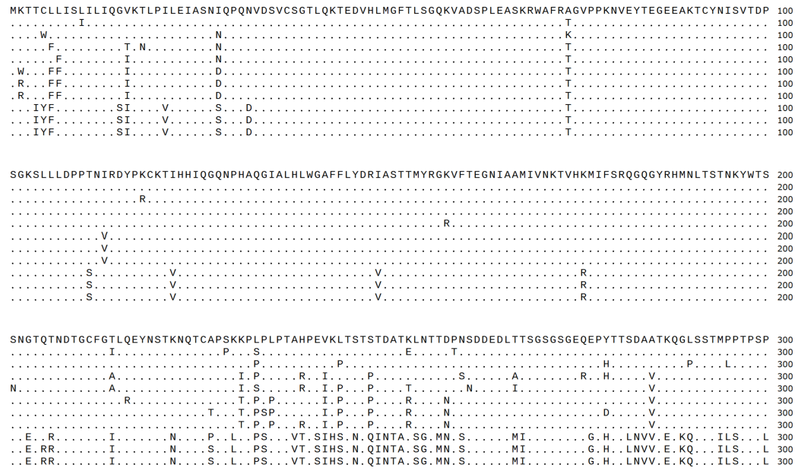
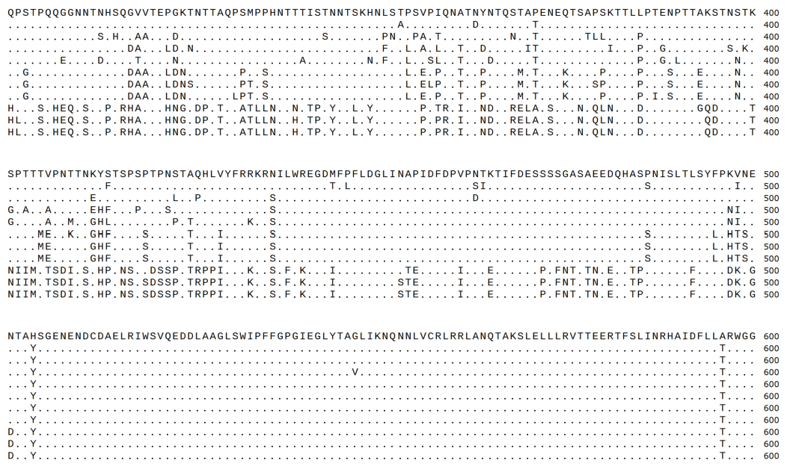
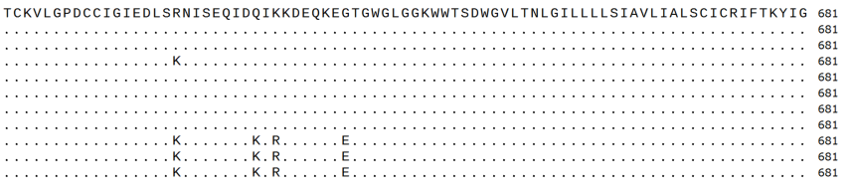
MARV Angola-20051379
1
100
MARV Ghana/2022
1
100
MARV Equatorial Guinea 2023
1
100
MARV Musoke
1
100
MARV Ci67
1
100
MARV 07DRC99
1
100
MARV 01Uga07
1
100
MARV 05DRC99
1
100
RAVV Kenya 1987
1
100
RAVV Uganda 200703648
1
100
RAVV Uganda 02Uga07
1
RBD
100
MARV Angola-20051379
101
200
MARV Ghana/2022
101
200
MARV Equatorial Guinea 2023
101
200
MARV Musoke
101
200
MARV Ci67
101
200
MARV 07DRC99
101
200
MARV 01Uga07
101
200
MARV 05DRC99
101
200
RAVV Kenya 1987
101
200
RAVV Uganda 200703648
101
200
RAVV Uganda 02Uga07
101
RBD
200
MARV Angola-20051379
201
300
MARV Ghana/2022
201
300
MARV Equatorial Guinea 2023
201
300
MARV Musoke
201
300
MARV Ci67
201
300
MARV 07DRC99
201
300
MARV 01Uga07
201
300
MARV 05DRC99
201
300
RAVV Kenya 1987
201
300
RAVV Uganda 200703648
201
300
RAVV Uganda 02Uga07
201
Glycan cap
300
MARV Angola-20051379
301
500
MARV Ghana/2022
301
500
MARV Equatorial Guinea 2023
301
500
MARV Musoke
301
500
MARV Ci67
301
500
MARV 07DRC99
301
500
MARV 01Uga07
301
500
MARV 05DRC99
301
500
RAVV Kenya 1987
301
500
RAVV Uganda 200703648
301
500
RAVV Uganda 02Uga07
301
MLD
500
MARV Angola-20051379
401
500
MARV Ghana/2022
401
500
MARV Equatorial Guinea 2023
401
500
MARV Musoke
401
500
MARV Ci67
401
500
MARV 07DRC99
401
500
MARV 01Uga07
401
500
MARV 05DRC99
401
500
RAVV Kenya 1987
401
500
RAVV Uganda 200703648
401
500
RAVV Uganda 02Uga07
401
MLD
500
MARV Angola-20051379
501
600
MARV Ghana/2022
501
600
MARV Equatorial Guinea 2023
501
600
MARV Musoke
501
600
MARV Ci67
501
600
MARV 07DRC99
501
600
MARV 01Uga07
501
600
MARV 05DRC99
501
600
RAVV Kenya 1987
501
600
RAVV Uganda 200703648
501
600
RAVV Uganda 02Uga07
501
IFL
HR1
600
MARV Angola-20051379
601
681
MARV Ghana/2022
601
681
MARV Equatorial Guinea 2023
601
681
MARV Musoke
601
681
MARV Ci67
601
681
MARV 07DRC99
601
681
MARV 01Uga07
601
681
MARV 05DRC99
601
681
RAVV Kenya 1987
601
681
RAVV Uganda 200703648
601
681
RAVV Uganda 02Uga07
601
HR2
681
Extended Data Fig. 4. Multiple sequence alignment of MARV and RAVV GP amino acid sequences
The GP amino acid sequences from MARV strains Angola-20051379, Ghana/2022, Equatorial Guinea 2023, Musoke, Ci67, 07DRC99, Uganda 01Uga07, 05DRC99, Uganda 200703648, Uganda 02Uga07, and RAVV were subjected to multiple sequence alignments using MUSCLE in MEGA11. Amino acid residues conserved with the MARV Angola-20051379 reference are indicated by dots.
Abbreviations: RBD, receptor-binding domain; MLD, mucin-like domain; IFL, internal fusion loop; HR1/HR2; heptad-repeat regions 1 and 2.
Extended Data Fig. 4

