Slide 1
Loss of Beclin 1 Primes Colorectal Cancer Cells for Immunogenic Necroptosis via Transcriptional De-Repression of RIPK1/RIPK3/MLKL Axis
Molecular Biology Reports
Dr Hatice Esenkaya*
*Corresponding author: *correspondance Address: Karolinska institute, H5 Laboratoriemedicin, H5 BCM El Andaloussi, 141 52 Huddinge, Email: hatice.esenkaya@ki.se
Contents
Western full images
RGB greyscale conversion
Inversion
Western blot
Western quantification
qRT-PCR analysis
Figure Online resource 2

Slide 2
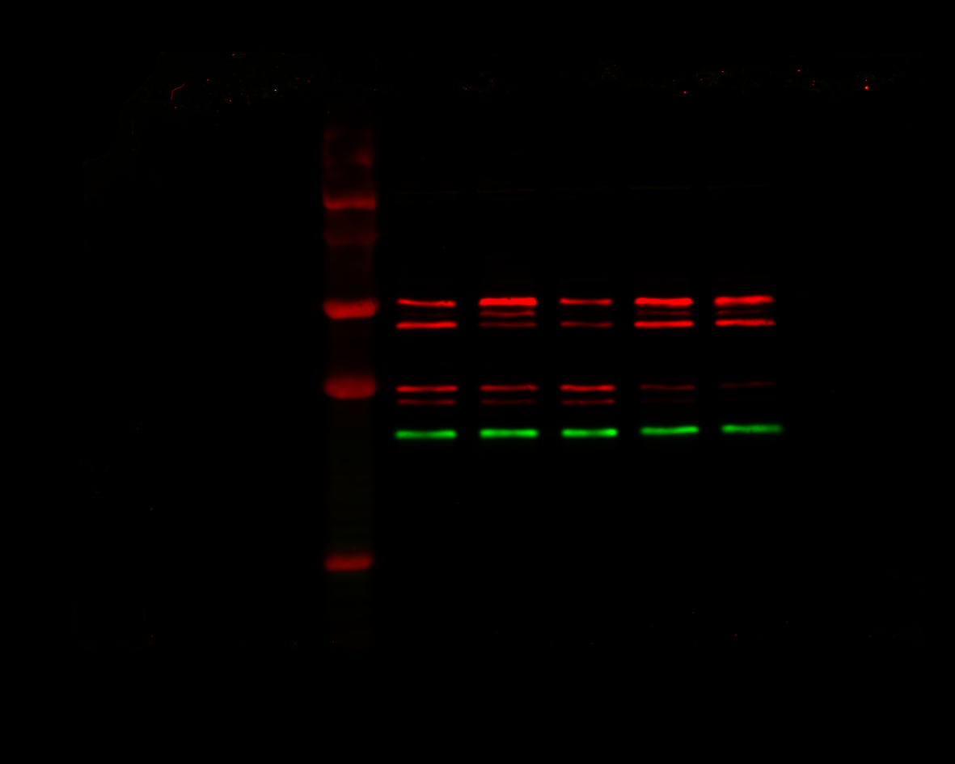
B
Control
Si-KD
Si-KD
Control
Control
pRIPK1 75 kDa
A
Beclin 1 60 kDa
Control
Control
Control
Si-KD
Si-KD
pRIPK3 55 kDa
pRIPK1 75 kDa
Beta actin 42kDa
Beclin 1 60 kDa
Control
Si-KD
Si-KD
Control
Beta actin 42kDa
Control
C
Beclin 1 60 kDa
pMLKL 54 kDa
Beta actin 42kDa
Fluorescence western blots

Slide 3
Red
Green
A
B
C
Fluorescence western blots – greyscale
With Image J

Slide 4
Greyscale- inverted
Red
Green
A
B
C
Fluorescence western blots – greyscale- inverted
With ImageJ

Slide 5
Si-Knockdown (KD)
pRIPK1 75 kDa
Control
Beclin 1 60 kDa
Beta actin 42kDa
pRIPK1 75 kDa
Si-KD
Control
Beclin 1 60 kDa
Control
pRIPK3 55 kDa
Beta actin 42kDa
Control
Si-KD
Beclin 1 60 kDa
Control
pMLKL 54 kDa
Beta actin 42kDa
Greyscale- inverted westerns - figure

Slide 6
A
P = 0.054
P = 0.014
B
P = 0.5
P = 0.2
P = 0.0008
C
P = 0.4
P = 0.015
Greyscale- inverted – figures- quantifications
See page 2 and 3 of online resource 1 excel

Slide 7
A
B
C
Combined qPCR data (n=3)
qPCR figures
Biological q PCR replicates
See page 4 of online resource 1 excel

Slide 8
Si-KD
A
pRIPK1 75 kDa
Control
B
C
Beclin 1 60 kDa
P = 0.054
P = 0.014
Beta actin 42kDa
pRIPK1 75 kDa
Si-KD
Control
Beclin 1 60 kDa
Control
P = 0.5
P = 0.2
pRIPK3 55 kDa
P = 0.0008
Beta actin 42kDa
Control
Si-KD
Beclin 1 60 kDa
Control
P = 0.4
pMLKL 54 kDa
P = 0.015
Beta actin 42kDa
Online Resource 2

Slide 9
Online Resource 2: siRNA reduces Beclin 1 expression at the protein and mRNA levels. A) Western blots showing Beclin1 in standard control conditions and upon SiRNA-knockdown (Si-Kd). B) quantification of Westerns in A. Significance value displayed from a one-tailed T.test assuming unequal variances. Error bars show standard error of the mean (SEM). (n=3). C) RT-qPCR results showing mRNA fold change after siRNA knockdown relative to control (normal conditions) and Act1 mRNA (red dashed line). Coloured x represent the values of the three biological replicates. Error bars show standard error of the mean (SEM). (n=3).

