Slide 1
Figure 2J
p-P65
p-IKBa
t-P65
Actin
DMSO
LPS
Co68
DMSO
LPS
Co68
DMSO
LPS
Co68
LPS
Co68
LPS-Co68
LPS-Co68
LPS-Co68
DMSO
LPS-Co68

Slide 2
Figure 6K
p-P65
Actin
p-IKBa
DMSO
LPS
Co68
DMSO
LPS
Co68
LPS
LPS-Co68
LPS-Co68
DMSO
Co68
LPS-Co68

Slide 3
Figure 6N
TLR4
STAT1
SYK
LPS
Co68
DMSO
LPS
Co68
DMSO
LPS
Co68
DMSO
LPS-Co68
LPS-Co68
LPS-Co68

Slide 4
Supplementary Figure 2E
pTBK1
pIRF3
tIRF3
tTBK1
Actin
DMSO
DMSO
DMSO
DMSO
DMSO
Co68-10μM
Co68-10μM
Co68-10μM
Co68-10μM
Co68-100μM
Co68-100μM
Co68-10μM
Co68-100μM
Co68-100μM
Co68-100μM

Slide 5
Supplementary Figure 2I
iNOS
Cox2
Actin
LPS
Co68
DMSO
LPS
Co68
DMSO
LPS-Co68
LPS-Co68
DMSO
LPS
Co68
LPS-Co68

Slide 6
Figure 3A and 3D
Figure 3D
Figure 3A

Slide 7
Figure 3G and 3J
Figure 3G
Figure 3J

Slide 8
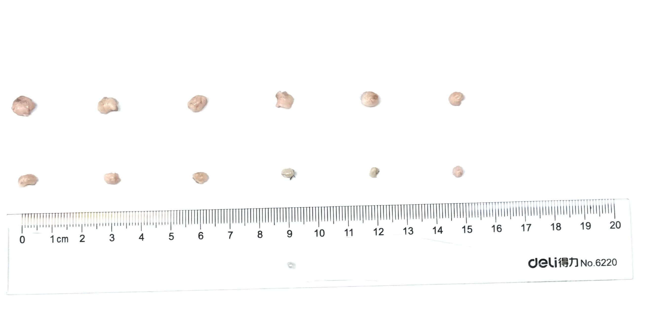
Supplementary Figure 3D and 3G
Figure S3D
Figure S3G

Slide 9
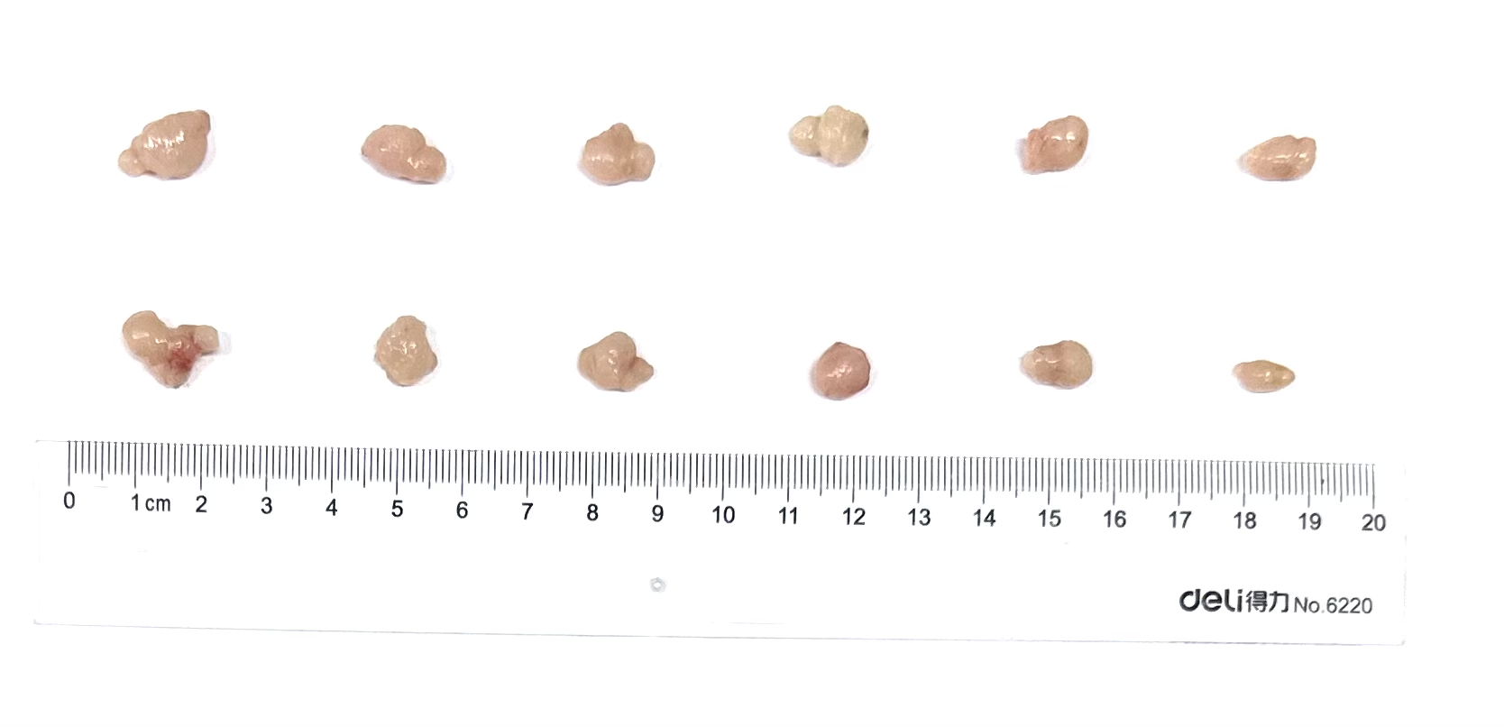
Supplementary Figure 6G-H
Figure S6G
Figure S6H

Slide 10
Supplementary Figure 7M-7P
SYK
TLR4
Actin
WCL-LPS
DMSO
LPS
Co68
KO
WT
KO
WT
WCL-DMSO
WCL-Co68

Slide 11
Supplementary Figure 7Q
p-P65
Actin
p-IKBa
LPS
Co68
LPS
Co68
LPS
LPS-Co68
LPS-Co68
LPS-Co68
Co68

