Slide 1
SUPPLEMENTARY FIGURES Protein kinase CK2α’ as a Dual Modulator of Neuroimmune Signaling and Synaptic Dysfunction in Tauopathy
Angel White, Peter Gavrilyuk, Rafael Falcon Moya, Reid Thurston, Amal Fickak, Nicholas B Rozema, Prarthana Keshavaram, Scott Vermilyea, Riley Schlichte, Joyce Meints, Ying Zhang, Alfonso Araque, Michael Lee, Rocio Gomez-Pastor

Slide 2
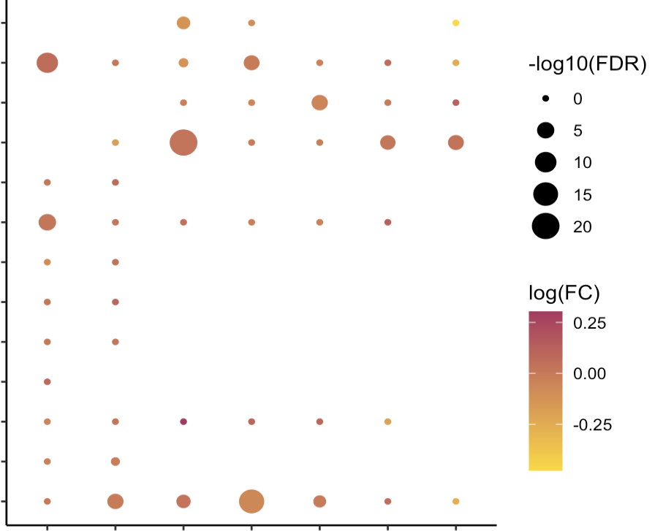
OPC
-log10(FDR)
Oligodendrocyte
0
Neuron (Inh)
5
Neuron (Ex)
10
Neuron
15
Microglia
20
Macrophage
log(FC)
Lymphocyte
0.25
Fibroblast
0.00
Excitatory neuron
Endothelial
-0.25
Astrocyte (Dis)
Astrocyte
Leng et al: EC
Gerrits et al: OL
Leng et al: SFG
Gerrits et al: OTC
Lau et al: PFC (F)
Lau et al: PFC (M)
Otero-Garcia et al: PFC
Supplementary Figure 1. CSNK2a2 scRNA-seq expression in human brain tissue. (A) Summary of CSNK2a2 single cell expression from studies found in The Alzheimer's Cell Atlas (TACA) in occipital lobe (OL), occipitotemporal cortex (OTC), entorhinal cortex (EC), superior frontal gyrus (SFG), and prefrontal cortex (PFC). Absence of expression for a cell type indicates that cell type was not identified as a cluster in the study.
Supplementary Figure1

Slide 3


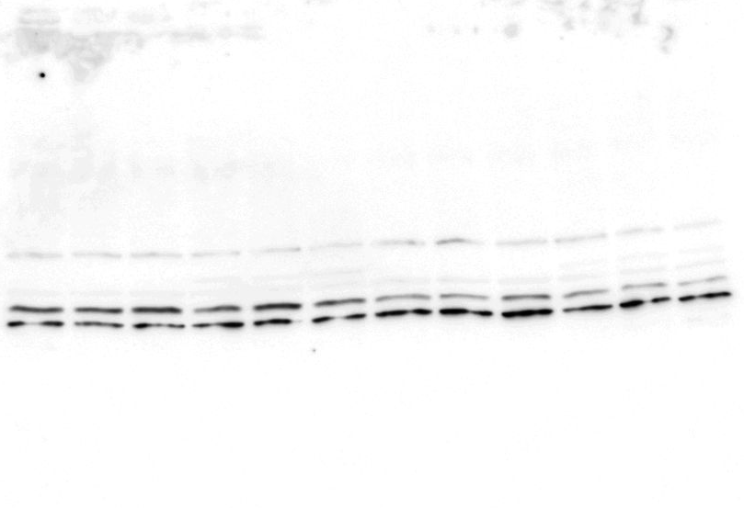
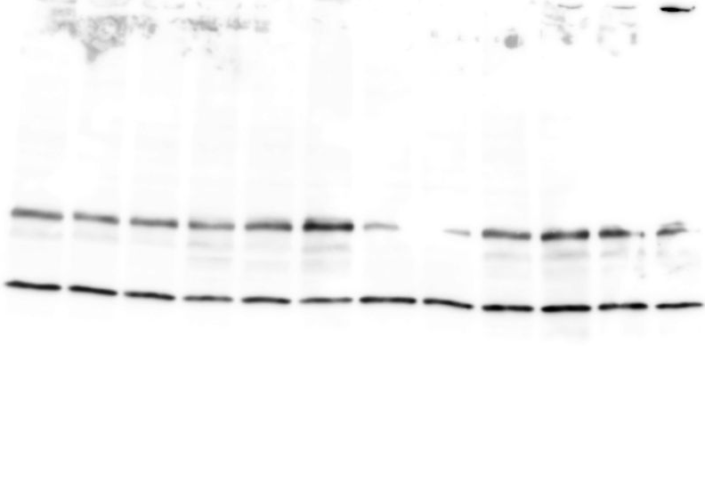
A)
C)
D)
PS19
CK2α’^{(+/-)}
1.5
*
1.5
***
X
1.0
1.0
CK2α’ protein levels
(relative to WT)
CK2α’ protein levels
(relative to PS19)
B)
PS19;
CK2α’^{(+/-)}
0.5
0.5
WT
PS19
CK2α’^{(+/-)}
0.0
0.0
WT
CK2α’^{(+/-)}
PS19
E)
F)
PS19;
CK2α’^{(+/-)}
1.5
***
2.0
**
1.0
1.5
CK2α’ expression
(relative to WT)
CK2α’ expression
(relative to PS19)
0.5
1.0
CK2α’
0.5
*
0.0
WT
CK2α’^{(+/-)}
0.0
PS19
PS19;
CK2α’^{(+/-)}
G)
PS19
WT
CK2α’^{(+/-)}
PS19;CK2α’^{(+/-)}
100
GAPDH
Probability of Survival (%)
50
0
0
20
40
60
Weeks
Supplementary Figure 2. Generation of a CK2α’ haploinsufficient tauopathy model. (A) The PS19 mouse model was crossed with mice haploinsufficient for CK2α’ (Illustration from NIAID NIH BIOART Source (bioart.niaid.nih.gov/bioart/283 & bioart.niaid.nih.gov/bioart/281). (B) CK2α’ immunoblotting in the hippocampus of symptomatic mice (Uncropped blots are shown). (C, D) Quantification of CK2α’ levels from B in CK2α’^{(+/-)} mice relative to WT and PS19;CK2α’^{(+/-)} mice relative to PS19 mice in symptomatic hippocampus (n=6 mice/genotype). Arrow (→) indicates CK2α’ band, asterisk (*) indicates unspecific band. (E, F) Relative mRNA expression of CK2α’ in CK2α’^{(+/-)} mice relative to WT and PS19;CK2α’^{(+/-)} mice relative to PS19 mice in the symptomatic hippocampus from qPCR (n=3 mice/genotype). (G) Survival curves up to 60 weeks for all 4 genotypes (n=64-74 mice/genotype). Data are shown as mean ± SEM. Statistical analyses were conducted using unpaired t-test *p<0.05, **p<0.01, ***p<0.001.
Supplementary Figure 2

Slide 4
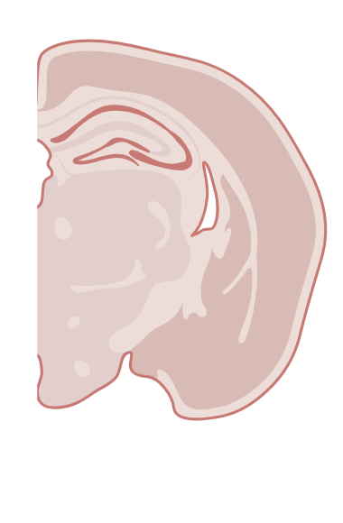
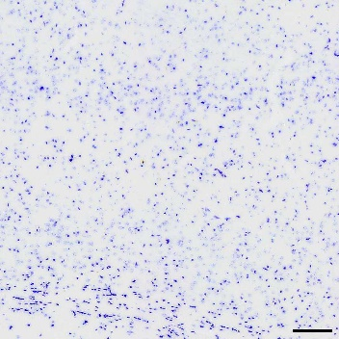
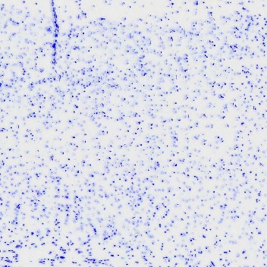
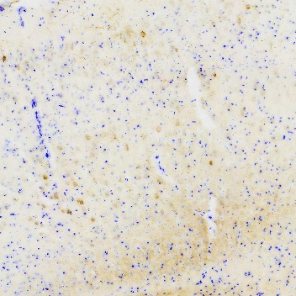
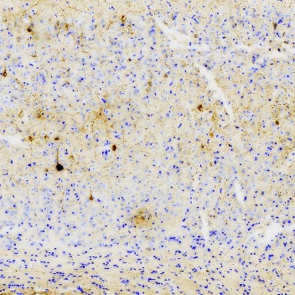
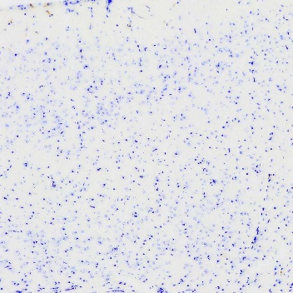
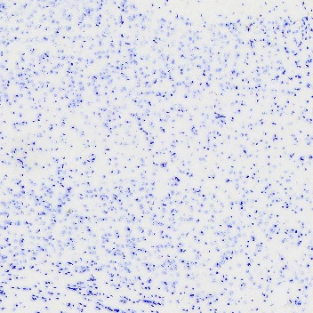
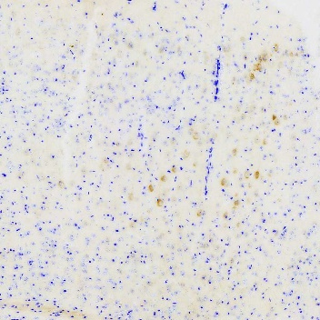
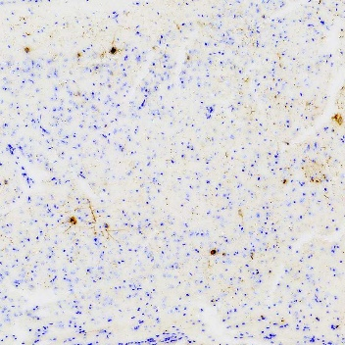
A)
B)
Prodromal
Symptomatic
WT
PS19
C)
15
a
10
b
5
0.5
CK2α’(+/-)
0.4
% Area AT8+
0.3
c
0.2
c
c
0.1
c
c
c
PS19;
CK2α’(+/-)
0.0
Prodromal
Symptomatic
Supplementary Figure 3. PS19;CK2α’(+/-) mice display decreased AT8 staining in the cortex of symptomatic mice. (A) Representative diagram of cortical region imaged for quantification in B and C. (B) Representative images of AT8 staining in the cortex of symptomatic mice. (C) Quantification of % area AT8+ in the cortex of prodromal and symptomatic mice (n=3-7 mice/genotype). Data are shown as mean ± SEM. Statistical analyses were conducted using Two-way ANOVA with Tukey’s post-hoc analysis and displayed with compact letter display. Panel A was created in BioRender (White, A. (2025) https://BioRender.com/eqznm6m).
Supplementary Figure 3

Slide 5
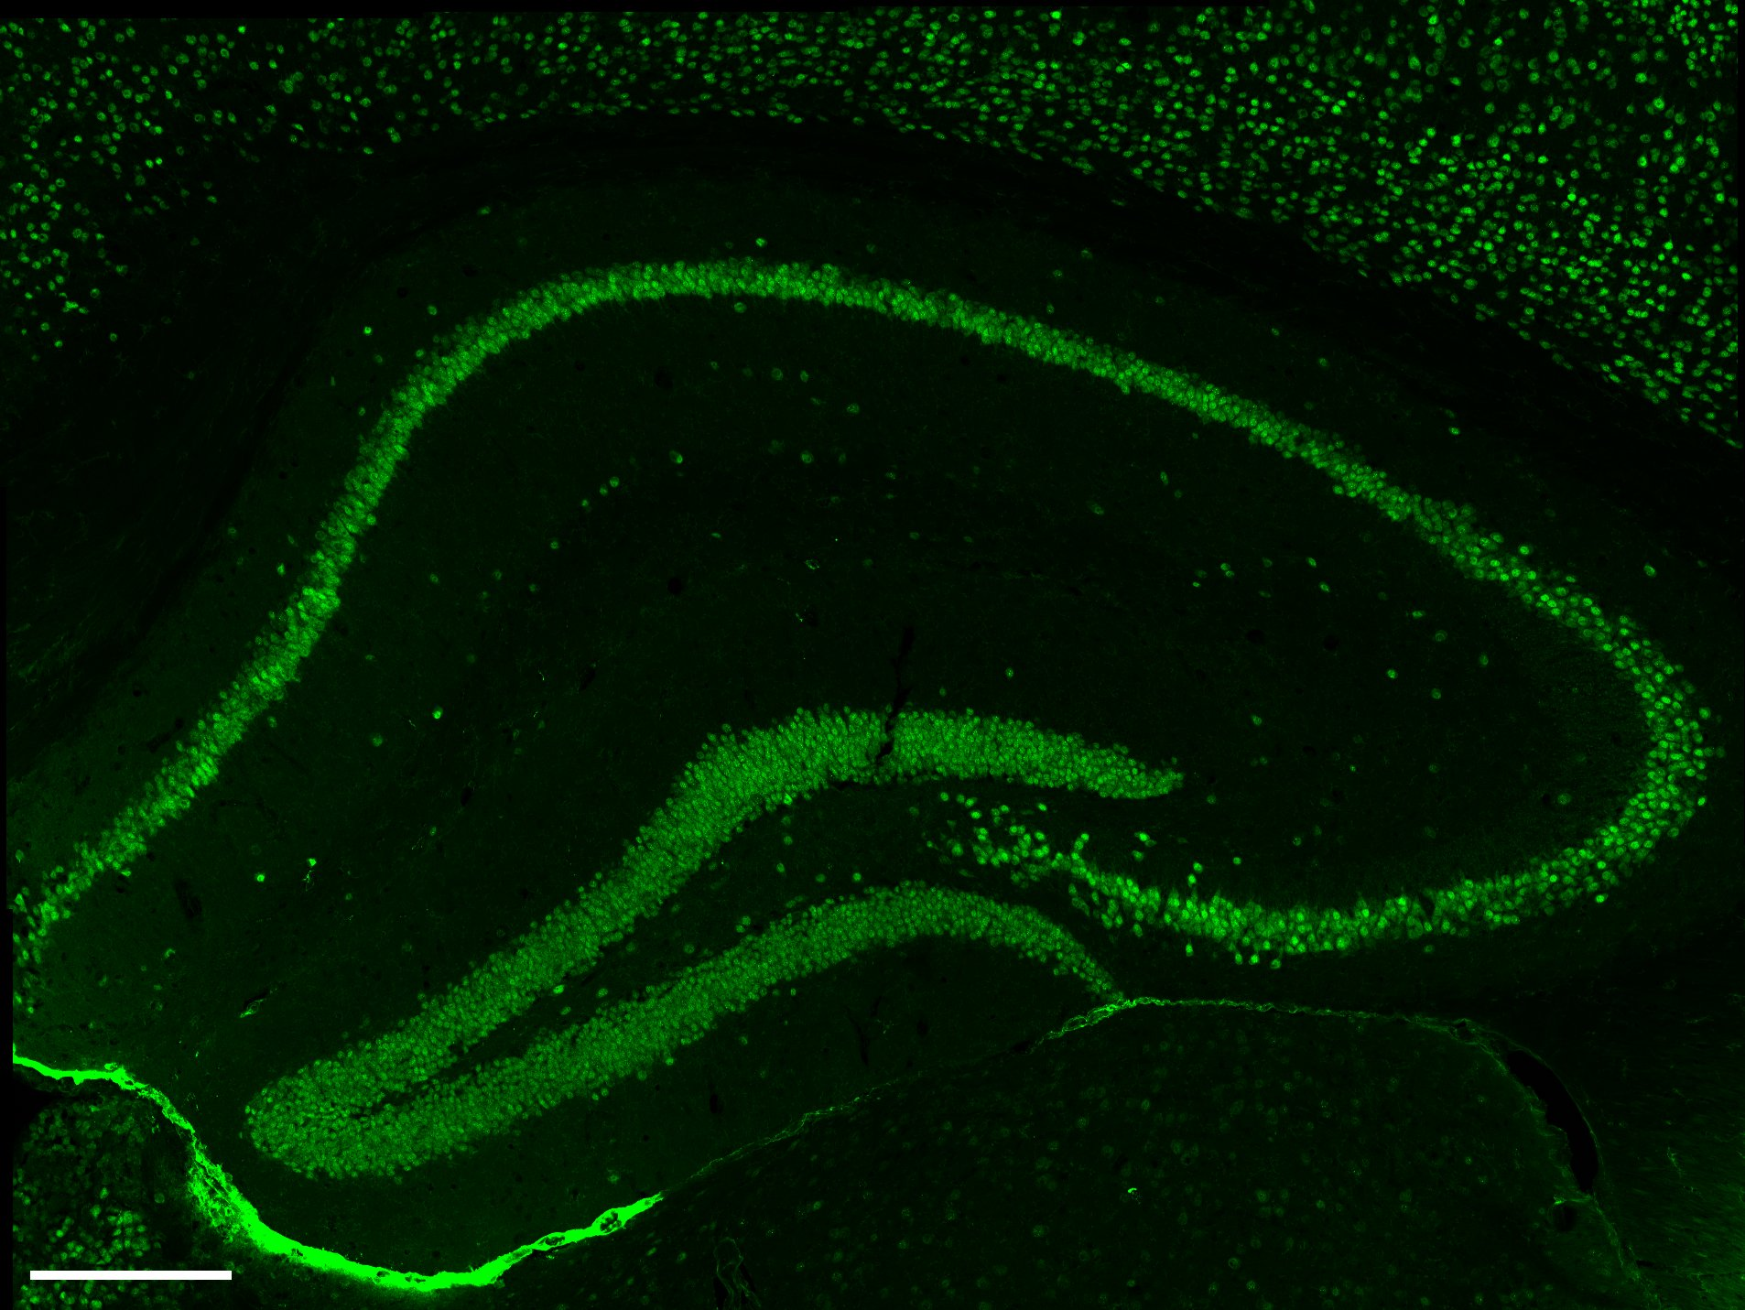
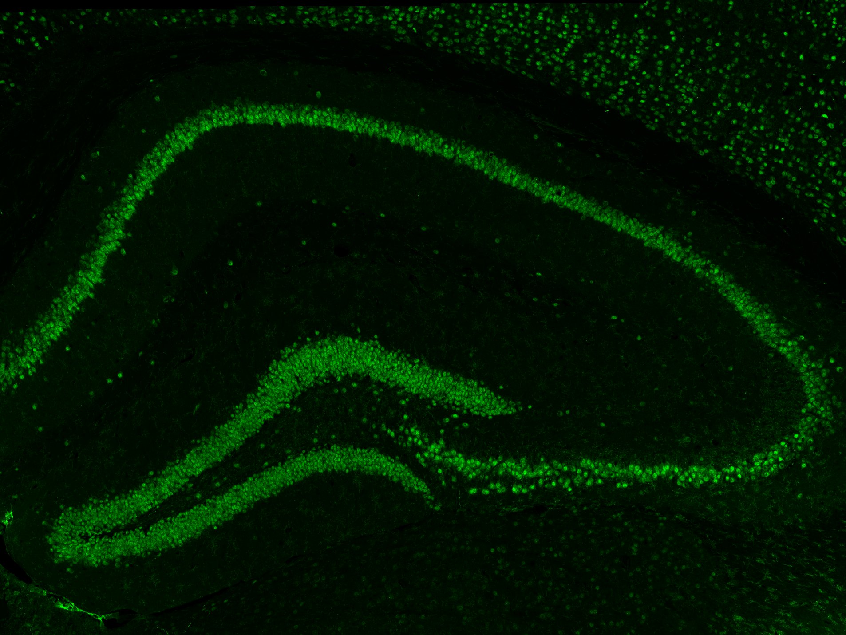
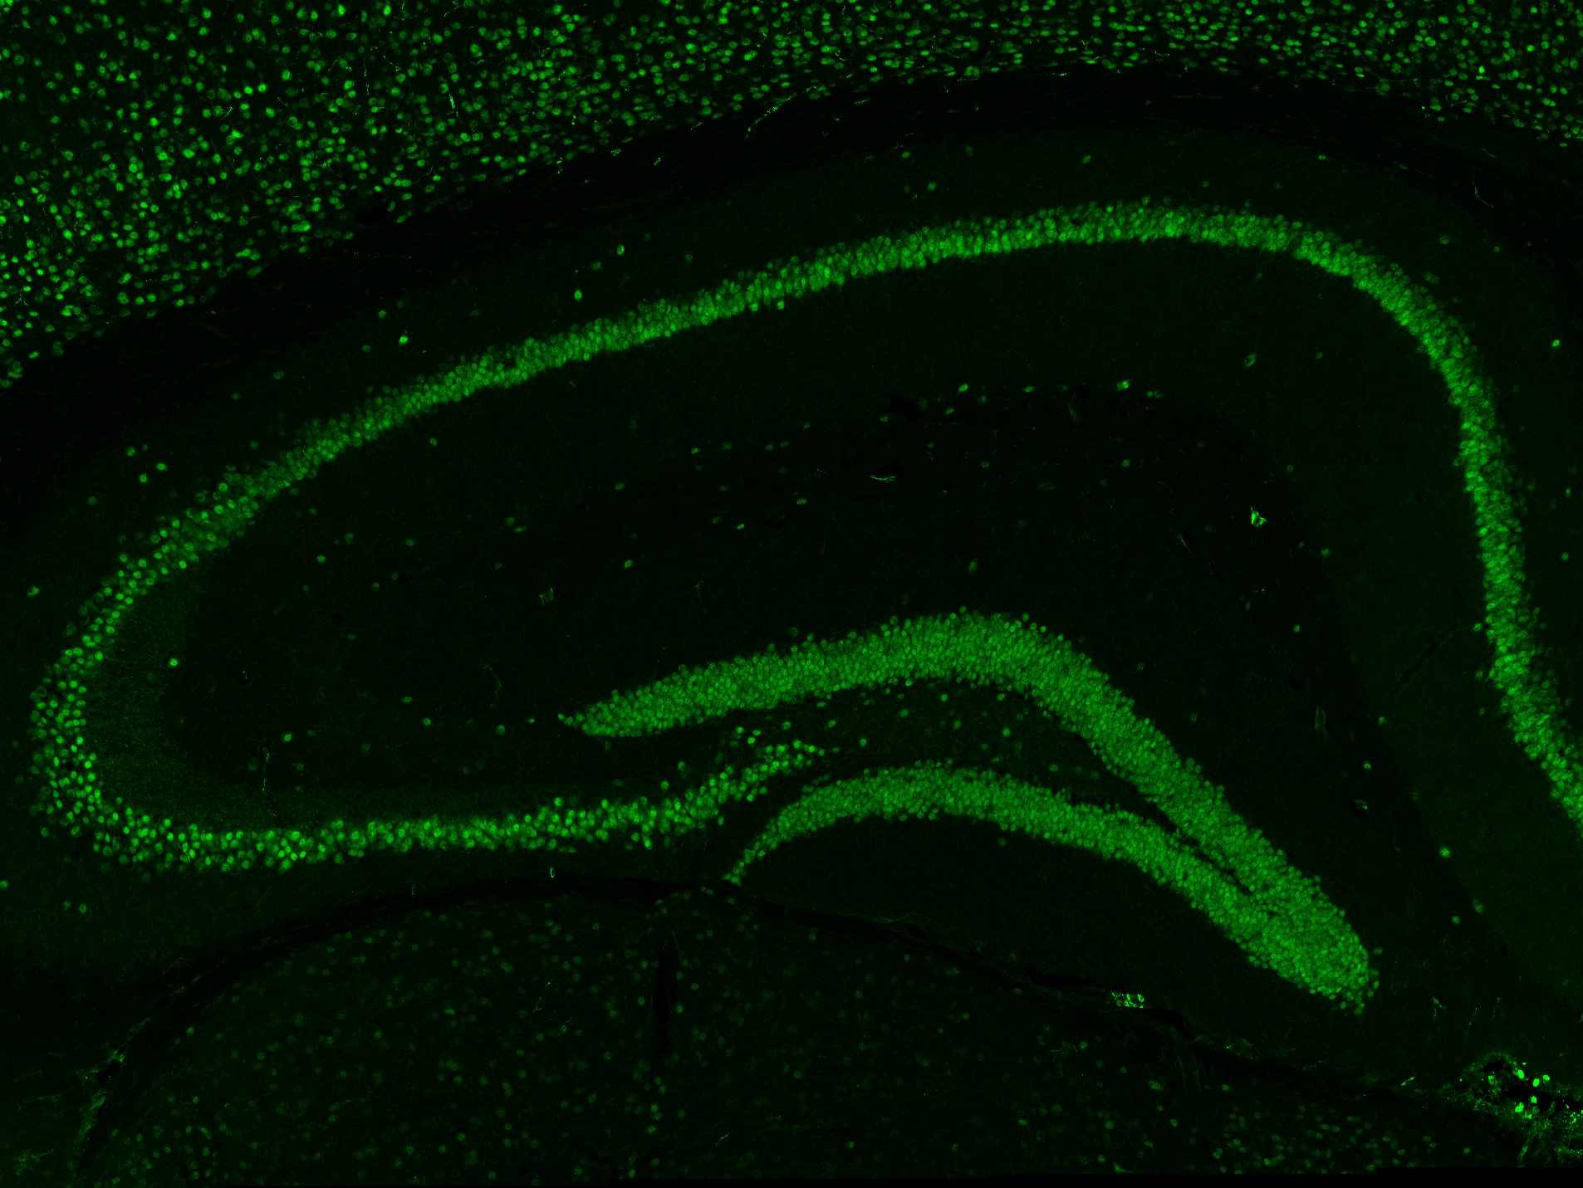
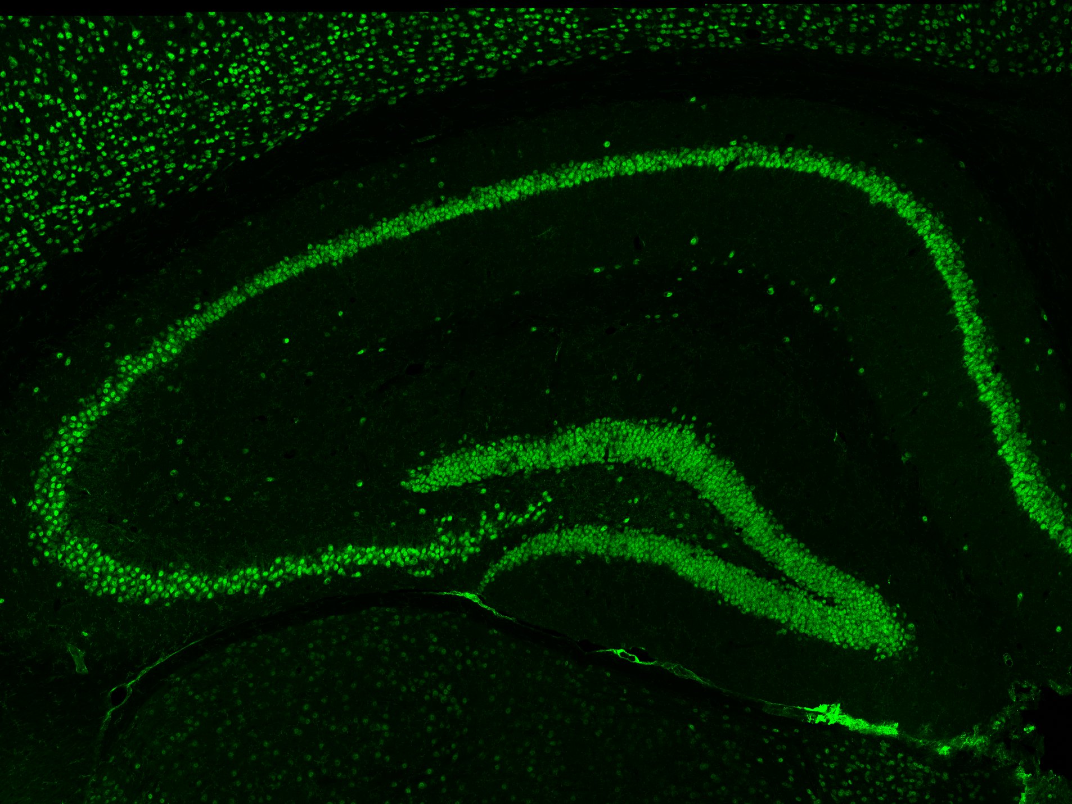
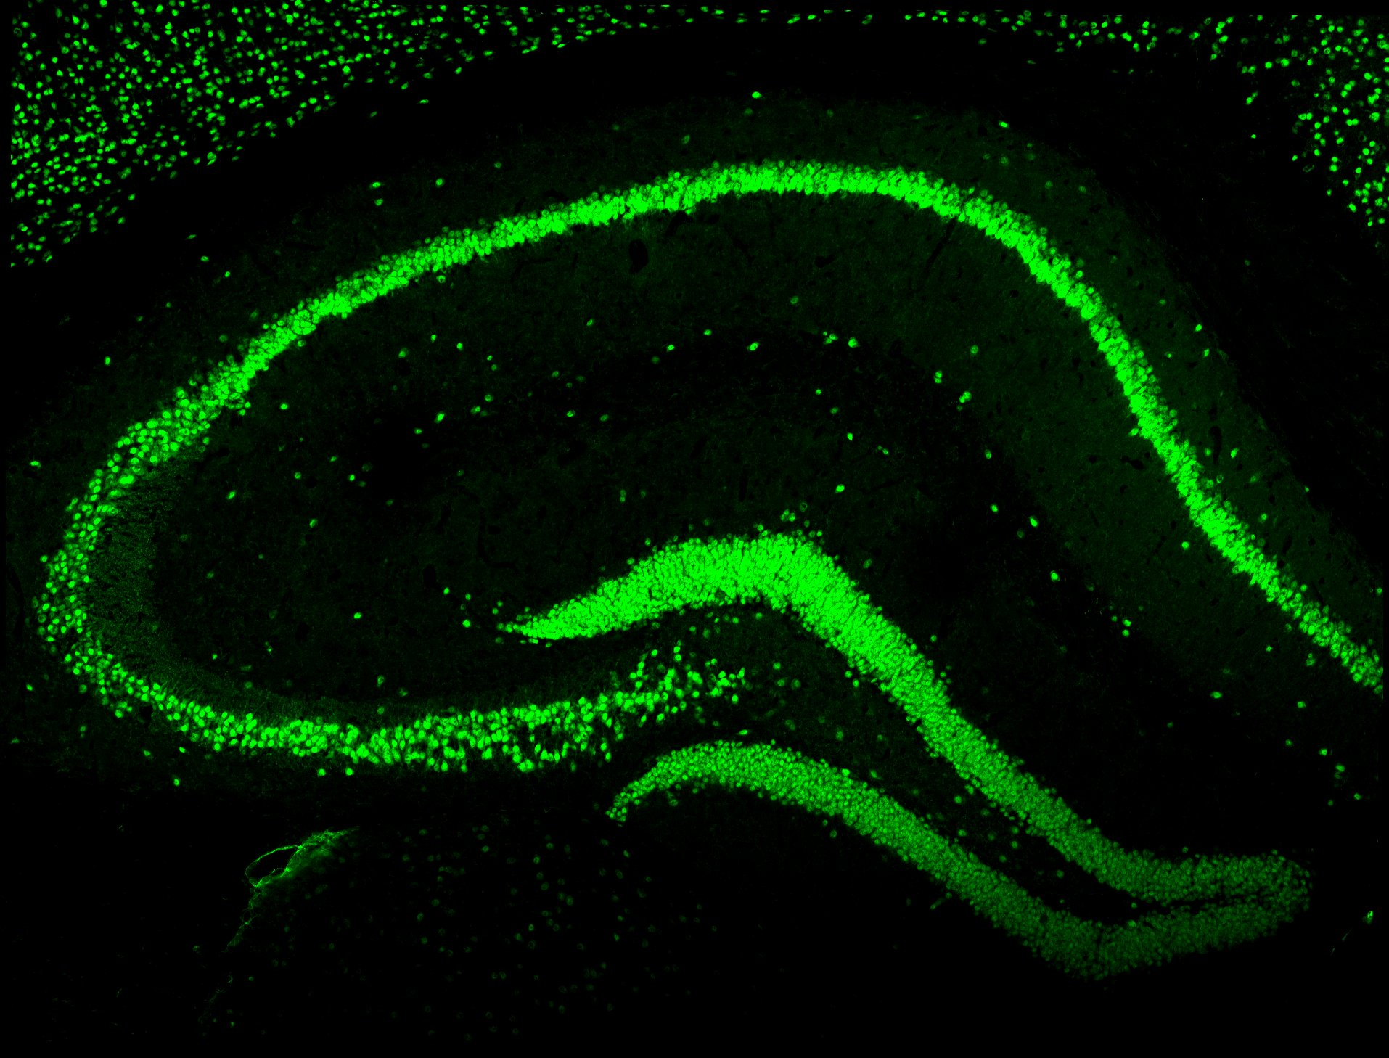
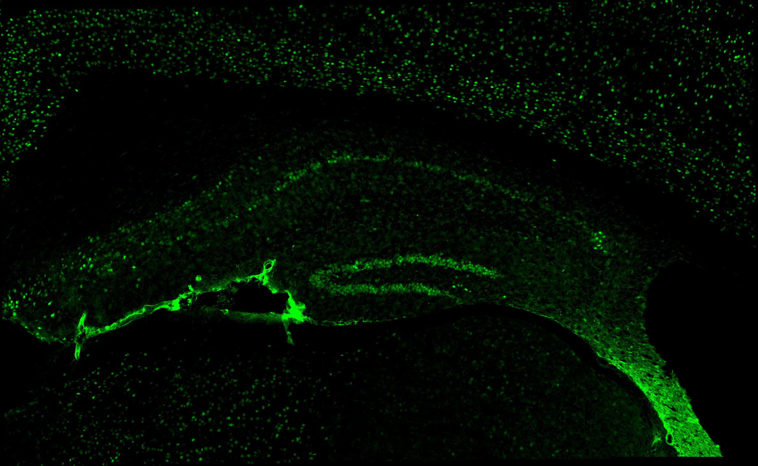
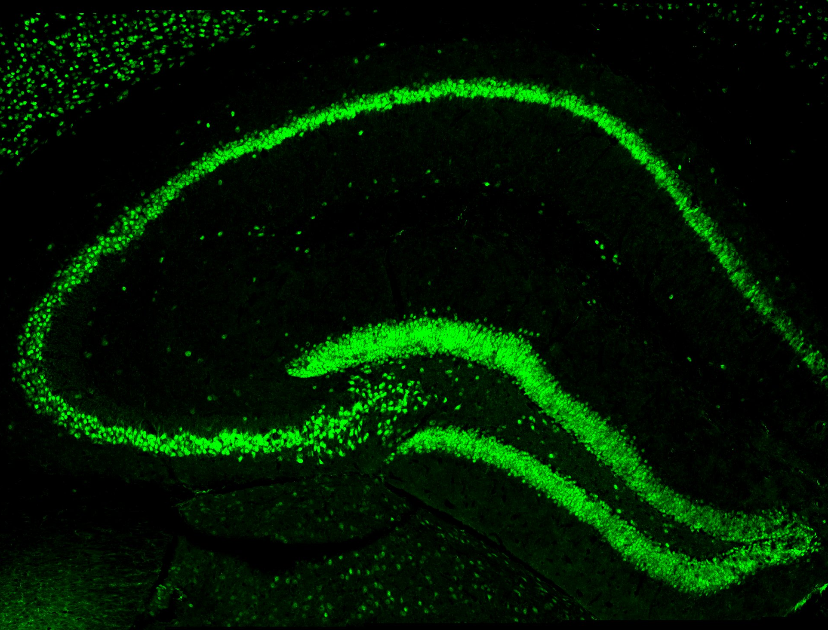
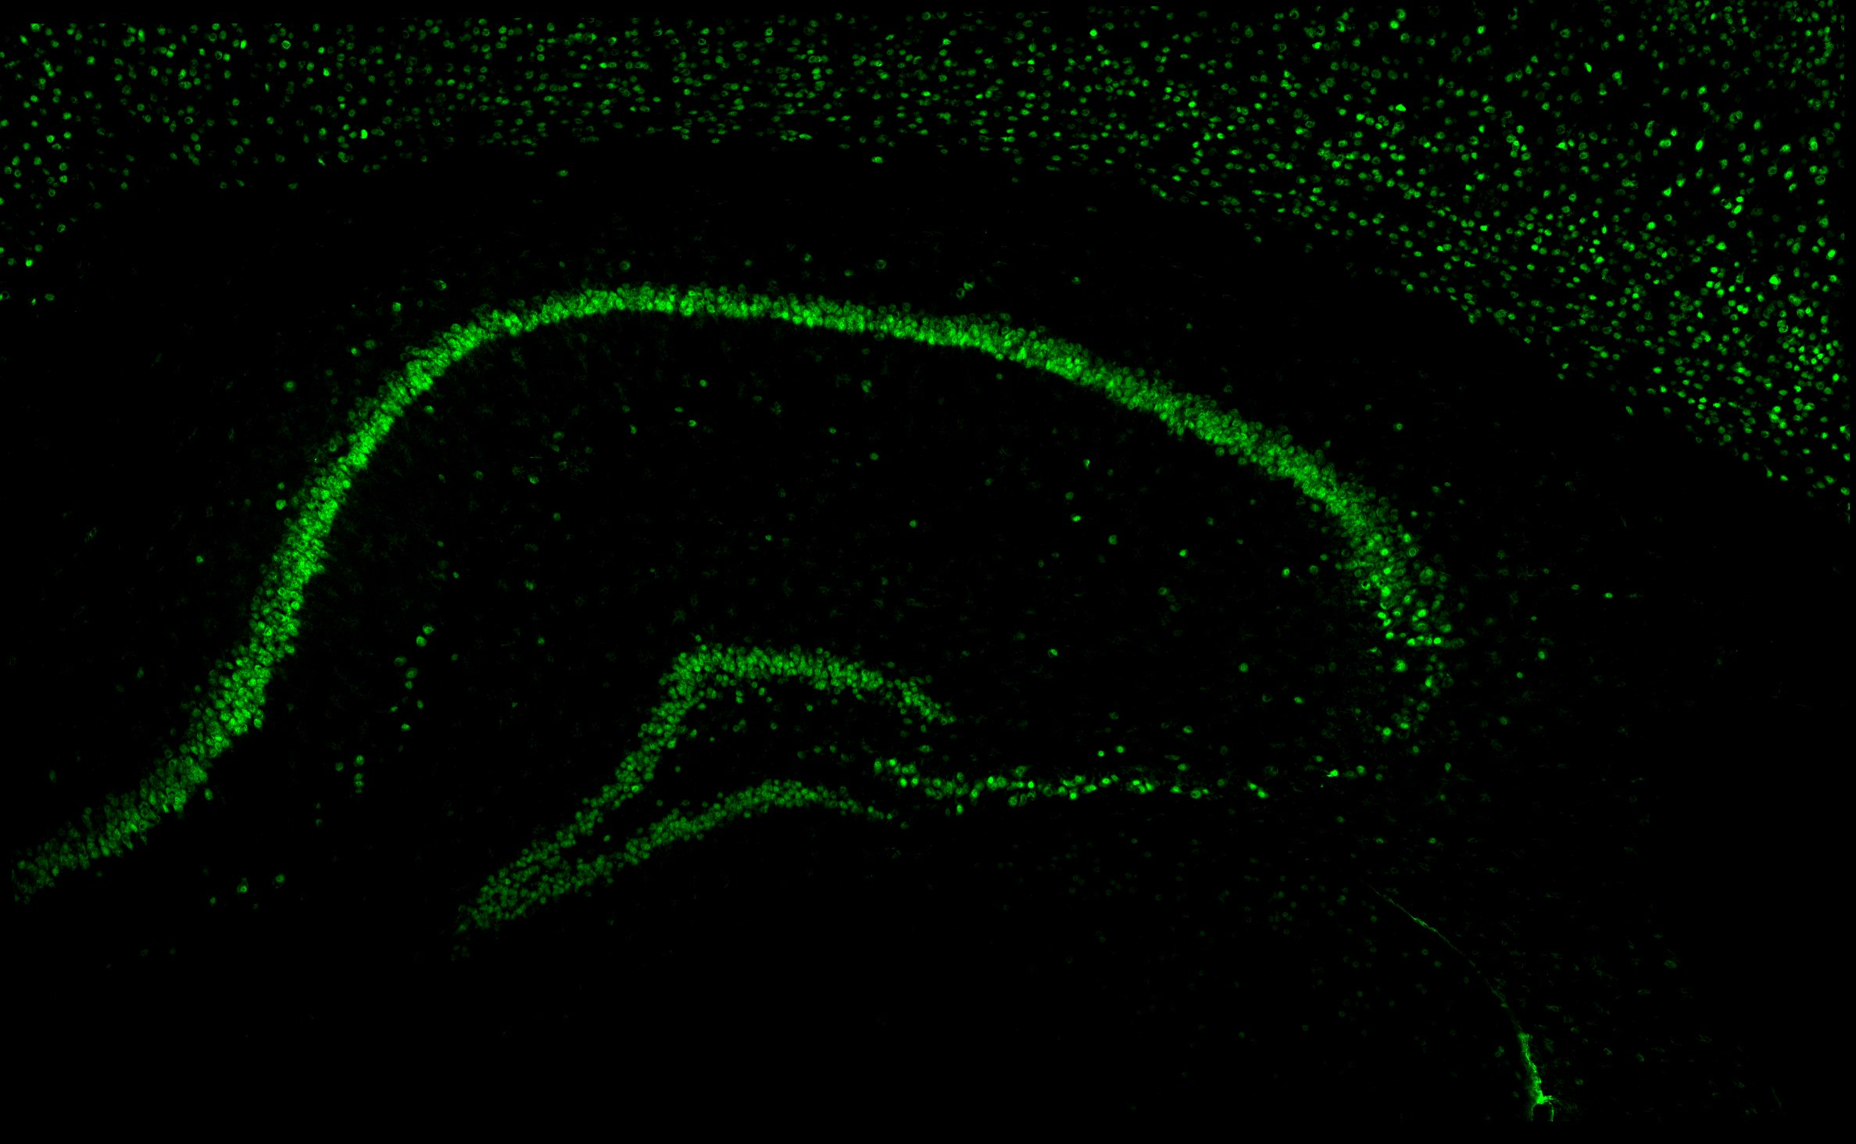
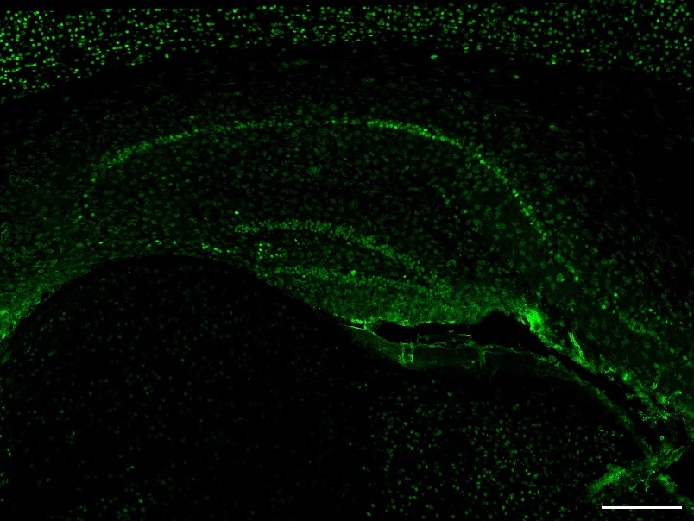
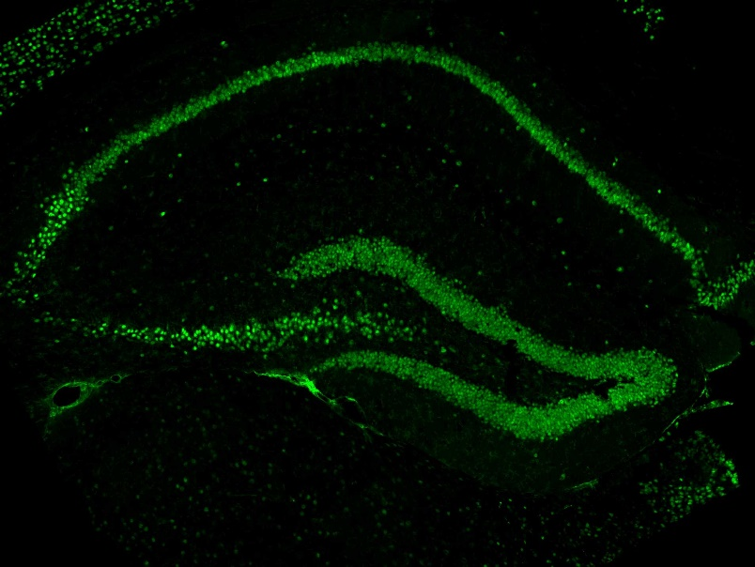
A)
WT
PS19
CK2α’^{(+/-)}
PS19;CK2α’^{(+/-)}
NeuN
CA1
CA1
CA1
CA1
Prodromal
CA3
DG
CA3
DG
CA3
DG
CA3
DG
CA1
CA1
CA1
CA1
Symptomatic
CA3
DG
CA3
DG
CA3
CA3
DG
DG
B)
CA3
C)
DG
WT
PS19
WT
PS19
5000
CK2α’^{(+/-)}
PS19;CK2α’^{(+/-)}
8000
CK2α’^{(+/-)}
PS19;CK2α’^{(+/-)}
a
a
a
a
a
a
a
a
a
a
a
a
4000
6000
b
3000
b
NeuN+ cells/mm²
NeuN+ cells/mm²
4000
b
2000
b
1000
2000
0
Prodromal
Symptomatic
0
Prodromal
Symptomatic
D
Symptomatic
E)
CA1
CA3
DG
NeuN
**
CA1
4000
4000
0.3001
8000
***
3000
3000
6000
“High” PS19
DG
4000
2000
2000
NeuN+ cells/mm²
CA3
NeuN+ cells/mm²
NeuN+ cells/mm²
1000
1000
2000
0
0
0
Low
High
Low
High
Low
High
CA1
F)
2 ^{x} 10⁶
***
“Low” PS19
CA3
1.5 ^{x} 10⁶
Hippocampal area (μm²)
DG
1 ^{x} 10⁶
5 ^{x} 10⁵
0
High
Low
Supplementary Figure 4

Slide 6
Supplementary Figure 4. NeuN pathology and variability among symptomatic PS19 mice. (A) NeuN immunostaining in the hippocampus of prodromal and symptomatic mice. Dotted boxes indicate quantified subregions: CA1, CA3, and DG. Scale bar = 250 μm. (B-D) Quantifications of NeuN+ cells (cells/mm²) in the CA3 (B), and DG (C) in prodromal and symptomatic cohorts (n= 3-6 mice/genotype;2-3 slices/mouse;1 data point=1 slice, shape of data point indicates slices of the same animal). Data was shown as mean ± SEM. Statistical analyses were conducted using one way-ANOVA with Tukey’s post-hoc analysis and displayed by compact letter display. Comparisons shown relative to cohort age group. (D) Representative NeuN immunofluorescence in the hippocampus of symptomatic PS19 mice, demonstrating high and low pathology within littermates. Scale bar=250 μm. (E) Quantification of NeuN+ cells in the CA1, CA3 and DG of the hippocampus in high and low pathology mice (n=3 mice/genotype). (F) Quantification of hippocampal area in high and low pathology mice (n=3 mice/genotype). Data are shown as mean ± SEM. Statistical analyses were conducted using unpaired t-test. **p<0.01, ***p<0.001.
Supplementary Figure 4

Slide 7
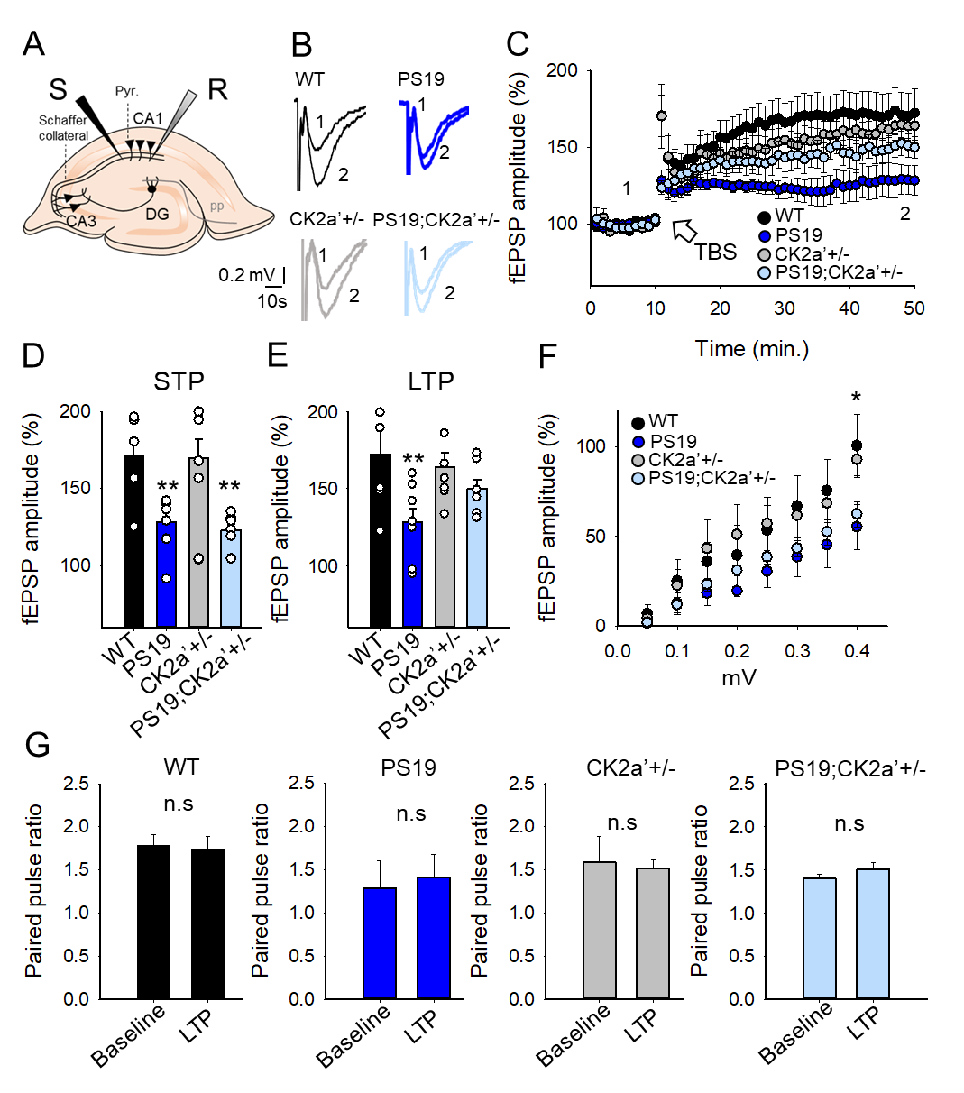
WT
PS19
2.5
2.5
2.0
2.0
1.5
1.5
Paired pulse ratio
Paired pulse ratio
1.0
1.0
0.5
0.5
0
LTP
0
LTP
Baseline
Baseline
CK2α’^{(+/-)}
PS19;CK2α’^{(+/-)}
2.5
2.5
2.0
2.0
1.5
1.5
Paired pulse ratio
Paired pulse ratio
1.0
1.0
0.5
0.5
0
LTP
0
LTP
Baseline
Baseline
Supplementary Figure 5. Paired pulse ratio of hippocampal slices shows no deficits between genotypes. (A) Paired-pulse ratio (PPR) in acute hippocampal slices of (WT, Black n=5; CK2α’^{(+/-)}, Grey, n=5; PS19, Red, n=5; PS19; CK2α’^{(+/-)}, Pink n=4). (*p < 0.05,**p < 0.01). Data are shown as mean ± SEM. Statistical analyses were conducted using two-sided Student’s t test. n.s. indicates no significance.
Supplementary Figure 5

Slide 8
A)
Prodromal:
Barnes Maze Probe phase
C)
Prodromal:
Open field
15
250
10
200
Distance traveled (m)
150
Distance traveled (m)
5
100
50
0
0
WT
PS19
WT
PS19
CK2α’^{(+/-)}
CK2α’^{(+/-)}
PS19;CK2α’^{(+/-)}
PS19;CK2α’^{(+/-)}
B)
Symptomatic:
Barnes Maze Probe phase
D)
Symptomatic:
Open field
10
***
**
400
8
**
**
300
6
Distance traveled (m)
Distance traveled (m)
4
200
2
100
0
0
WT
PS19
WT
PS19
CK2α’^{(+/-)}
CK2α’^{(+/-)}
PS19;CK2α’^{(+/-)}
PS19;CK2α’^{(+/-)}
Supplementary Figure 6. Symptomatic PS19 demonstrates decreased movement on Barnes Maze, but hyperactive phenotype in open field. (A-B) Distance traveled in prodromal and symptomatic mice during the probe phase of Barnes Maze. (C-D) Distance traveled by prodromal and symptomatic mice during 1 hour in an open field arena. Data are shown as mean ± SEM (n=10-12 mice/genotype, outliers removed using ROUT (Q=1%). Statistical analyses were conducted using One-Way ANOVA with Tukey’s post-hoc analysis. *p<0.05, **p<0.01, ***p<0.001, ****p<0.0001.
Supplementary Figure 6

Slide 9
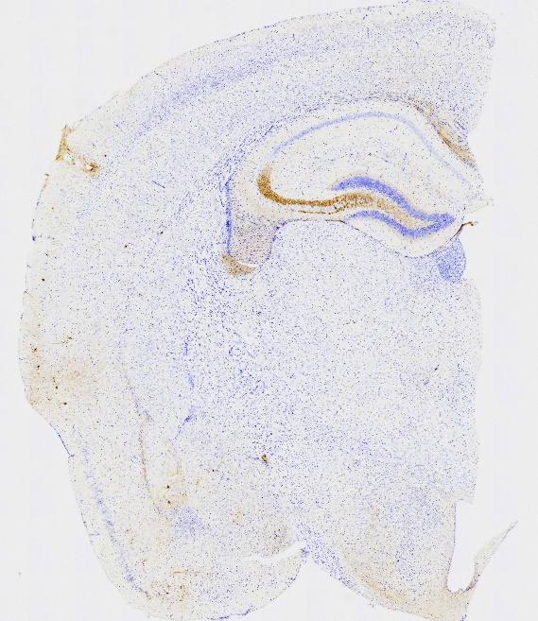
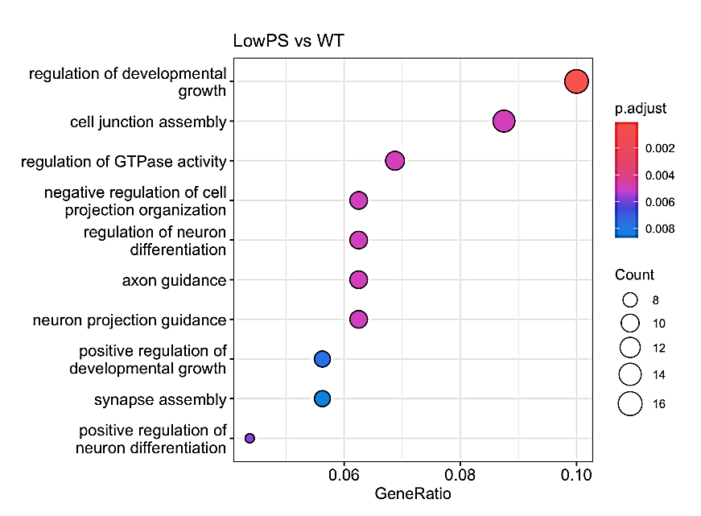
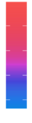
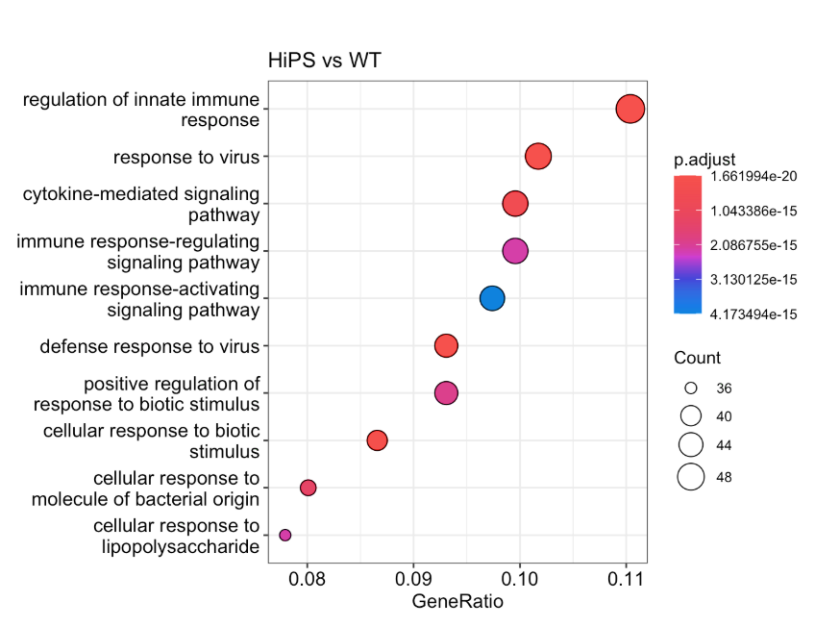
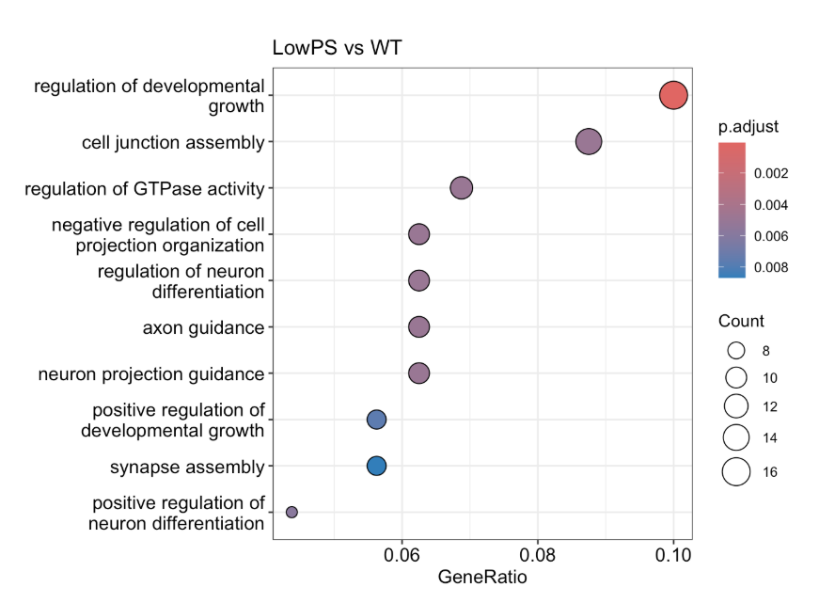
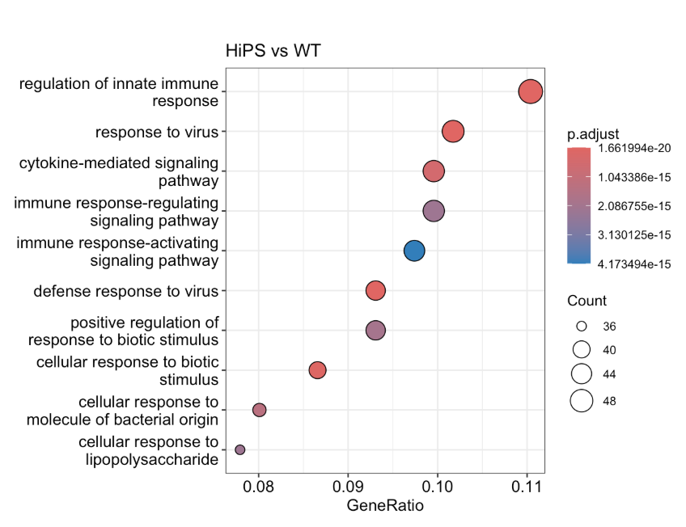
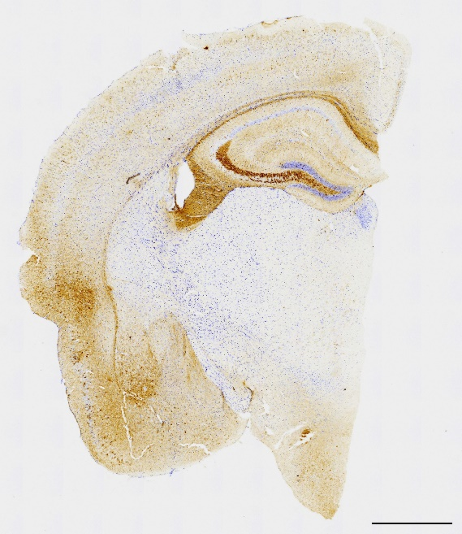
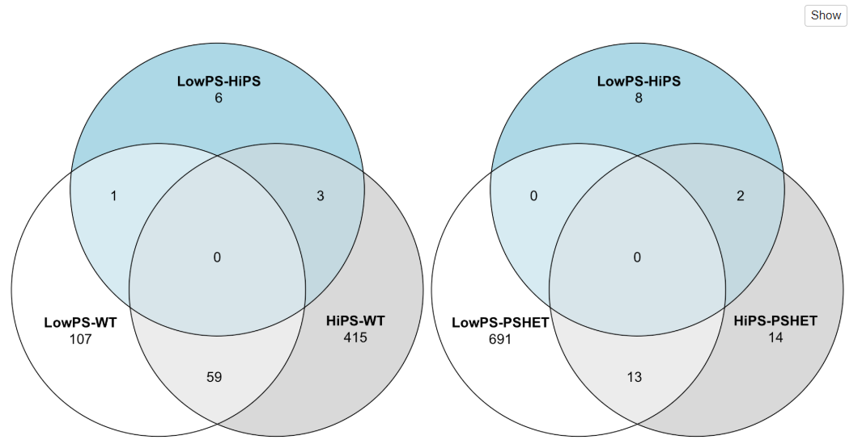
A)
B)
DGE: Low-Pathology
PS19 vs WT
C)
DGE: High-Pathology
PS19 vs WT
“Low” pathology PS19
p.adjust
p.adjust
AT8
regulation of developmental
growth
regulation of innate immune
response
1.66e-20
cell junction assembly
0.002
response to virus
1.04e-15
0.004
2.09e-15
regulation of GTPase activity
0.006
cytokine mediated-signaling
pathway
3.13e-15
0.008
4.17e-15
negative regulation of cell
projection organization
Count
immune response-regulating
signaling pathway
Count
regulation of neuron
differentiation
8
immune response-activating
signaling pathway
36
axon guidance
10
40
12
defense response to virus
44
neuron projection guidance
14
positive regulation of
response to biotic stimulus
48
positive regulation of
developmental growth
16
cellular response to biotic
stimulus
synapse assembly
cellular response to
molecule of bacterial origin
positive regulation of
neuron differentiation
0.06 0.08 0.10
cellular response to
lipopolysaccharide
0.08 0.09 0.10 0.11
Gene ratio
Gene ratio
“High” pathology PS19
D)
E)
AT8
LowPS19
vs
PS19;CK2α’^{(+/-)}
6
E)
LowPS19
vs
PS19
8
1
3
0
2
0
0
LowPS19
vs
WT
107
HighPS19
vs
WT
415
LowPS19
vs
PS19;CK2α’^{(+/-)}
691
HighPS19
vs
PS19;CK2α’^{(+/-)}
14
59
13
Supplementary Figure 7. RNA-Seq analyses in PS19 cohort show genetic variability associated with high and low pathology. (A) Representative AT8 staining of a low and high pathology prodromal PS19 mice scale bar= 1000 μm. (B) Gene ontology top related pathways for Low pathology PS19 vs WT. (C) Gene ontology top related pathways for High pathology PS19 vs WT comparison. (D-E) Venn diagram of the number of unique and overlapping DGEs for 6 total comparisons of interest.
Supplementary Figure 7

Slide 10
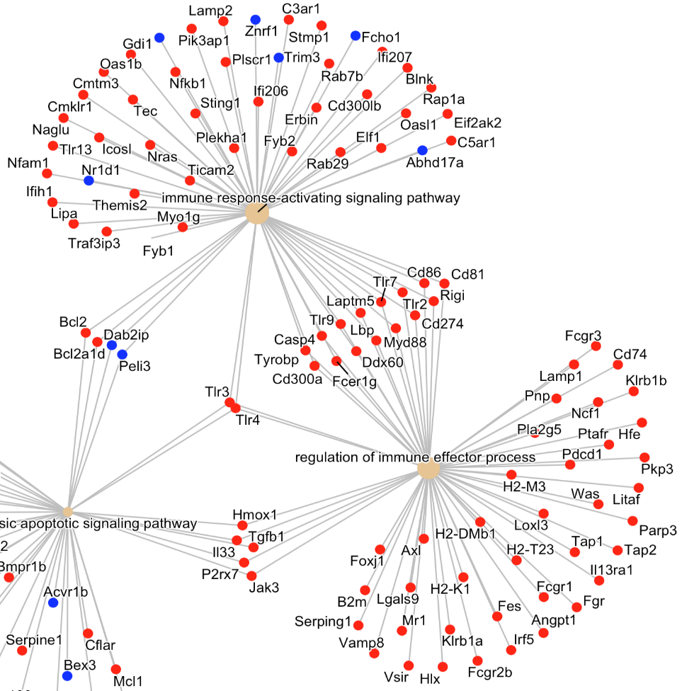
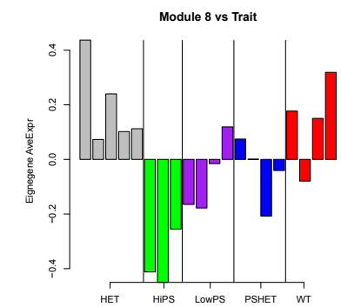
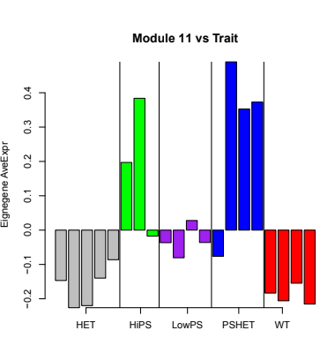
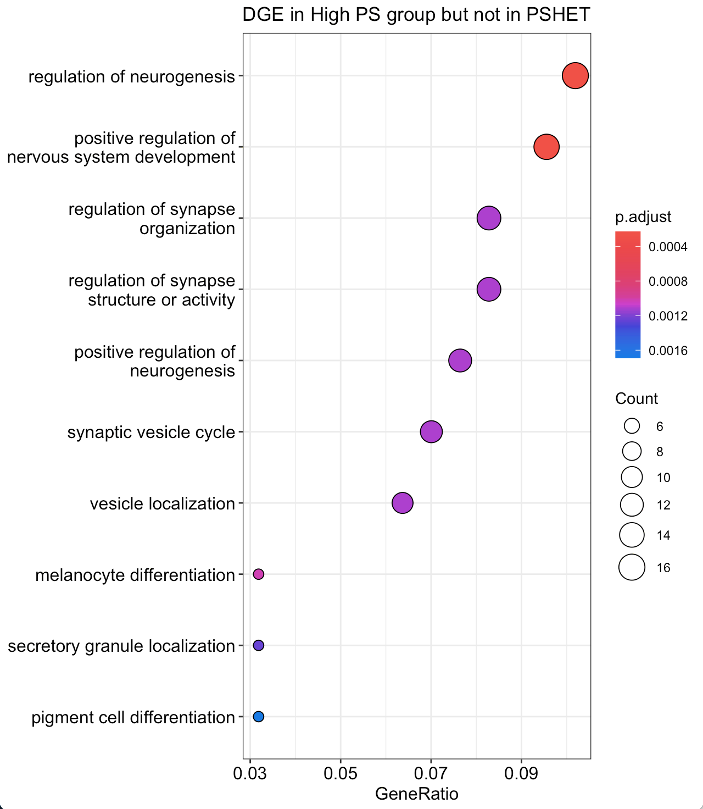
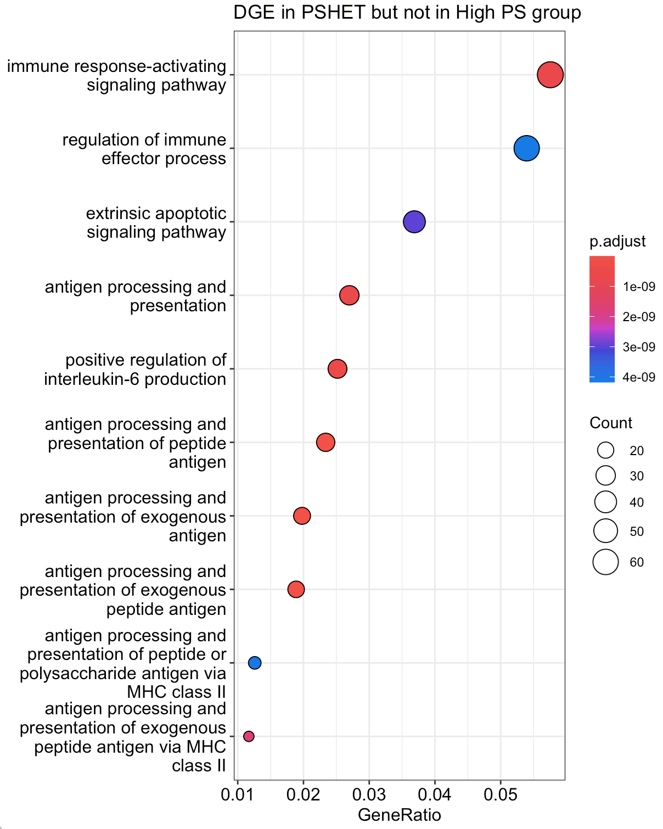

A)
MEtan module
B)
MEturquoise module
E)
0.4
0.4
0.2
0.3
Eignegene AveExpr
0.2
0
Eignegene AveExpr
0.1
-0.2
0
-0.4
-0.1
= upregulated in
PS19;CK2α’^{(+/-)} vs WT
PS19
PS19;
CK2α’^{(+/-)}
WT
-0.2
PS19
PS19;
CK2α’^{(+/-)}
WT
= downregulated in
PS19;CK2α’^{(+/-)} vs WT
CK2α’^{(+/-)}
CK2α’^{(+/-)}
C)
Comparison 1:
D)
Comparison 2:
DGE in PS19 but not PS19;CK2α’(+/-)
DGE in PS19;CK2α’(+/-) but not PS19
regulation of neurogenesis
immune response-activating signaling pathway
positive regulation of nervous system development
p.adjust
regulation of immune effector process
p.adjust
0.0004
extrinsic apoptotic signaling pathway
1e-9
regulation of synapse organization
0.0008
2e-9
0.0012
3e-9
regulation of synapse structure or activity
0.0016
antigen processing and presentation
4e-9
positive regulation of neurogenesis
Count
positive regulation of interleukin-6 production
Count
6
20
8
30
synaptic vesicle cycle
10
antigen processing and presentation of peptide antigen
40
12
50
vesicle localization
14
antigen processing and presentation of exogenous antigen
60
melanocyte differentiation
16
antigen processing and presentation of exogenous peptide antigen
secretory granule localization
antigen processing and presentation of peptide or polysaccharide antigen via MHC class II
pigment cell differentiation
0.03 0.05 0.07 0.09
antigen processing and presentation of exogenous peptide antigen via MHC class II
0.01 0.02 0.03 0.04 0.05
Gene ratio
Gene ratio
Supplementary Figure 8. PS19;CK2α’(+/-) mice display increased immune-related gene expression. (A) Eigengene Average expression for tan module. (A) Eigengene Average expression for turquoise module. (C) Gene ontology for the top-related pathways for the DGEs in PS19 vs WT not present in the PS19;CK2α’^{(+/-)} vs WT comparison. (D) Gene ontology for the top-related pathways for the DGEs in PS19;CK2α’^{(+/-)} vs WT not present in the PS19 vs WT comparison. (E) Gene network for the top 2 pathways returned in (D).
Supplementary Figure 8

Slide 11
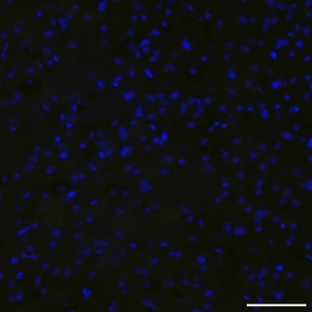
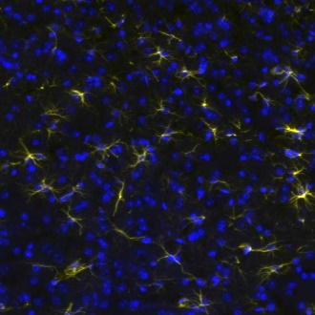
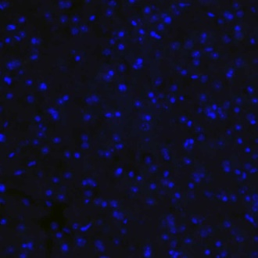
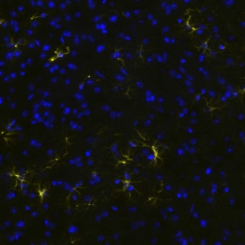
A)
Prodromal
B)
Symptomatic
CA1
CA3
DG
CA1
CA3
DG
GFAP
DAPI
GFAP
DAPI
WT
WT
PS19
PS19
CK2α’^{(+/-)}
CK2α’^{(+/-)}
PS19;
CK2α’^{(+/-)}
PS19;
CK2α’^{(+/-)}
C)
D)
E)
WT
CA1
WT
CA3
E)
WT
DG
PS19
PS19
PS19
600
CK2α’^{(+/-)}
500
CK2α’^{(+/-)}
a
600
CK2α’^{(+/-)}
a
a
PS19;CK2α’^{(+/-)}
a
PS19;CK2α’^{(+/-)}
PS19;CK2α’^{(+/-)}
a
b
a
b
400
b
400
b
300
400
bc
GFAP+ cells/mm²
GFAP+ cells/mm²
bc
GFAP+ cells/mm²
c
bc
200
c
c
c
c
200
c
c
c
c
200
c
c
c
100
0
Prodromal
Symptomatic
0
Prodromal
Symptomatic
0
Prodromal
Symptomatic
F)
G)
WT
PS19
H)
GFAP
DAPI
WT
1.0
PS19
a
CK2α’^{(+/-)}
0.8
PS19;CK2α’^{(+/-)}
0.6
b
Symptomtic Cortex
CK2α’^{(+/-)}
PS19;CK2α’^{(+/-)}
GFAP+ cells/mm²
0.4
0.2
c
c
0
Symptomatic
Supplementary Figure 9

Slide 12
Supplementary Figure 9. CK2α’ haploinsufficency decreased GFAP+ astrocytes in the overlaying cortex but not in the hippocampus of PS19 mice. (A-B) Immunostaining for GFAP in the CA1, CA3 and DG of the hippocampus in prodromal (A) and symptomatic (B) cohorts. Scale bar=100 μm. (C-E) Quantification of GFAP+ cells in CA1, CA3 and DG of hippocampus. (n=3-6 mice/genotype). (F) Representative area corresponding to overlying cortex is indicated with a boxed area. (G) Representative GFAP immunostaining in the cortex. Scale bar= 50 μm. (H) Quantification of GFAP+ cells in the cortex (n=3-6/genotype). All Data are shown as mean ± SEM. Statistical analyses were conducted using two-way ANOVA with tukey’s multiple corrections and represented with compact letter display. Panel F was created in BioRender (White, A. (2025) https://BioRender.com/eqznm6m).
Supplementary Figure 9

Slide 13
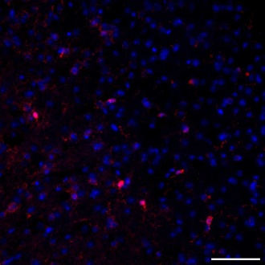
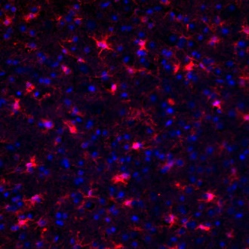
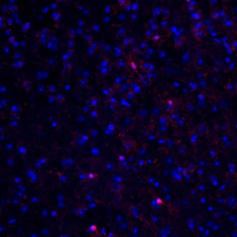
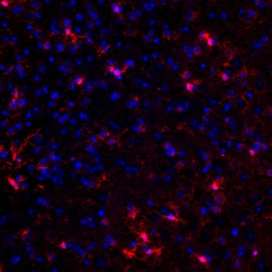
A)
Prodromal
B)
Symptomatic
CA1
CA3
DG
CA1
CA3
DG
Iba1
DAPI
Iba1
DAPI
WT
WT
PS19
PS19
CK2α’^{(+/-)}
CK2α’^{(+/-)}
PS19;
CK2α’^{(+/-)}
PS19;
CK2α’^{(+/-)}
CK2α’^{(+/-)}
C)
CA1
D)
CA3
E)
DG
800
WT
600
WT
a
500
WT
PS19
PS19
PS19
a
ab
CK2α’^{(+/-)}
a
CK2α’^{(+/-)}
b
400
CK2α’^{(+/-)}
600
PS19;CK2α’^{(+/-)}
b
PS19;CK2α’^{(+/-)}
PS19;CK2α’^{(+/-)}
400
300
bc
cd
Iba1+ cells/mm²
c
400
c
Iba1+ cells/mm²
cd
Iba1+ cells/mm²
cd
200
ce
de
200
cd
d
d
200
cd
cd
d
d
de
e
100
d
0
Prodromal
Symptomatic
0
Prodromal
Symptomatic
0
Prodromal
Symptomatic
F)
G)
Symptomtic Cortex
I)
Prodromal Hippocampus
WT
PS19
WT
PS19
CK2α’^{(+/-)}
PS19;
CK2α’^{(+/-)}
Iba1
DAPI
CD68
CA1
H)
0.6
a
CK2α’^{(+/-)}
CA3
0.4
b
PS19;CK2α’^{(+/-)}
Iba1+ cells/mm²
0.2
b
b
DG
0.0
Symptomatic
Supplementary Figure 10

Slide 14
Supplementary Figure 10. CK2α’ haploinsufficency decreased Iba1+ microglia cell number in the hippocampus and overlaying cortex of PS19 mice. (A-B) Immunostaining for Iba1 in the CA1, CA3 and DG of the hippocampus in prodromal (A) and symptomatic (B) cohorts. Scale bar=100 μm. (C-E) Quantification of Iba1+ cell counts in CA1, CA3 and DG of hippocampus (n=3-6 mice/genotype). (F) Representative area corresponding to overlying cortex is indicated with a boxed area. (G) Representative Iba1 immunostaining in the cortex scale bar=50 μm. (H) Quantification of Iba1+ cells in the cortex (n=3-6 mice/genotype). All data are shown as mean ± SEM. Statistical analyses were conducted using two-way ANOVA with tukey’s multiple corrections and represented with compact letter display. Panel F was created in BioRender (White, A. (2025) https://BioRender.com/eqznm6m).
Supplementary Figure 10

