Slide 1
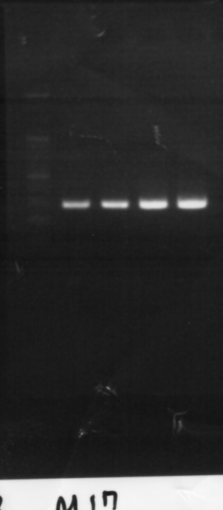
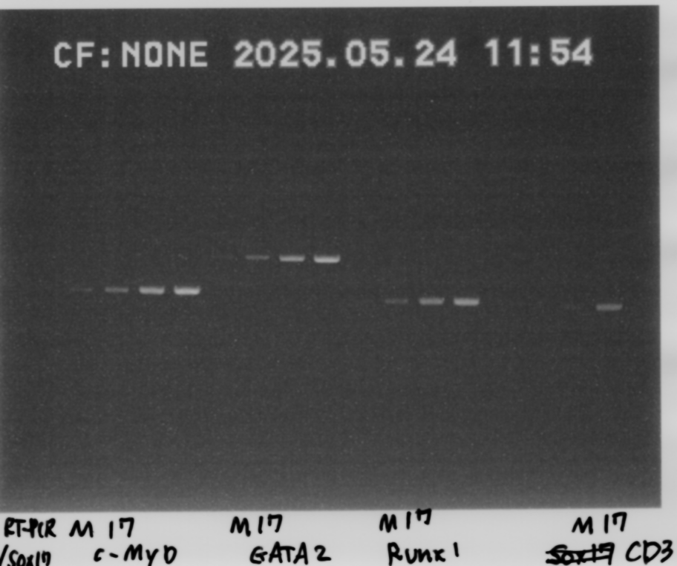
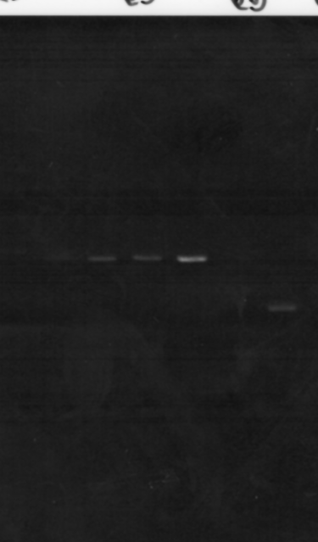
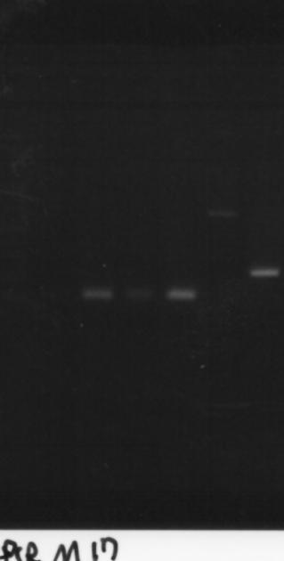
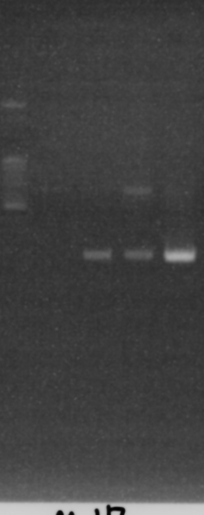
Fig. 1E
AGM: Mock or Sox17
β-actin
GATA2
CD31
c-Myb
Runx1
Notch1
VE-Cad
Sox17

Slide 2
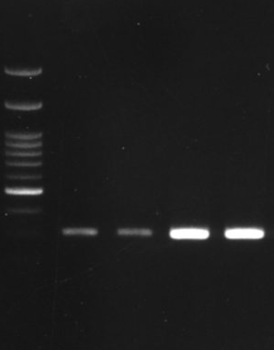
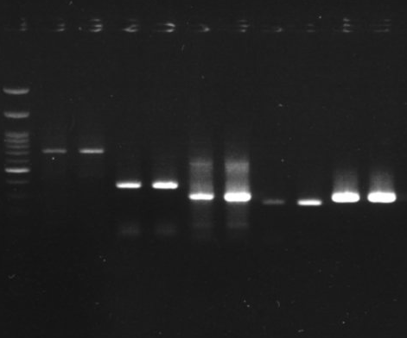
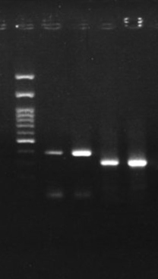
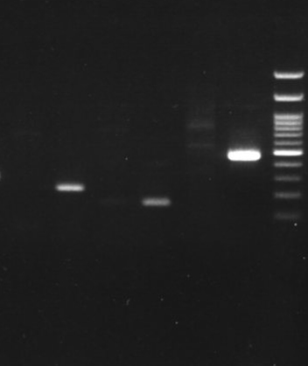
Fig. 1E
FL: Mock or Sox17
β-actin
c-Myb
CD31
GATA2
Runx1
Notch1
Sox17
VE-Cad

Slide 3
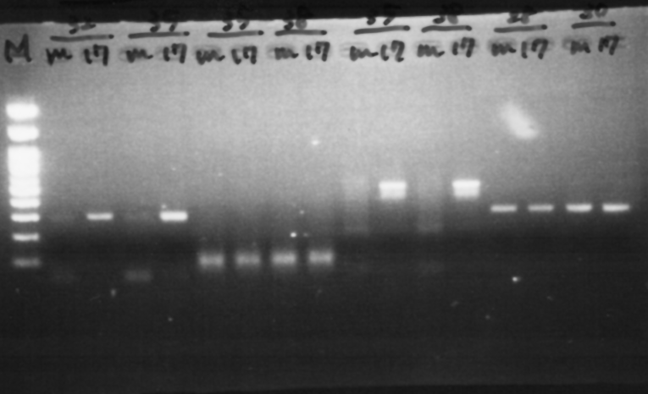
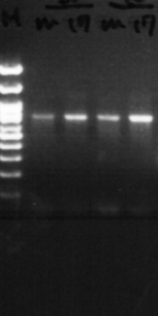
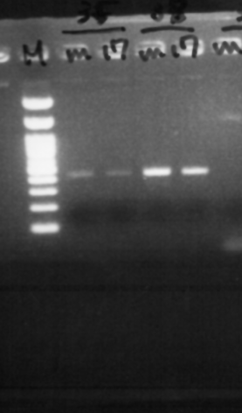
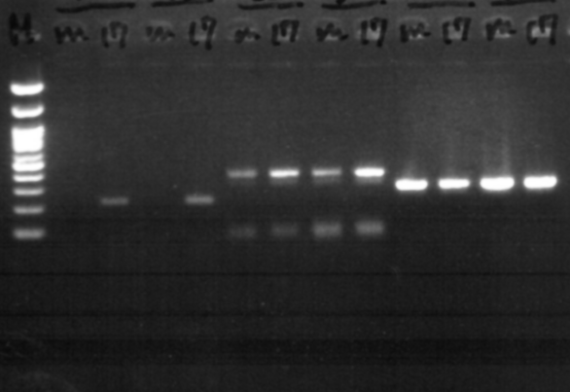
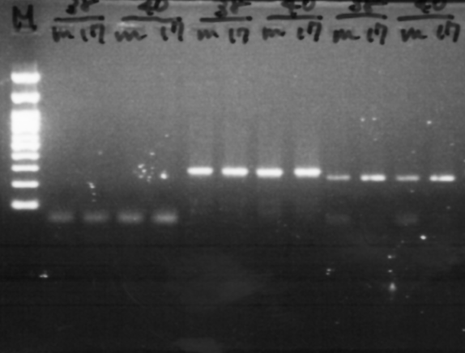
Fig. 1E
BM: Mock or Sox17
Runx1
VE-Cad
β-actin
GATA2
Notch1
Sox17
c-Myb
CD31

Slide 4
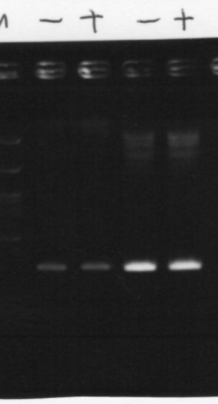
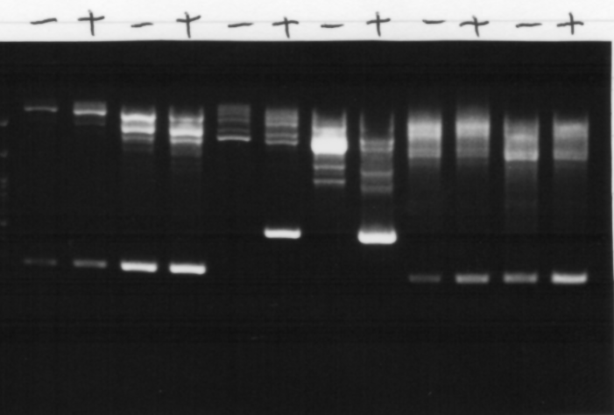
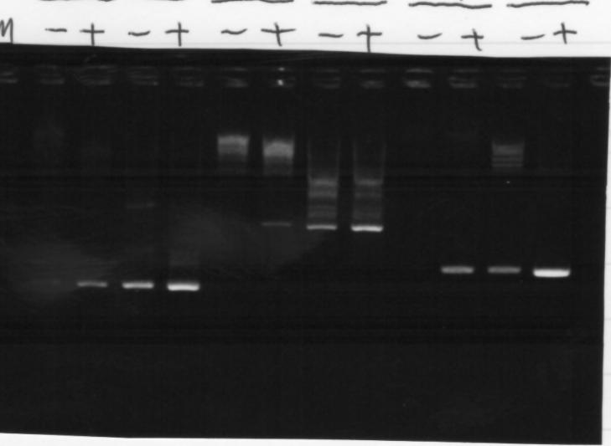
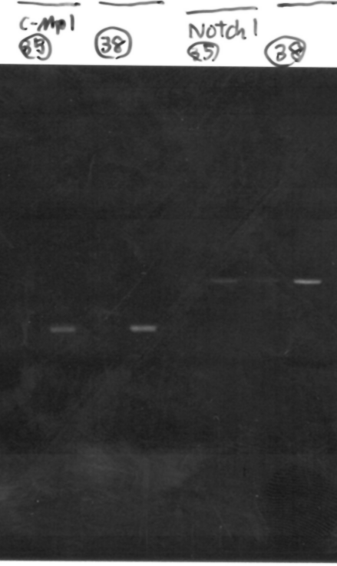
Fig. 2E
AGM: Sox17-ERT
β-actin
CD31
VE-Cad
Sox17
Runx1
GATA2
c-Myb
Notch1

Slide 5
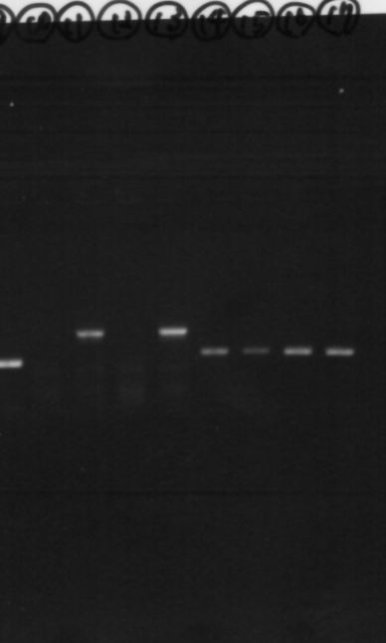
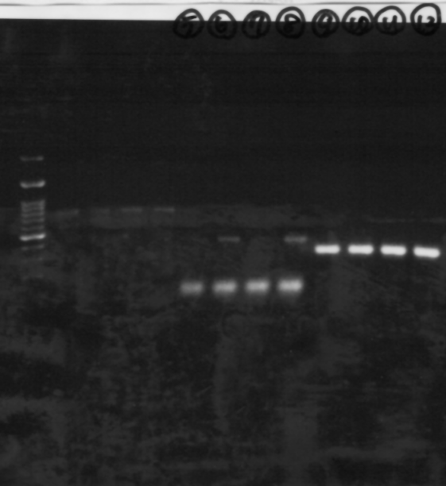
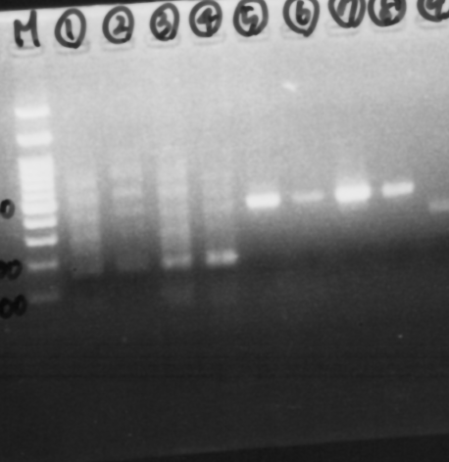
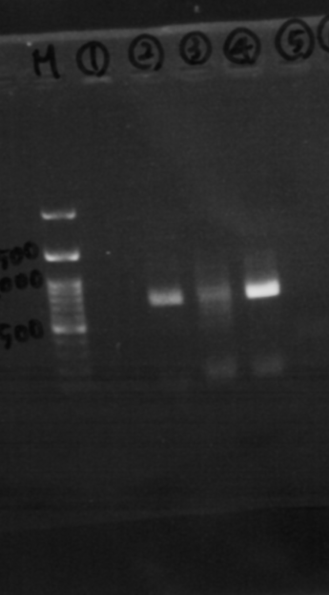
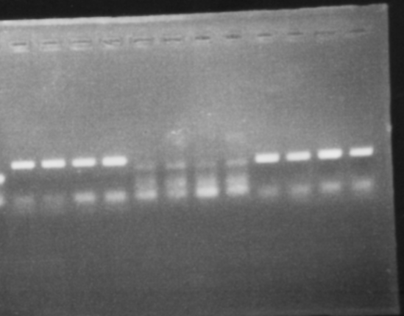
Fig. 2E
FL: Sox17-ERT
VE-Cad
β-actin
c-Myb
Runx1
Notch1
GATA2
CD31
Sox17

Slide 6
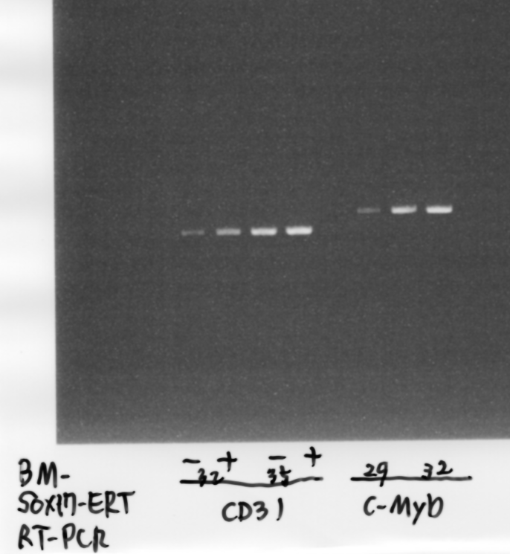
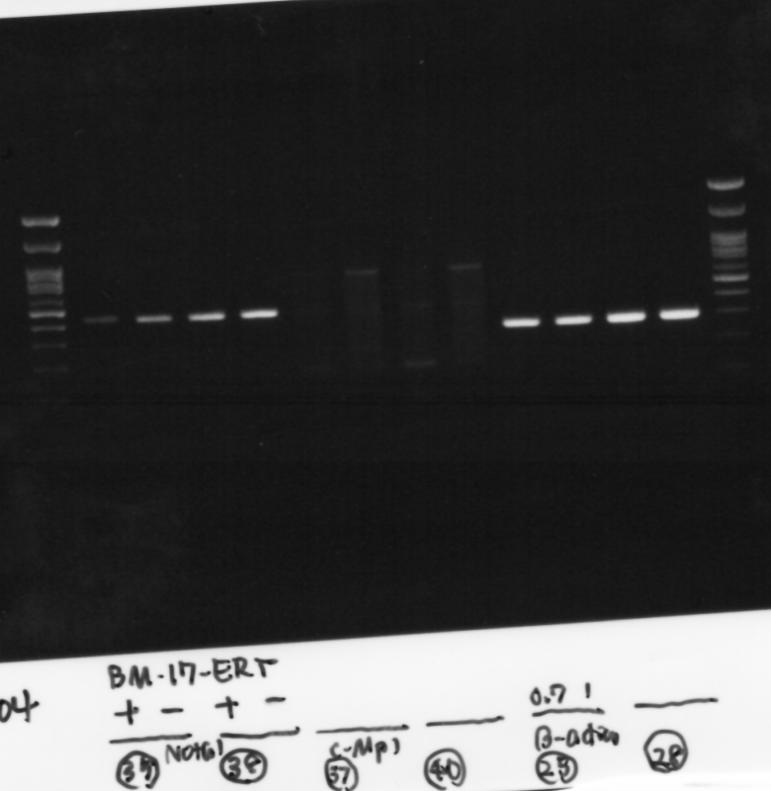
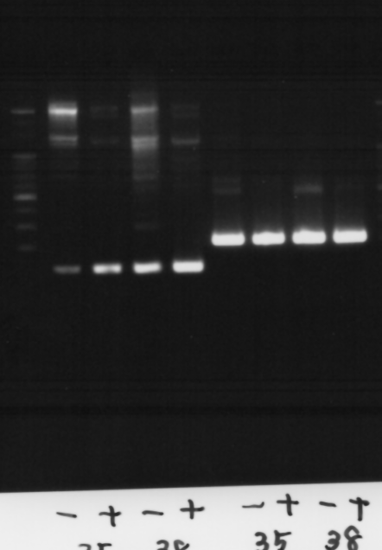
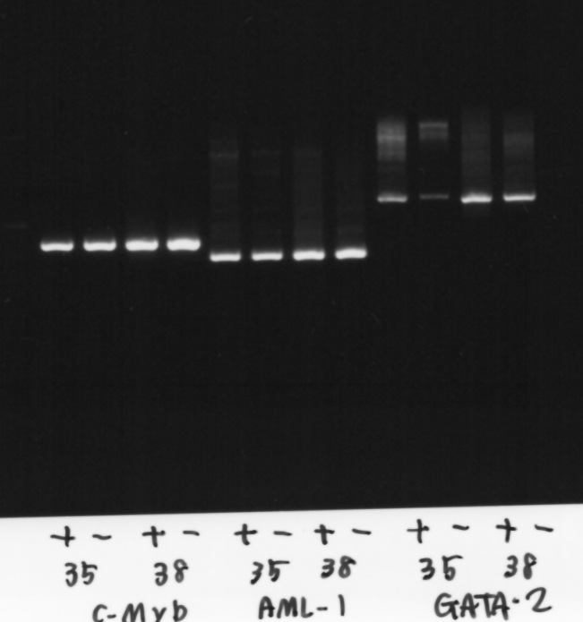
Fig. 2E
BM: Sox17-ERT
CD31
c-Myb
Notch1
β-actin
VE-Cad
Sox17
Runx1
GATA2

Slide 7
Fig. 5
Procr
β-actin
Fig. 5A
AGM
AGM
Tam
＋
－
Tam
＋
－
Fig. 5B
Procr
β-actin
cycles
32
35
28

