Slide 1
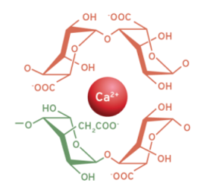
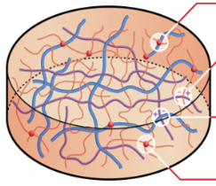
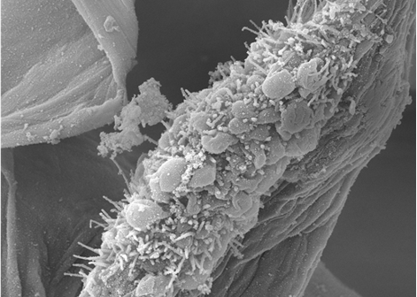
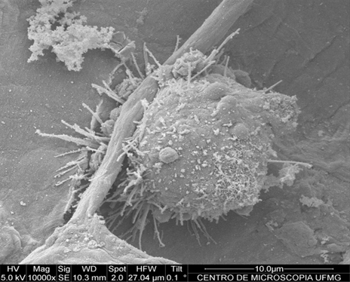
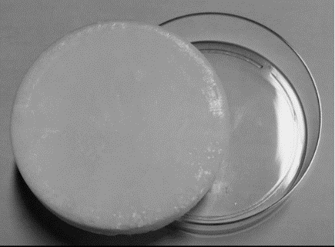
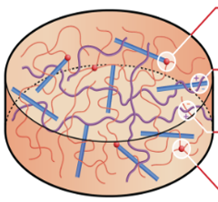
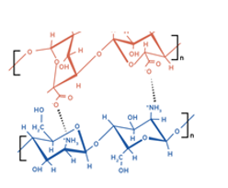
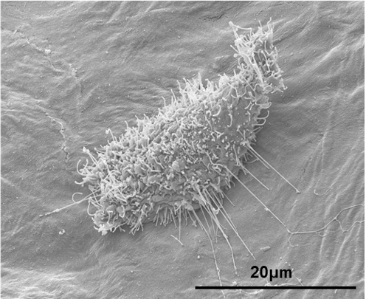
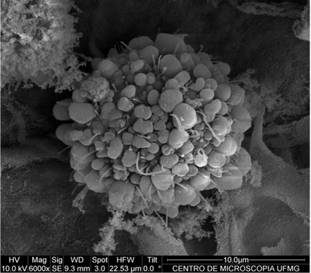
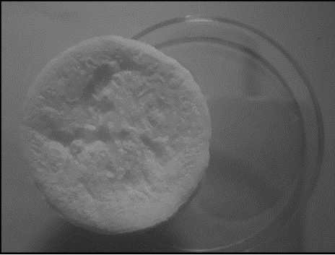
carboxylate groups/glucose units
Alg, NFCT and CNCT
(ionic crosslinking)
Cell adhesion
Proliferation
Differentiation
Eco-friendly
Green chemistry
Sustainability
Alg/Ch and NFC or NFCT semi-IPN
carboxylate/amine groups
Alg, NFCT or CNCT/Ch
(semi-IPN)
Alg/Ch and CNC or CNCT semi-IPN

