Slide 1
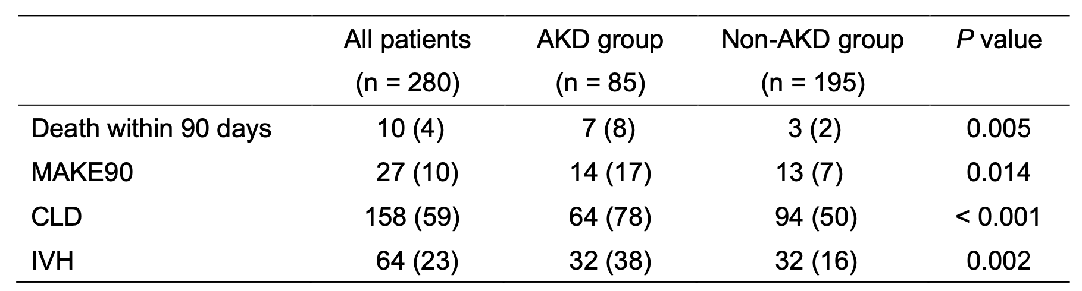


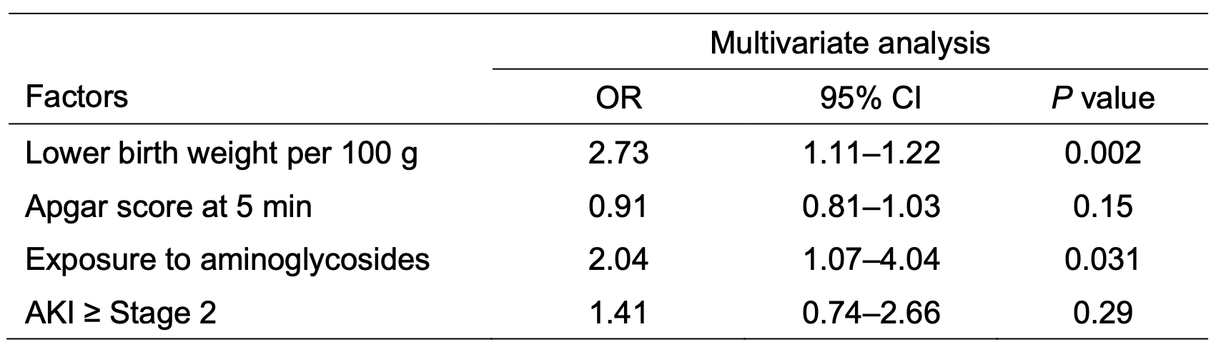
Neonatal acute kidney disease in the NCCHD-neoAKI Cohort:
risk factors and prognostic outcomes
AIM: To investigate the risk factors and outcomes of neonatal AKD in a cohort of neonates with AKI.
■Outcomes of neonates with and without AKD
DESIGN & OUTCOMES:
345 neonates
with AKI
85 (30%)
AKD neonates
■Multivariable logistic regression analysis of AKD development
195 (70%)
Non-AKD
neonates
65 were
excluded
AKD, acute kidney disease; AKI, acute kidney injury; CLD, chronic lung disease
IVH, intraventricular hemorrhage ; MAKE90, major adverse kidney events at 90 days
Nishi et al. 2025
CONCLUSION: Neonatal AKD was common and associated with increased mortality and major adverse kidney events. Aminoglycoside exposure and lower birth weight were independently associated with AKD.

