Slide 1
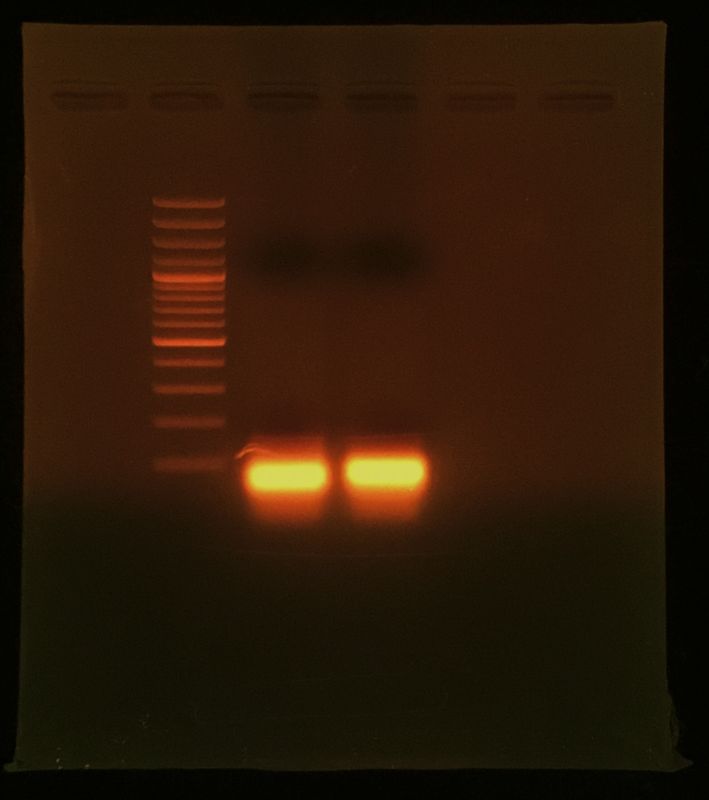
Fig. 1B
gRNA A
gRNA B
contr A
contr B

Slide 2
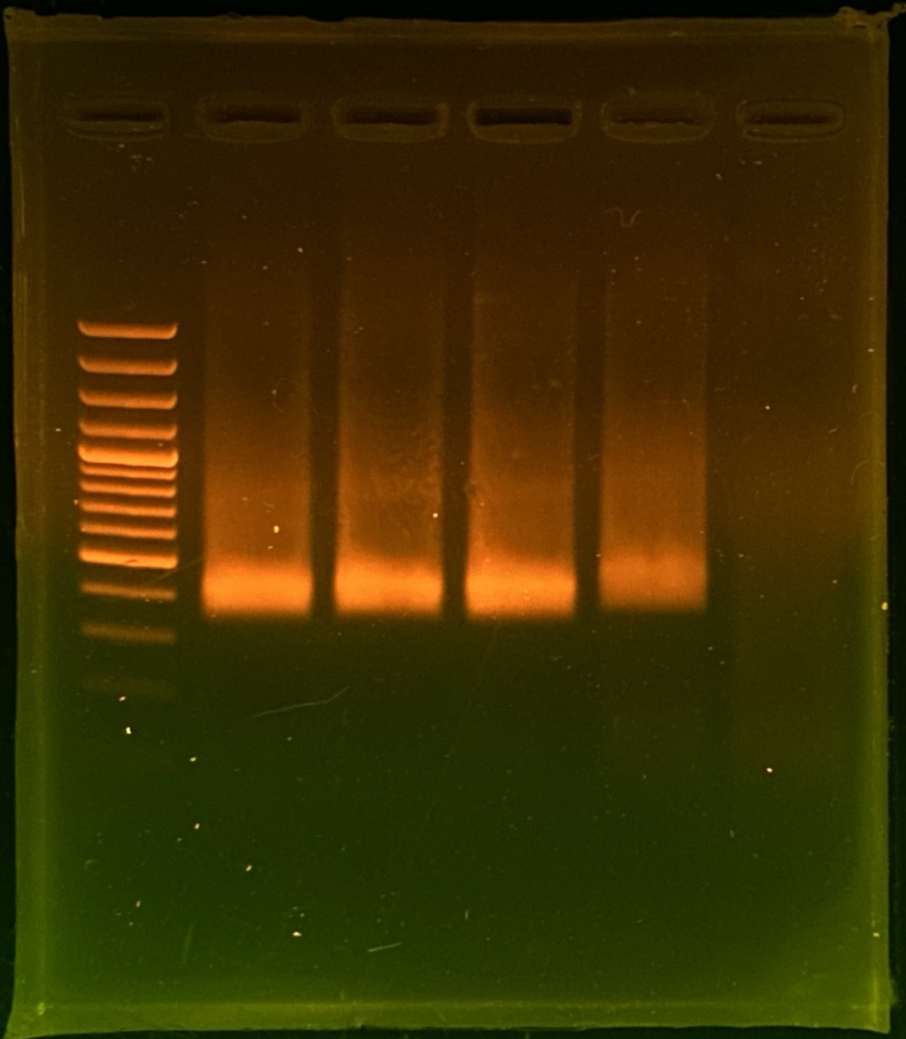
Fig. 2A
M PA PU PD PV N
PA = Phyllanthus amarus
PU = Phyllanthus urinaria
PD = Phyllanthus debilis
PV = Phyllanthus virgatus

Slide 3
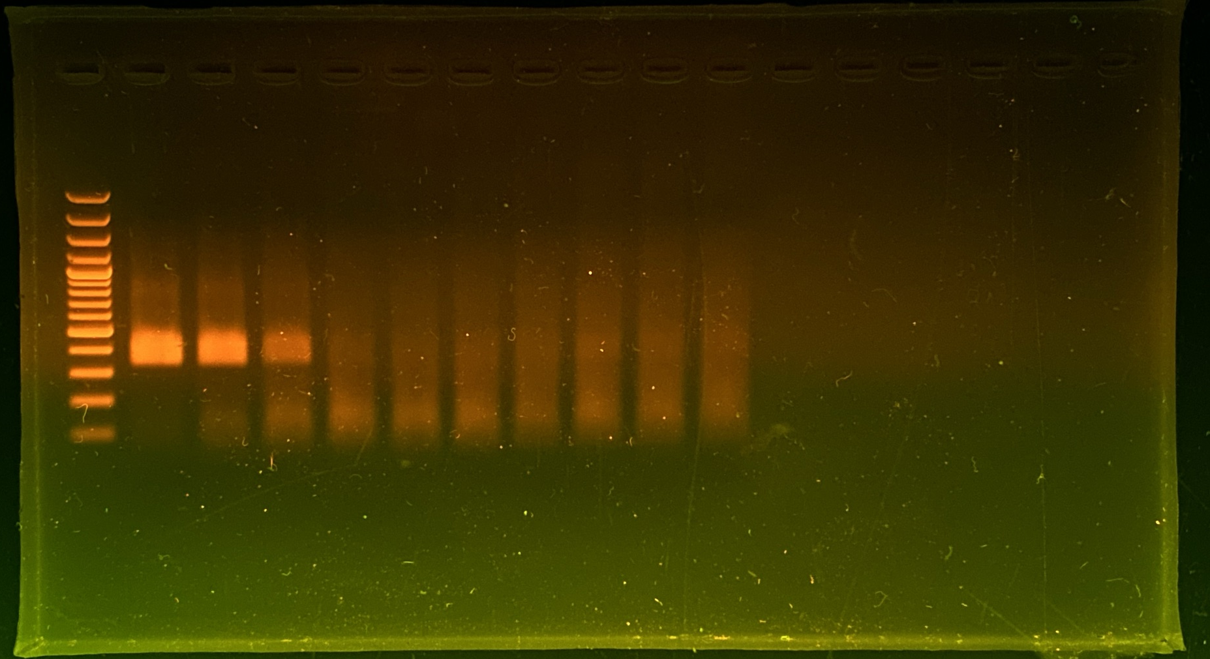
Fig. 2B and 2D
${ \text{M}\text{ 10}}^{\text{0}}$ ${ \text{10}}^{\text{−1}}$ ${ \text{10}}^{\text{−2}}{ \text{10}}^{\text{−3}}{ \text{10}}^{\text{−4}}{ \text{10}}^{\text{−5}}{ \text{10}}^{\text{−6}}$ ${\text{10}}^{\text{−7}}$ ${\text{10}}^{\text{−8}}$ N

Slide 4
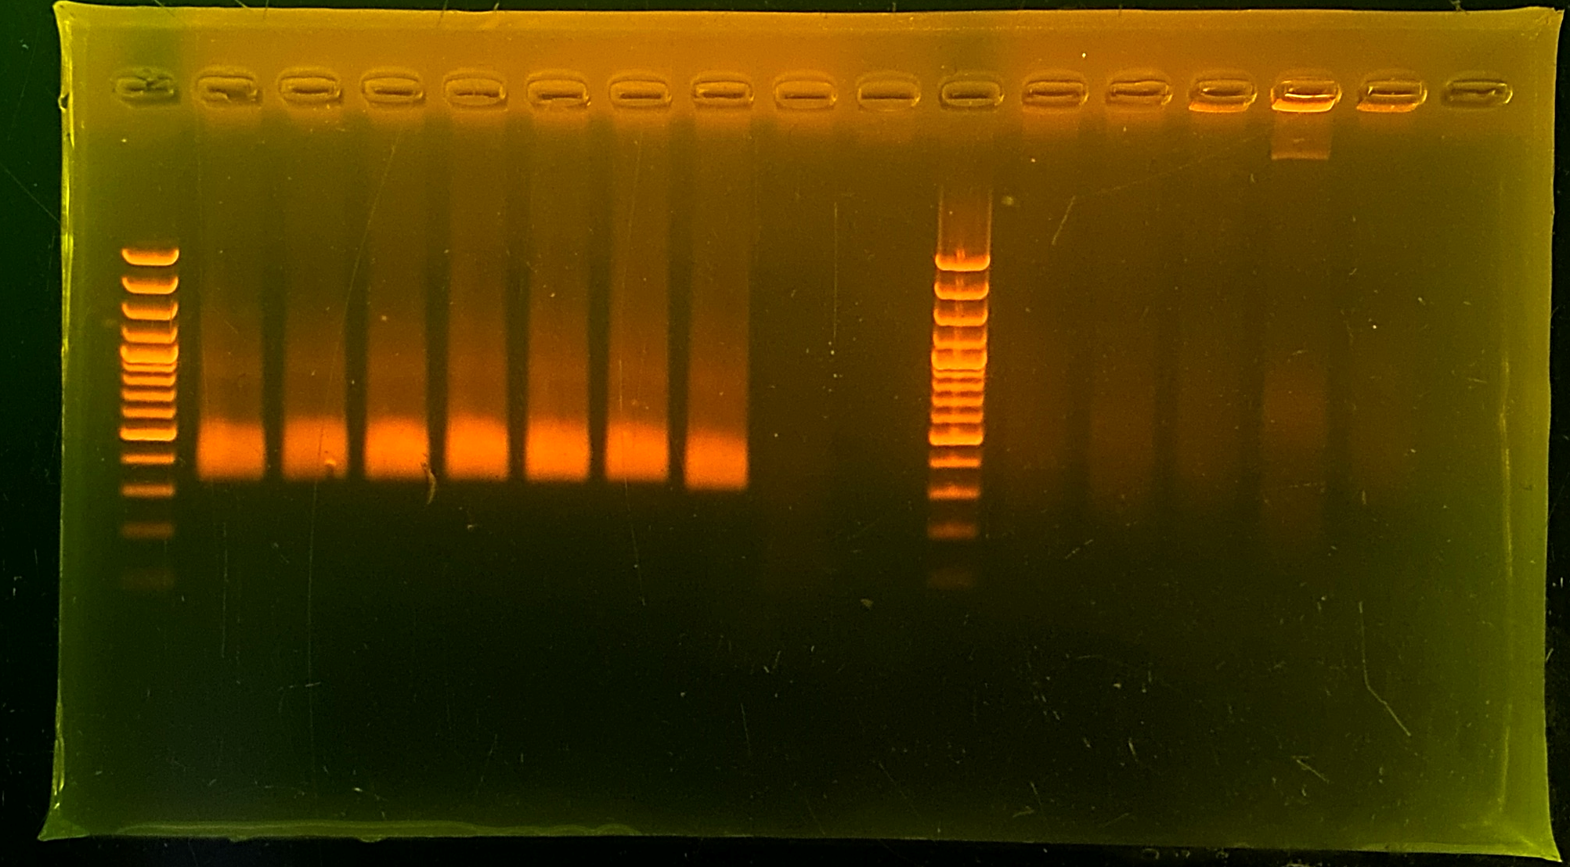
Fig. 3A
amount ratio
PA : PU
M
100:0
50:50
25:75
10:90
5:95
2:98
0:100
N
37 ᵒC 20 mins.
PA = Phyllanthus amarus
PU = Phyllanthus urinaria

