Slide 1
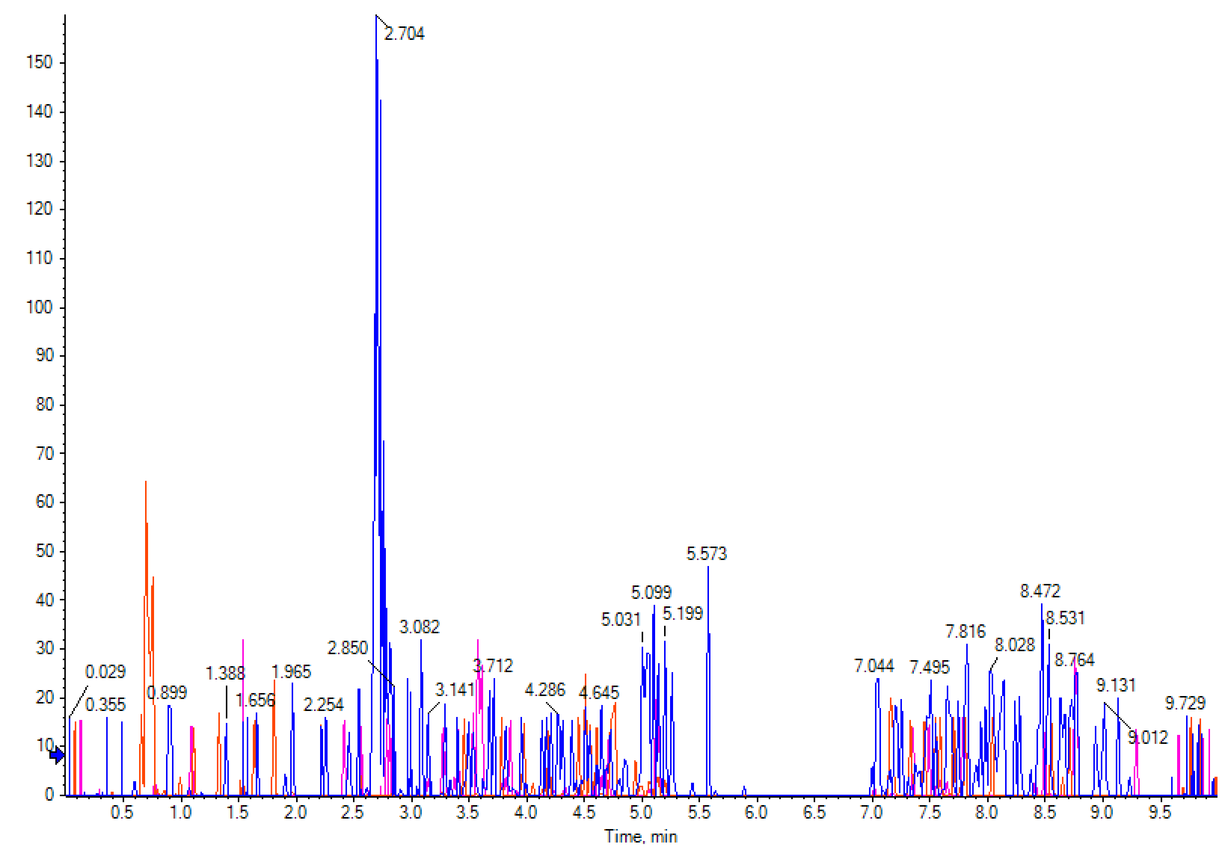
Figure S1. The ion mass spectrum of MFAE by UPLC-ESI-MS/MS.

Slide 2
A
B
C
D
Figure S2. Effects of MFAE pretreatment on different oxidative stress-related factors in H₂O₂-induced LO2 cells.
Malondialdehyde (MDA), B. Glutathione (GSH), C. Superoxide dismutase (SOD), D. Catalase (CAT).
Note: LO2 cells were preincubated with MFAE (0.2 and 1.0 mg/mL), C3G (0.2 mg/mL), NAC (0.1 mM/L) for 24 h and then stimulated with H₂O₂ (1.0 mM) for an additional 4 h. *, P<0.05; **, P<0.01; ***, P<0.001.

Slide 3
Figure S3. Effects of MFAE on the reproduction of C. elegans.
Note: N2 nematodes were exposed to either MFAE (0.2, 1.0, 5.0 mg/mL) or C3G (0.2 mg/mL) for 6 d.

