Slide 1
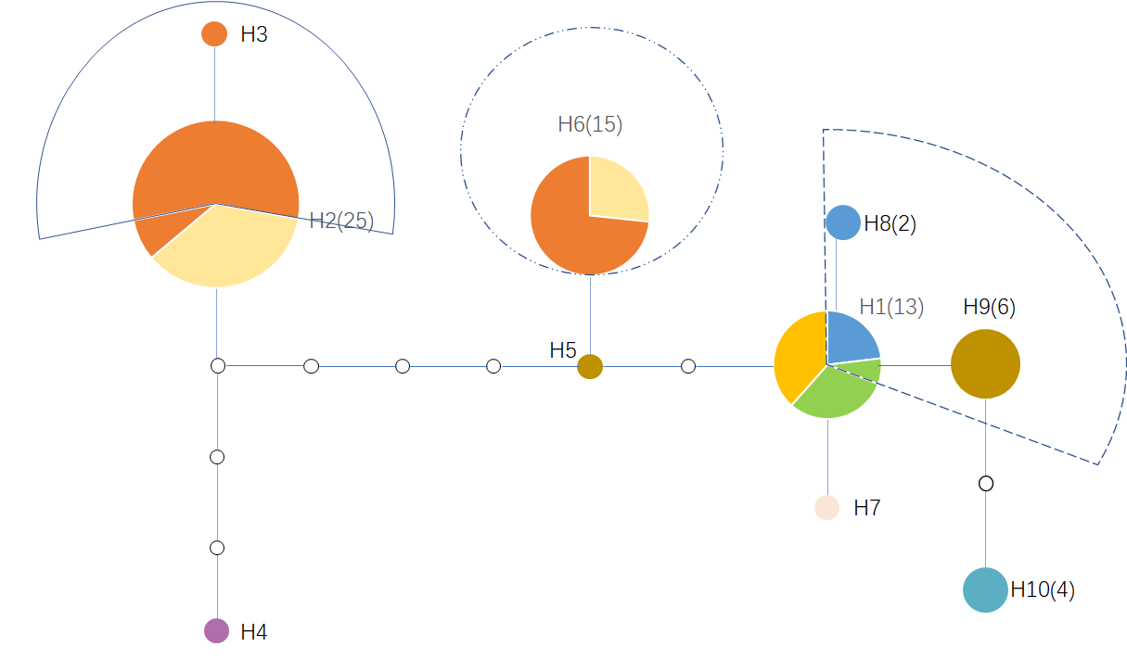
China Yunnan
China Sichuan
This study
P. proliferus
China Hubei
China Fujian
China Guangdong
China Guangxi
Japan
Vietnam
P. miyazakii
India
P. miyazakii
This study
P. proliferus
Others are P. skrjabini
P. skrjabini
25
15
strains
6
1
Fig. 7 Statistical parsimony network showing genetic relationships and distance among 10 haplotypes of P. skrjabini complex from different countries.
Numbers of haplotypes correspond to Table 1. In the network, solid circles indicate sampled haplotypes; small hollow circles indicate unsampled or extinct haplotypes. Each mutation step is shown as either a short or longer line connecting neighboring haplotypes (including observed and unobserved one). The size of the solid circles roughly represents the numbers of strains carrying the haplotype, with the scale given beside the network; different filled patterns represent the corresponding geographical origin from which the haplotype was sample

