Slide 1
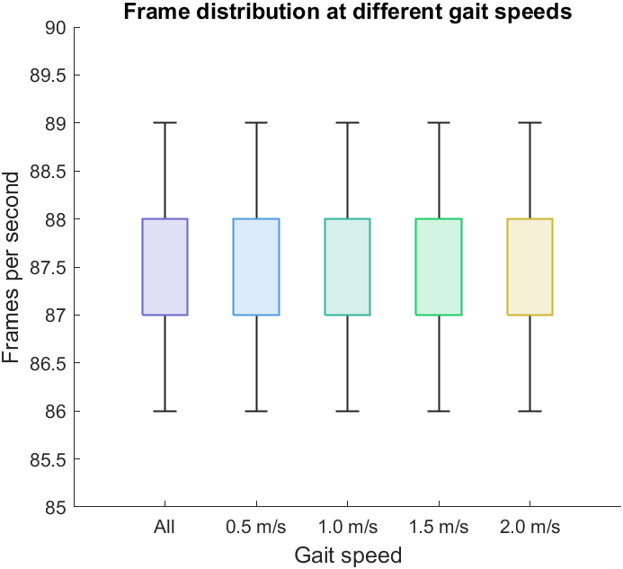
Appendix C. The actual frames per second of 100 sample rates at overall and four different gait speeds (0.5, 1.0, 1.5, and 2.0 m/s).

