Slide 1
Supplementary Figures
TITLE: Mesoporous Silicon Microparticles enhance robust immunity and protection against SARS-CoV-2 in mice and improves memory response in human PBMCs.
Drug Delivery and Translational Reasearch
Ana López-Gómez^{1,2}, Irene Real-Arévalo^{2,3}, Elsa Mayol-Hornero^{1,2}, Jana Ausio Cendra¹, Diego Laxalde-Fernández⁴, Pablo Nogales-Altozano⁶, Benigno Rivas-Pardo², Beatriz Amorós-Pérez^{2,3}, Beatriz Martín-Adrados², Ignacio Juárez², Álvaro Martínez-Del-Pozo⁴, Raúl J. Martín-Palma⁵, Noemí Sevilla⁶, Eduardo Martínez Naves^{2*}, Manuel Gómez del Moral^{1*}
¹ Department of Cellular Biology and Histology, School of Medicine, Universidad Complutense of Madrid (UCM), 28040 Madrid, Spain
mgomezm@ucm.es

Slide 2
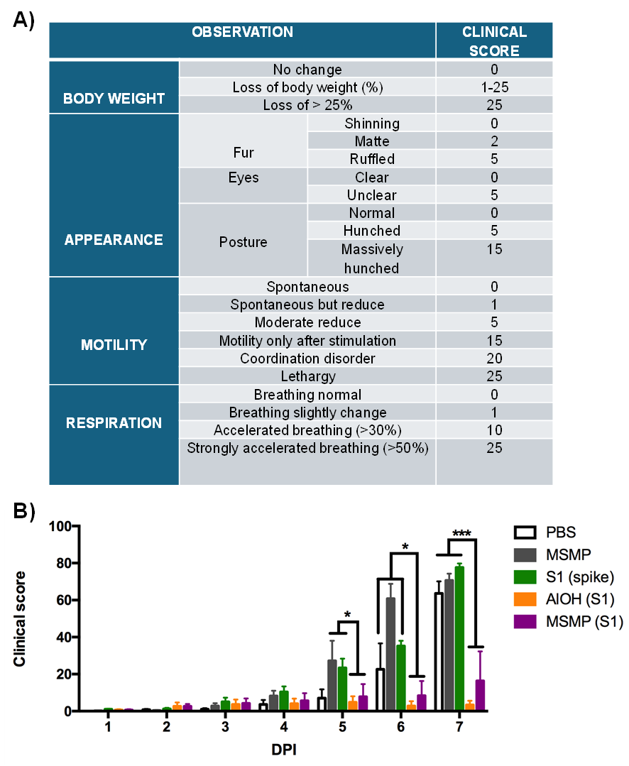
Supplementary Fig.1

Slide 3
Supplementary figure 1: Clinical score after infection. A) Parameters and characteristics assessed in mice with the corresponding score system. B) Clinical score over seven days post-infection for each group. Statistical significance was determined using ANOVA with Fisher's least significant difference. *p < 0.05, **p < 0.01, ***p < 0.001. The control groups analyzed were PBS (white), MSMPs (gray), while the immunized groups were: S1 (green), MSMPs-S1 (purple) and Al(OH)₃-S1 (orange).

Slide 4
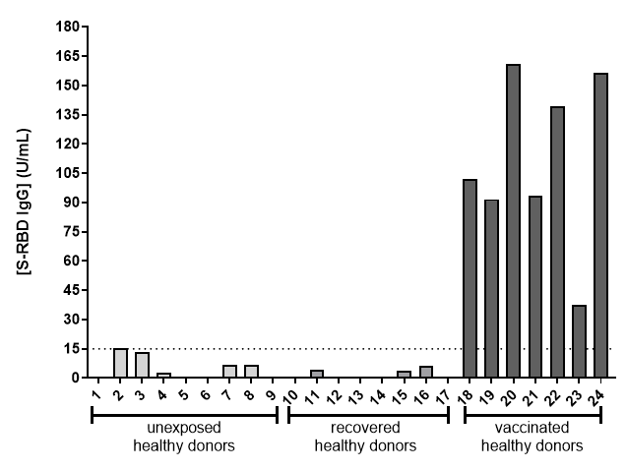
Supplementary Fig.2

Slide 5
Supplementary figure 2: IgG response against SARS-CoV-2 RBD. A positive IgG response was defined as values above 15U/mL, indicated by the dashed line

