Slide 1

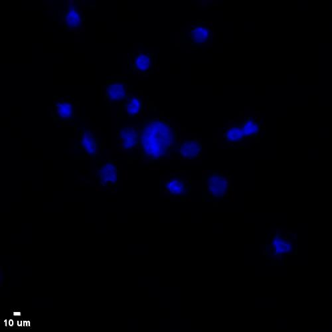
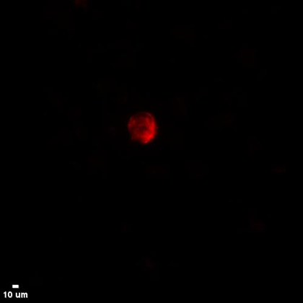
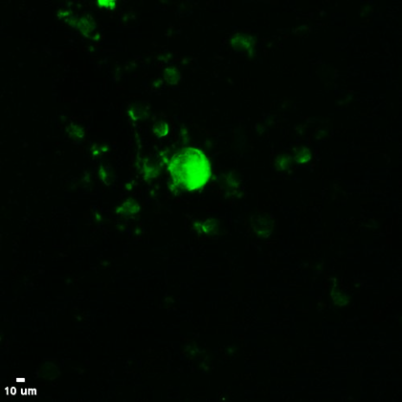
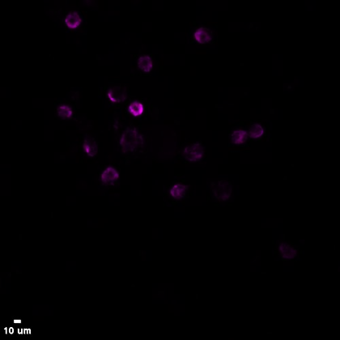
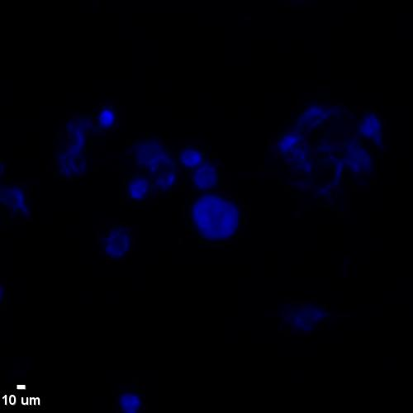
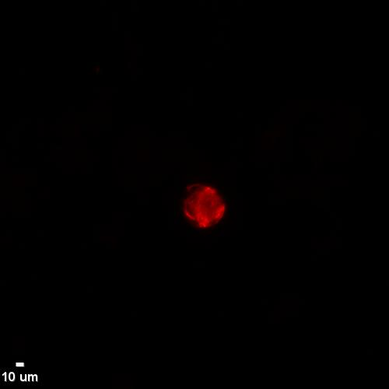
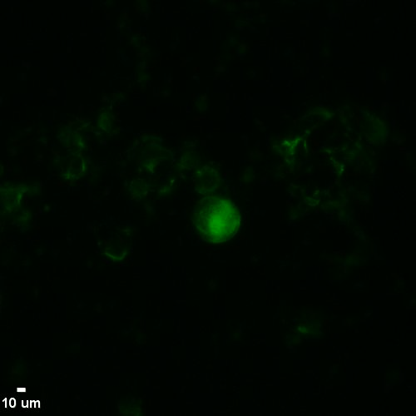
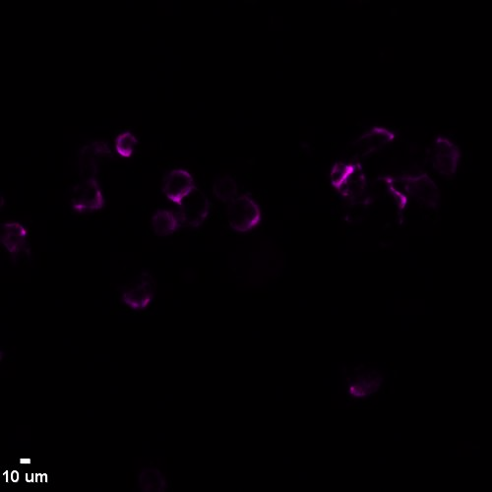
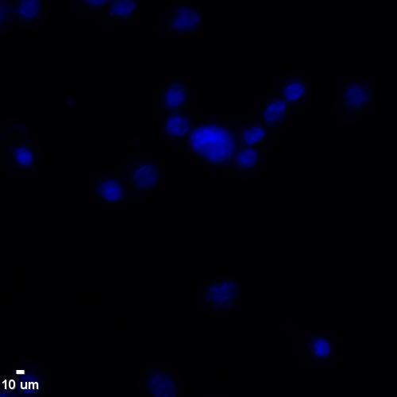
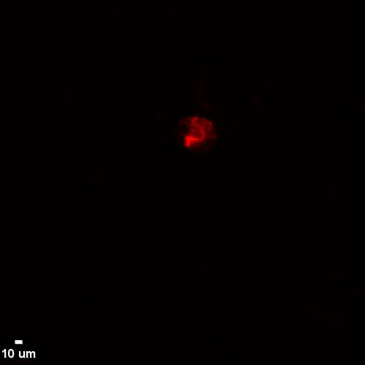
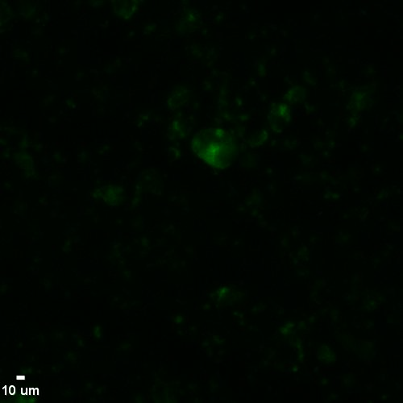
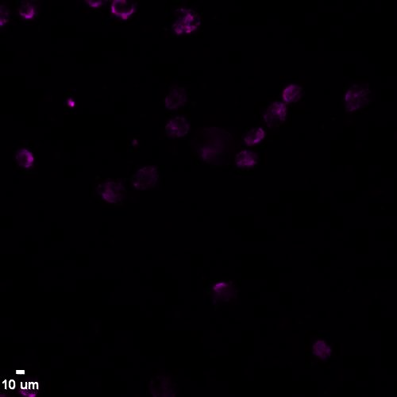
A
Mean Intensity: 6000 High Expression
DAPI CK PSMA CD45
B
Mean Intensity: 3642 Low Expression
DAPI CK PSMA CD45
C
Mean Intensity: 2938 Negative Expression
DAPI CK PSMA CD45
Notes:
Supplementary Figure 1. Expression Levels of PSMA in MDA-MB-231 Cancer Cells (Control Samples). (A) High Expression: The MDA-MB-231 cell line was triple-stained with pan-cytokeratin (panCK; A45 – B/B3), PSMA, and CD45 antibodies. The stained cells were analyzed using VyCAP microscopy (VyCAP B.V., Enschede, The Netherlands). The mean intensity of PSMA expression was quantified using ICY software. (B) Low Expression: The MDA-MB-231 cell line was triple-stained with pan-cytokeratin (panCK; A45 – B/B3), PSMA, and CD45 antibodies, followed by analysis with VyCAP microscopy. The mean intensity of PSMA expression was assessed using ICY software. (C) Negative Expression: The MDA-MB-231 cell line was stained only with panCK and CD45 antibodies, omitting the PSMA primary antibody, while including the secondary IgG antibody. The analysis was performed using VyCAP microscopy, and the mean intensity of PSMA expression was measured using ICY software. Scale bars = 10μm.

Slide 2
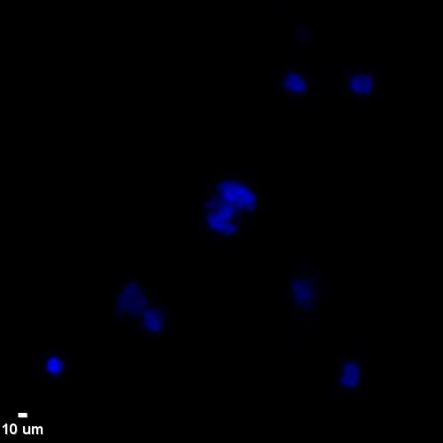
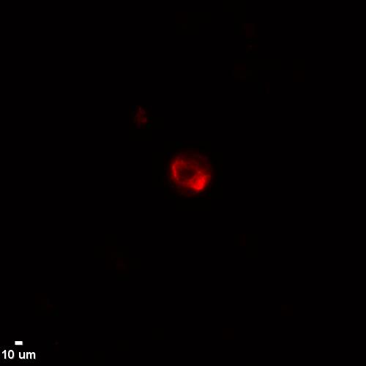
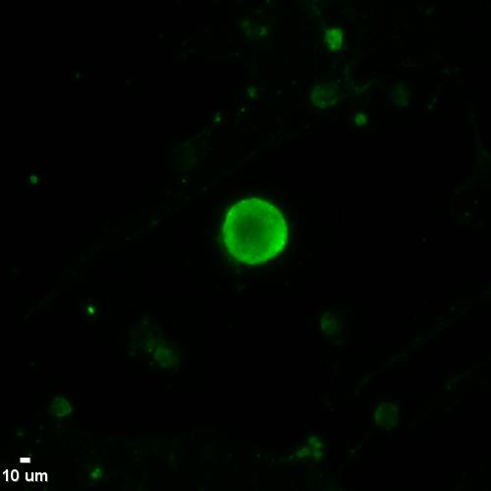
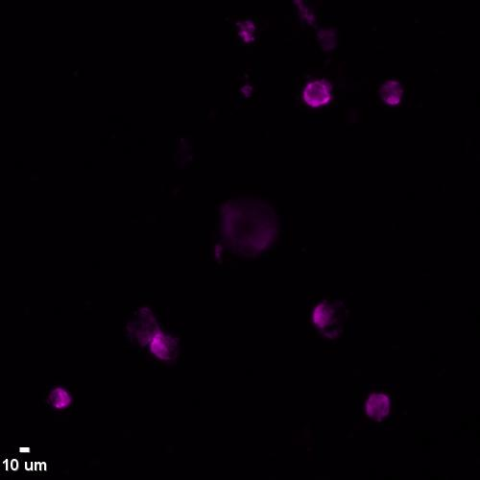
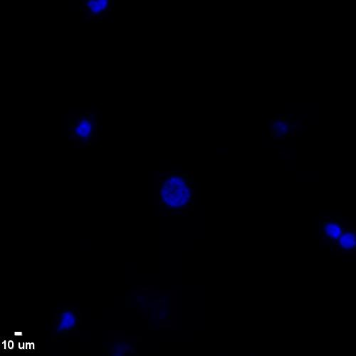
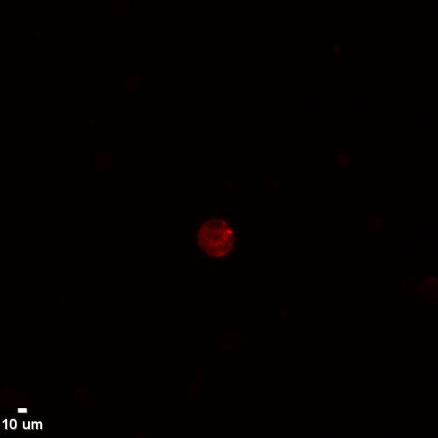
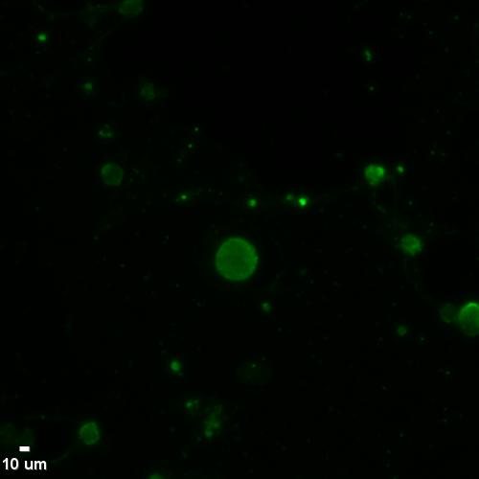
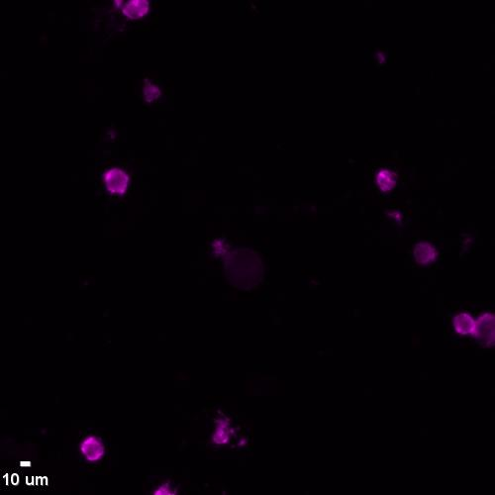
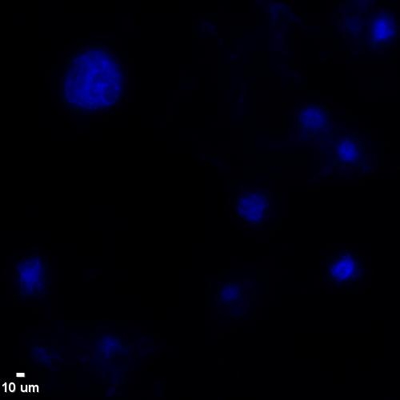
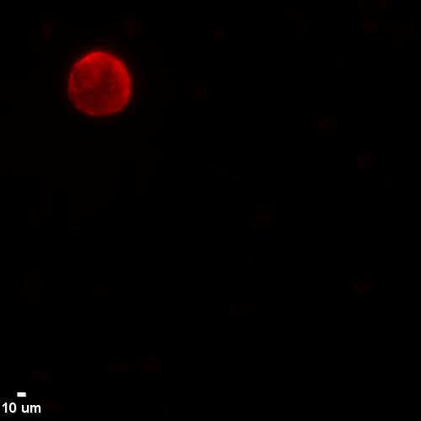
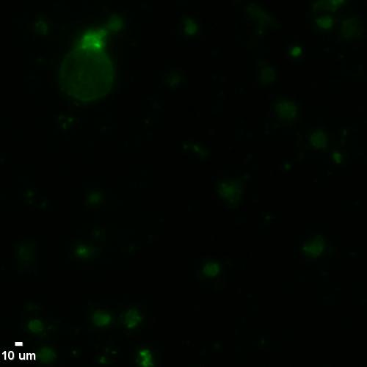
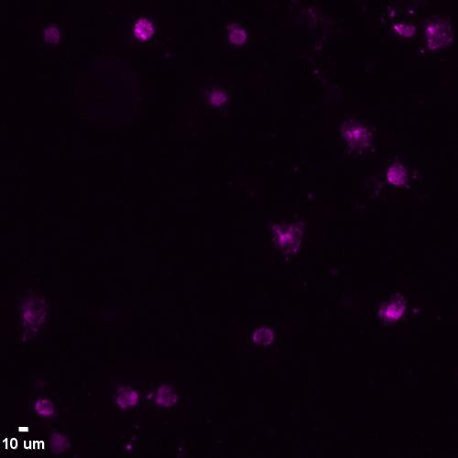
A
Mean Intensity: 18114 High Expression
DAPI CK PD-L1 CD45
B
Mean Intensity: 7915 Low Expression
DAPI CK PD-L1 CD45
C
Mean Intensity: 2052 Negative Expression
DAPI CK PD-L1 CD45
Notes:
Supplementary Figure 2. Expression Levels of PD-L1 in MDA-MB-231 Cancer Cells (Control Samples). (A) High Expression: The MDA-MB-231 cell line was triple-stained with pan-cytokeratin (panCK; A45 – B/B3), PD-L1, and CD45 antibodies. The stained cells were analyzed using VyCAP microscopy (VyCAP B.V., Enschede, The Netherlands). The mean intensity of PD-L1 expression was quantified using ICY software. (B) Low Expression: The MDA-MB-231 cell line was triple-stained with pan-cytokeratin (panCK; A45 – B/B3), PD-L1, and CD45 antibodies, followed by analysis with VyCAP microscopy. The mean intensity of PD-L1 expression was assessed using ICY software. (C) Negative Expression: The MDA-MB-231 cell line was stained only with panCK and CD45 antibodies, omitting the primary PD-L1 antibody, while including the secondary IgG antibody. The analysis was performed using VyCAP microscopy, and the mean intensity of PD-L1 expression was measured using ICY software. Scale bars = 10μm.

