Slide 1
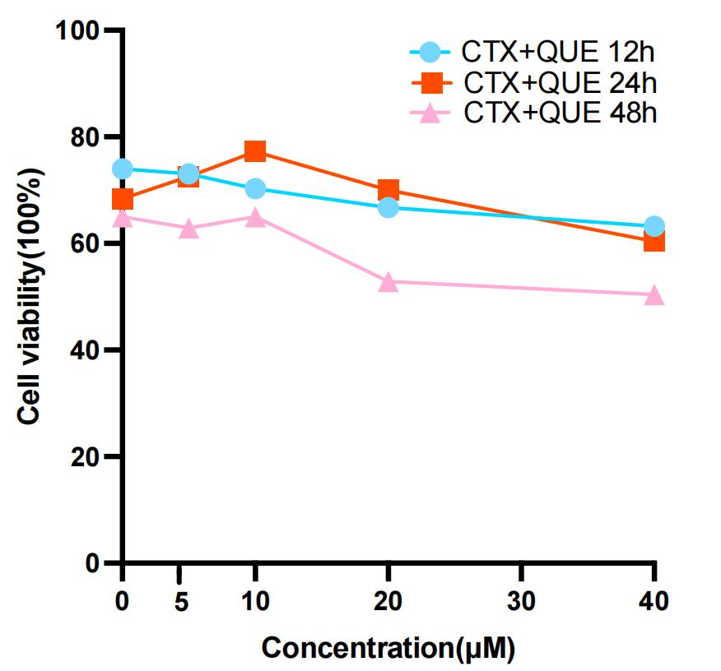
Fig.S1
A
B
0μM
50μM
100μM
200μM
400μM
C
A Numbers of corpus luteums in groups of mice (n=6). B Flow cytometry analysis of apoptosis in KGN cells treated with different CTX doses. C CCK8 assessment of KGN cell viability under different treatments (n=6).

