Slide 1
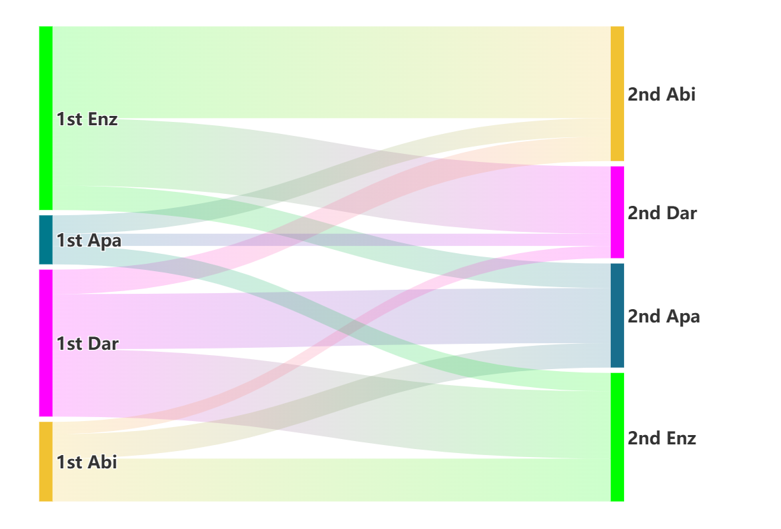
Fig. S1
Sequence of administration of ARSIs
n = 22
n = 30
n = 15
n = 8
n = 17
n = 24
n = 21
n = 13

