Slide 1
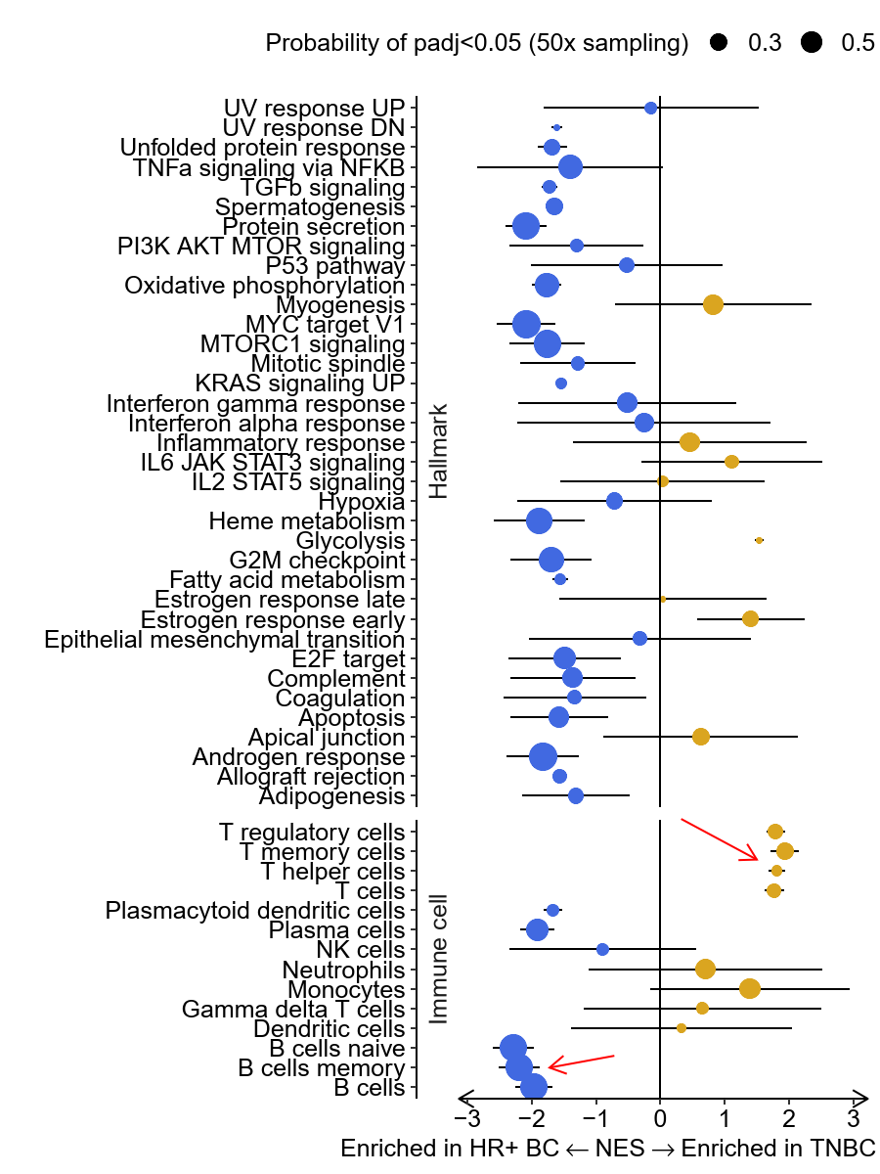
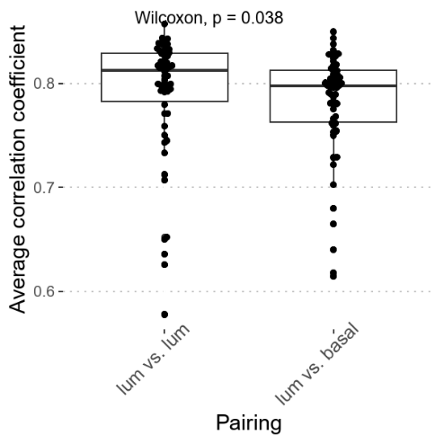
B
A
Supplement Figure 1. Peripheral immunological signature is associated with breast cancer subtype at baseline. (A) The average correlation coefficient between the peripheral blood signatures of a luminal-like breast cancer sample versus all other luminal-like breast cancer sample is higher than the average correlation coefficient between that of a luminal-like breast cancer versus all other basal-like breast cancer. Wilcoxon test is performed. (B) 50X random sampling was performed to evaluate whether a Hallmark pathway or immune cell subtype is stably enriched in either HR+ BC or TNBC. Point size indicate the proportion of times a pathway is significantly enriched. The 95% confidence interval of the net enrichment score is depicted.

Slide 2
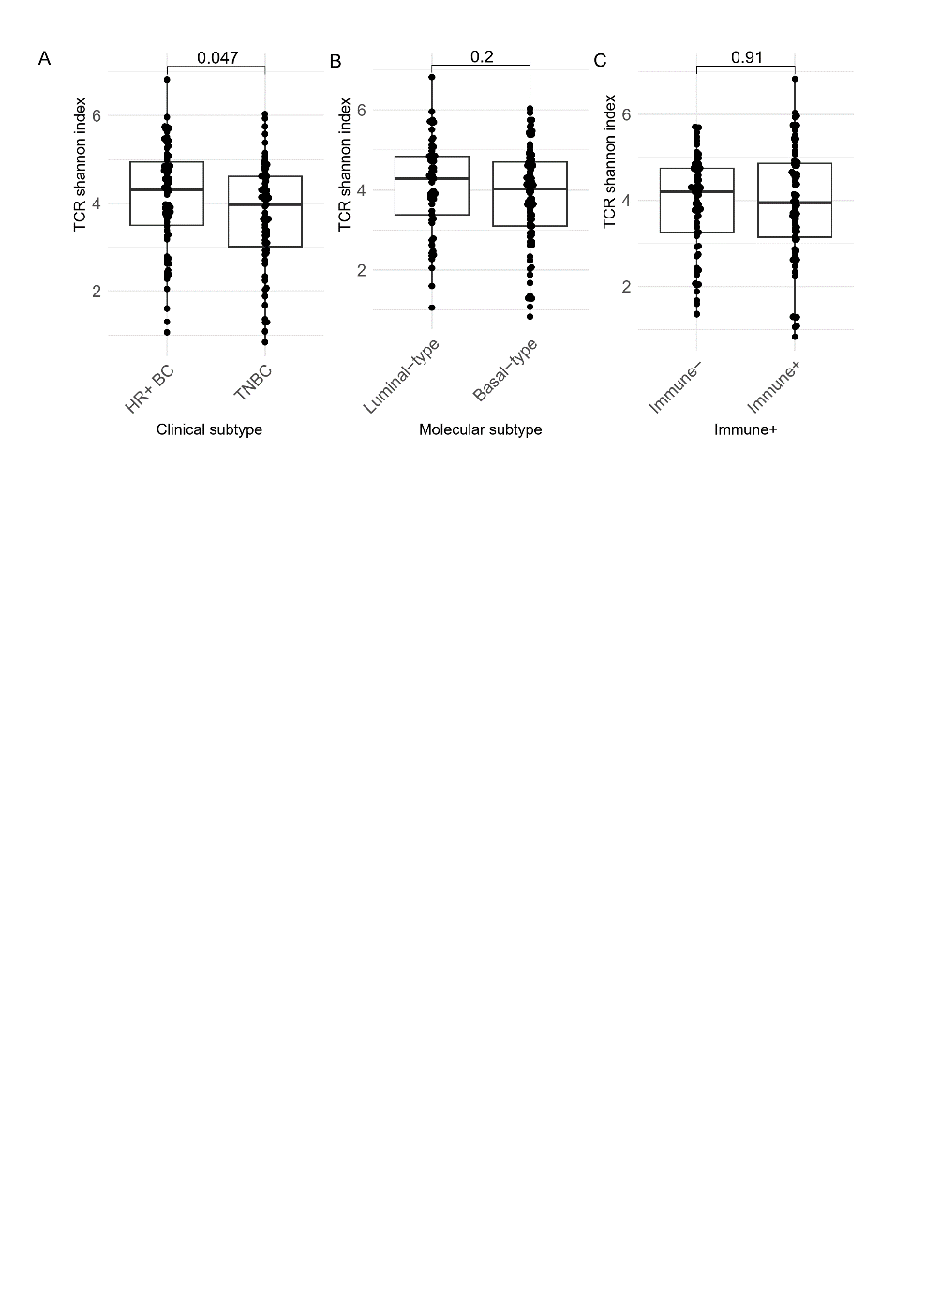
Supplement Figure 2. Baseline TCR diversity is higher in TNBC patients. TCR Shannon diversity index was compared between (A) breast cancer clinical subtype (B) molecular subtype (C) Immuno-phenotype, two tailed t-test was performed

Slide 3
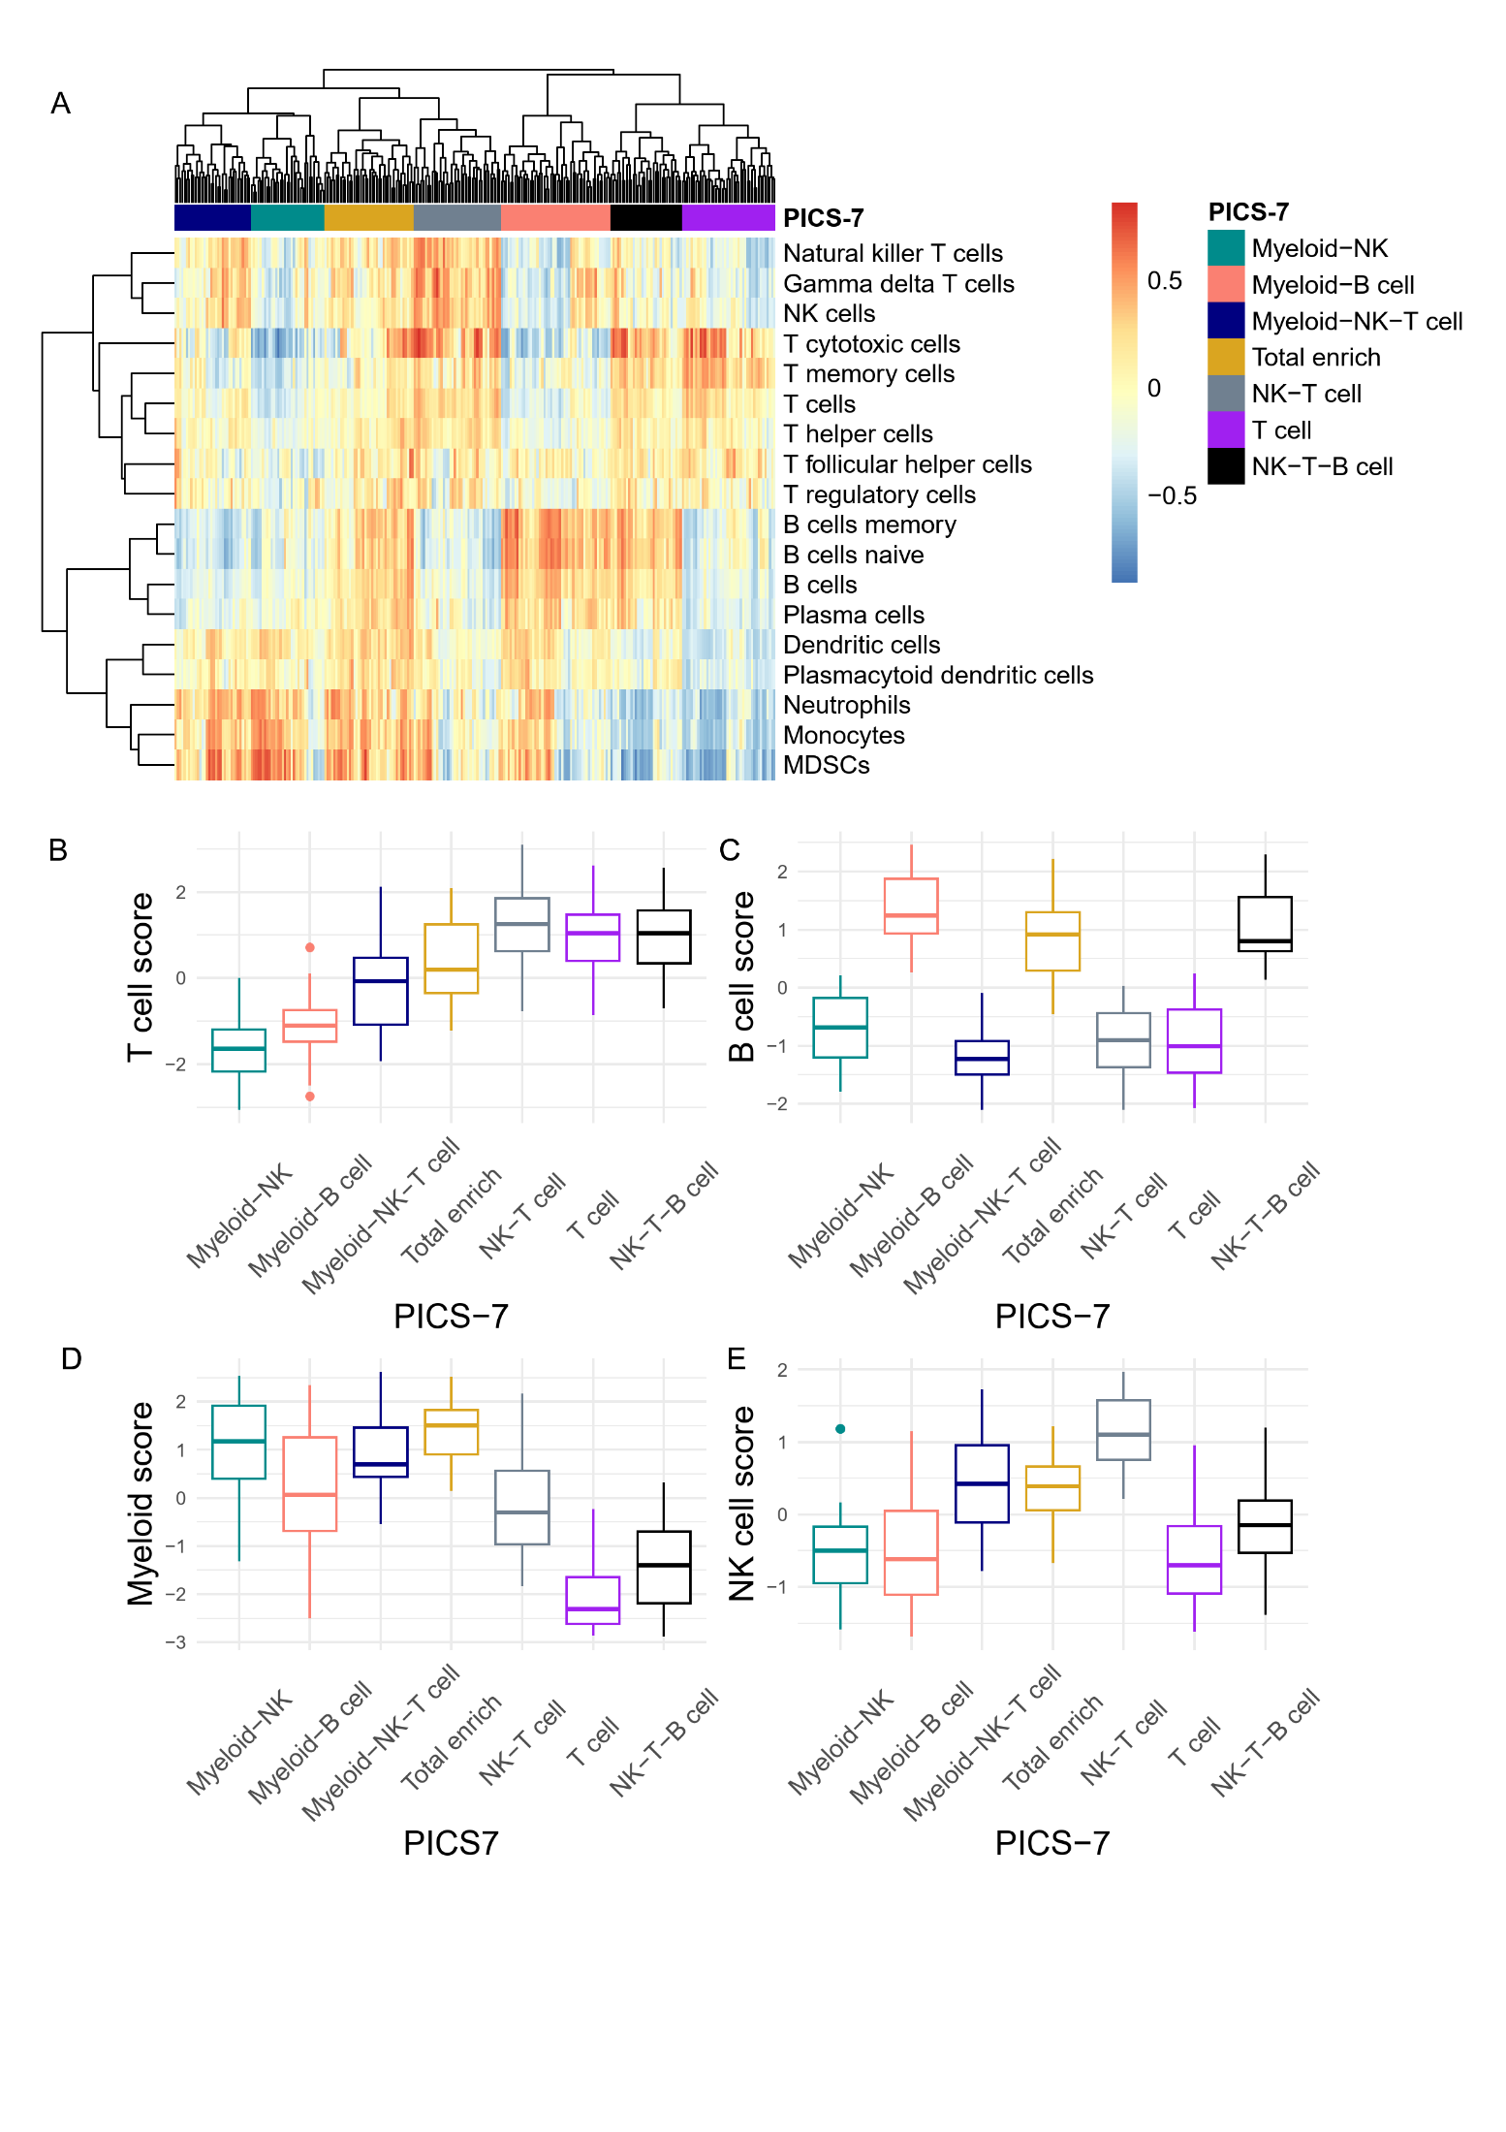
Supplement Figure 3. PICS-7 classification. (A) PICS-7 clusters were generated based on hierarchical clustering of blood samples collected at Baseline and EarlyTreatment timepoints. The sum of (B) T cell, (C) B cell, (D) Myeloid cell, and (E) NK cell score was depicted across different PICS-7 clusters.

Slide 4
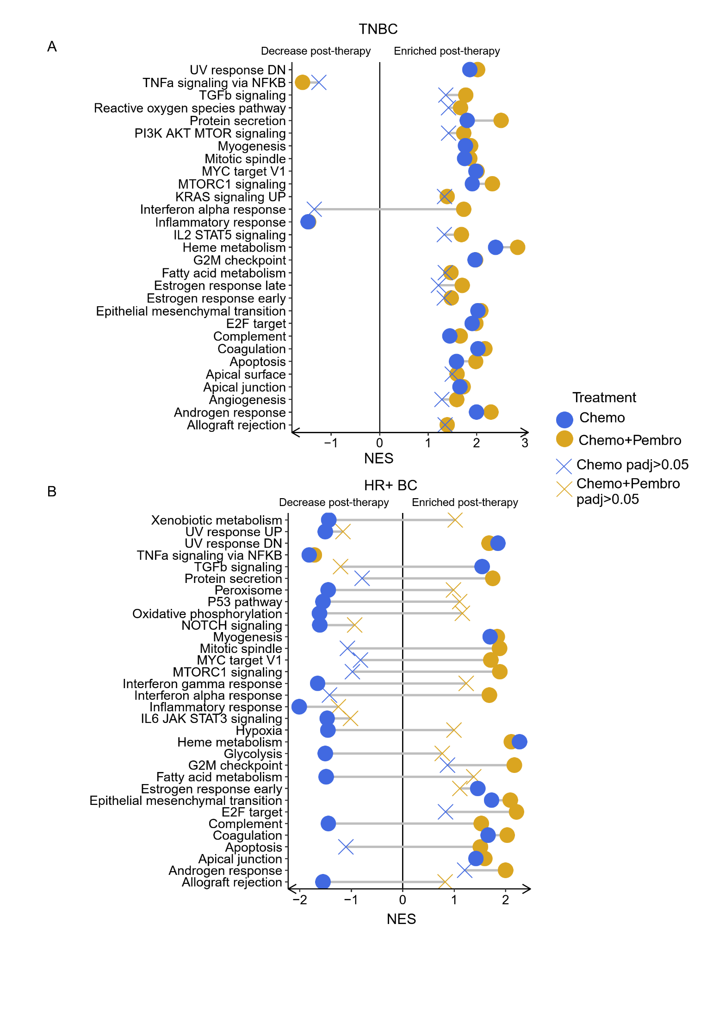
Supplement Figure 4. Chemo+Pembro induced upregulation of interferon and inflammatory response in PBMC. Gene set enrichment analysis using Hallmark pathways performed between EarlyTreatmant and Baseline for (A) TNBC and (B) HR+ BC, with non-significant enrichment labeled with X

Slide 5
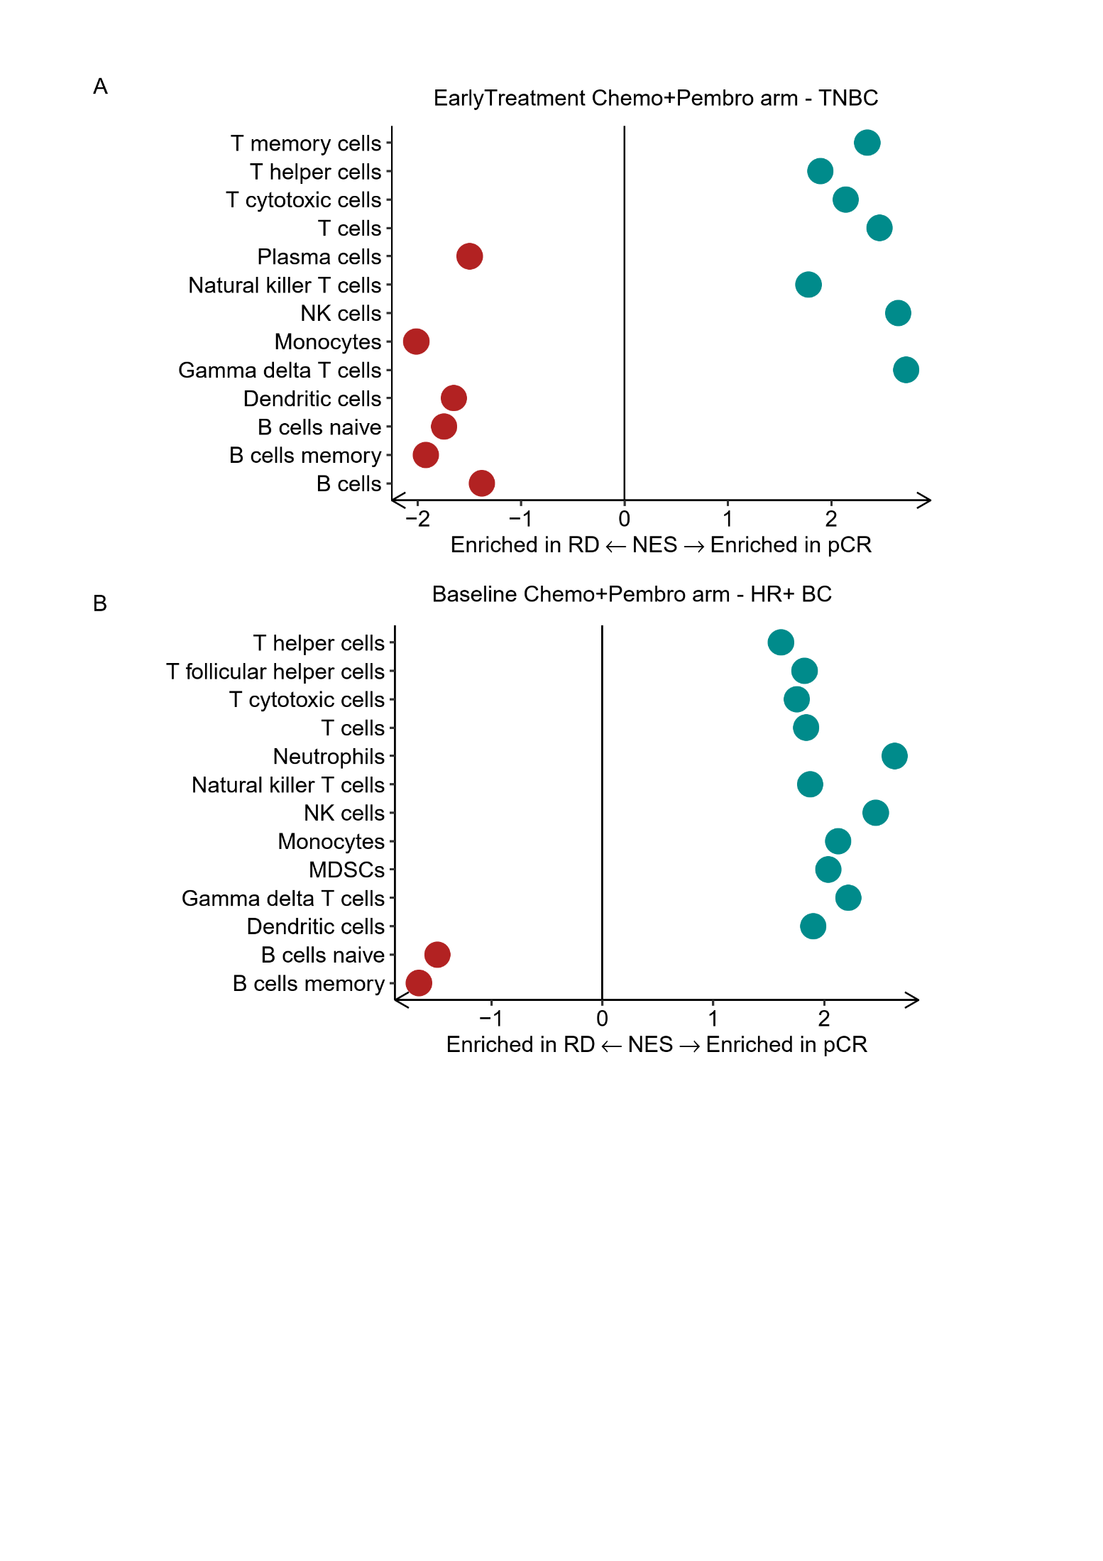
Supplement Figure 5. T cell associated signatures enriched in pCR patients. (A) Enrichment of immune cell signatures in pCR and RD TNBC patients at EarlyTreatment. (B) Enrichment of immune cell signatures in pCR and RD HR+ BC patients at Baseline. Only pathways with GSEA permutation test adjusted p value < 0.05 are presented here

Slide 6
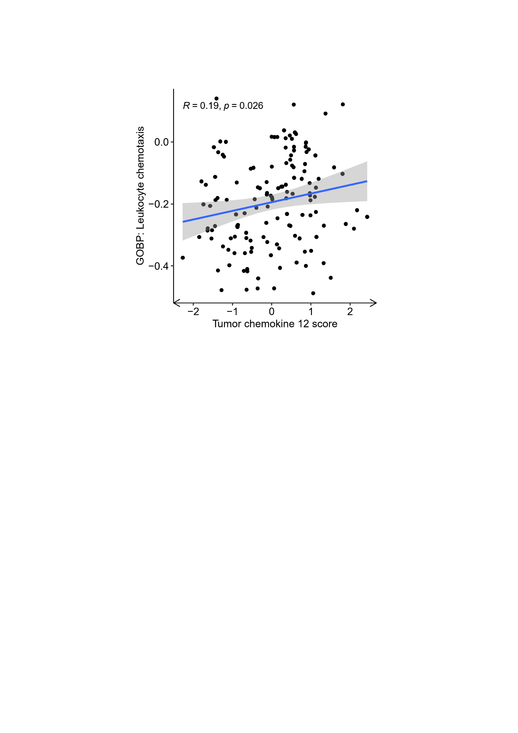
Supplement Figure 6. Positive correlation observed between tumoral chemokine score and blood leukocyte chemotaxis score. Pearson correlation test was performed to identify correlation between tumoral chemokine score and blood leokocyte chemotaxis score calculated through GSVA.

Slide 7
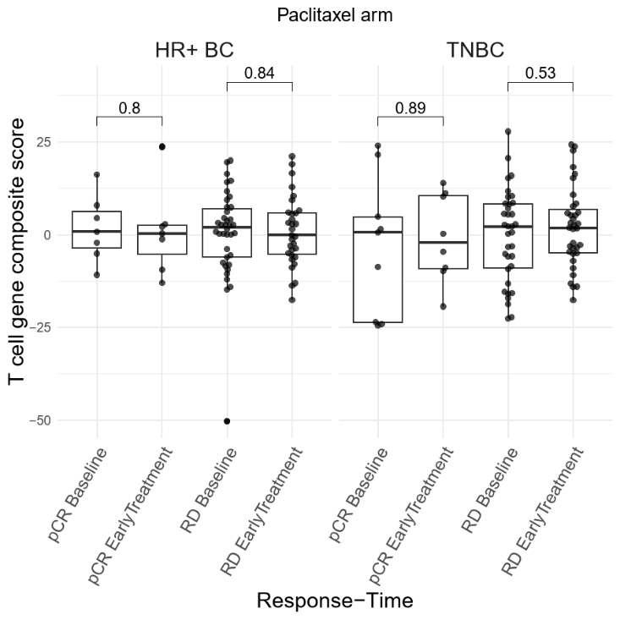
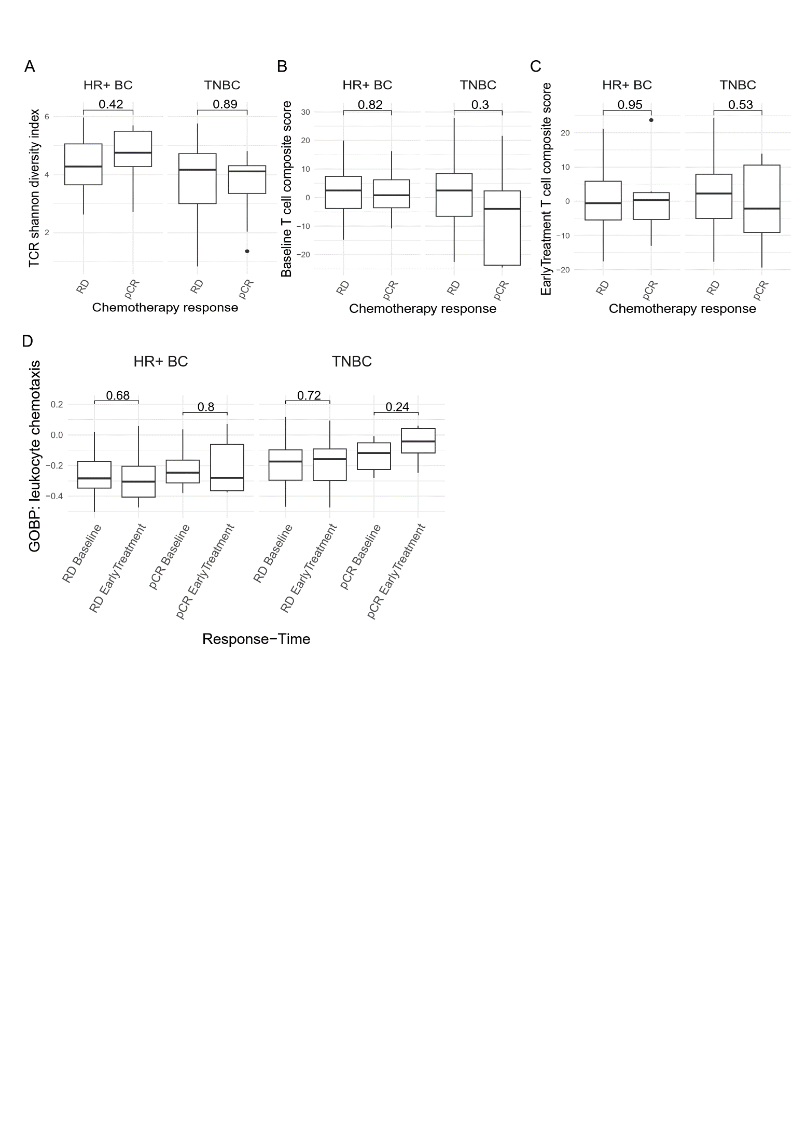
A
B
C
D
Supplement Figure 7. Peripheral immune features associated with Chemo+Pembro response could not be extend to Chemo response. (A) The 17-gene T cell composite score was compared between pCR and RD at baseline using t test. (B) Paired T test was performed to calculate the difference of 17 gene T cell composite score before and after chemotherapy treatment (C) Paired T test was applied to monitor leukocyte chemotaxis score after Chemo in TNBC and HR+ BC patients. (D) Baseline TCR Shannon diversity index, and

Slide 8
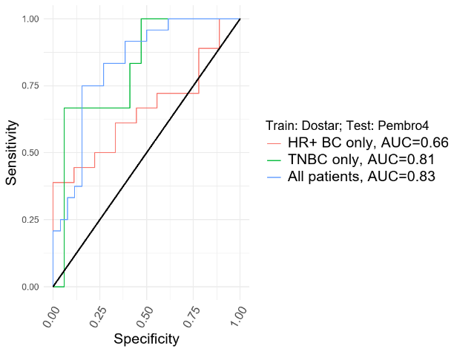
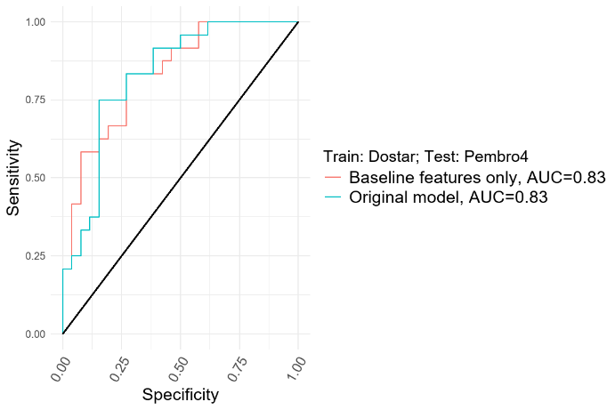
A
B
Supplement Figure 8. Immunotherapy response prediction model with reduced parameter. (A) AUC curve for the immunotherapy response prediction model when applied to all patients, HR+ BC only, and TNBC only. Model trained on Dostar arm and tested on Pembro4 arm. (B) AUC curve for the original immunotherapy response prediction model and the model containing only baseline clonality, T cell composite score and breast cancer subtype parameter. Model trained on Dostar arm and tested on Pembro4 arm.

