Slide 1
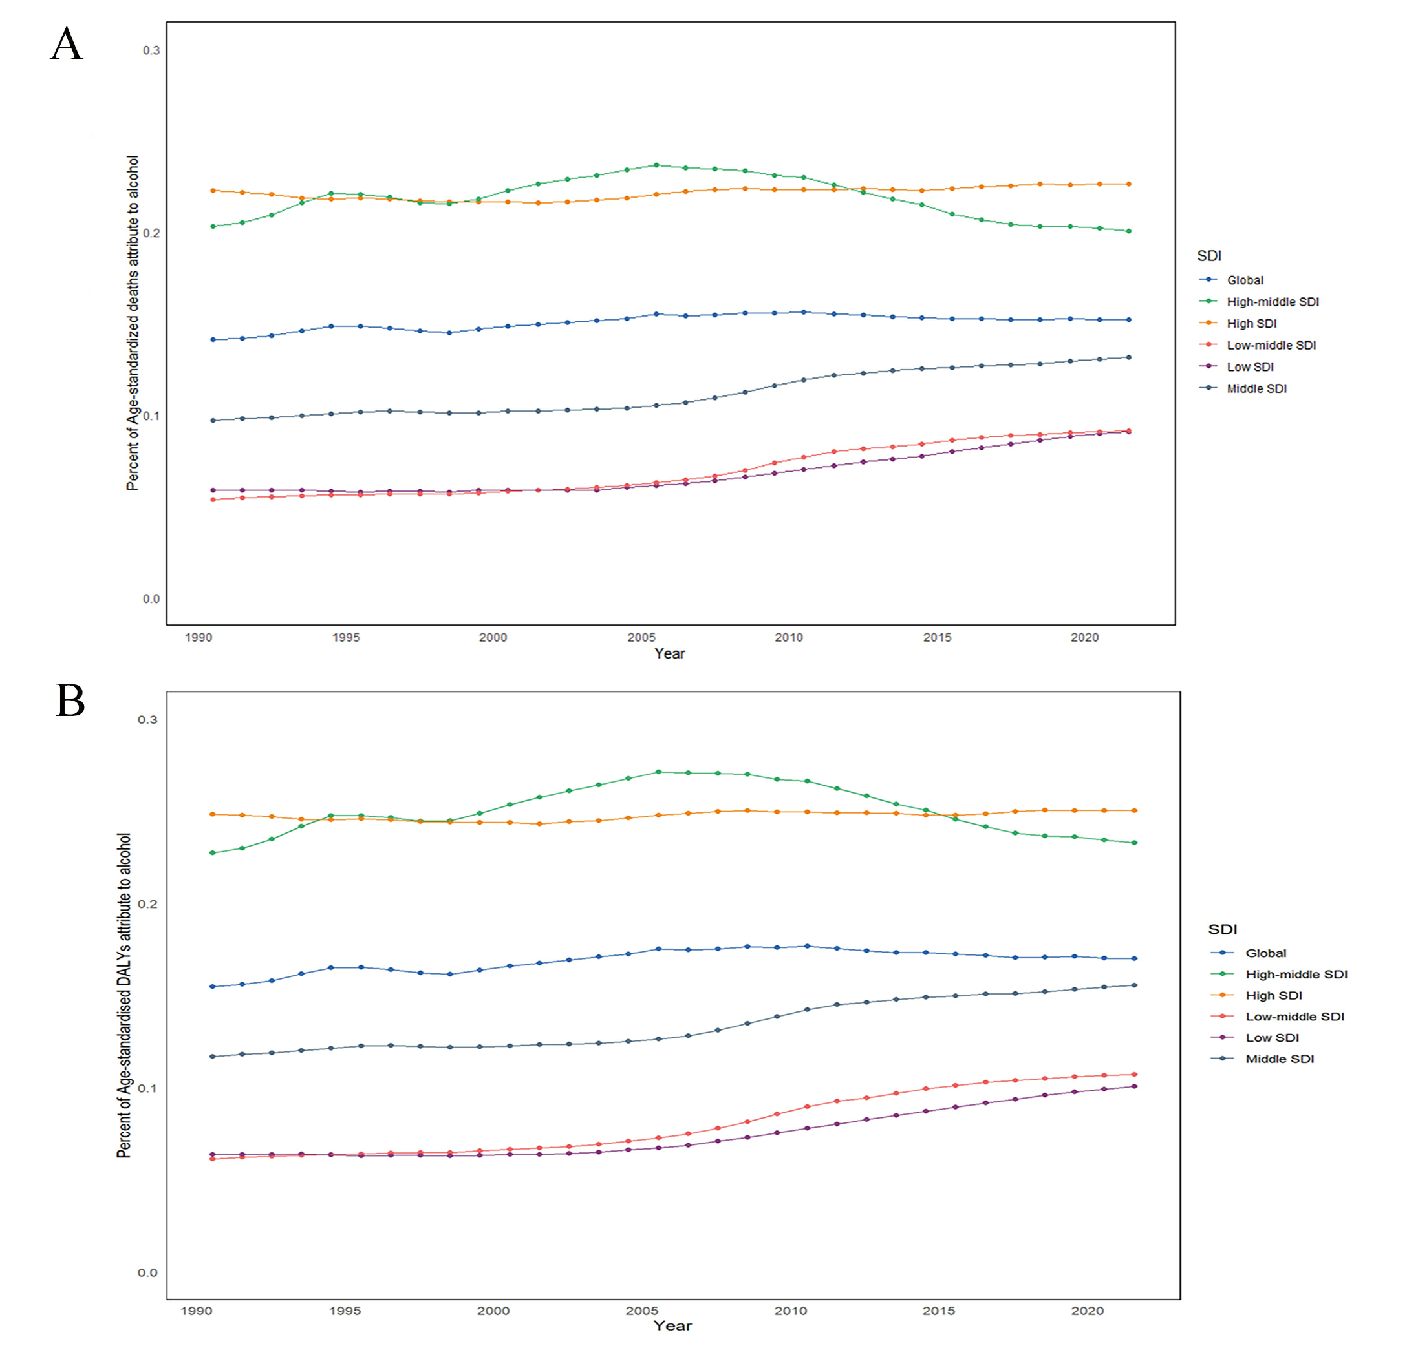
Fig S1:Global trends in percentage of age standardized deaths (A) and age standardized DALYs (B) for pancreatitis attribute to alcohol use and across five SDI quintiles from 1990 to 2021. DALYs, disability-adjusted life-years rate; SDI, Socio-Demographic Index.

Slide 2
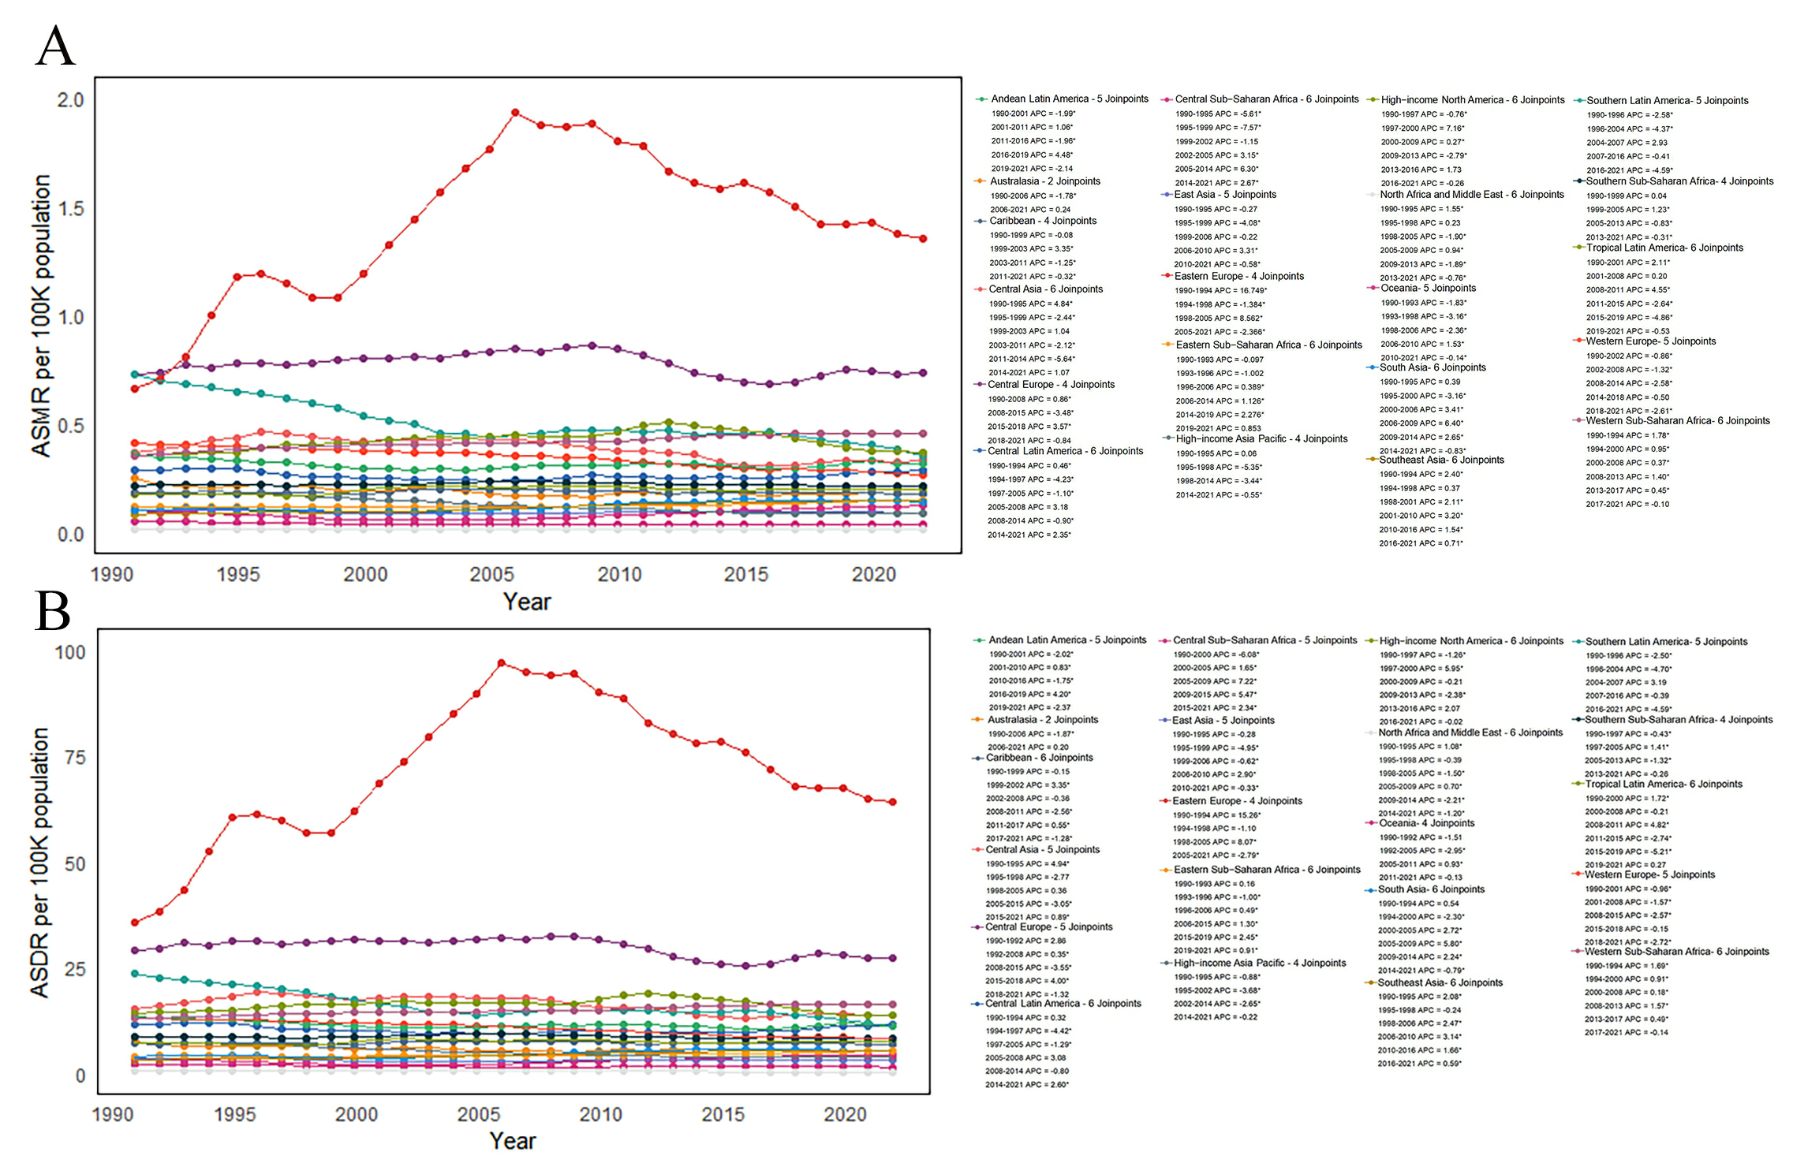
Fig S2:Trends in ASMR (A) and ASDR (B) for pancreatitis attribute to alcohol use across 21 GBD regions from 1990 to 2021 in Joinpoint models. ASMR, age standardized mortality rate; ASDR, age standardized disability-adjusted life-years rate; APC, annual percent change; GBD, global burden of diseases.

