Slide 1

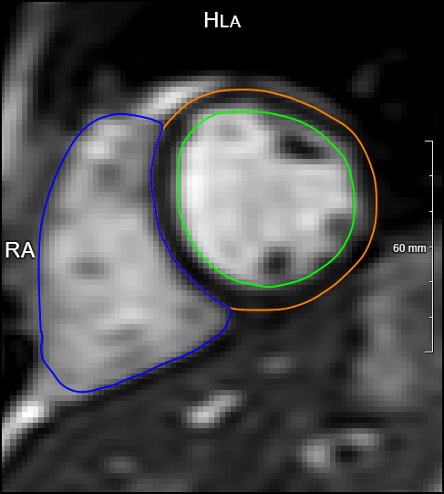
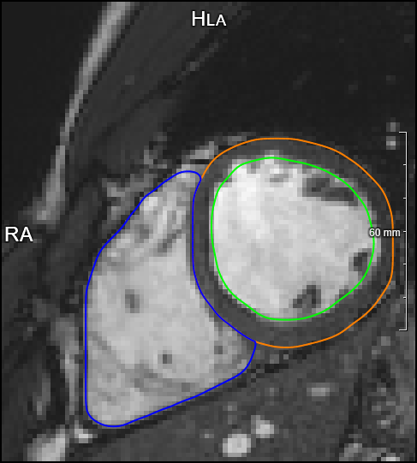
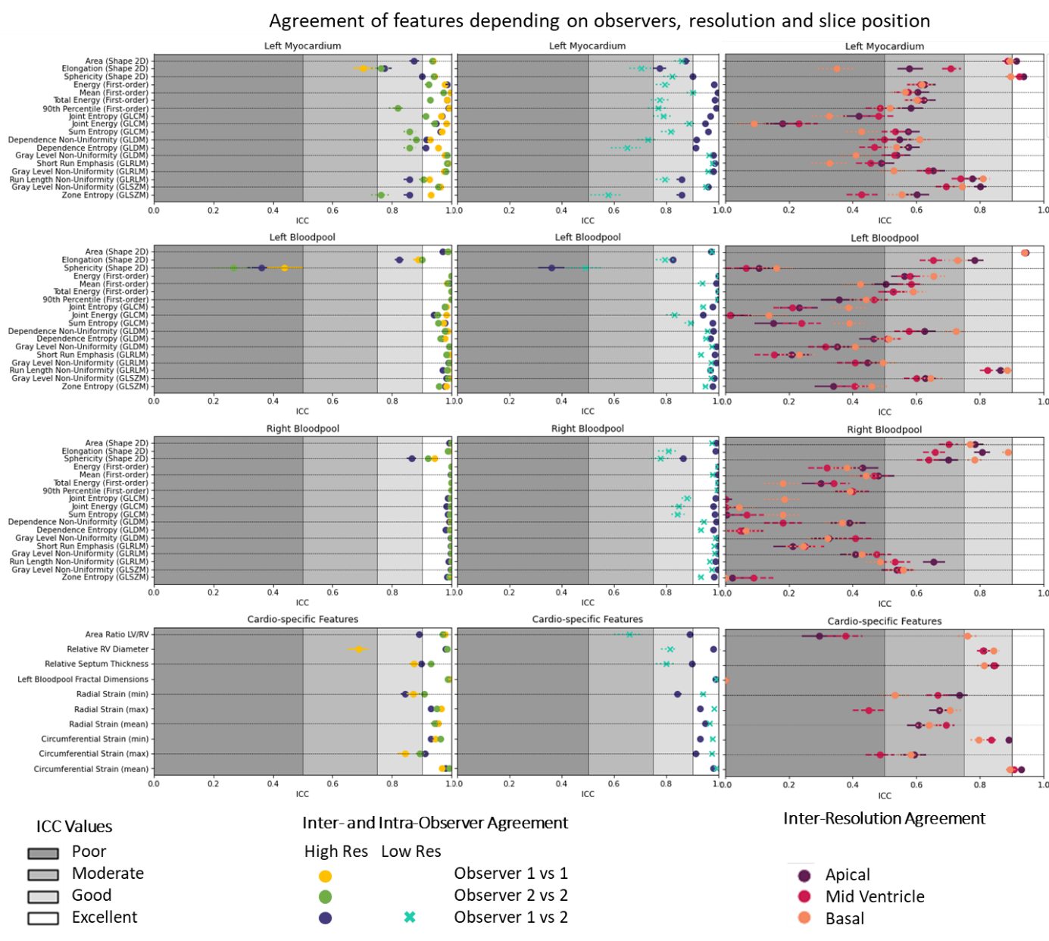






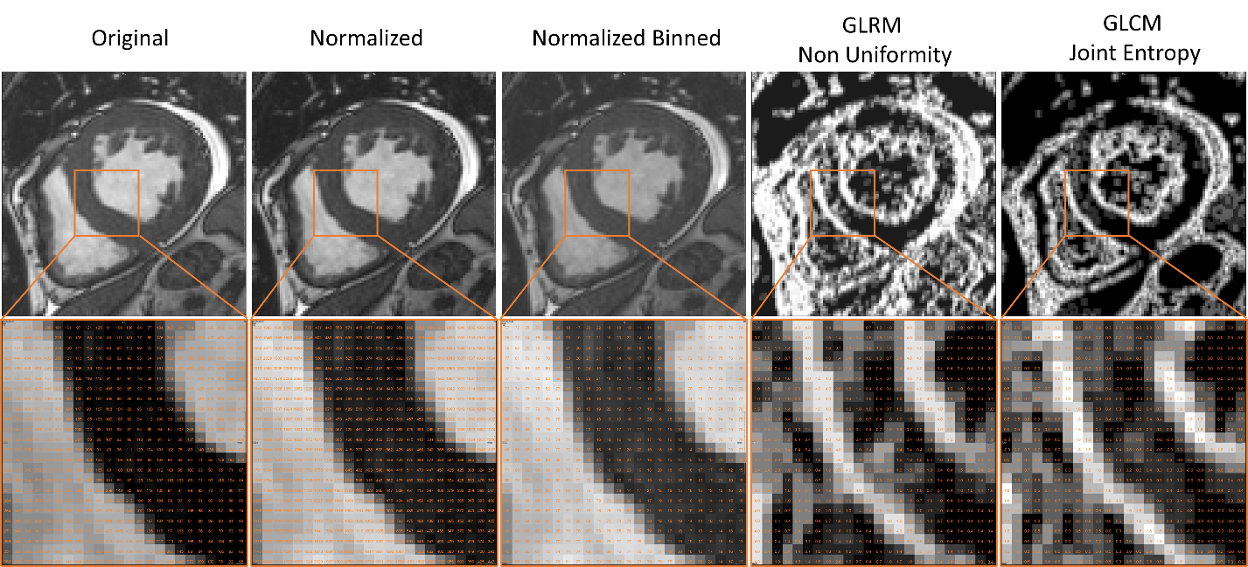


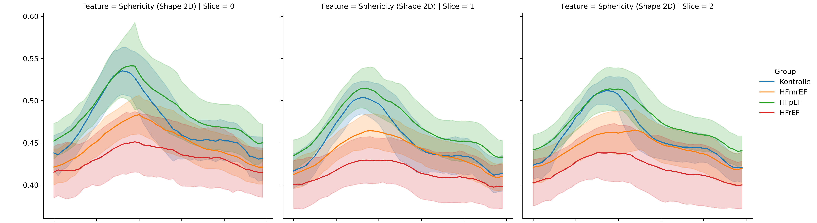


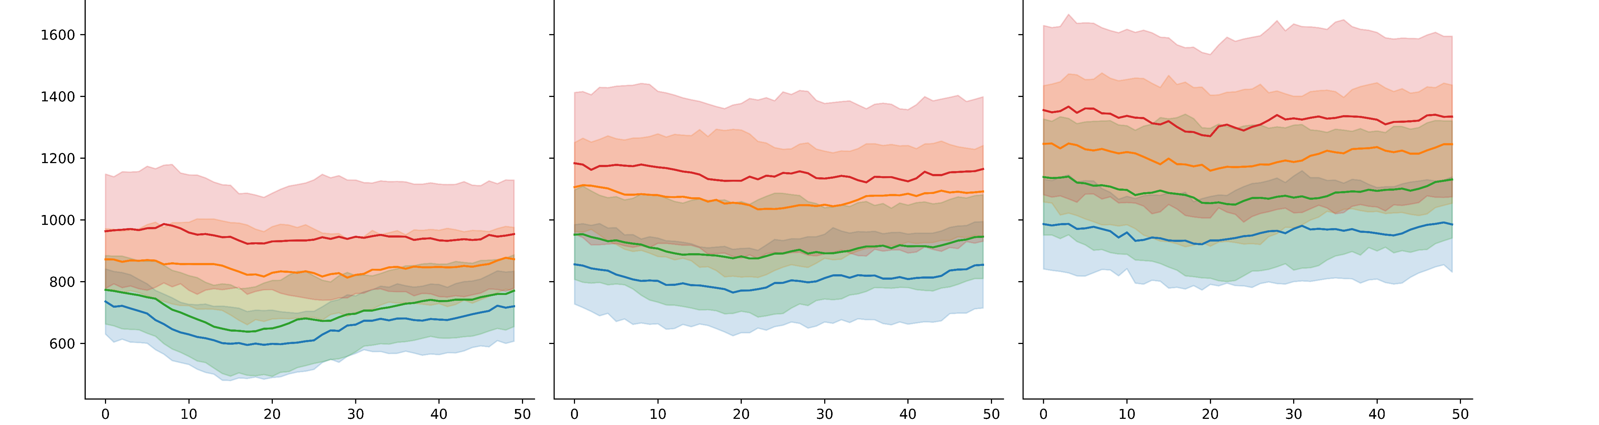

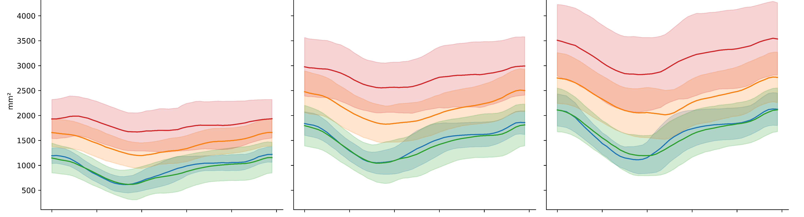


 | Low Resolution | High Resolution
In-plane resolution (isotropic) | 1.43 ± 0.12 mm | 1.39 ± 0.03 mm
Slice thickness | 10mm | 5mm
Temporal resolution | 20 phases/cycle | 50 phases/cycle
Healthy volunteers
Multi Resolution Expert Segmentations
Feature Robustness Analysis
Major Findings
Age: 27.5 (IQR 9) LV EF: 60% (IQR 59, 60)
N:6
N:6
> 90% of the radiomics features show good to excellent inter- and intraobserver reproducibility
Radiomics features are more sensitive to spatiotemporal image resolution than to observer variation of the segmentation
Observer 2
Observer 1
Empathy Cohort
Controls
Age: 62(IQR 11 )
LV EF:64% (IQR 8 )
Resampling, Normalization, Feature Calculation
N:10
N:9
N:10
N:9
Preserved Ejection Fraction
Age: 78 (IQR 9) LV EF: 59% (IQR 12)
N:11
N:11
Robust Feature Variation in Heart Failure Subgroups
Robust radiomics feature average values of the left ventricular bloodpool and myocardium show significant differences between
healthy controls,
heart failure patients with
reduced ejection fraction,
mildly reduced ejection fraction,
preserved ejection fraction
Mri scanner icons created by ekays.dsgn - Flaticon
Mildly Reduced Ejection Fraction
ECG-Gated bSSFP Cine MRI
Apical
Mid Ventricle
Basal
Age: 73 (IQR 10) LV EF: 44% (IQR 5)
Myocardium Sphericity
N:4
N:13
Reduced Ejection Fraction
Automatic Segmentations
Run Length Non-Uniformity
Age: 63 (IQR 14) LV EF: 34% (IQR 7)
In-plane resolution (isotropic) | 1.45-1.63 mm
Slice thickness | 8 mm
Temporal resolution | 50 phases/cycle
N:3
N:12
Bloodpool Area
CNN
Time

