Slide 1
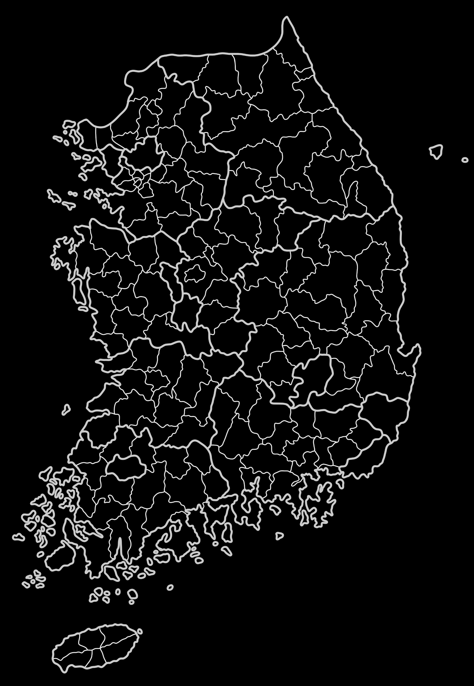
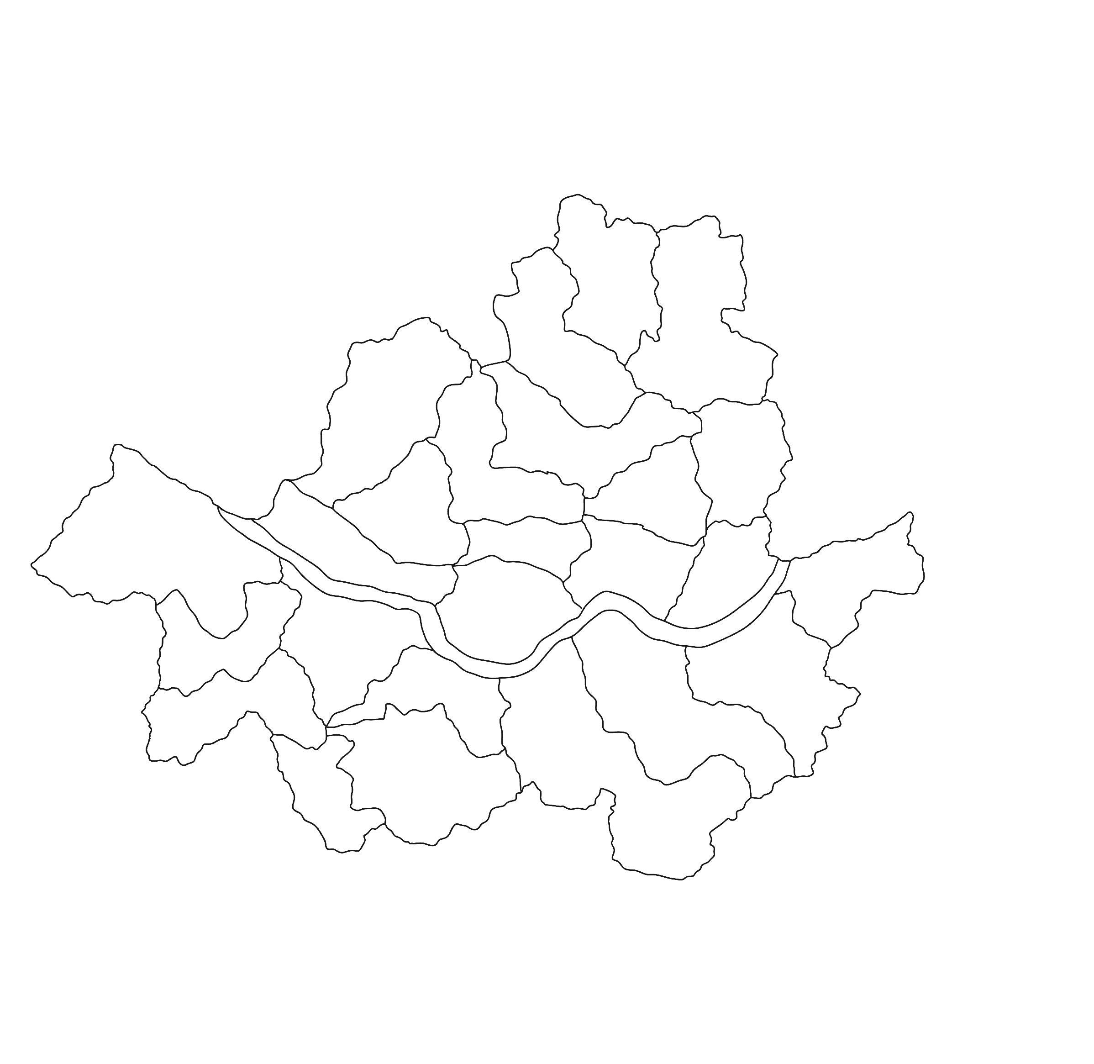
Supplementary Fig. 1. Locations of Korean Medicine clinics participating in the registry

