Slide 1
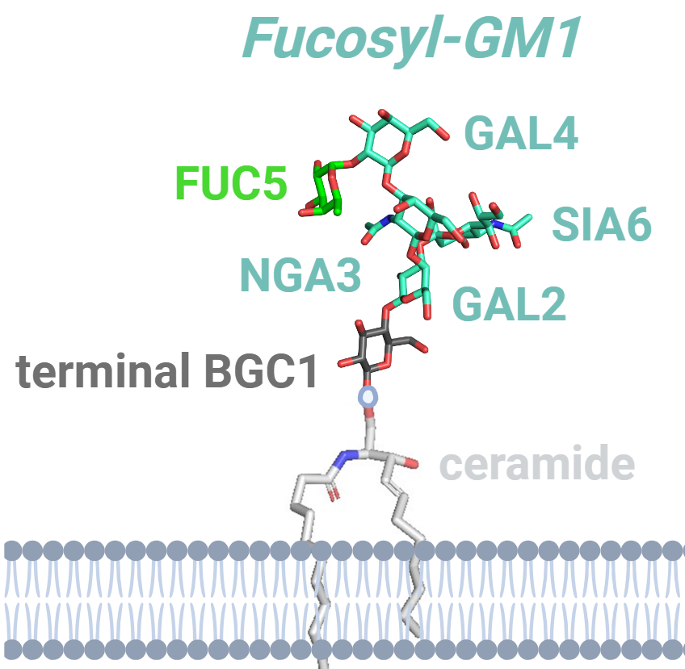
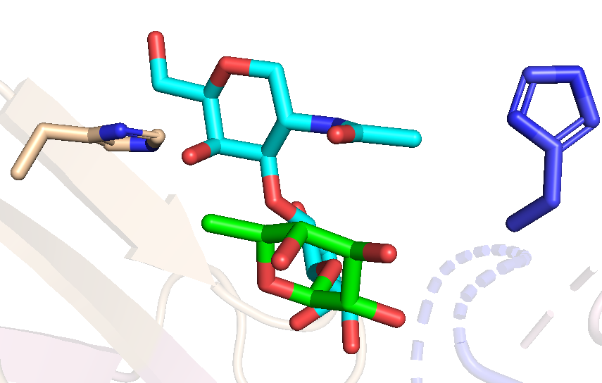
Supplemental Figure 1. Fucosyl-GM1 docking onto SC134 using HADDOCK. Fucosyl-GM1 (stick, cyan and green for fucose, FUC5) with terminal BGC1 facing the membrane via ceramide A. SC34 bound to fucosyl-GM1 in cartoon (B). NGA3 flanked by residues from CDRH2 and CDRL3 to support GAL4-FUC5 (F)
A
B
NGA3
HIS211
HIS53
FUC5
GAL4

Slide 2
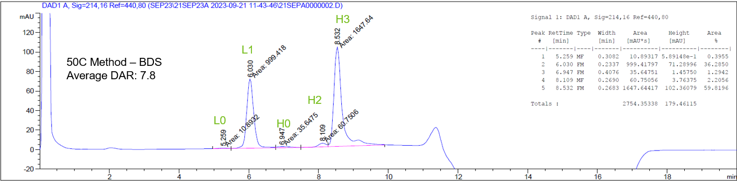
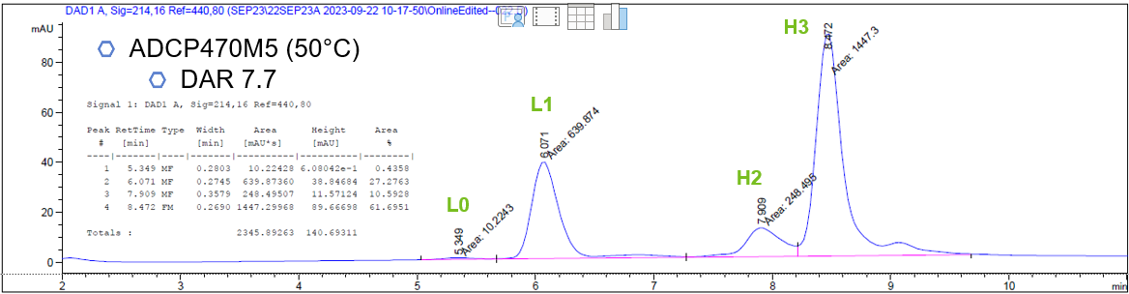
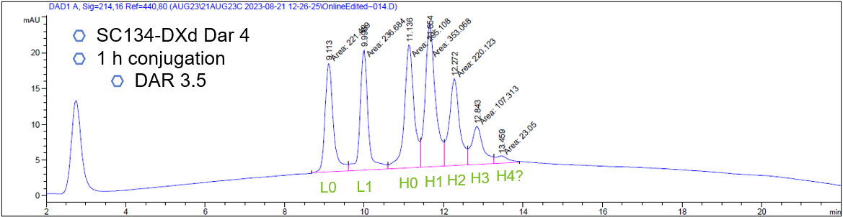
Supplemental Figure 2. RP-HPLC chromatograms of Rituximab (A) and SC134 following conjugation to deruxtecan at DAR8 (B) and DAR4 (C).
A
B
C

Slide 3
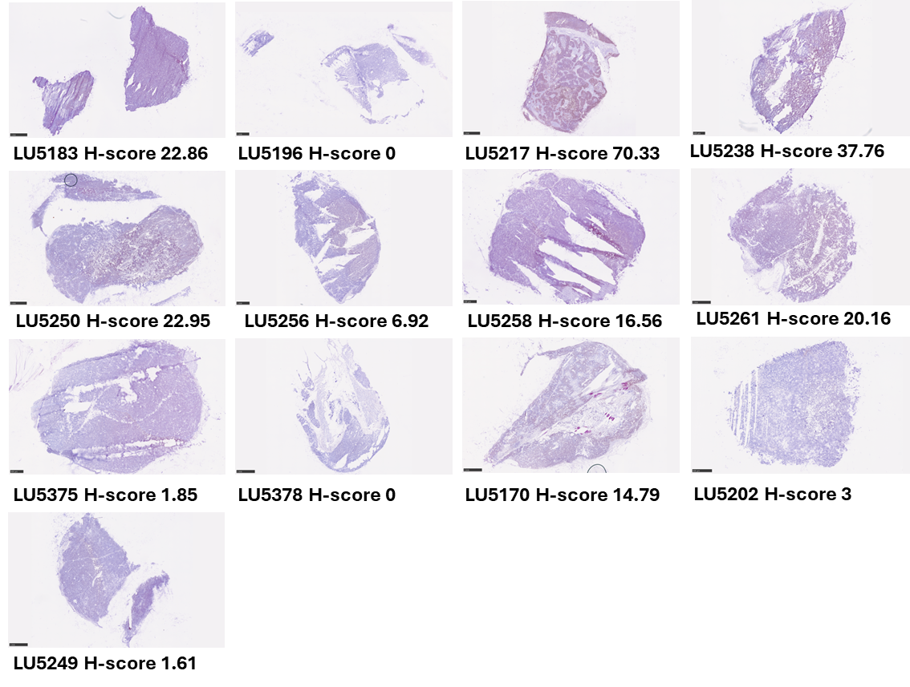
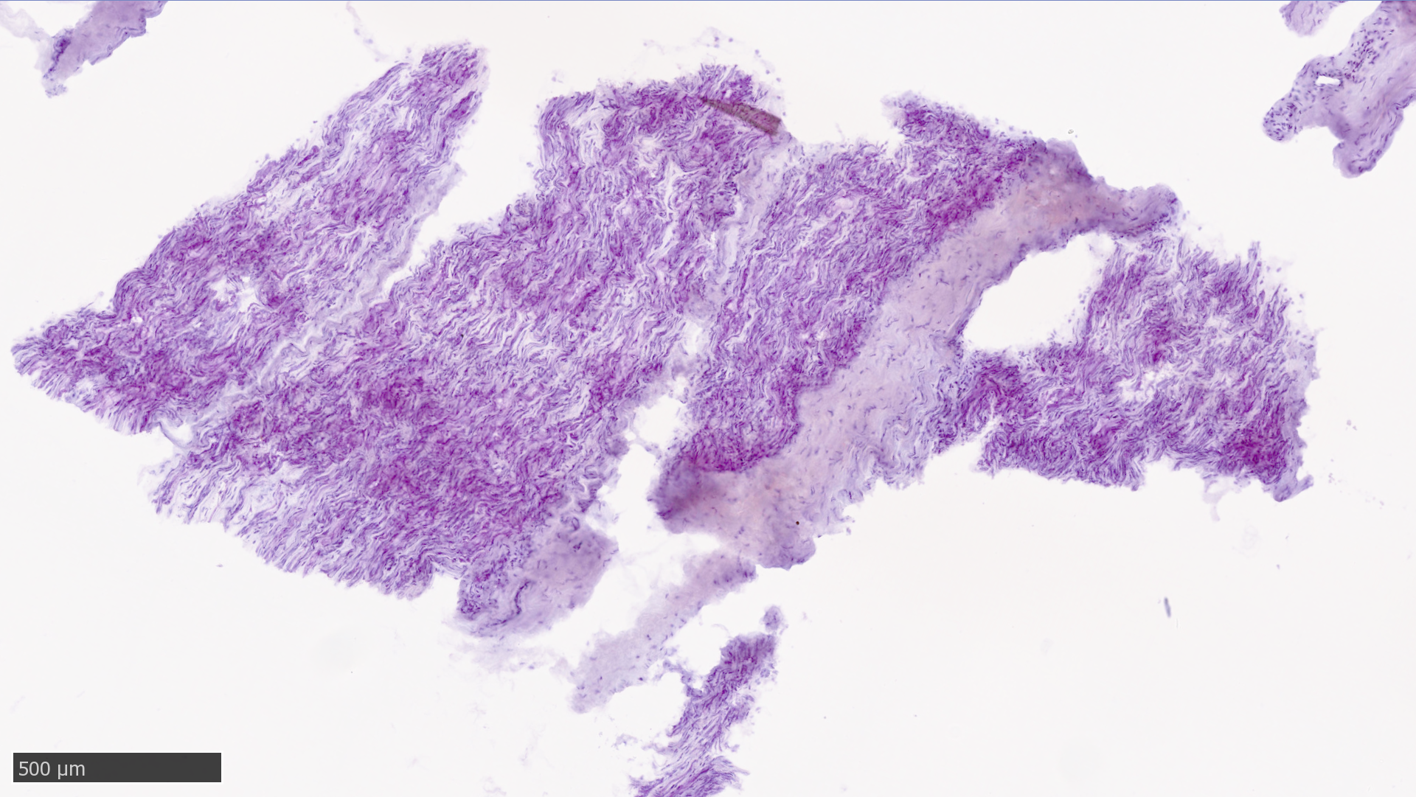
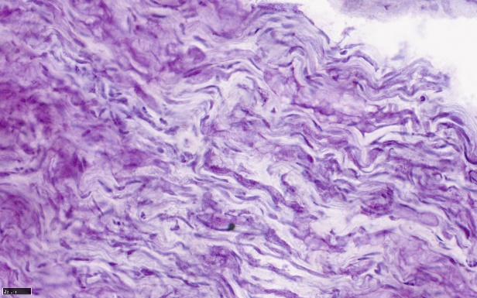
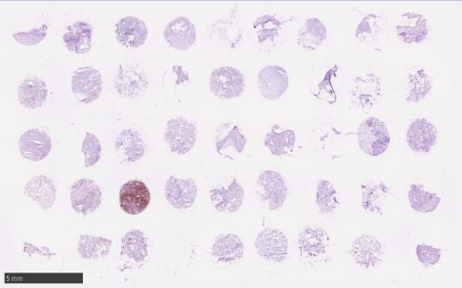
Supplemental Figure 3. A. IHC analysis of DLL3 distribution in Crown PDX tissues; B. Absence of FucGM1 (via IHC) in frozen full face peripheral nerve tissue; C. IHC analysis of FucGM1 distribution in NSCLC (NSCLC array (AMSBIO, T6235152-1)
A
B
C

Slide 4
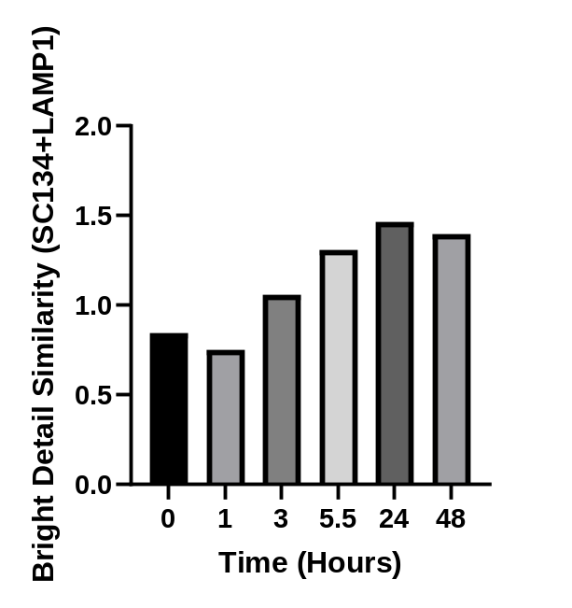
Supplemental Figure 4. Median bright detail similarity of SC134-AF647 and anti-LAMP1-AF488 fluorescence following culture of DMS79 in the presence of SC134-AF647 for the indicated lengths of time. A higher bright detail similarity value indicates higher colocalization between the two fluorescence channels. Median of 1500-3000 events at each time point.

Slide 5
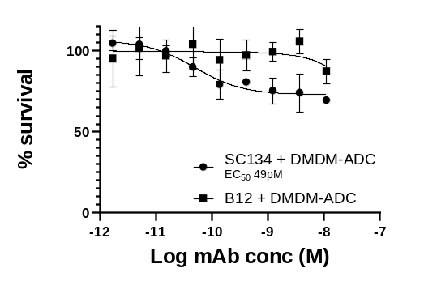
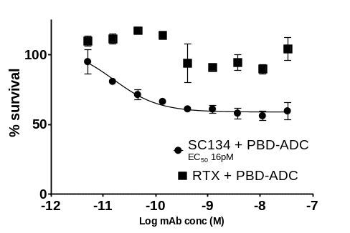
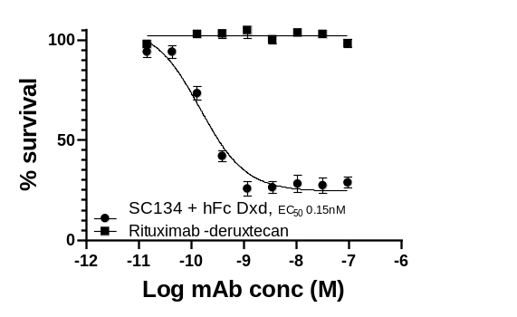
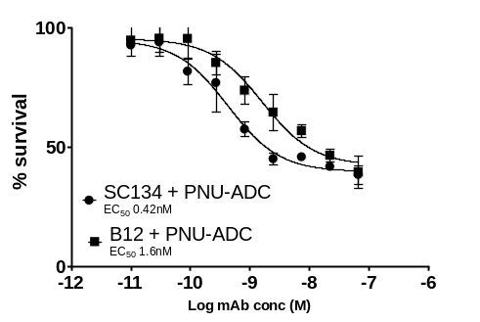
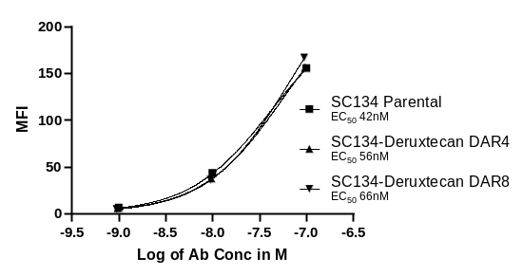
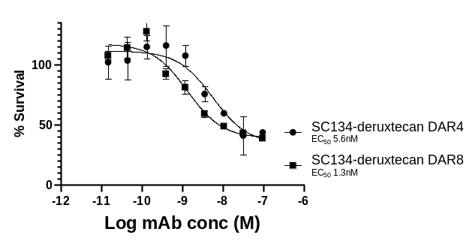
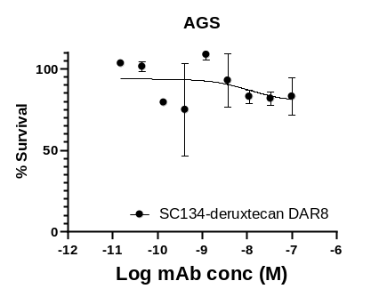
Supplemental Figure 5. DMS79 cell survival, following 72-hour culture with titrated SC134 plus ADC secondaries, compared to a non-targeting control antibody+ADC (rituximab (RTX) or B12). Titrated SC134 or B12/RTX complexed with 0.2ug/ml DMDM secondary (A), 0.2ug/ml PBD (B), 1ug/ml DX895 (C), or 0.6ug/ml PNU (D). DMS79 binding by unconjugated SC134 compared to SC134-deruxtecan DAR8 and DAR4 (E). Cytotoxicity of SC134-deruxtecan DAR4 or DAR8 on DMS79 (F). Target negative AGS cells cultured in the presence of SC134-deruxtecan DAR8 (G).
A.
B.
C.
D.
E.
F.
G.

Slide 6
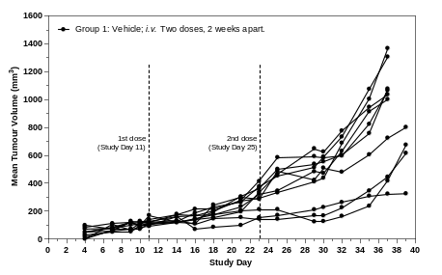
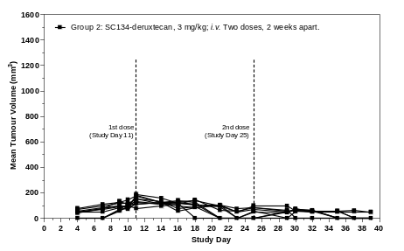
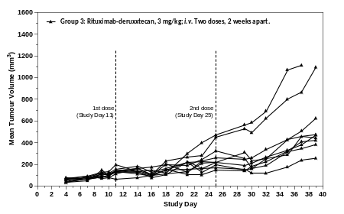
Supplemental Figure 6. Individual tumour growth curves, per group, in the DMS79 xenograft model. Mice (n=10) were dosed twice on day 11 and day 25 with vehicle control, SC134-deruxtecan or Rituximab-deruxtecan (3mg/kg).

