Slide 1
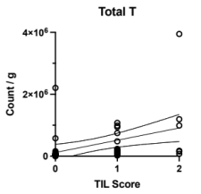
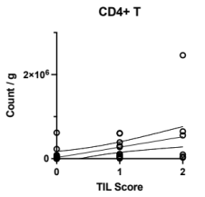
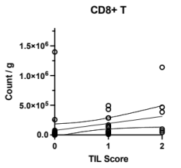
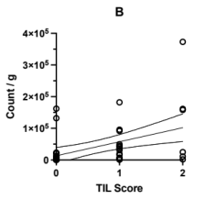
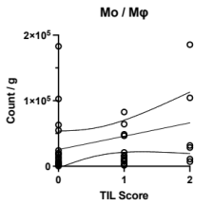
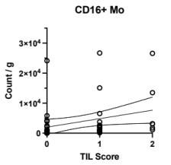
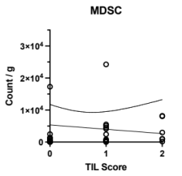
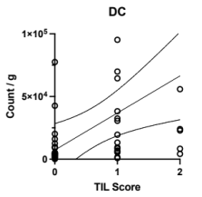
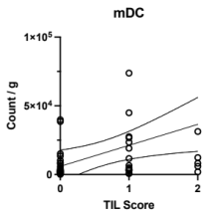
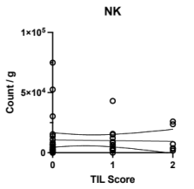
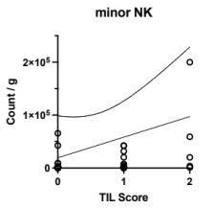
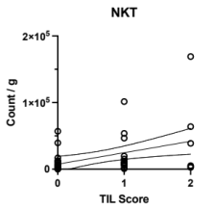
Supplemental Figure 5
a
b
c
d
Summary of statistical values
 | Spearman r | P-value
Total T | 0.625 | <.001*
CD4+ T | 0.590 | <.001*
CD8+ T | 0.605 | <.001*
B | 0.507 | 0.001*
Mo / Mφ | 0.336 | 0.026*
CD16+ Mo | 0.455 | 0.002*
MDSC | 0.406 | 0.006*
DC | 0.450 | 0.002*
mDC | 0.363 | 0.016*
NK | 0.105 | 0.498
minor NK | 0.359 | 0.017*
NKT | 0.359 | 0.017*
*Statistically significant P-value
e
f
g
h
i
j
k
l

