Slide 1
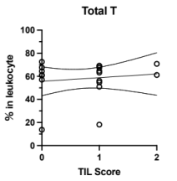
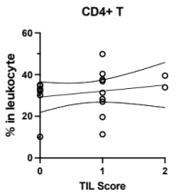
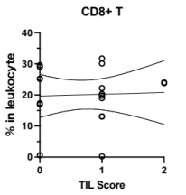
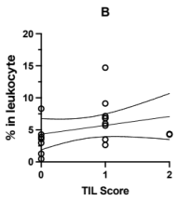
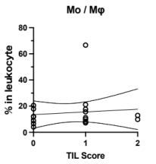
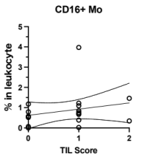
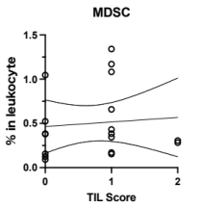
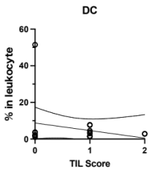

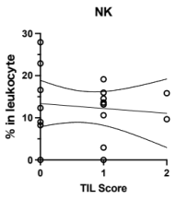
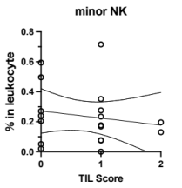
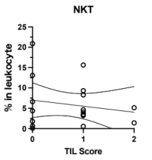
Supplemental Figure 2
a
b
c
d
Summary of statistical values
 | Spearman r | P-value
Total T | 0.084 | 0.739
CD4+ T | 0.237 | 0.343
CD8+ T | -0.032 | 0.900
B | 0.411 | 0.090
Mo / Mφ | 0.101 | 0.692
CD16+ Mo | 0.290 | 0.243
MDSC | 0.153 | 0.545
DC | 0.009 | 0.971
mDC | 0.027 | 0.914
NK | -0.037 | 0.886
minor NK | -0.169 | 0.503
NKT | -0.029 | 0.911
e
f
g
h
i
j
k
l

