Slide 1
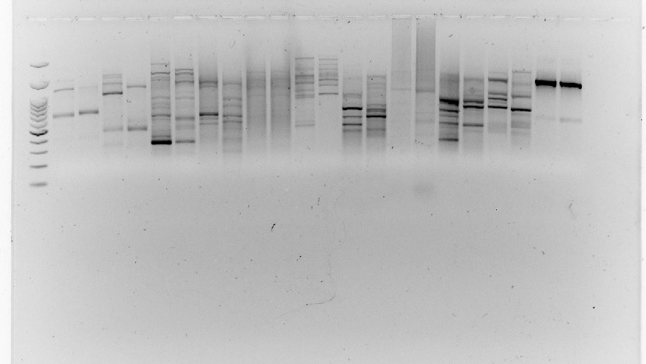
50°C 50°C 59°C 50°C 50°C 50°C 50°C 52°C 56°C 50°C 50°C
852 853 856 841 867 873 880 807 826 868 842
M
4 11 4 11 4 11 4 11 4 11 4 11 4 11 4 11 4 11 4 11 4 11

Slide 2
PRIMERS THAT WORKED IN ALL INDIVIDUALS (11):
873
880
868
812
853
852
818
841
826
808
811
PRIMERS with ready-to-apply reactions:
856
809
GRADIENT THAT WORKS BUT I HAVE NOT TESTED IT ON ALL INDIVIDUALS:
815

Slide 3
868 Ok!
Lecythis pisonis Lecythis lanceolata

Slide 4
853
Lecythis pisonis Lecythis lanceolata
Lecythis pisonis Lecythis lanceolata
852
818
868

Slide 5
853
Lecythis pisonis Lecythis lanceolata
Lecythis pisonis Lecythis lanceolata
852
818
868

Slide 6
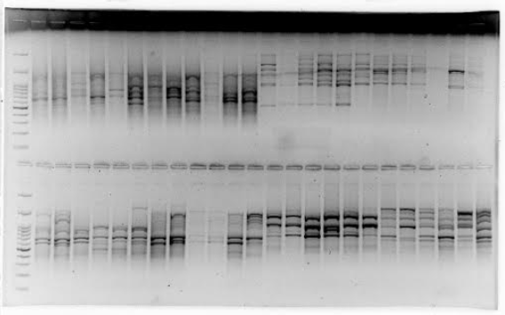
841
873
880
868

Slide 7
841
Lecythis pisonis Lecythis lanceolata
873
Lecythis pisonis Lecythis lanceolata
812
880

Slide 8
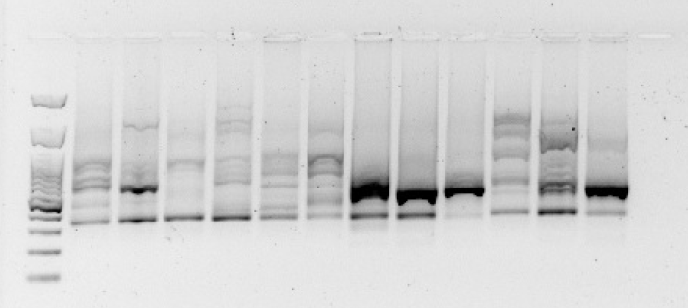
856
Lecythis pisonis Lecythis lanceolata

Slide 9
841
856
Lecythis pisonis Lecythis lanceolata
Lecythis pisonis Lecythis lanceolata

Slide 10
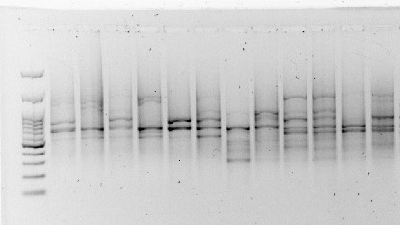
841
Lecythis pisonis Lecythis lanceolata

Slide 11
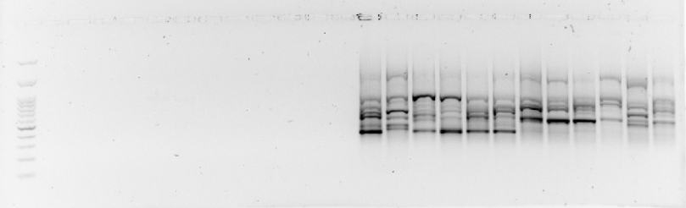
826
Lecythis pisonis Lecythis lanceolata

Slide 12
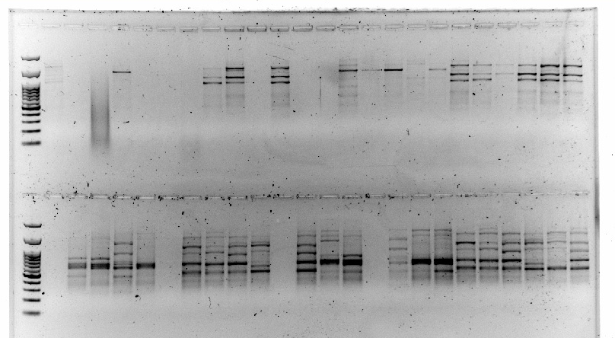
Lecythis pisonis Lecythis lanceolata
Lecythis pisonis Lecythis lanceolata
808
1 2 3 4 5 6 7 8 10 11 12 13 1 2 3 4 5 6 7 8 10 11 12 13
1 2 3 4 5 6 7 8 10 11 12 13 1 2 3 4 5 6 7 8 10 11 12 13
811

Slide 13
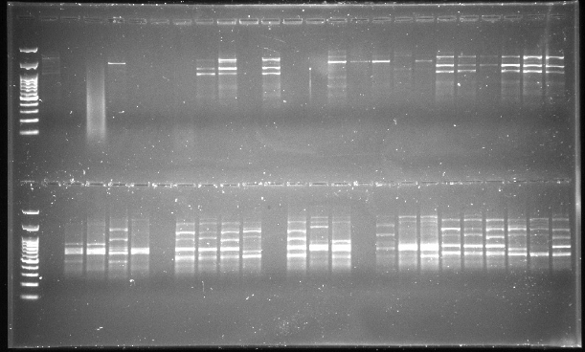
808
811

