Slide 1
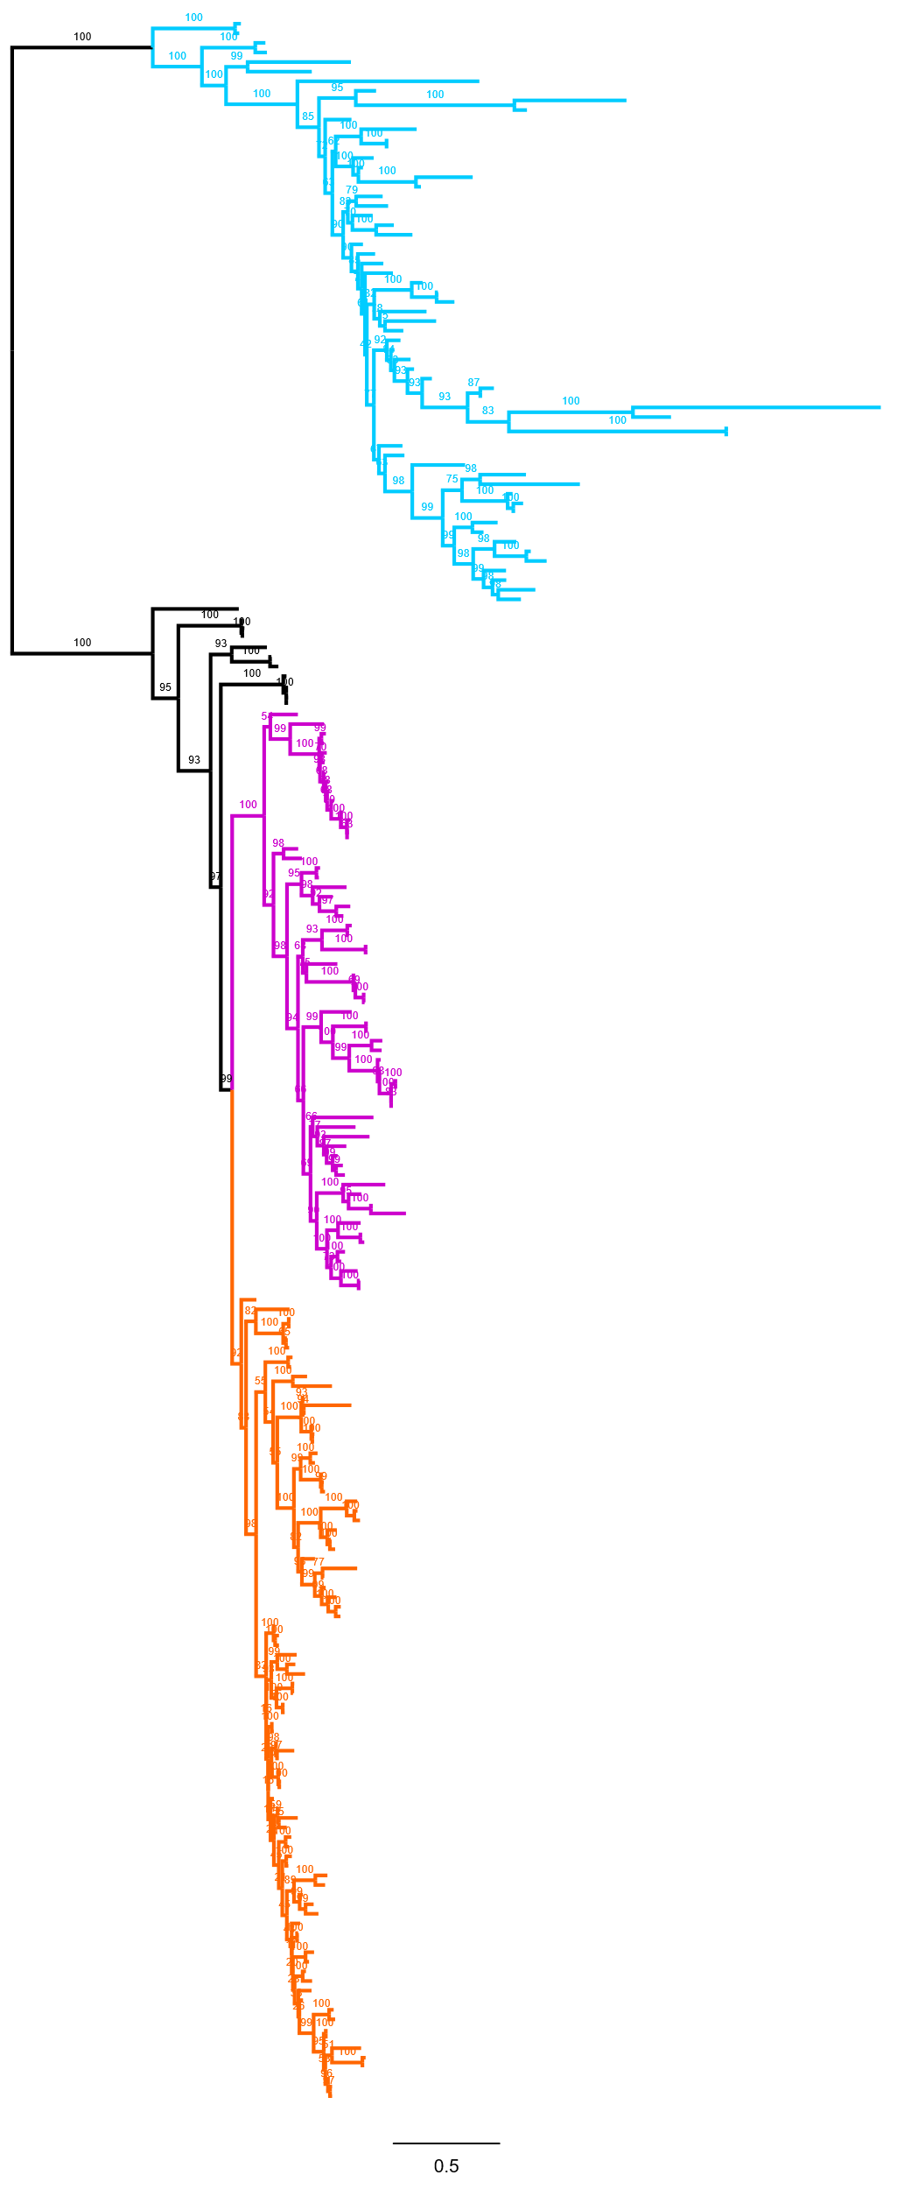
AttD
Hcam AttD
Hconf AttD
Dmel AttD
Dmel AttC
AttC
Hcam AttC
Hcam AttC
Hconf AttC
Hconf AttC
Hconf AttC
AttA/AttB
Sdef AttA/B
Dmel AttA
Dmel AttB
Hcam AttA/B
Hcam AttA/B
Hconf AttA/B
Hconf AttA/B

