Slide 1
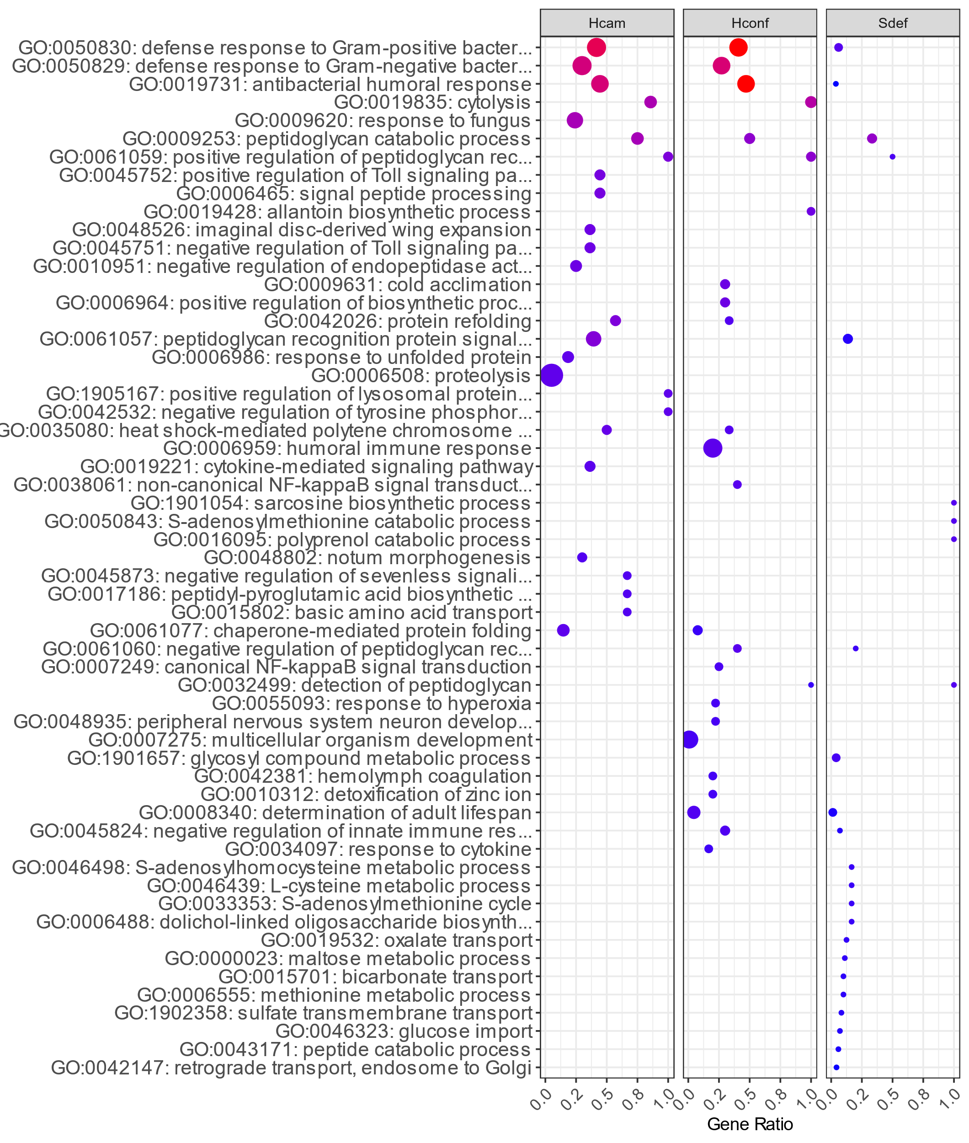
10
20
15
Count
20
-log10(p-value)
30
10
5

