Slide 1
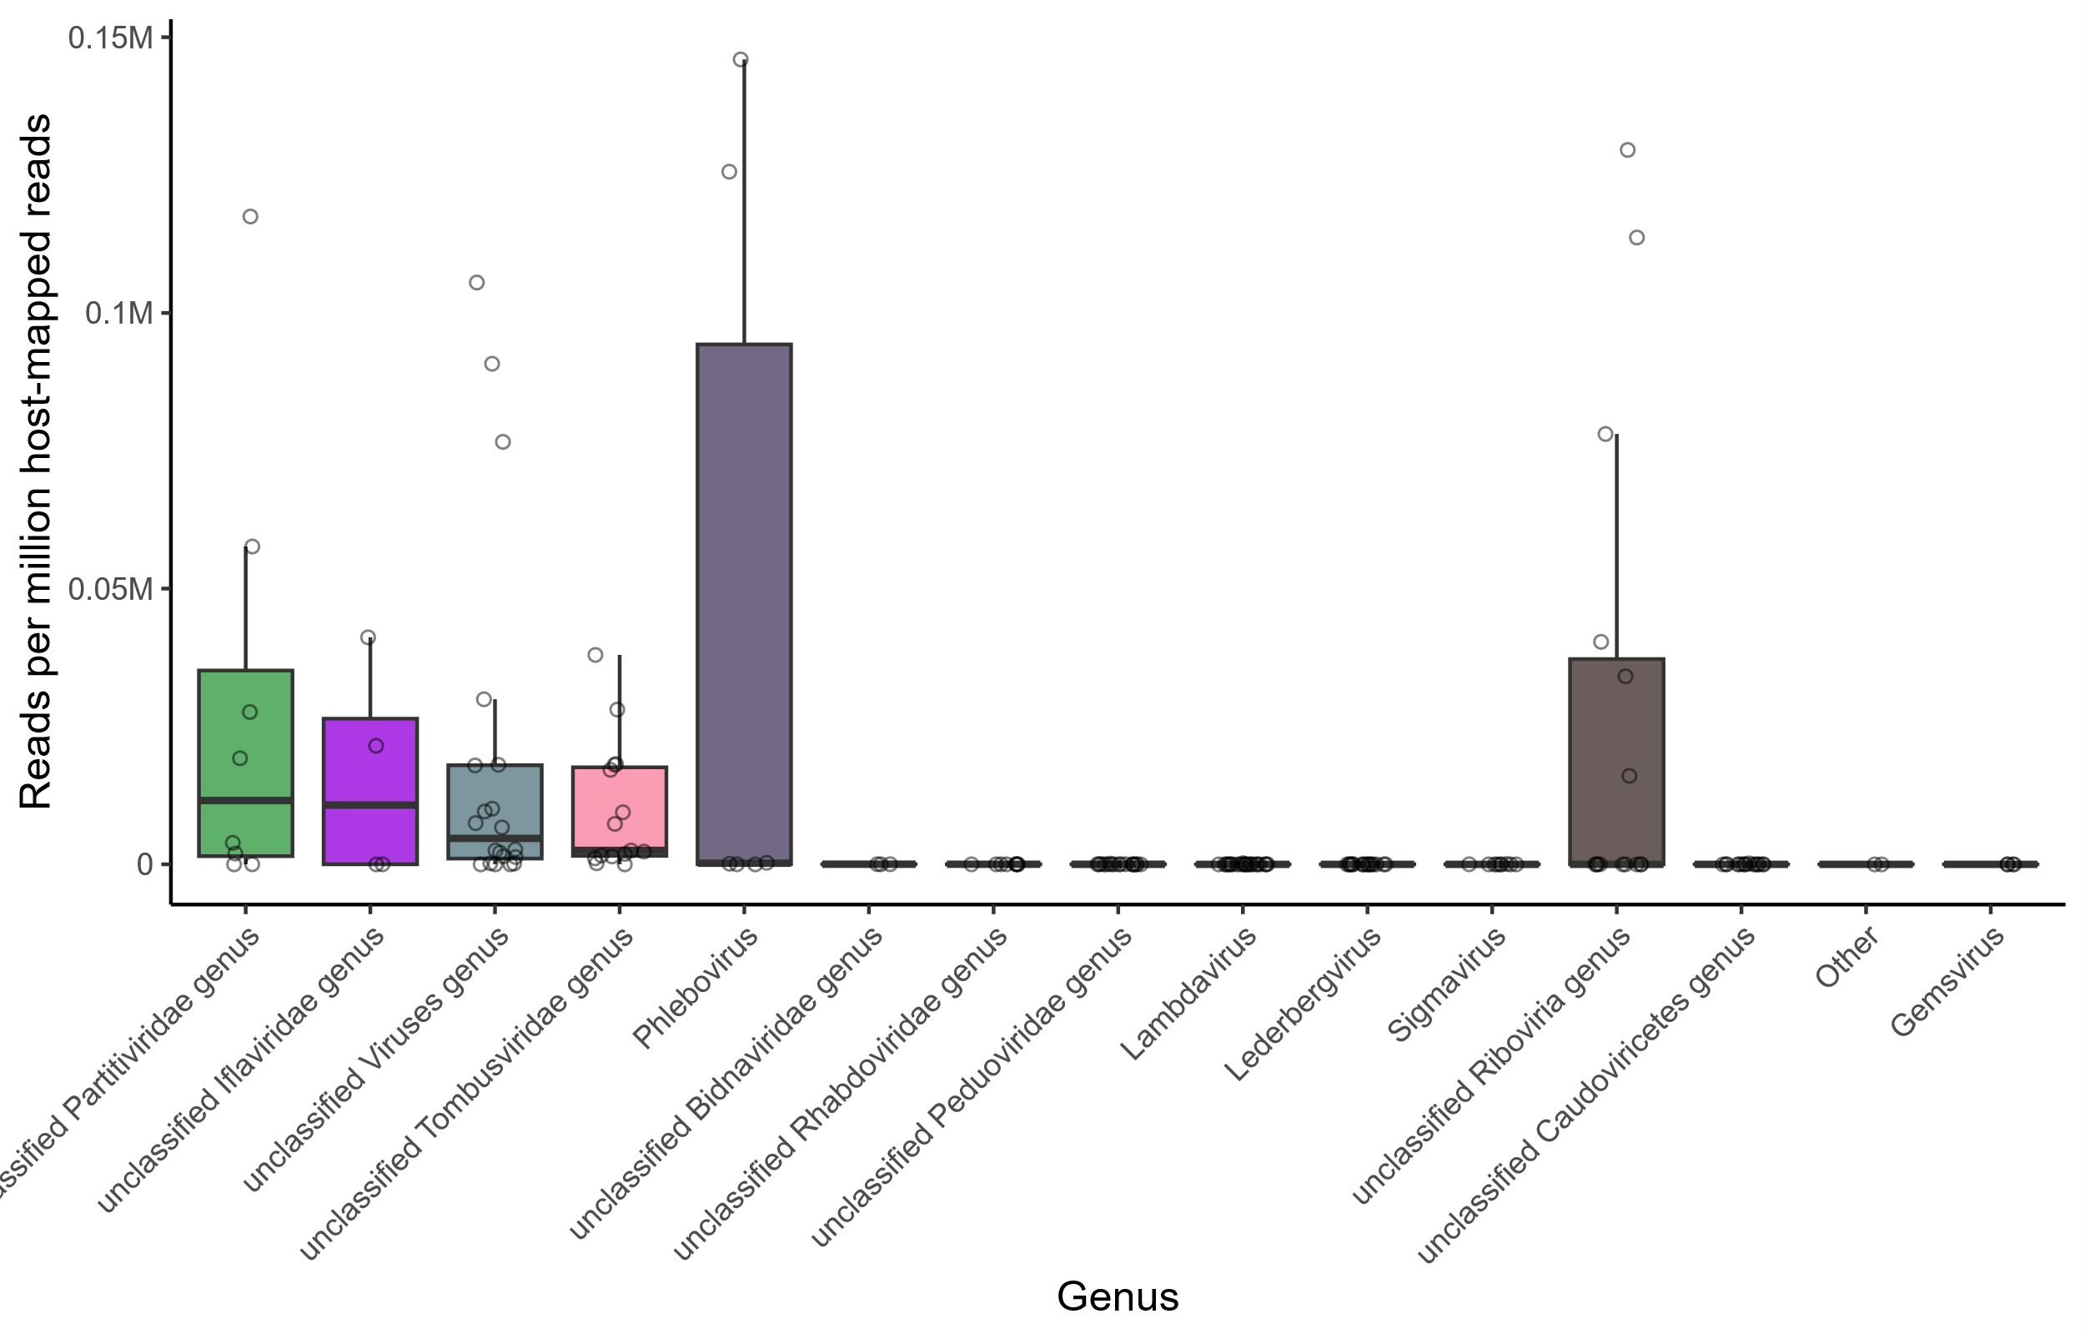
Genus (Viruses)
Lambdavirus
unclassified Caudoviricetes genus
unclassified Partitiviridae genus
unclassified Iflaviridae genus
unclassified Viruses genus
unclassified Riboviria genus
unclassified Rhabdoviridae genus
unclassified Bidnaviridae genus
Lederbergvirus
unclassified Tombusviridae genus
Phlebovirus
Other
unclassified Peduoviridae genus
Sigmavirus
Gemsvirus

