Slide 1
Reduced DNA methylation by Mn₃O₄ nanozyme protein corona formation improves cotton yield in saline land
Lingling Chen^{1,2}, HuiXin Ma^{1,2}, Xue Yao^{1,2}, Wenying Xu^{1,2}, Hezhen Yuan^{1,2}, Quanlong Gao¹, Jie Qi^{1,2}, Fangjun Li⁴, Zhiyong Song³, Jiangjiang Gu³, Zhouli Xie^{1,2}, Juan Pablo Giraldo⁵, Zhaohu Li^{1,2*}, Honghong Wu^{1,2*}
¹ National Key Laboratory for Germplasm Innovation & Utilization of Horticultural Crops, The Center of Crop Nanobiotechnology, College of Plant Science & Technology, Huazhong Agricultural University, Wuhan 430070, China
² Hubei Hongshan Laboratory, Wuhan 430070, China
³ College of Chemistry, Huazhong Agricultural University, Wuhan 430070, China
⁴ State Key laboratory of Plant Environmental Resilience, Engineering Research Center of Plant Growth Regulator, Ministry of Education & College of Agronomy and Biotechnology, China Agricultural University, No. 2 Yuanmingyuan Xilu, Haidian District, Beijing 100193, China
⁵ Department of Botany and Plant Science, University of California, Riverside, CA 92507, U.S.A.

Slide 2
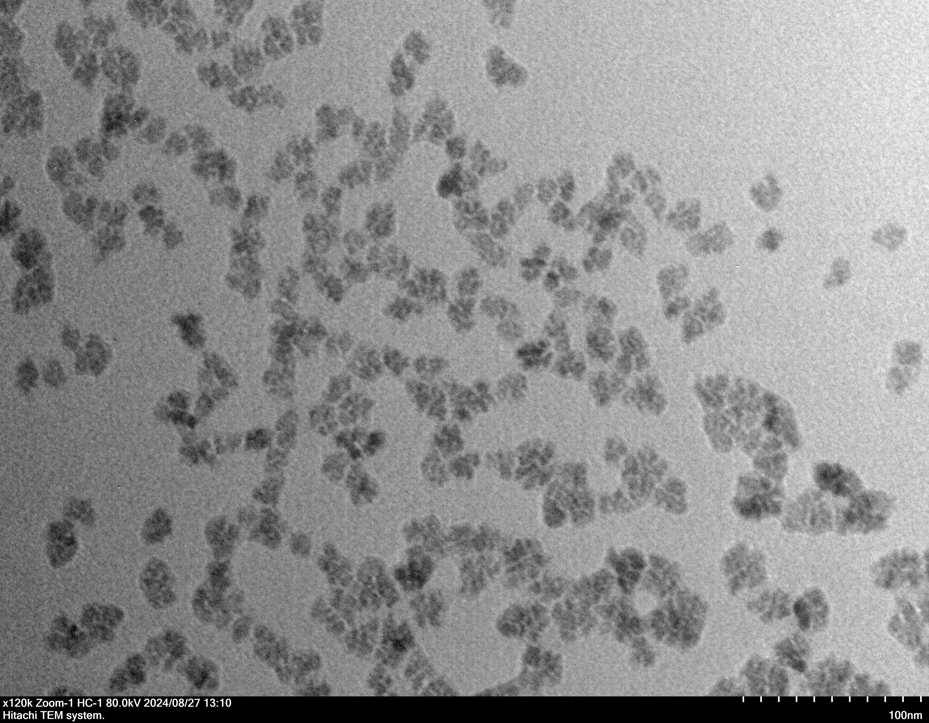
a
c
Zeta potential (mV)
DLS (d. nm)
100 nm
b
(103)
d
e
(200)
(112)
(224)
15.54±0.32 nm
(101)
(004)
(312)
(220)
Intensity(%)
Intensity (a.u.)
(105)
(400)
Diameter(nm)
2θ (°)
f
g
Intensity (a.u.)
Intensity(%)
Binding Energy (eV)
Binding Energy (eV)
Supplementary Figure 1. Characterization of PMO nanoparticles. a, the TEM imaging of the synthesized PMO. Scale bar is 20 nm. b, c, the zeta potential (b) and DLS (c) of the synthesized PMO. Mean ± SE (n = 3). d, size distributions of PMO in TEM. e, XRD analysis of PMO. f, g, XPS analysis of PMO. B.C. (Background Correction), F.C. (Cumulative fit curve).

Slide 3
a
d
**
Cell viability %
Cell viability %
Concentration mg/L
Concentration mg/L
Supplementary Figure 2. Cell viability assay. a,b, LO2, Raw 264.7 cell survival after PMO. Mean ± SE (n = 6). Comparisons were performed by independent samples t-test (two tailed). *, p < 0.05; **, p < 0.01.

Slide 4
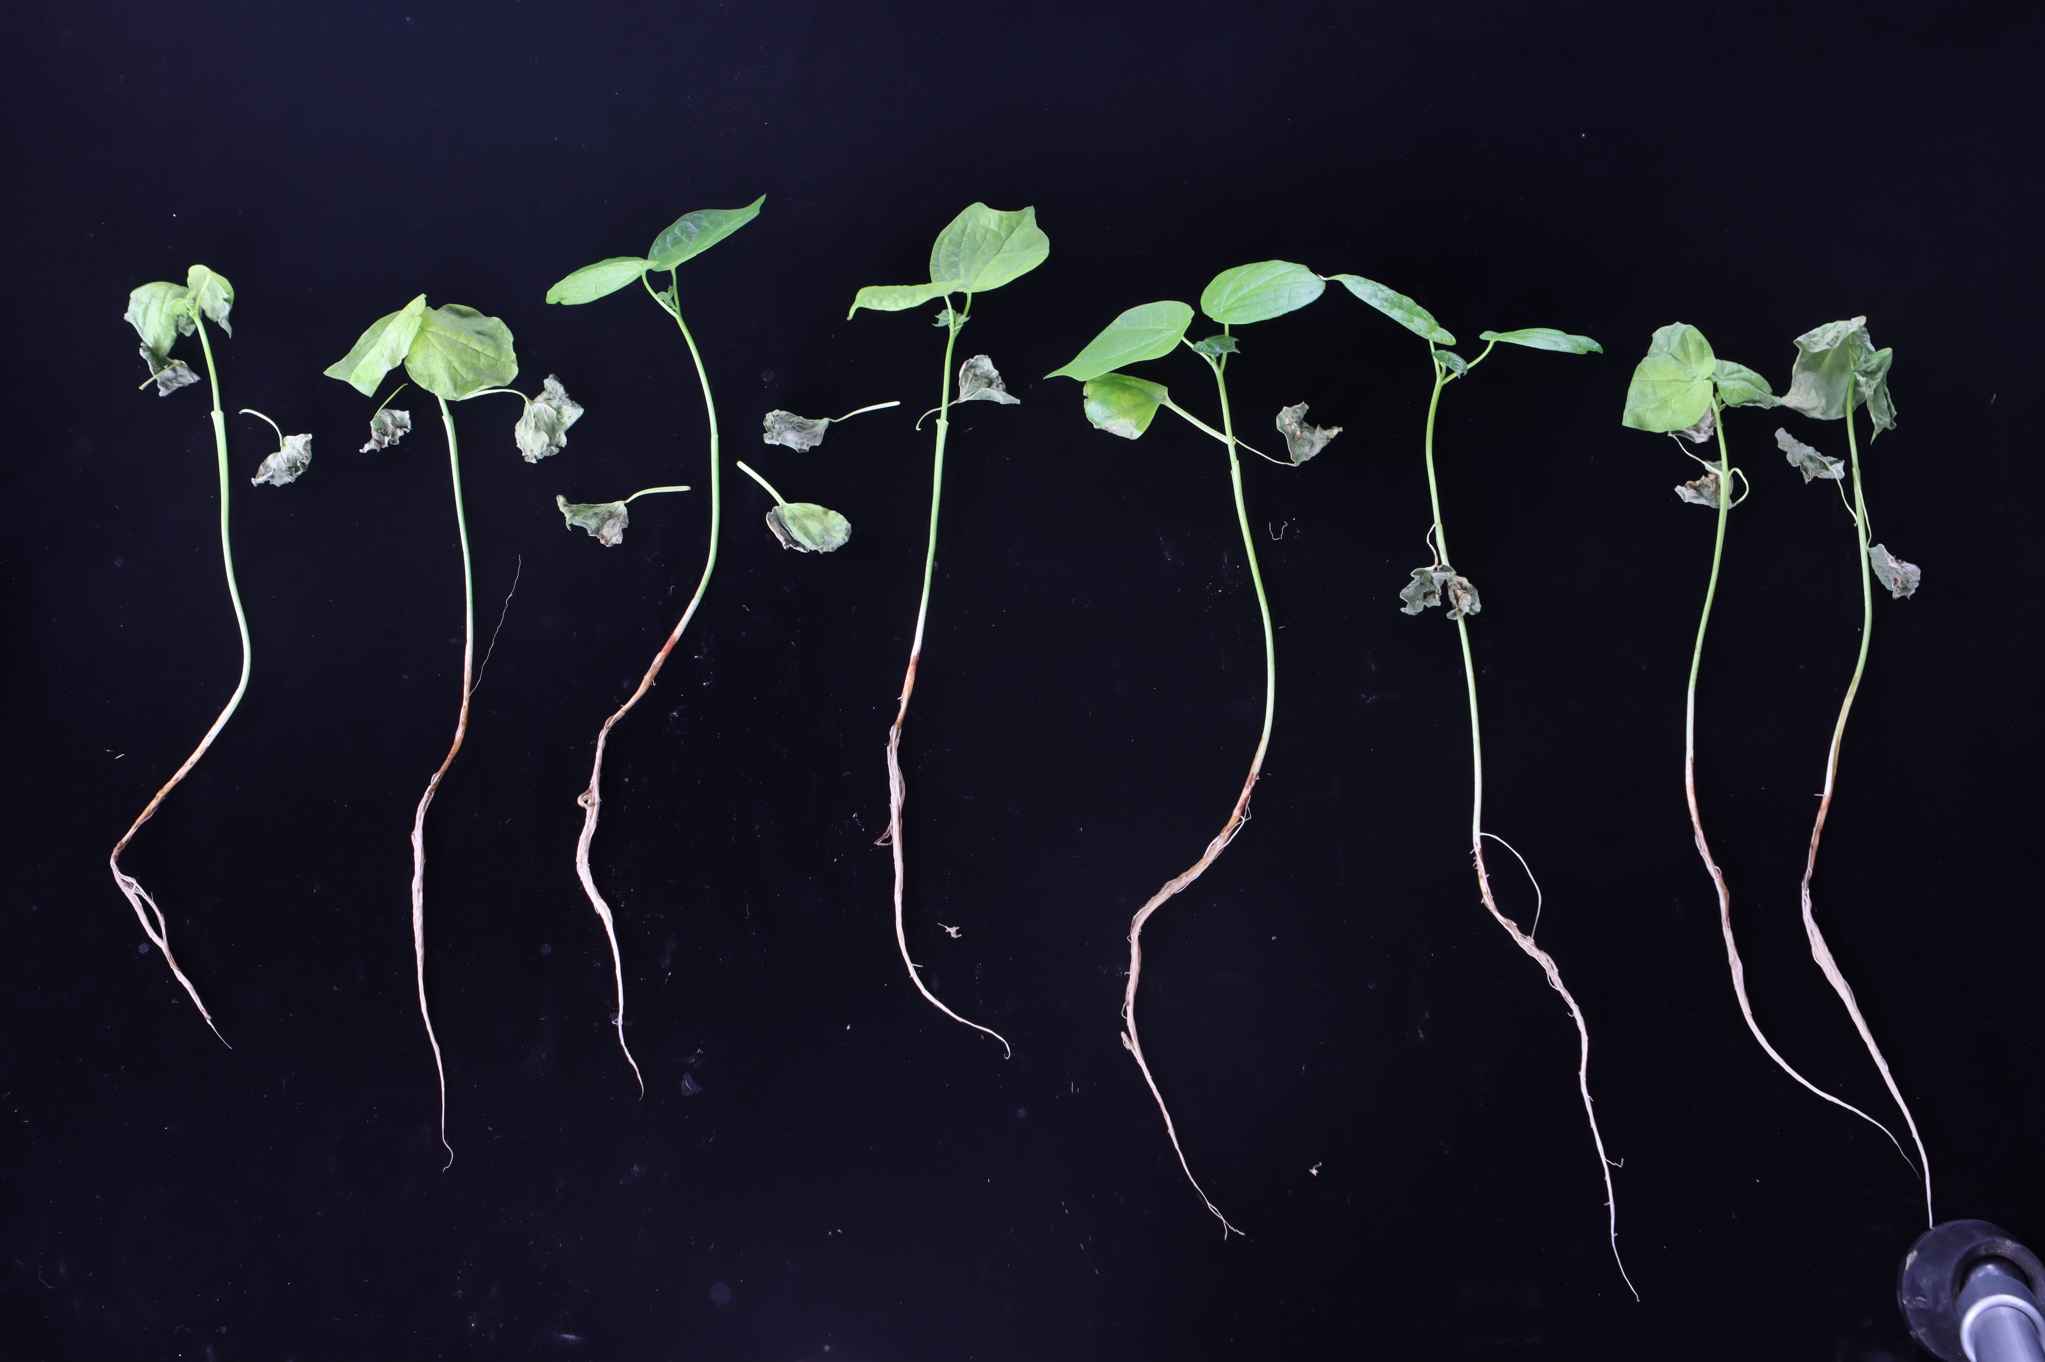
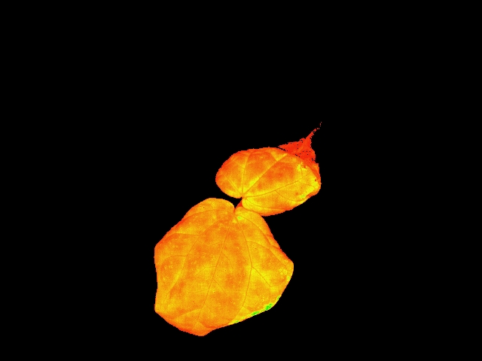
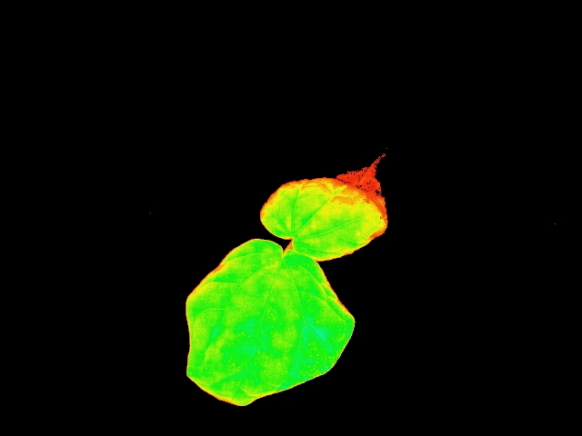
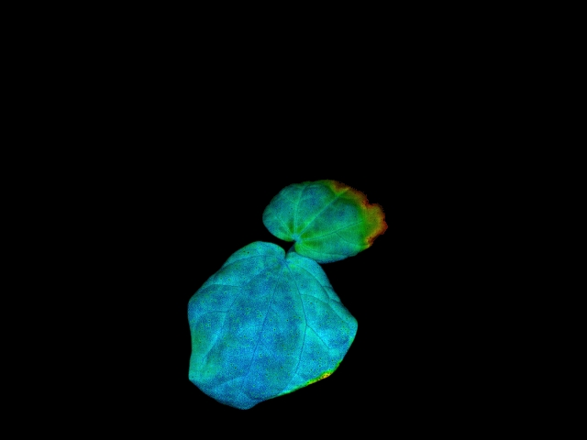
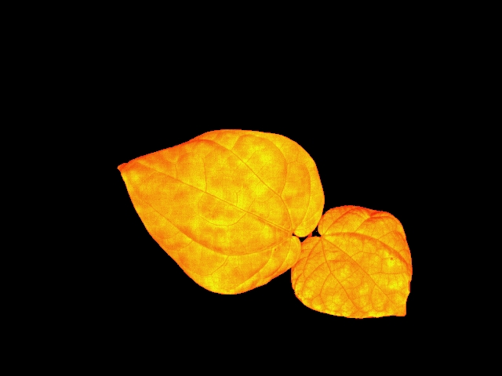
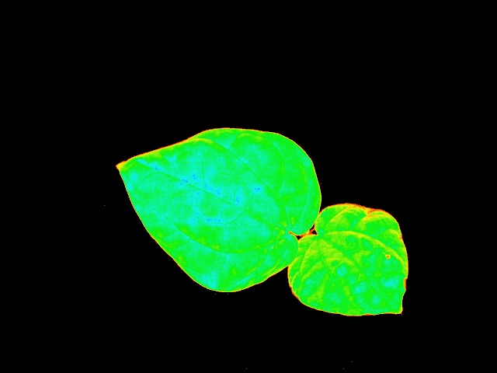
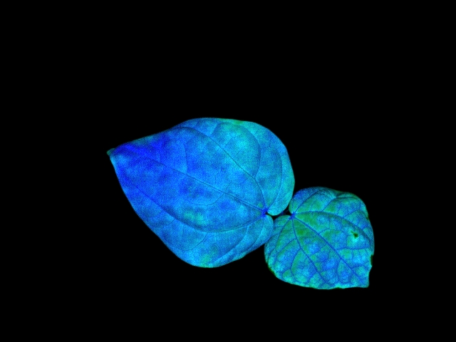

XLZ 74, 200 mM NaCl (Day 5)
b
c
a
Dry weight (g/plant)
Chlorophyll content (mg/g)
2 cm
Con
PMO
Con
PMO
Con
PMO
Control
Dil-PMO
Control
Dil-PMO
Colocalization rate (%)
d
e
Chloroplast
20 µm
Dil
20 µm
Overlay
1st leaf
2nd leaf
First leaf
20 µm
Second leaf
F₀
Fm
Fv/Fm
g
h
f
*
Con
Value
NS
Fresh weight (g/plant)
PMO
F₀
F_{m}
F_{v}/F_{m}
Con
PMO
i
j
k
*
**
**
H₂O₂ content (mM/g)
·O₂⁻ (µM/g)
Ability to scavenge ·OH
(U/mg prot)
Con
PMO
Con
PMO
Con
PMO
Supplementary Figure 3. The colocalization of PMO with chloroplasts and its effect on chlorophyll fluorescence, fresh weight and ROS levels in cotton under salt stress (200 mM NaCl, 5 days). a, the phenotypic performance of salt stressed (200 mM NaCl, 5 days) cotton plants with and without PMO (200 mg/L) treatment. b, c, the dry weight and chlorophyll content of salt stressed cotton plants with and without PMO treatment. Mean±SE (n=6). d, e, confocal imaging results showing the distribution of PMO in the first and second cotton leaves. Mean ± SE (n = 6). f, the chlorophyll fluorescence imaging. g, The chlorophyll fluorescence parameters of cotton plants with and without PMO treatment. Mean ± SE (n = 4). h, the fresh weight of salt stressed cotton plants with and without PMO treatment. Mean ± SE (n = 6).). i, j, the content of H₂O₂ and ·O₂⁻ in salt stressed cotton leaves with and without PMO treatment. Mean ± SE (n = 6). k, the ability to scavenging ·OH in salt stressed cotton leaf extractions with and without PMO treatment. Mean ± SE (n = 6). NS, no significant difference. *, p < 0.05; **, p < 0.01. Different lower-case letters indicate the significance level at 0.05.

Slide 5
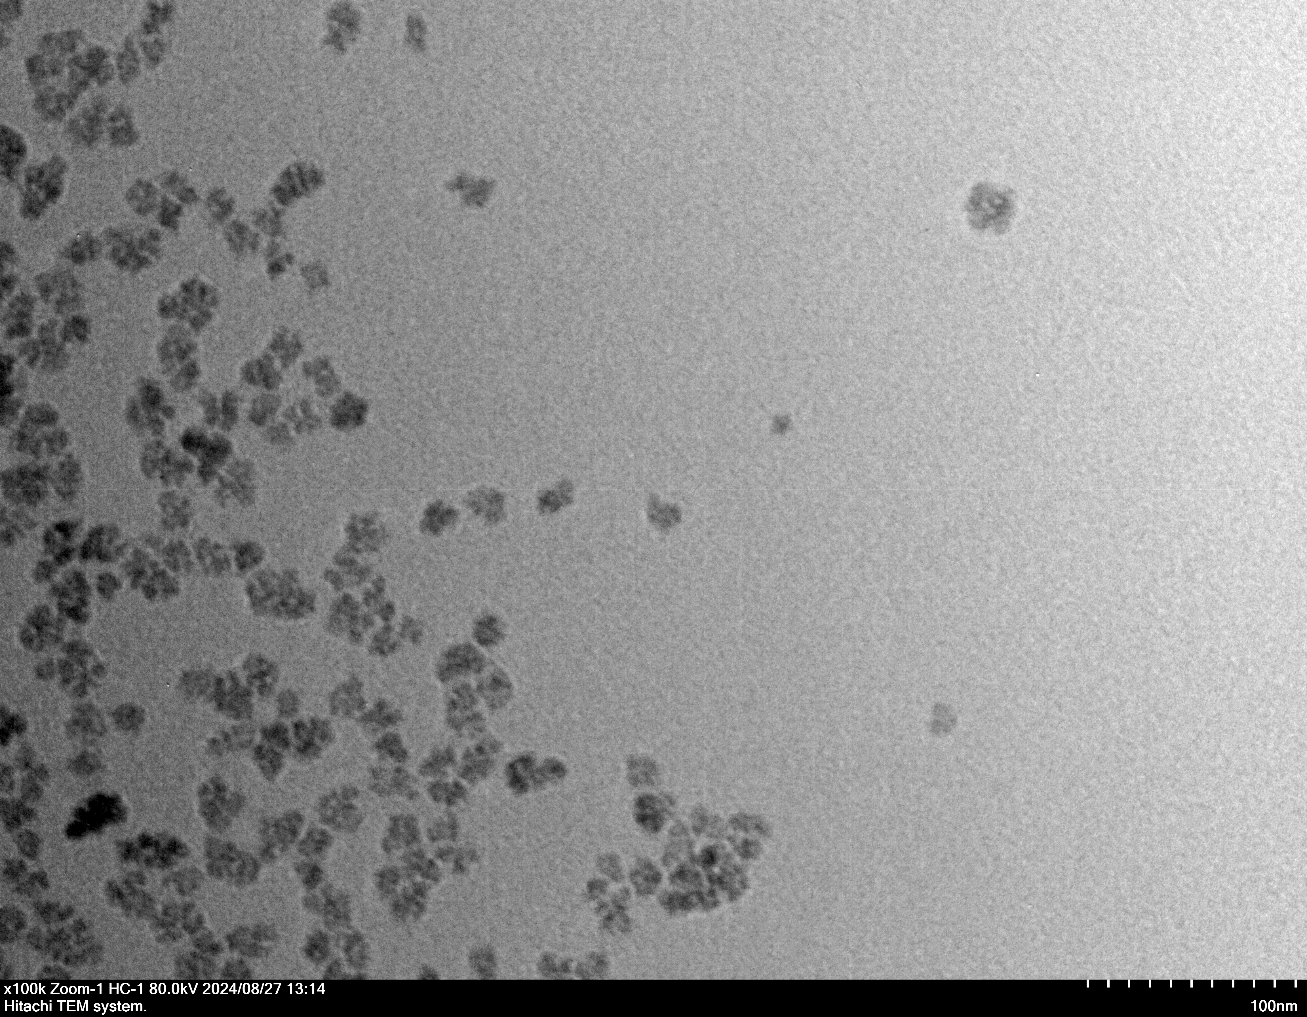
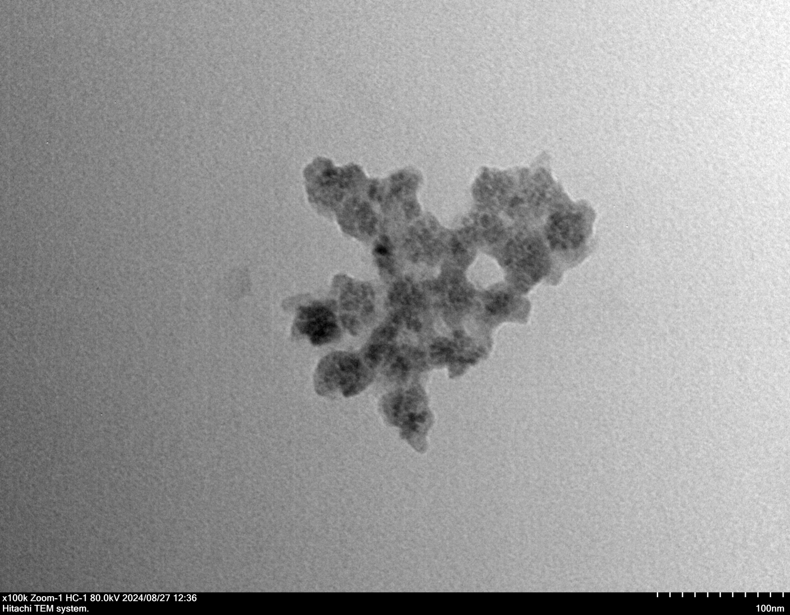
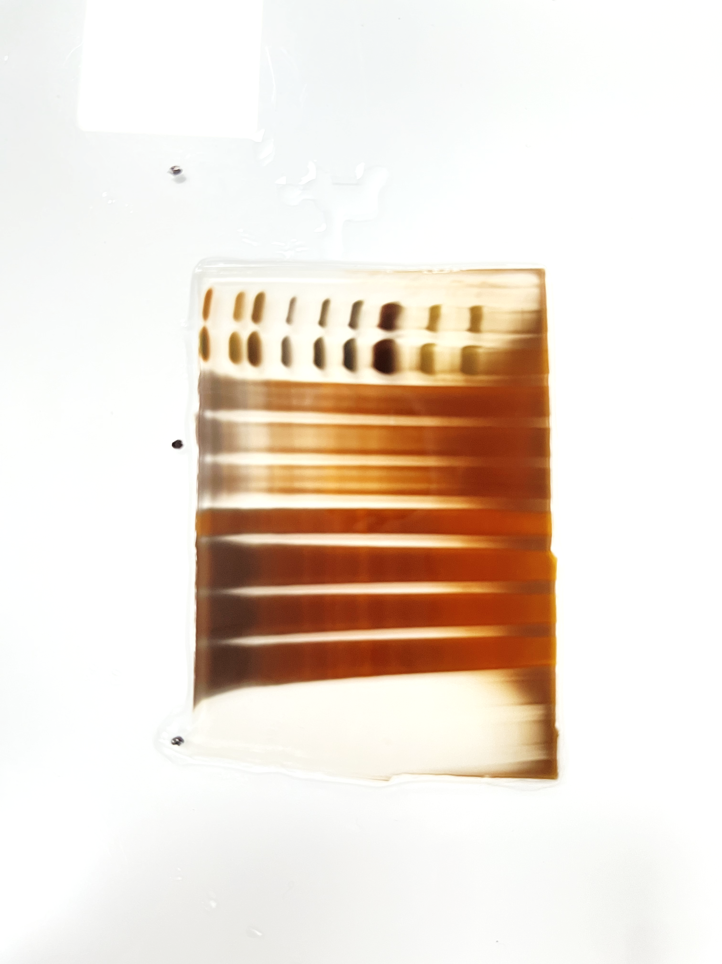
b
a
PMO
PMOPC
Absorbance A .U
100 nm
100 nm
50 nm
c
d
Marker
PMO-PC
Total protein
130 KD
95 KD
Zeta potential (mV)
**
75 KD
55 KD
35 KD
25 KD
PMO
PMOPC
15 KD
Supplementary Figure 4. Characterization of protein corona on PMO. a, the UV-absorption spectra of PMO protein corona (PMOPC). b,the transmission electron microscope observation of PMO protein corona. c, the zeta potentia of PMO protein corona. Mean ± SE (n = 3). d, silver-stained SDS–PAGE gel of protein corona on PMO.

Slide 6
a
b
N-H
C-H
Reflectance %
Zeta potential (mV)
N-H
C-H
1656
C=O
1563
amide Ⅱ
Wavenumbers (cm⁻¹)
Supplementary Figure 5. Characteristics of PMO modified by His tag. a, FTIR spectra of PMO, His and PMO-His. b, zeta potential of PMO, His and His-PMO Mean ± SE (n = 3).

Slide 7
a
b
c
*
Relative expression level
Relative
expression level
NS
SAM:SAH ratio
GhDDM1
GhNERD
GhROS1
GhDME
Con
PMO
d
**
e
NS
f
NS
Contents of ATP (mmol/g prot)
Contents of Met
(mg/g)
Ethylene content pmol/g
Con
PMO
Con
PMO
Con
PMO
g
NS
Ethylene content ng/g
Con
PMO
Supplementary Figure 6. The effect of PMO on DNA methylation level and ethylene level in cotton under salt stress (200 mM NaCl, 5 days). a, b, the expression level of GhDDM1, GhNERD, GhROS1 and GhDME genes of salt stressed (200 mM NaCl, 5 days) cotton leaves. c, SAM:SAH ratio. Mean ± SE (n = 6). d, e, the content of ATP and methionine substances in salt stressed cotton leaves. Mean ± SE (n = 6). f, g, the content of ethylene measured by Elisa and gas chromatography, respectively. Mean ± SE (n = 3). *, p < 0.05; **, p < 0.01. NS, no significant difference.

Slide 8
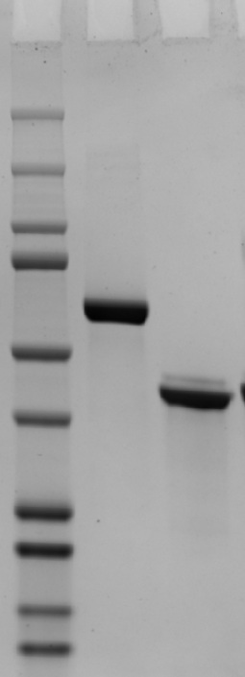
Ndel
ATG
His tag
GhSAMS2
Stop codon
a
Marker
BSA
GhSAMS2
b
kDa
250
150
100
75
Absorbance A .U
50
13.2 %
37
25
20
15
10
Wavelength, nm
c
d
Fluorescence Intensity, A .U
55.4%
Fluorescence Intensity, A .U
64.9 %
Wavelength, nm
Wavelength, nm
Supplementary Figure 7. Effect of PMO on GhSAMS2 protein. a, induction and purification of GhSAMS2 protein. BSA protein was used as a positive control. b, UV-absorption spectra of GhSAMS2 incubated with PMO or an equal volume of ddH₂O. c, d, the fluorescence emission spectra of GhSAMS2 with or without PMO treatment under 275 nm and 295 nm excitation.

Slide 9
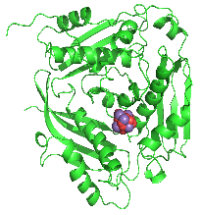
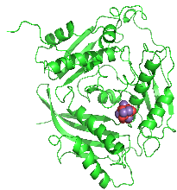
a
0 ns
100 ns
d
Pro391
Met1
Gln99
Arg237
Trp388
RMSF (nm)
Gln105
Arg356
Length (Da)
Supplementary Figure 8. Effect of PMO on the stability of GhSAMS2 protein. a, molecular dynamics simulation analysis of the interaction between PMO unit and GhSAMS2. Typical snapshots of the initial (left panels) and final (right panels) structures of PMO unit on GhSAMS2. b-e, the associated parameters over the simulation time including the binding energy (b), Root Mean Square Deviation (c), Root Mean Square Fluctuation (d), and hydrogen bond (e). f, time evolution of GhSAMS2 protein secondary structure during the MD simulation. The data are presented as mean ± SD with n=5,000 (independent binding conformations within 100 ns simulation).

Slide 10
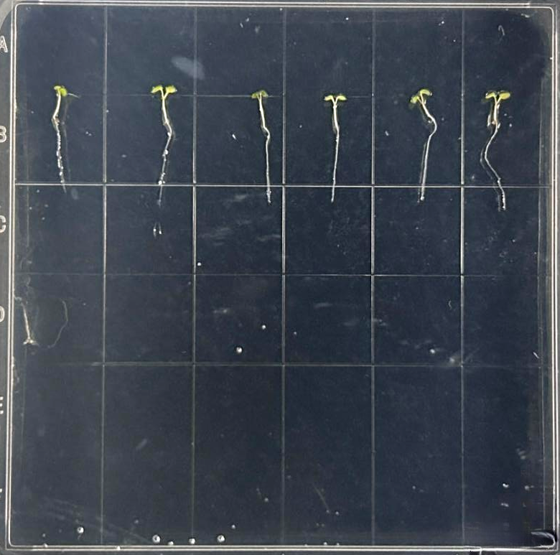
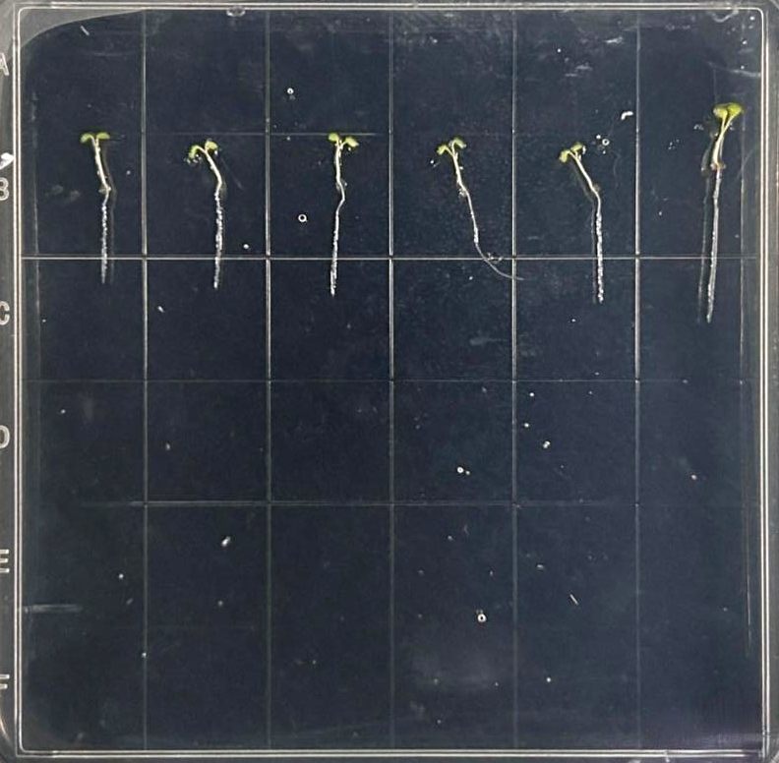
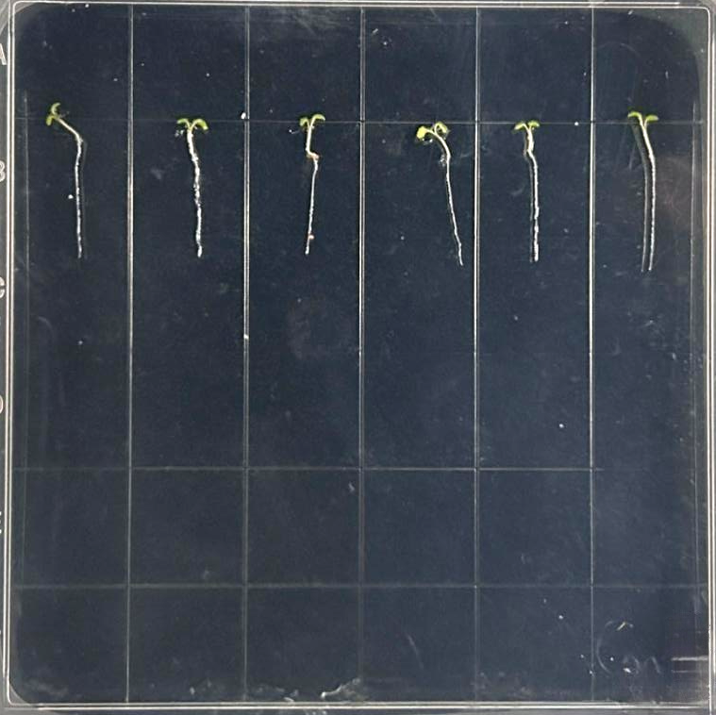
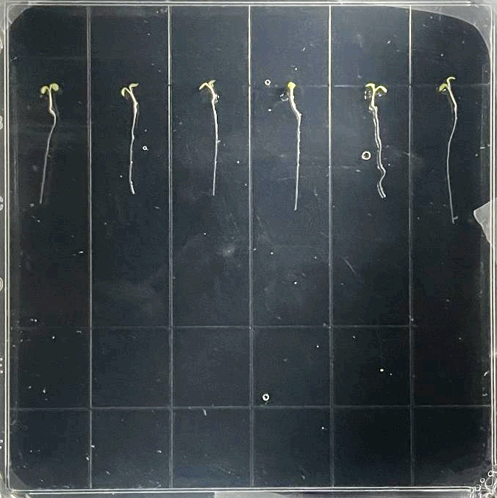
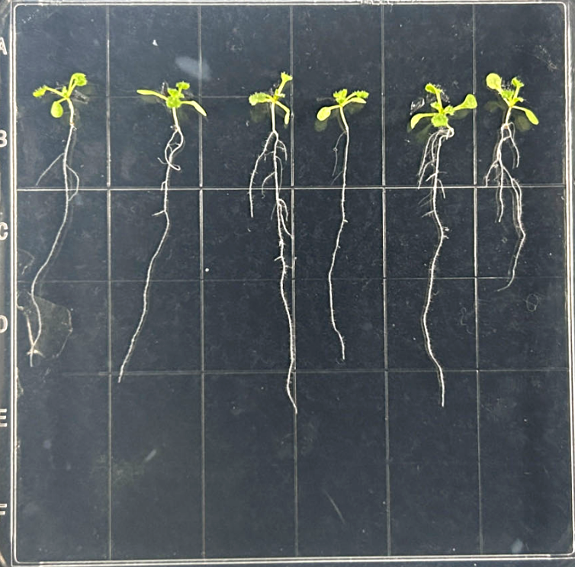
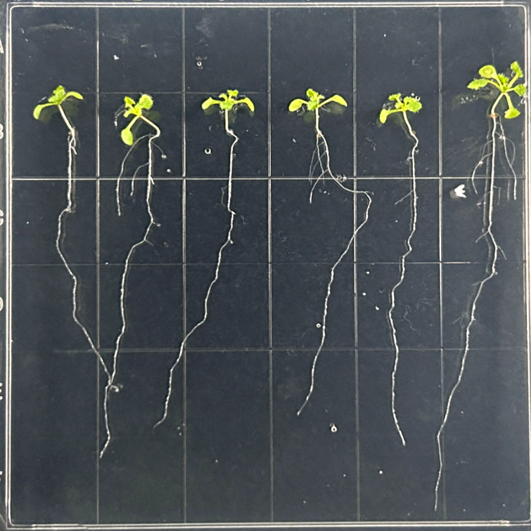
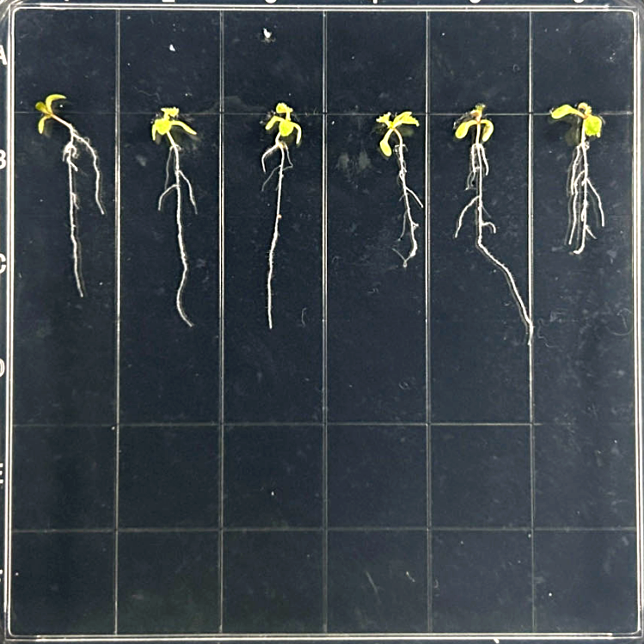
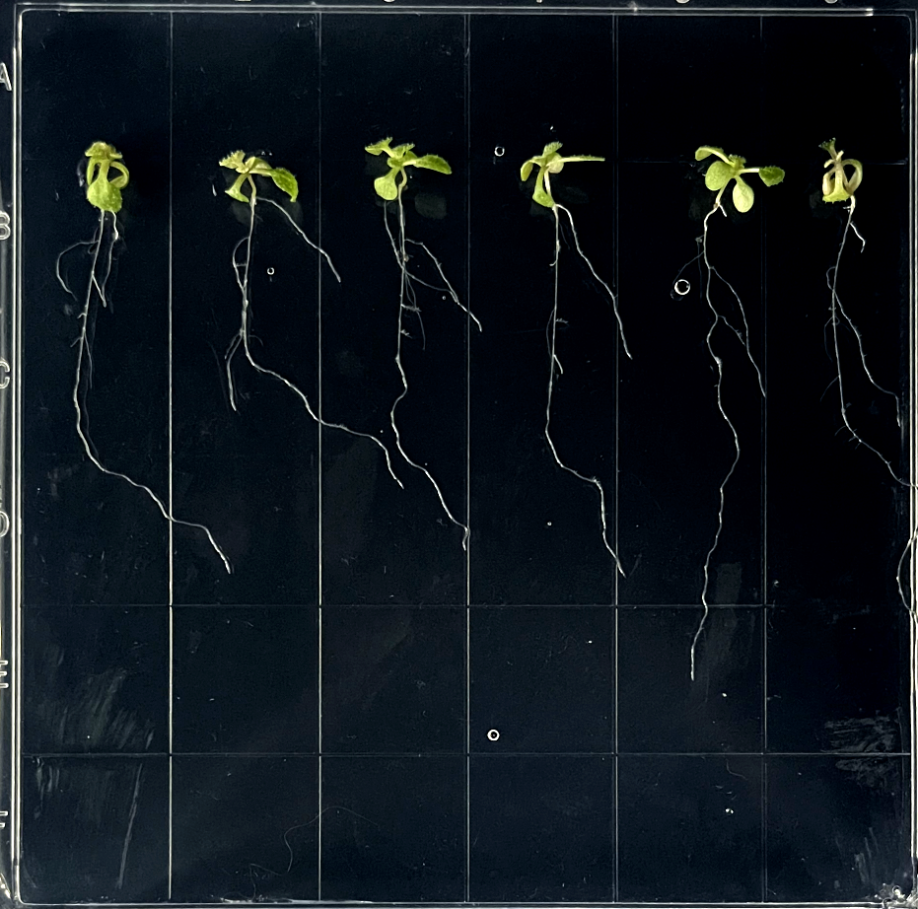
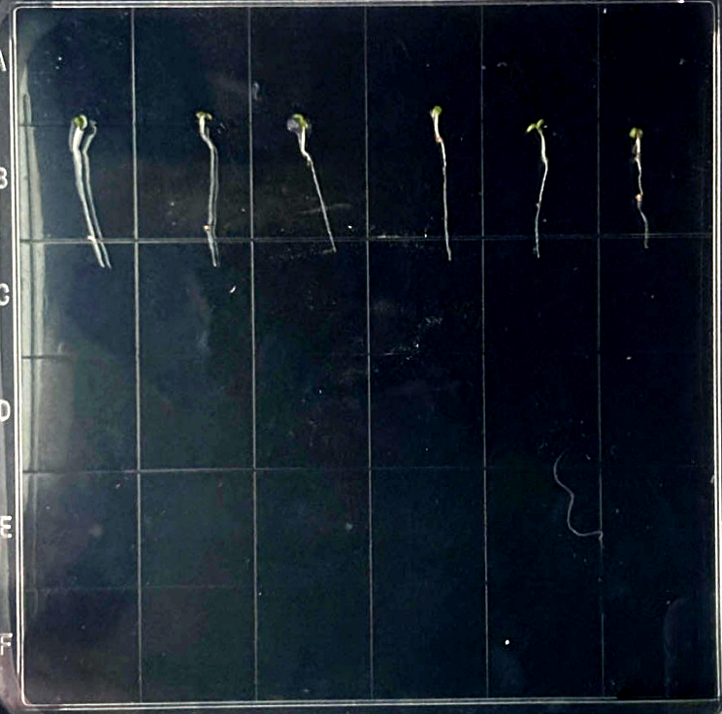
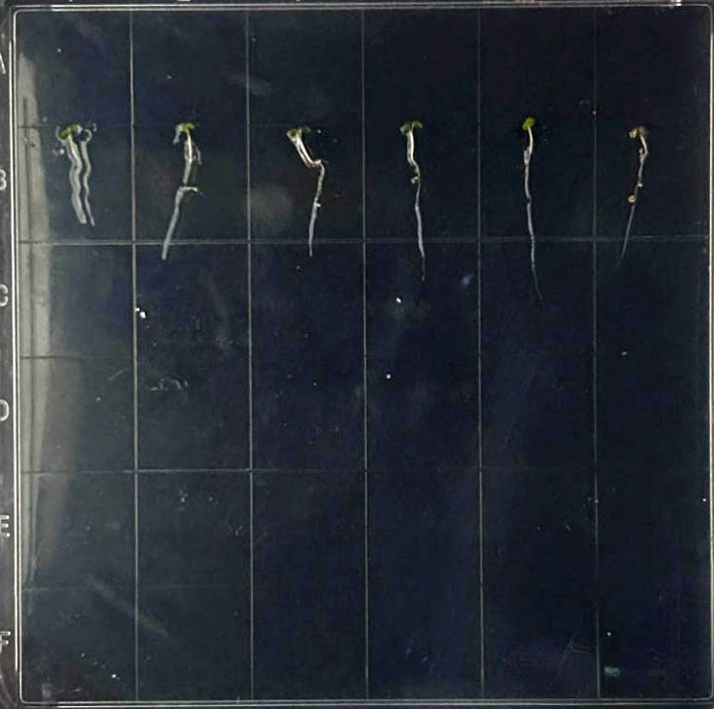
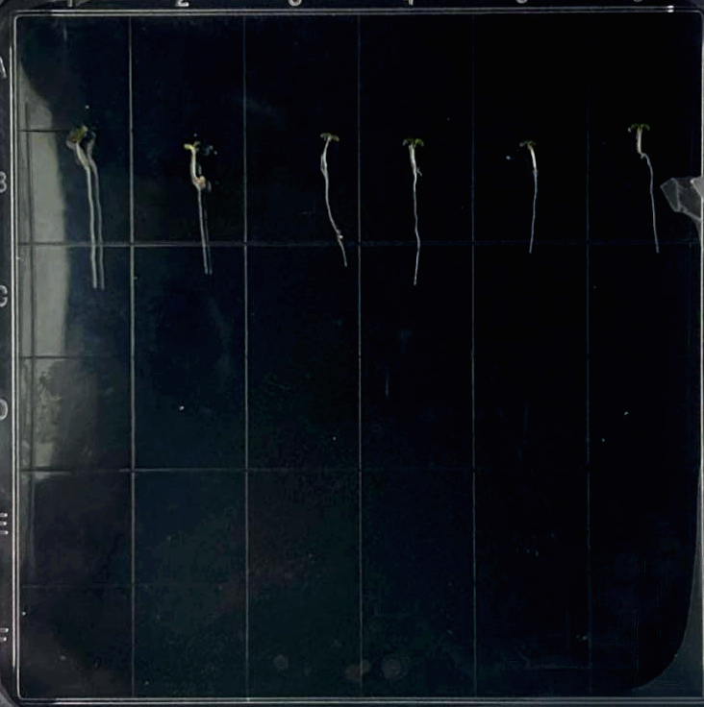
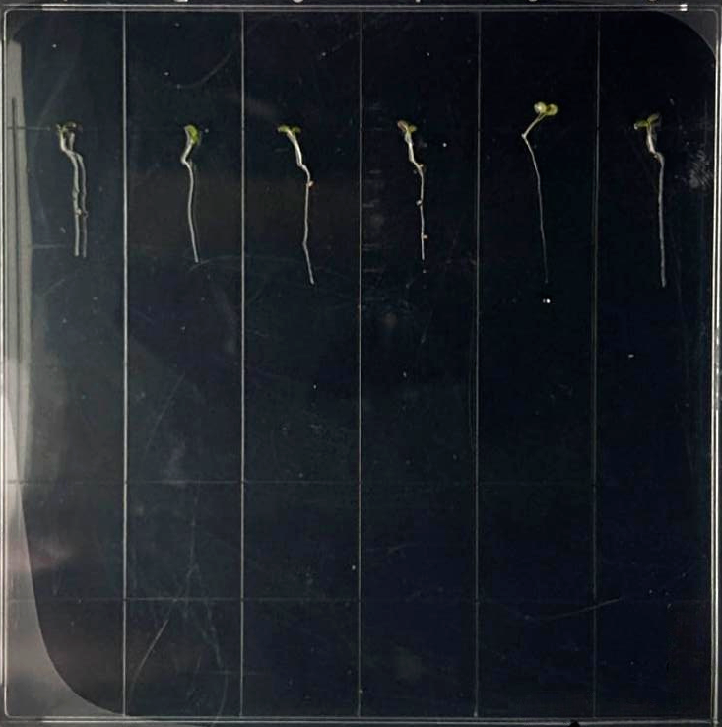
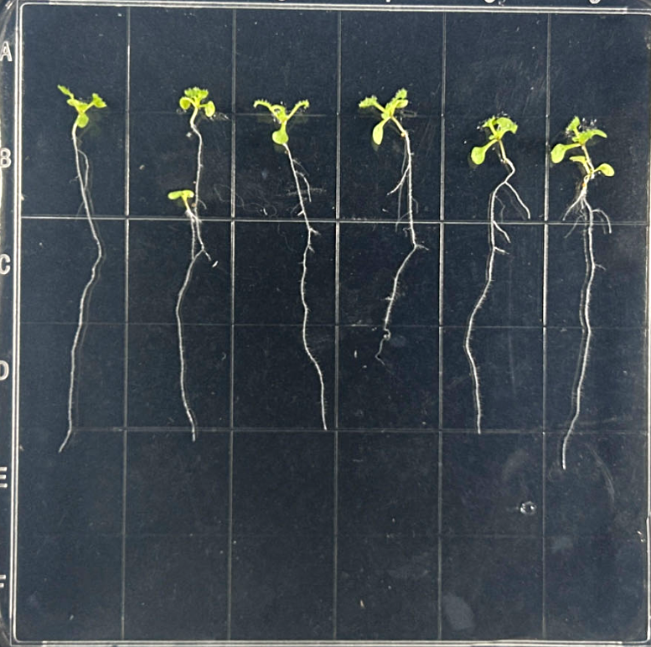
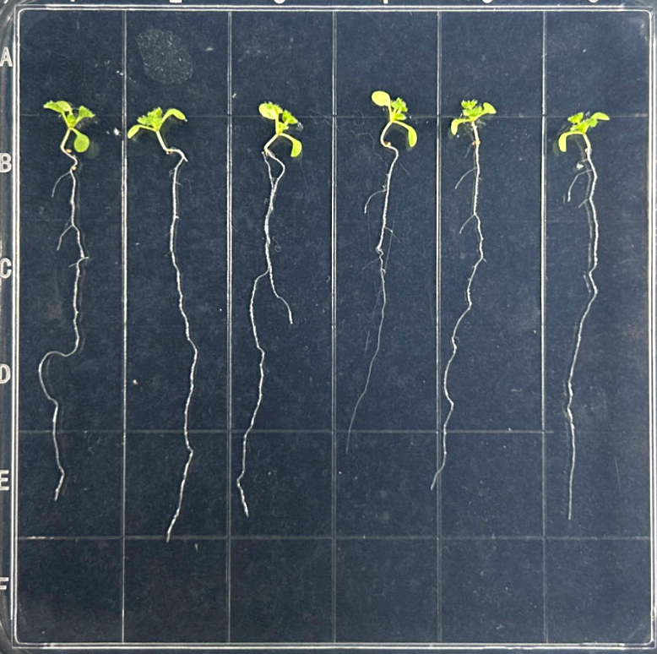
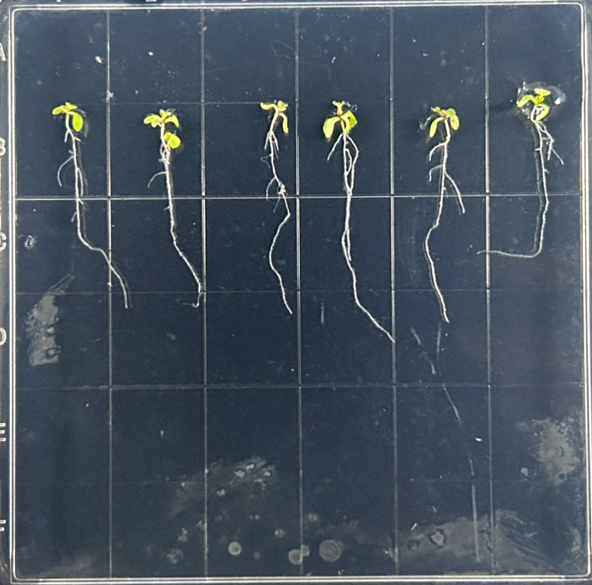
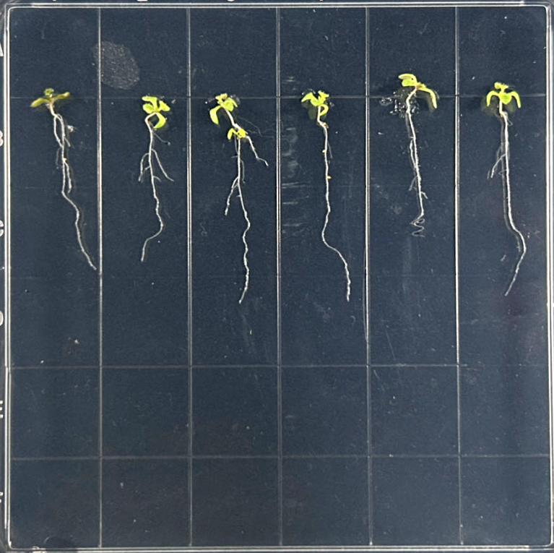
0 mM NaCl
100 mM NaCl
ddH2O
PMO
a
ddH2O
PMO
D 0
Col
D 6
b
a
a
b
b
c
b
c
Biomass (mg/plant)
bc
D 0
Atsams 2 mutant
D 6
Col
Atsams2
Supplementary Figure 9. Mutation of Atsams2 resulted in no improvement of PMO on Arabidopsis salt tolerance. a, the phenotype of Atsams2 mutants under salt stress. b, The biomass of Atsams2 mutants. Mean ± SE (n = 24). Different lower-case letters indicate the significance level at 0.05.

Slide 11
Supplementary Table 1. The input and output of applying PMO to cotton plants in saline land.
Locations | Varieties | Input from PMO (CNY/hm²) | Increased profit by PMO application (CNY/hm²)
Dongying city (2022) | LM522 | 514 | 1565.75
Wuhan city (2023) | HM3097 | 771 | 9271.05
Changji city (2024) | XLZ74 | 514 | 11135.525
Note: PMO was applied at the rate of 12 g/hm². The synthesis cost of 1.4 g PMO was ~30 CNY (including polyacrylic acid, MnSO₄·H₂O, and equipment). Thus, the input cost of once PMO application was ~257 CNY/hm² = [(30 CNY ÷ 1.4 g) × 12 g/hm²]. The increased profit by PMO application for cotton (CNY/hm²) = (yield of treatment group - yield of control group)*7.5-(257*PMO application times).

