Slide 1
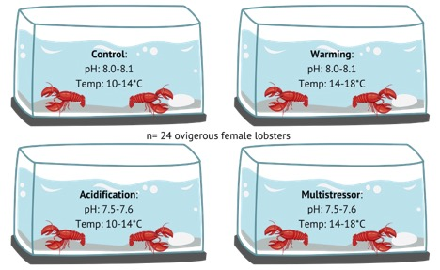
Supplemental Fig. 1: Lobster treatment groups throughout duration of experiment. Ovigerous female lobsters were caught from Maine and Massachusetts (n=24) and housed in 1 of 4 aquarium types in pairs, with one lobster from each region. Lobsters were monitored from October to May or until larval hatching. Temperature was adjusted seasonally to mirror changes in the Gulf of Maine.

Slide 2
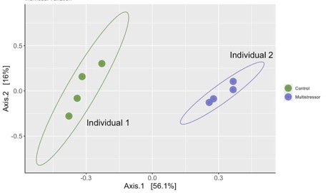
Supplemental Fig. 2: Four embryos from two lobsters were chosen randomly to assess intra-individual variation of lobster embryo clutch microbiomes. Each point represents one egg microbiome. Maximum variation observed was 16% indicating one embryo is adequate for capturing the majority of bacterial community members present associated with the lobster clutch.

Slide 3
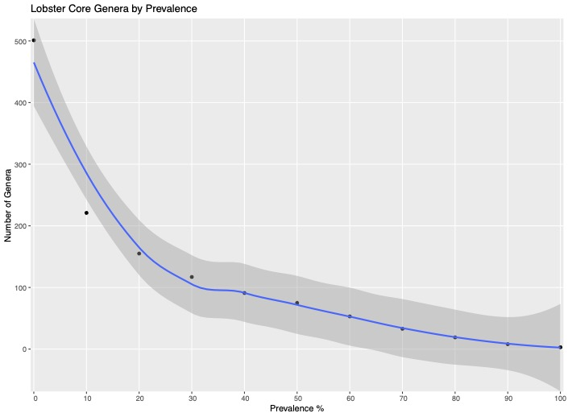
Supplemental Figure 3: Number of genera plotted by their prevalence on lobster embryos and larvae shows a leveling off between 90-100% prevalence. 100% prevalence was selected as representatives of the core community.

