Slide 1
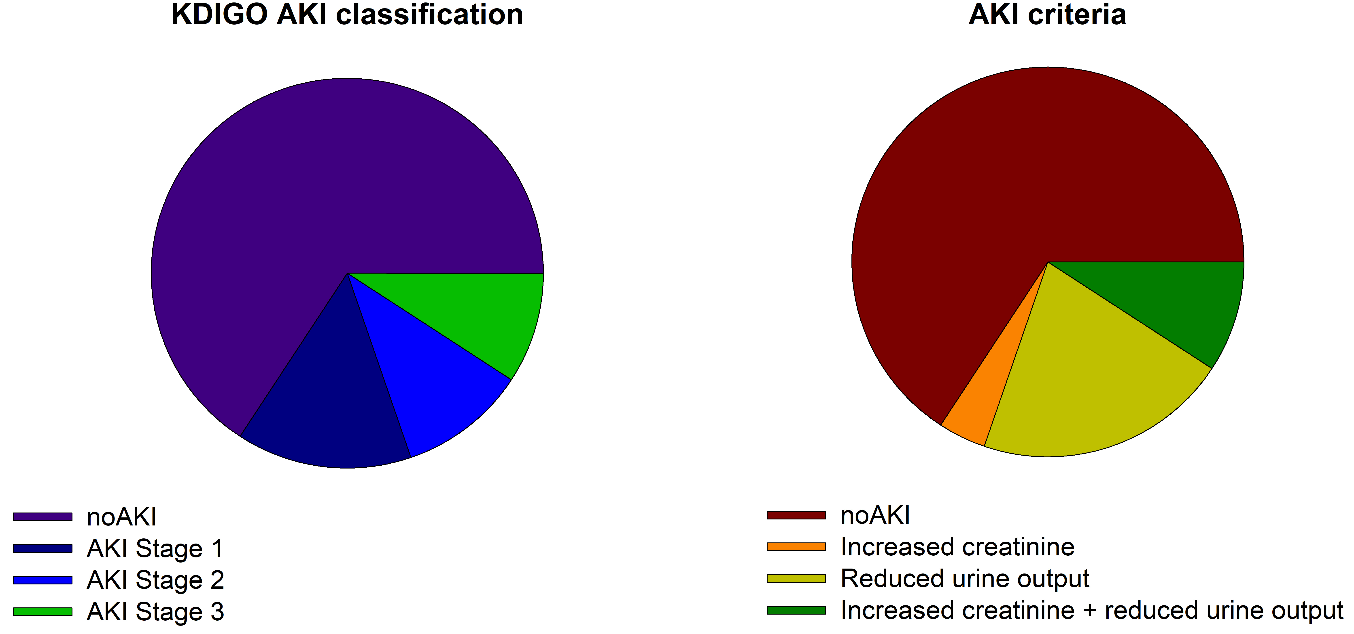
INCIDENCE AND RISK FACTORS ASSOCIATED WITH ACUTE KIDNEY INJURY IN NEWBORNS AFFECTED BY PERINATAL ASPHYXIA (HIE)
HYPOTHESIS: We hypothesized that asphyxiated newborns have an increased risk of AKI
>34 weeks, >1800 g
Diagnosed with HIE and treated with hypothermia
DESIGN & OUTCOMES:
76 term infants
AKI score significantly associated with:
Reduction of urine output
Severe hyponatremia
Lactate clearance
CONCLUSION: Up to 40% of asphyxiated newborns develop kidney impairment; early AKI detection via lactate, urine output, and sodium monitoring is key to improving outcomes.
Sinelli et al. 2025

